Slide 1
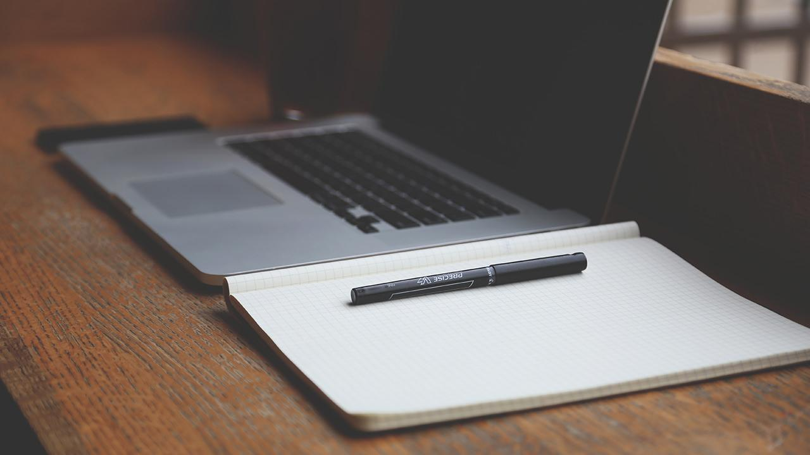
Présentation de TPI
Par Christian Carbonara
18.06.2018

Slide 2
Sommaire
Introduction
Déroulement du projet
Résultat
Conclusion
Questions
Introduction
Déroulement du projet
Résultat
Conclusion
Questions

Slide 3
1.Introduction

Slide 4
Introduction
Introduction
Déroulement du projet
Résultat
Conclusion
Questions

Slide 5
Déroulement du projet
Introduction
Déroulement du projet
Résultat
Conclusion
Questions

Slide 6
BIG CONCEPT
Bring the attention of your audience over a key concept using icons or illustrations

Slide 7
Résultat
7
White
Is the color of milk and fresh snow, the color produced by the combination of all the colors of the visible spectrum.
Introduction
Déroulement du projet
Résultat
Conclusion
Questions

Slide 8
In two or three columns
Yellow
Is the color of gold, butter and ripe lemons. In the spectrum of visible light, yellow is found between green and orange.
Blue
Is the colour of the clear sky and the deep sea. It is located between violet and green on the optical spectrum.
Red
Is the color of blood, and because of this it has historically been associated with sacrifice, danger and courage.

Slide 9

Want big impact? USE BIG IMAGE

Slide 10
Use charts to explain your ideas
White
Gray
Black

Slide 11
And tables to compare data
 | A | B | C
Yellow | 10 | 20 | 7
Blue | 30 | 15 | 10
Orange | 5 | 24 | 16

Slide 12
Our process is easy
first
second
last

Slide 13
Let’s review some concepts
Yellow
Is the color of gold, butter and ripe lemons. In the spectrum of visible light, yellow is found between green and orange.
Blue
Is the colour of the clear sky and the deep sea. It is located between violet and green on the optical spectrum.
Red
Is the color of blood, and because of this it has historically been associated with sacrifice, danger and courage.
Yellow
Is the color of gold, butter and ripe lemons. In the spectrum of visible light, yellow is found between green and orange.
Blue
Is the colour of the clear sky and the deep sea. It is located between violet and green on the optical spectrum.
Red
Is the color of blood, and because of this it has historically been associated with sacrifice, danger and courage.

Slide 14
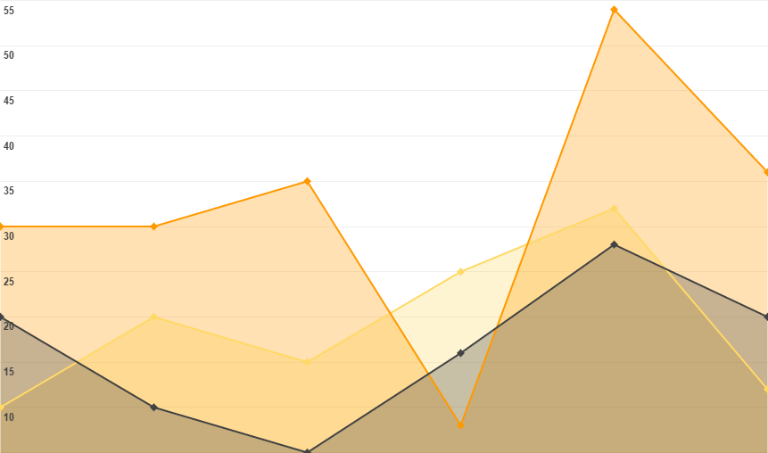
You can insert graphs from Google Sheets

Slide 15
DESKTOP PROJECT
Show and explain your web, app or software projects using these gadget templates.
Place your screenshot here

Slide 16
Conclusion

Slide 17
THANKS!
Any questions?
You can find me at @username & user@mail.me

Slide 18
Credits
Special thanks to all the people who made and released these awesome resources for free:
Presentation template by SlidesCarnival
Photographs by Startupstockphotos

Slide 19
Presentation design
This presentation uses the following typographies and colors:
Titles: Dosis
Body copy: Roboto
You can download the fonts on these pages:
https://www.fontsquirrel.com/fonts/dosis
https://material.google.com/resources/roboto-noto-fonts.html
Orange 0 180 133
You don’t need to keep this slide in your presentation. It’s only here to serve you as a design guide if you need to create new slides or download the fonts to edit the presentation in PowerPoint®

Slide 20
Instructions for use
EDIT IN GOOGLE SLIDES
Click on the button under the presentation preview that says "Use as Google Slides Theme".
You will get a copy of this document on your Google Drive and will be able to edit, add or delete slides.
You have to be signed in to your Google account.
EDIT IN POWERPOINT®
Click on the button under the presentation preview that says "Download as PowerPoint template". You will get a .pptx file that you can edit in PowerPoint.
Remember to download and install the fonts used in this presentation (you’ll find the links to the font files needed in the Presentation design slide)
More info on how to use this template at www.slidescarnival.com/help-use-presentation-template
This template is free to use under Creative Commons Attribution license. You can keep the Credits slide or mention SlidesCarnival and other resources used in a slide footer.

Slide 21
SlidesCarnival icons are editable shapes.
This means that you can:
Resize them without losing quality.
Change line color, width and style.
Isn’t that nice? :)
Examples:

Slide 22
😉
Now you can use any emoji as an icon!
And of course it resizes without losing quality and you can change the color.
How? Follow Google instructions https://twitter.com/googledocs/status/730087240156643328
✋👆👉👍👤👦👧👨👩👪💃🏃💑❤😂😉😋😒😭👶😸🐟🍒🍔💣📌📖🔨🎃🎈🎨🏈🏰🌏🔌🔑 and many more...

