Slide 1
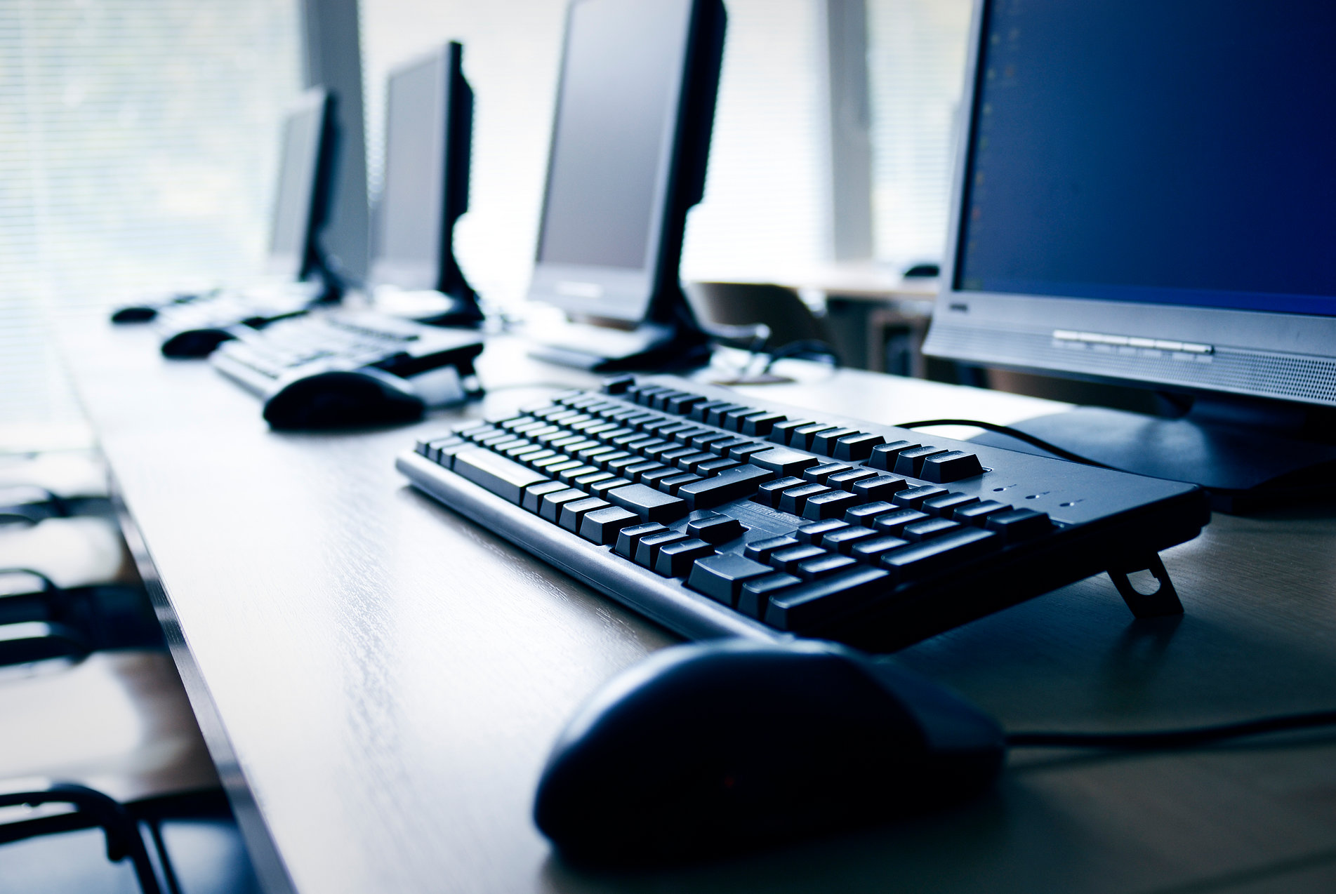
Présentation de TPI
Par Christian Carbonara
18.06.2018

Slide 2
Sommaire
Introduction
Déroulement du projet
Résultat final
Conclusion
Questions
Sources
Introduction
Déroulement du projet
Résultat final
Conclusion
Questions
Sources

Slide 3
Introduction

Slide 4
Introduction
Cahier des charges
Technologies utilisées
C#
Visual Studio 2017
NET Framework 4.5.2
Introduction
Déroulement du projet
Résultat final
Conclusion
Questions
Sources

Slide 5
Déroulement du projet
5

Slide 6
Déroulement du projet
Analyse
Introduction
Déroulement du projet
Résultat final
Conclusion
Questions
Sources

Slide 7
Déroulement du projet
Maquette graphique pour les conversions
Introduction
Déroulement du projet
Résultat final
Conclusion
Questions
Sources

Slide 8
Déroulement du projet
Maquette sur l’affichage du calcul
Introduction
Déroulement du projet
Résultat final
Conclusion
Questions
Sources

Slide 9
Déroulement du projet
Maquette sur la soustraction
Introduction
Déroulement du projet
Résultat final
Conclusion
Questions
Sources

Slide 10
Déroulement du projet
Maquette sur l’affichage du calcul
Introduction
Déroulement du projet
Résultat final
Conclusion
Questions
Sources

Slide 11
Résultat final
3

Slide 12
Fonctionnalités nécessaires | Fonctionne ?
Conversion de nombres entiers binaires signés dans les autres bases | Binaire non signé en décimal et en octal
Conversion de nombres réels signés, à virgule fixe dans les autres bases | Décimal à binaire signé ou à virgule fixe, décimal non signé à octal, binaire non signé à octal et décimal
Conversion de nombres décimaux signés dans les autres bases | Décimal signé à binaire signé
Conversion de nombres décimaux signés, à virgule fixe, dans les autres bases | Décimal signé à binaire signé ou à virgule
Conversion de nombres hexadécimaux signés dans les autres bases | Ne fonctionne pas
Ergonomie intuitive et agréable pour tout type d’utilisateur de l’ETML | Oui
La réalisation doit prendre en compte au moins un point significatif des bonnes pratiques en matière d’écoconception | Non appliqué
Introduction
Déroulement du projet
Résultat final
Conclusion
Questions
Sources

Slide 13
Résultat
Tableau des chiffres à convertir
Convertir 93 en binaire
0 | 1 | 2 | 3 | 4 | 5 | 6 | 7
= 46
reste 1
23
11
1
0
93 % 2
93
46
5
2
46 % 2
= 23
reste 0
Tableau des restes de la conversion
= 11
reste 1
23 % 2
0 | 1 | 2 | 3 | 4 | 5 | 6
1
0
1
1
1
0
1
11 % 2
Introduction
Déroulement du projet
Résultat final
Conclusion
Questions
Sources
= 5
reste 1
5 % 2
= 2
reste 1
2 % 2
= 1
reste 0
1 % 2
= 0
reste 1

Slide 14
Conclusion
3

Slide 15
In two or three columns
Yellow
Is the color of gold, butter and ripe lemons. In the spectrum of visible light, yellow is found between green and orange.
Blue
Is the colour of the clear sky and the deep sea. It is located between violet and green on the optical spectrum.
Red
Is the color of blood, and because of this it has historically been associated with sacrifice, danger and courage.

Slide 16
Use charts to explain your ideas
White
Gray
Black

Slide 17
And tables to compare data
 | A | B | C
Yellow | 10 | 20 | 7
Blue | 30 | 15 | 10
Orange | 5 | 24 | 16

Slide 18
Our process is easy
first
second
last

Slide 19
Let’s review some concepts
Yellow
Is the color of gold, butter and ripe lemons. In the spectrum of visible light, yellow is found between green and orange.
Blue
Is the colour of the clear sky and the deep sea. It is located between violet and green on the optical spectrum.
Red
Is the color of blood, and because of this it has historically been associated with sacrifice, danger and courage.
Yellow
Is the color of gold, butter and ripe lemons. In the spectrum of visible light, yellow is found between green and orange.
Blue
Is the colour of the clear sky and the deep sea. It is located between violet and green on the optical spectrum.
Red
Is the color of blood, and because of this it has historically been associated with sacrifice, danger and courage.

Slide 20
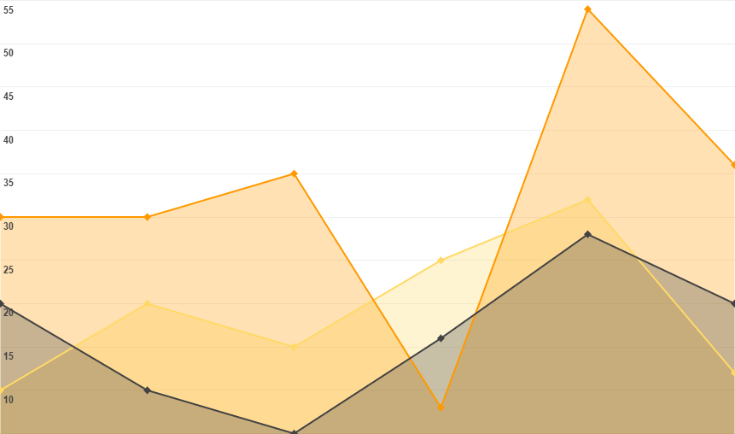
You can insert graphs from Google Sheets

Slide 21
DESKTOP PROJECT
Show and explain your web, app or software projects using these gadget templates.
Place your screenshot here

Slide 22
Conclusion

Slide 23
THANKS!
Any questions?
You can find me at @username & user@mail.me

Slide 24
Credits
Special thanks to all the people who made and released these awesome resources for free:
Presentation template by SlidesCarnival
Photographs by Startupstockphotos

Slide 25
Sources
https://doughquote.gq/specotca/computers-images-download2294.php#gallery-10
https://www.slidescarnival.com/william-free-presentation-template/1541

Slide 26
Presentation design
This presentation uses the following typographies and colors:
Titles: Dosis
Body copy: Roboto
You can download the fonts on these pages:
https://www.fontsquirrel.com/fonts/dosis
https://material.google.com/resources/roboto-noto-fonts.html
Orange 0 180 133
You don’t need to keep this slide in your presentation. It’s only here to serve you as a design guide if you need to create new slides or download the fonts to edit the presentation in PowerPoint®

Slide 27
Instructions for use
EDIT IN GOOGLE SLIDES
Click on the button under the presentation preview that says "Use as Google Slides Theme".
You will get a copy of this document on your Google Drive and will be able to edit, add or delete slides.
You have to be signed in to your Google account.
EDIT IN POWERPOINT®
Click on the button under the presentation preview that says "Download as PowerPoint template". You will get a .pptx file that you can edit in PowerPoint.
Remember to download and install the fonts used in this presentation (you’ll find the links to the font files needed in the Presentation design slide)
More info on how to use this template at www.slidescarnival.com/help-use-presentation-template
This template is free to use under Creative Commons Attribution license. You can keep the Credits slide or mention SlidesCarnival and other resources used in a slide footer.

Slide 28
SlidesCarnival icons are editable shapes.
This means that you can:
Resize them without losing quality.
Change line color, width and style.
Isn’t that nice? :)
Examples:

Slide 29
😉
Now you can use any emoji as an icon!
And of course it resizes without losing quality and you can change the color.
How? Follow Google instructions https://twitter.com/googledocs/status/730087240156643328
✋👆👉👍👤👦👧👨👩👪💃🏃💑❤😂😉😋😒😭👶😸🐟🍒🍔💣📌📖🔨🎃🎈🎨🏈🏰🌏🔌🔑 and many more...

