Slide 1



Genome Analytics SNP Browser
Christian, Eri, Rym and Yasemin

Slide 2
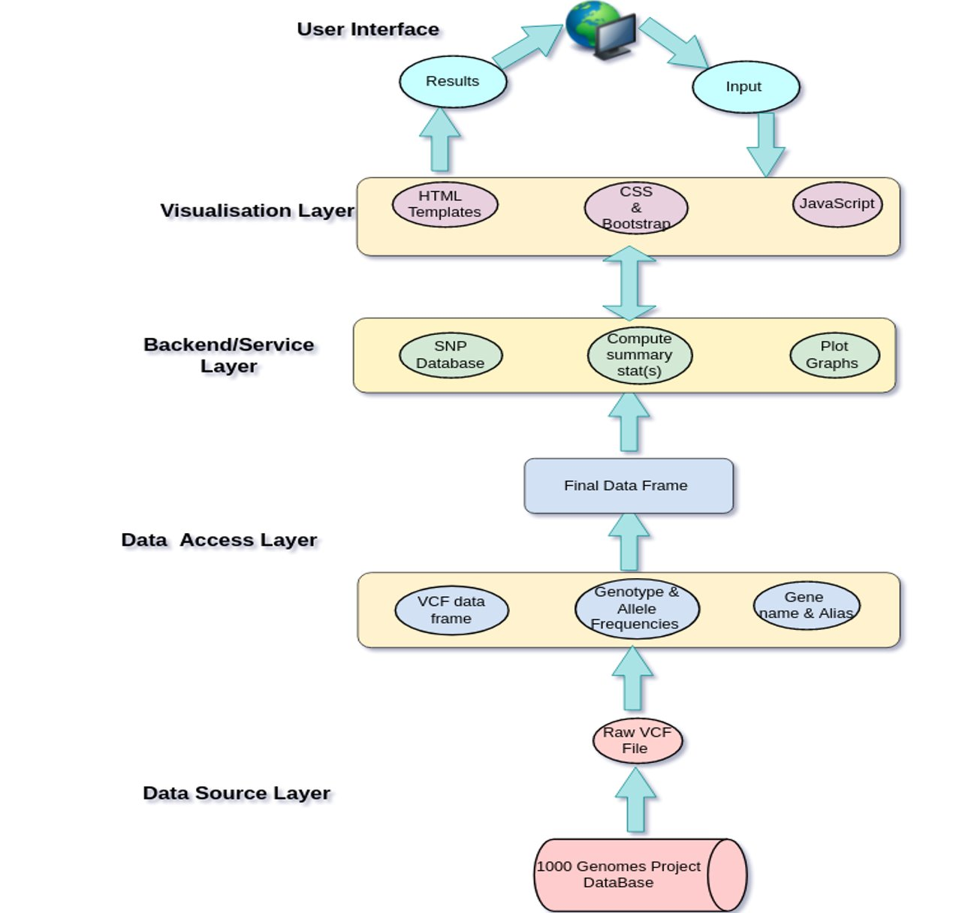
Software architecture ​

Slide 3
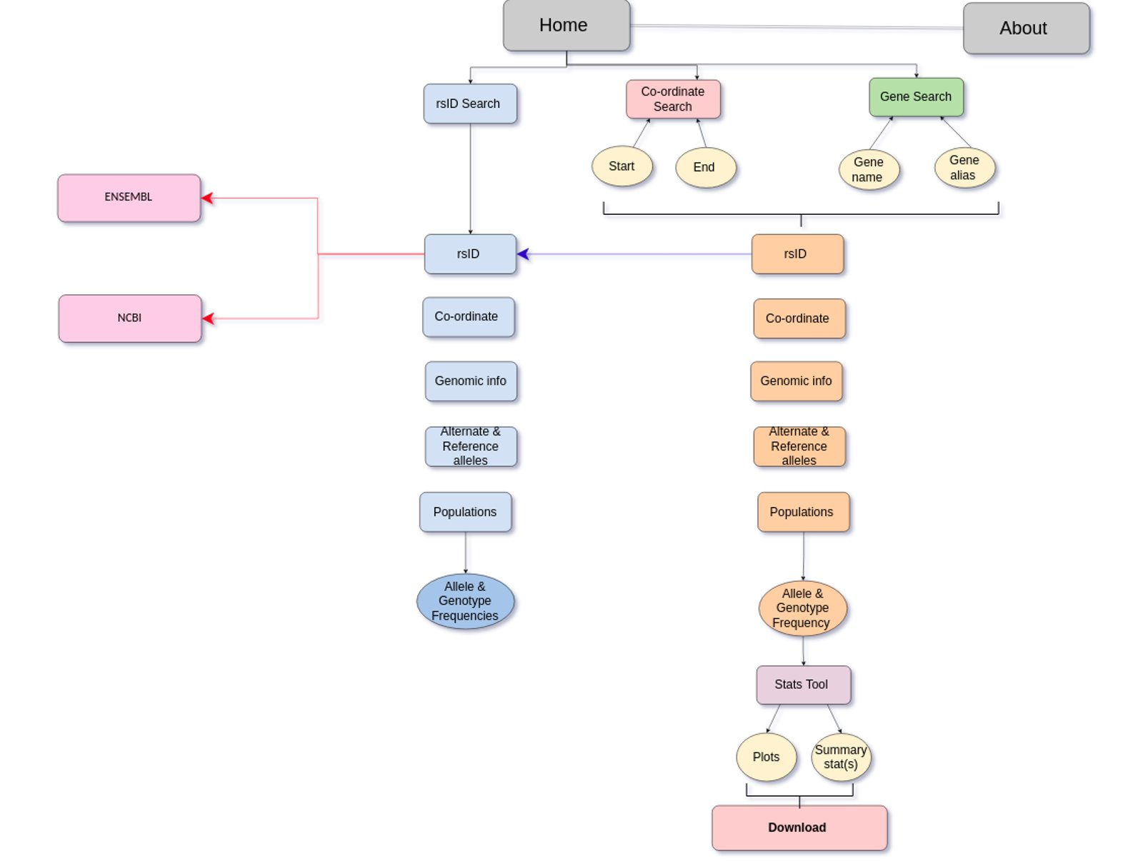
Website Schematic​

Slide 4
SNP data collection​
1000 Genomes Phase 3 data​
Obtained from NCBI FTP​
VCF file manipulations
Retained only bi-allelic SNPs
Extracted 5 populations
Utilised external software BCFtools

Slide 5
Gene name and alias data collection​
Annotated VCF with SnpEff software
Cross checked gene names obtained with HGNC multi-symbol checker
Obtained all gene data from NCBI
Mapped the alias names obtained from NCBI to the corrected gene list
Gene names and aliases stored in CSV format

Slide 6
Allele and Genotype frequencies​
Allele frequencies obtained for each population
Used VCFtools for calculations
Stored in CSV format
Genotype frequencies obtained for each population
Used VCFtools for genotype count
Sci-kit allel for genotype frequency data
Stored in CSV format

Slide 7
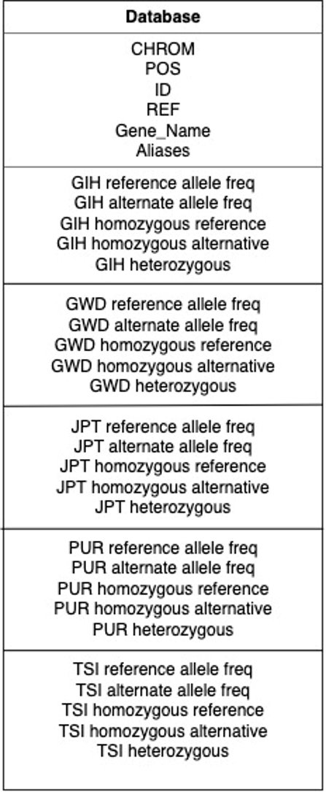

Data Base​
Genomic
Chromosome 22
Biallelic.vcf
Frequencies
Gene_names_Aliases.csv​
Genotype_frequencies.csv
Allele_frequencies.csv

Slide 8
Population Summary Statistics Data Store​
Bi-allelic VCF raw data​
Extraction of population specific phased genotype array​
Conversion to haplotype arrays​
Data frame to compressed pickle files​
Gujarati​
Gambian Mandinka​
Japanese​
Puerto Rican​
Toscani

Slide 9
Nucleotide Diversity
The average pairwise differences between all possible pairs of individuals within the population.​
Accurately estimated even with small population sizes.​
Often used in population genomics.

Slide 10
Homozygosity
The frequency of homozygous haplotypes within the population, whether this is homozygous for the reference or alternate allele.​
Easy interpretation of results.​
Calculated from phased genotype data

Slide 11
Tajima’s D
Tajima's D test is used to differentiate between sequences that evolve randomly or under a non-random mechanism
Positive Tajima’s D = indicating a decrease in population size and/or balancing selection.​
Negative Tajima’s D = this indicates population size expansion and/or positive selection.
Arguably one of the most famous neutrality tests used. Used for detecting selective sweeps.​

Slide 12
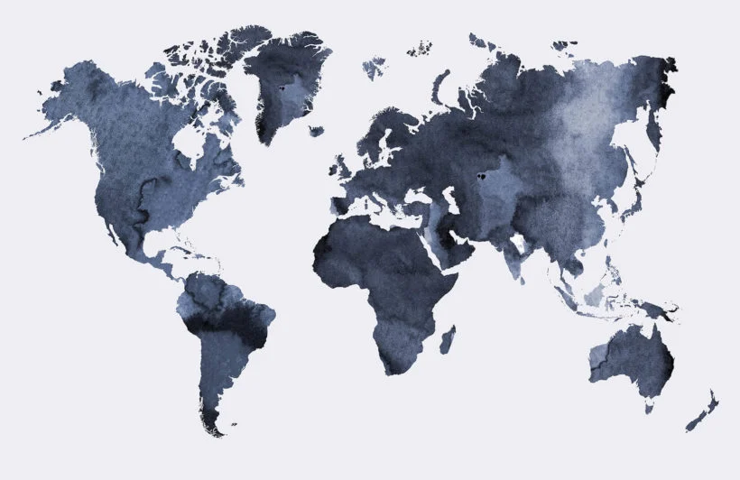
Fixation index (f_{st})
Divergence between two population based on genetic structure ​
Hudson's estimator was chosen ​
FST of different combinations are computed

Slide 13
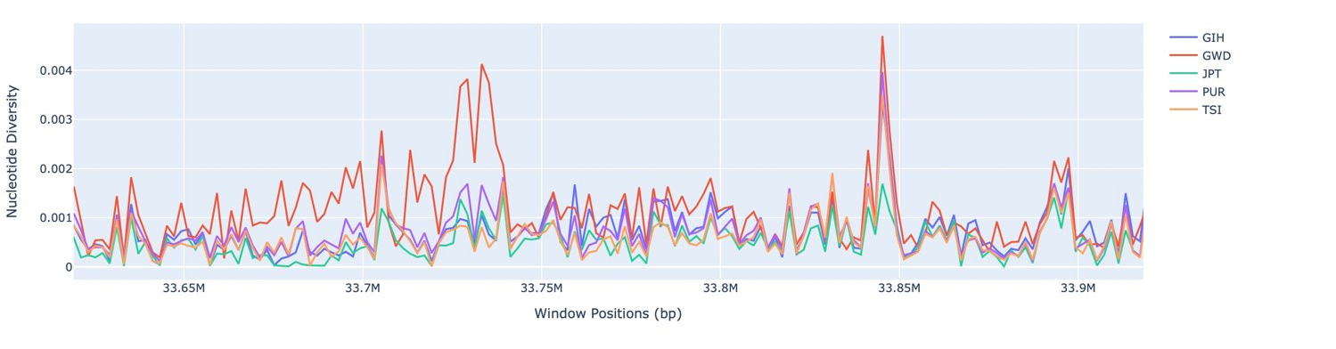
Data visualisation
Python package Plotly was used. ​
Plotly gives a wide range of interactivity options. ​
The user has the option to download the plots as a png file.

Slide 14
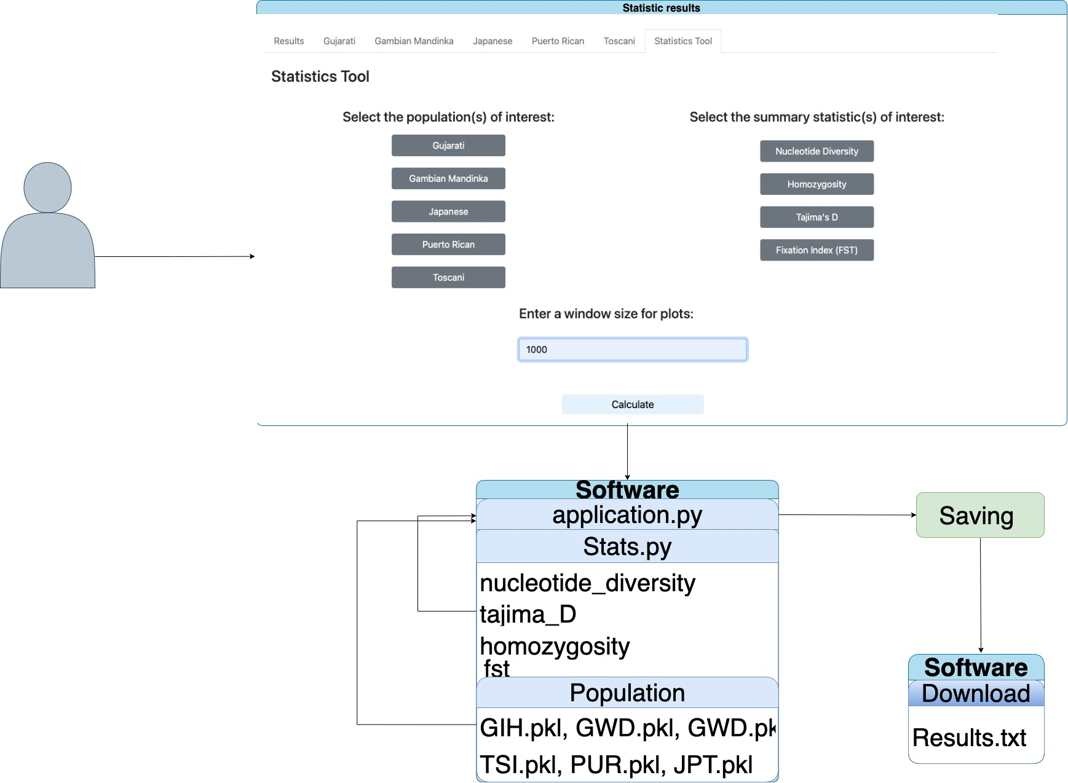
Download and clean function
Download
- Saving
- Downloading
- Deleting

Slide 15
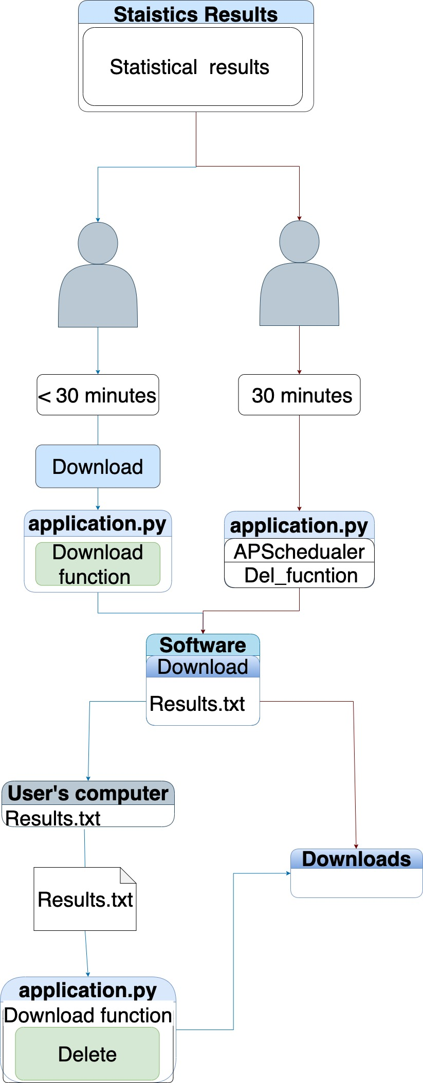
Download and clean function
Download
- Saving
- Downloading
- Deleting
Clean
- 30 after running our software
- APScheduler
- Del function
- Deletes all files from download folder

Slide 16
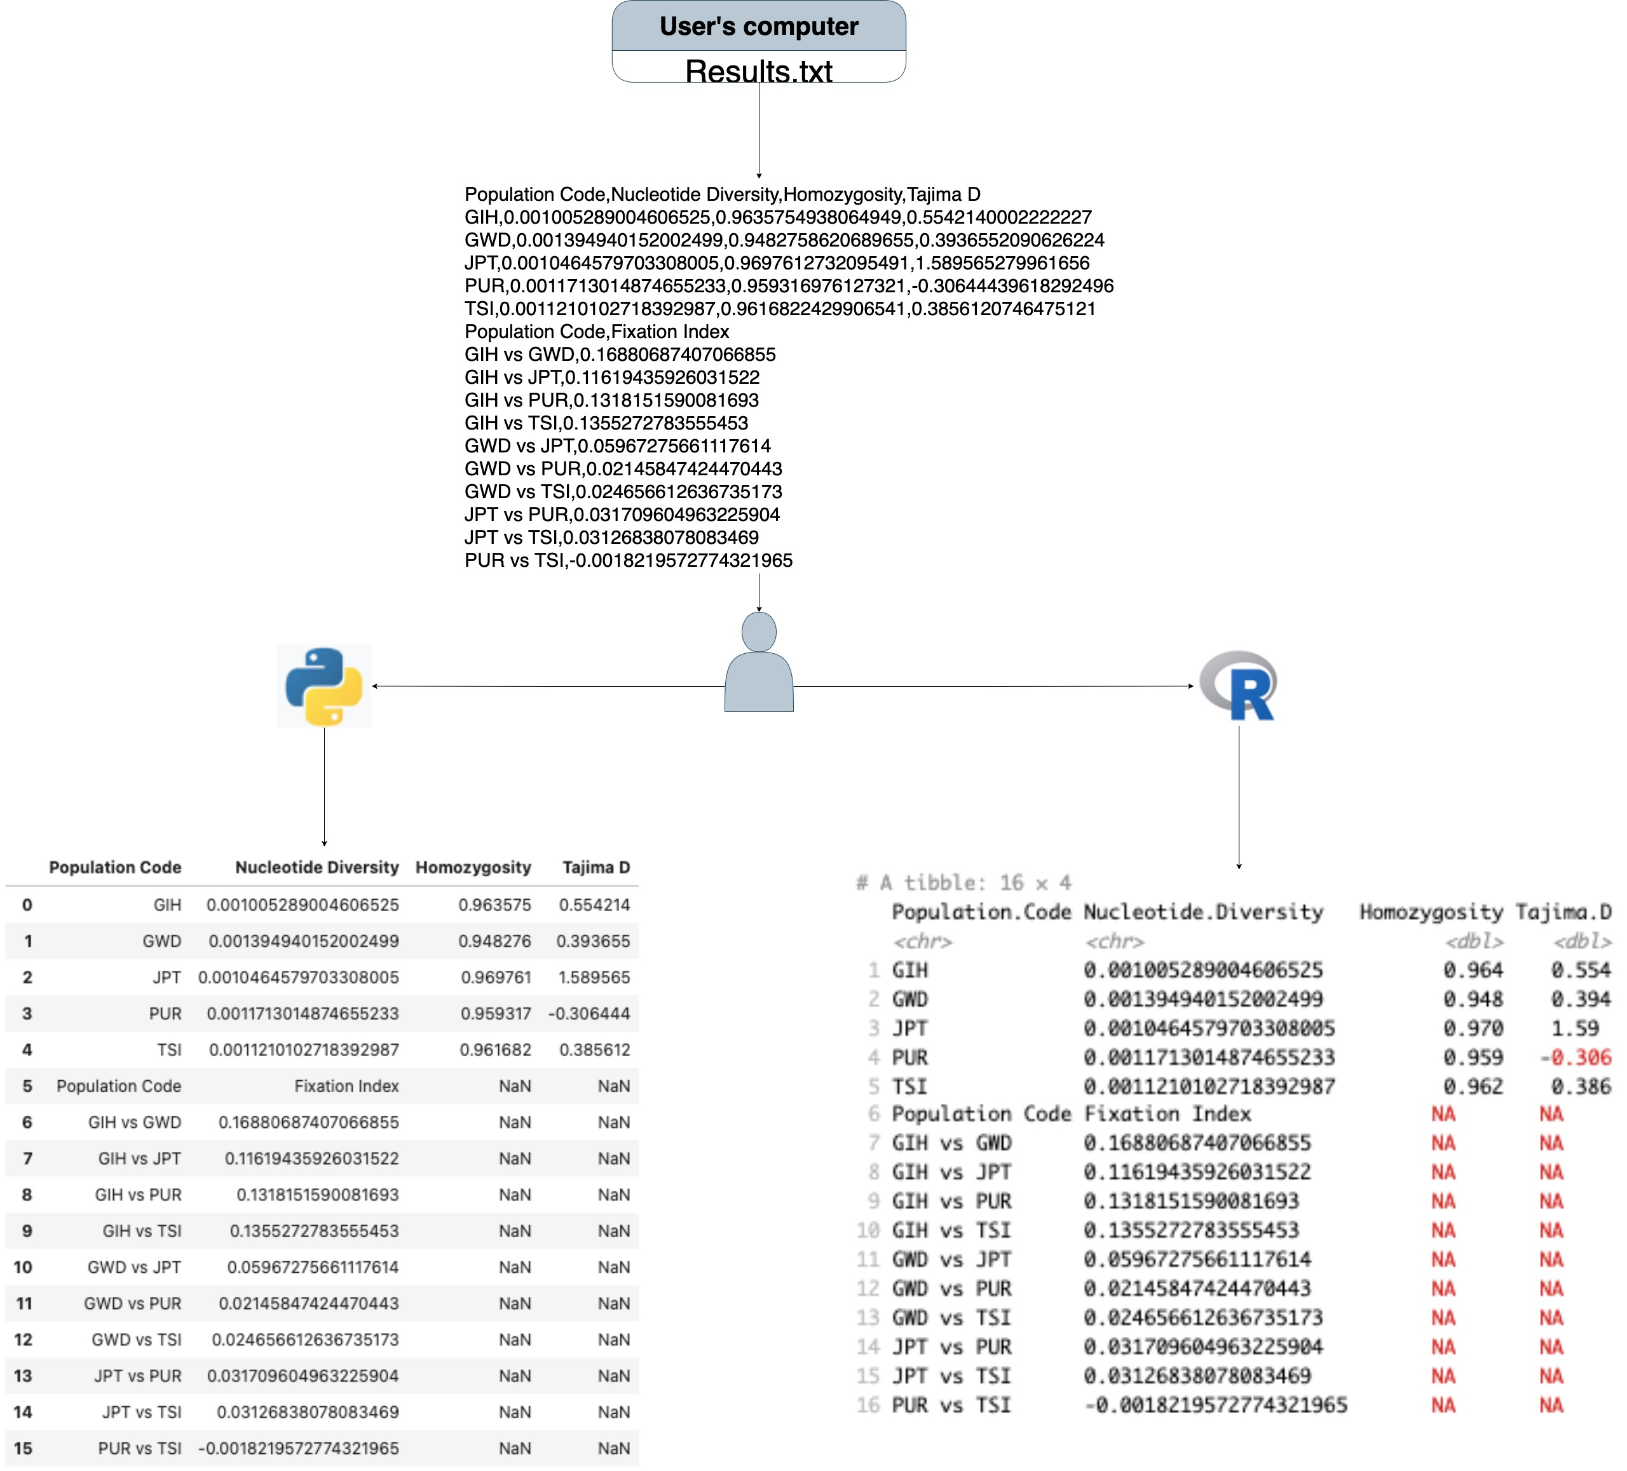
Downloaded RESULTS file
- Read the Results.txt file
- Select your desire results
- Format your results

Slide 17
LIVE DEMO

Slide 18
Future developments
Updating of the VCF data ​
Upgrade the database ​
Summary statistics expansion
Notes:
Updating of the vcf data- allow users to update snp data and cross check it, must be in the format of vcf and then it is cross checked with publications and verified

