Slide 1
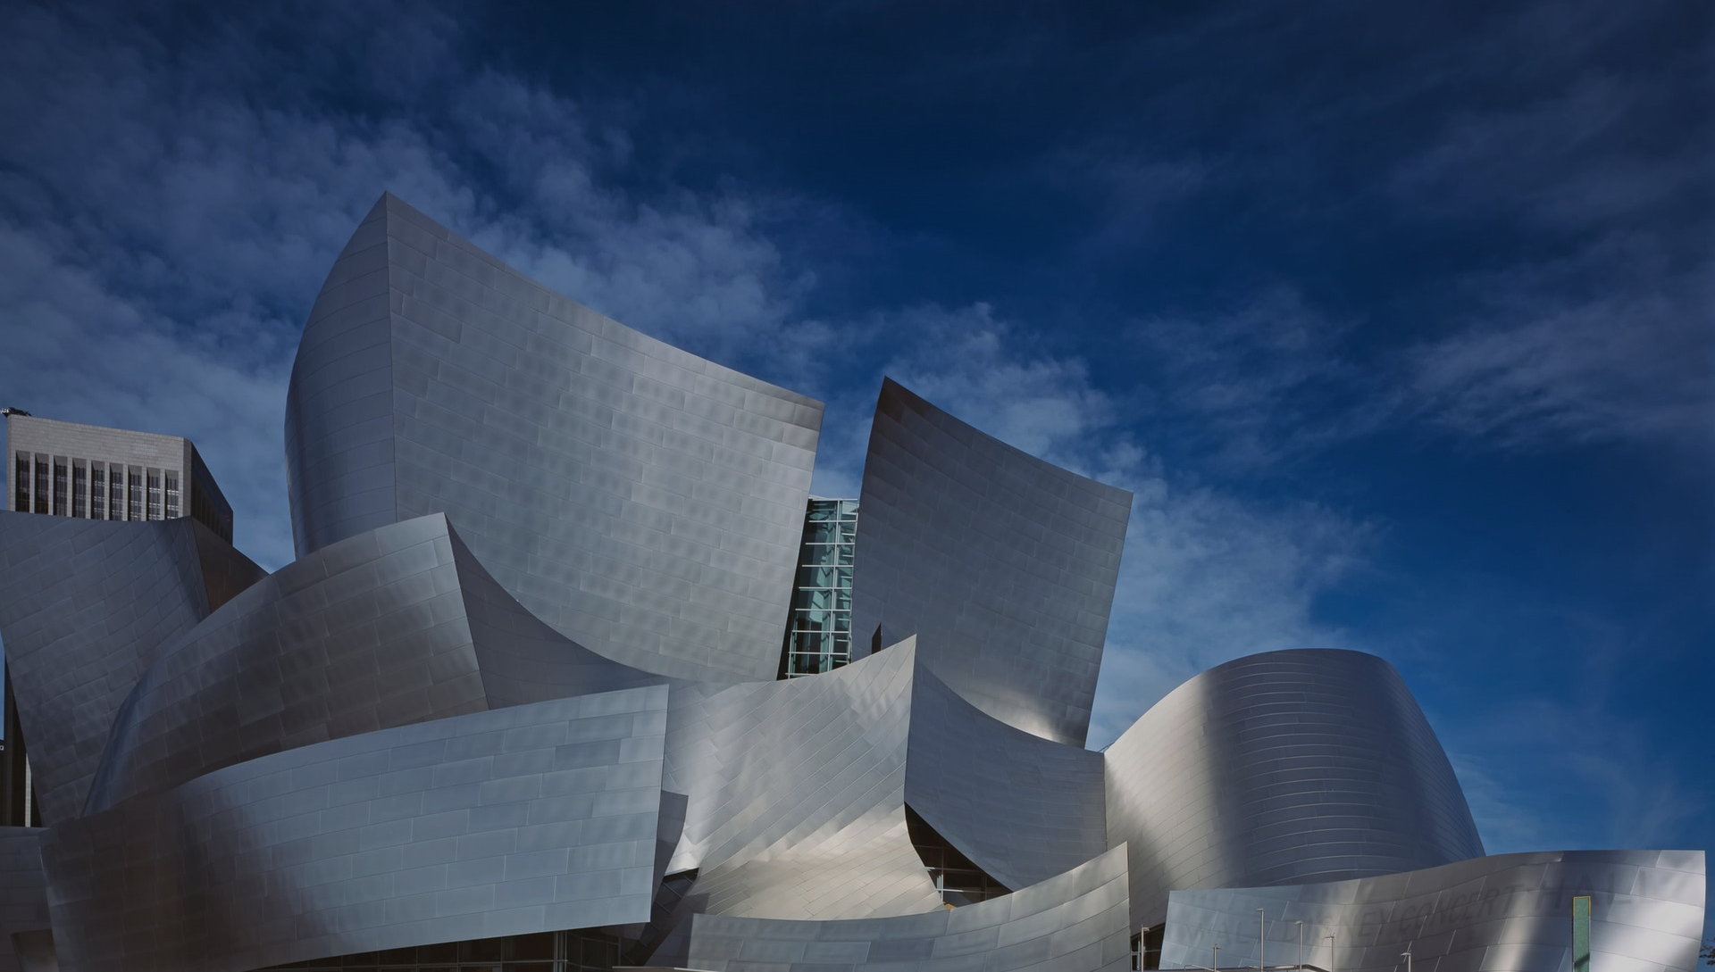
Architecture & Infrastructure As Code Hands on

Slide 2
Setup your environment
… Using a provided developer VM
RDP into your VM
IP: See beamer
User: dev
Password: See beamer
Run VS Code
Execute the following commands:
cd C:\repos\pulumi-structurizr-workshop
Set-ExecutionPolicy RemoteSigned
.\scripts\finalize-vm-setup.ps1
code .
… Using your own machine or VM
Make sure you have git & npm installed
git clone https://github.com/ChristianEder/pulumi-structurizr-workshop.git
Run pulumi-structurizr-workshop/scripts/install-pulumi.ps1 in PowerShell

Slide 3


Infrastructure & architecture as code
https://github.com/ChristianEder/pulumi-structurizr-workshop

Slide 4



Thank for your feedback
@_ceder
https://github.com/ChristianEder

