Slide 1
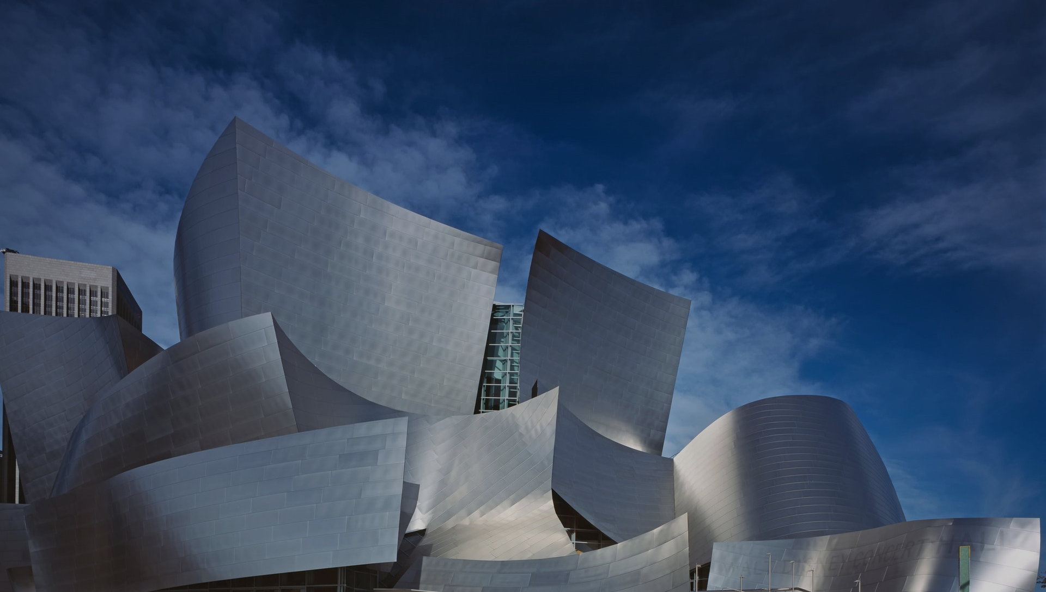
Architecture & Infrastructure As Code Hands on

Slide 2
Setup your environment
… Using a provided developer VM
RDP into your VM
IP: see paper notes
User: dev
Password: see paper notes
Run VS Code
Open C:\Users\dev\repos\pulumi-structurizr-workshop
… Using your own machine or VM
Make sure you have git & npm installed
git clone https://github.com/ChristianEder/pulumi-structurizr-workshop.git
Run pulumi-structurizr-workshop/scripts/install-pulumi.ps1 in PowerShell

