Slide 1
Home Automation
Christian Everett GitHub: ChristianEverett
Rotana Nou Github: RotanaNou

Slide 2
Overview
Create a home automation system with using raspberry pi
Remote control over system with GUI Client in racket
Switch lights and other devices on/off via relays

Slide 3
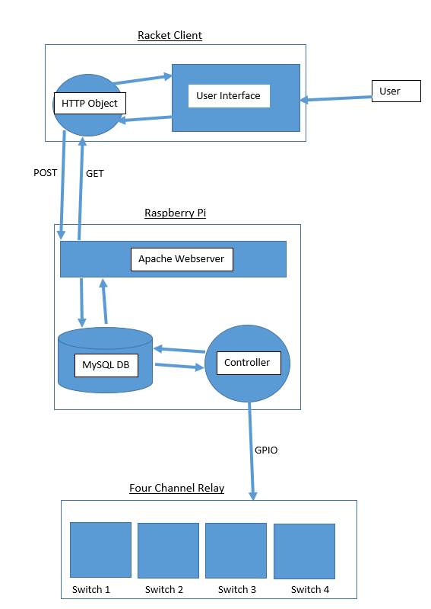
Architecture Diagram

