Slide 1
ATCS – Automatic Target Classification System
Student: Christian Geyer
Supervisor: Prof. Armando Luís Sousa Araújo

Slide 2
Motivation
ISSF - International Sport Shooting Federation
Existing Technologies
High accuracy
High Cost
Specialized Hardware
Need for an alternative low cost solution

Slide 3

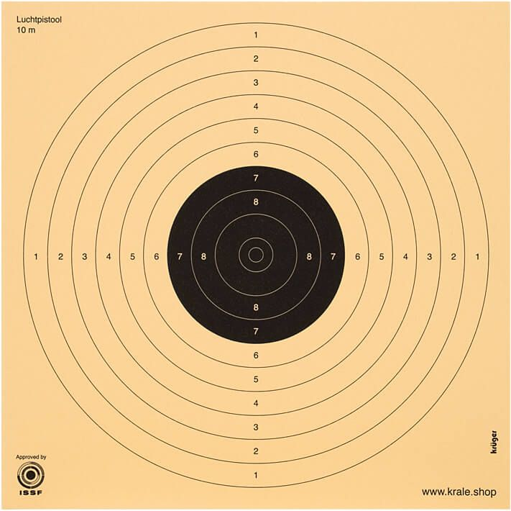
Goal
Vision-based system
Low-cost
Enough Accuracy
ISSF paper targets
10m-air-rifle
10m-air-pistol

Slide 4
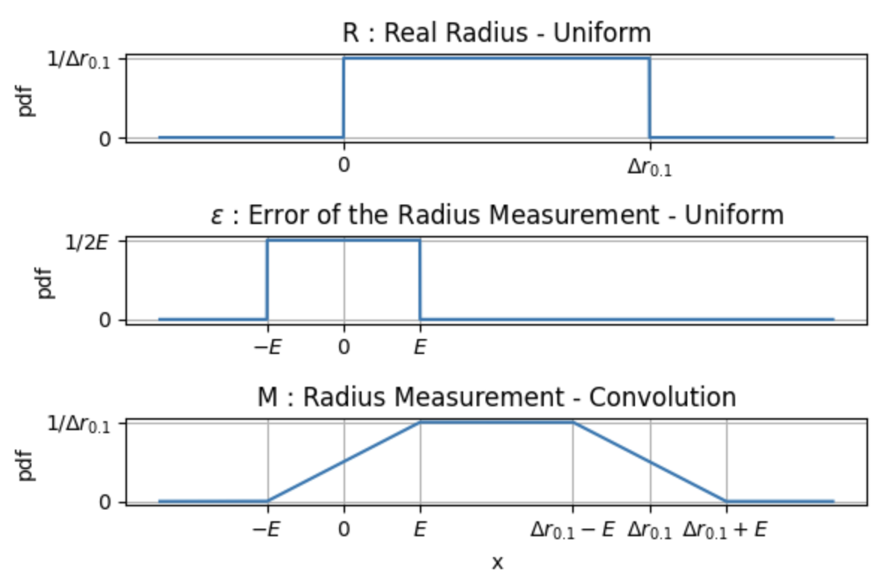
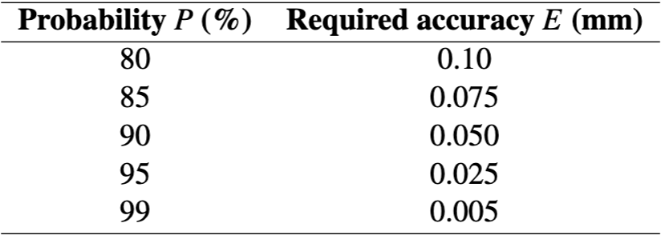
Accuracy Requirements

Slide 5
Classical Approaches
Thresholding
Morphological
Contours
Moments
Circle Regression
Watershed
Hough
Temporal Differencing
High Accuracy for good images
Parameter tuning
Not robust

Slide 6
Deep-Learning Approaches
CNN
Detection
Segmentation
Regression
Yolov8 (1-stage)
Faster R-CNN (2-stage)
Good detection-precision
Insufficient geometry-accuracy
Robust

Slide 7
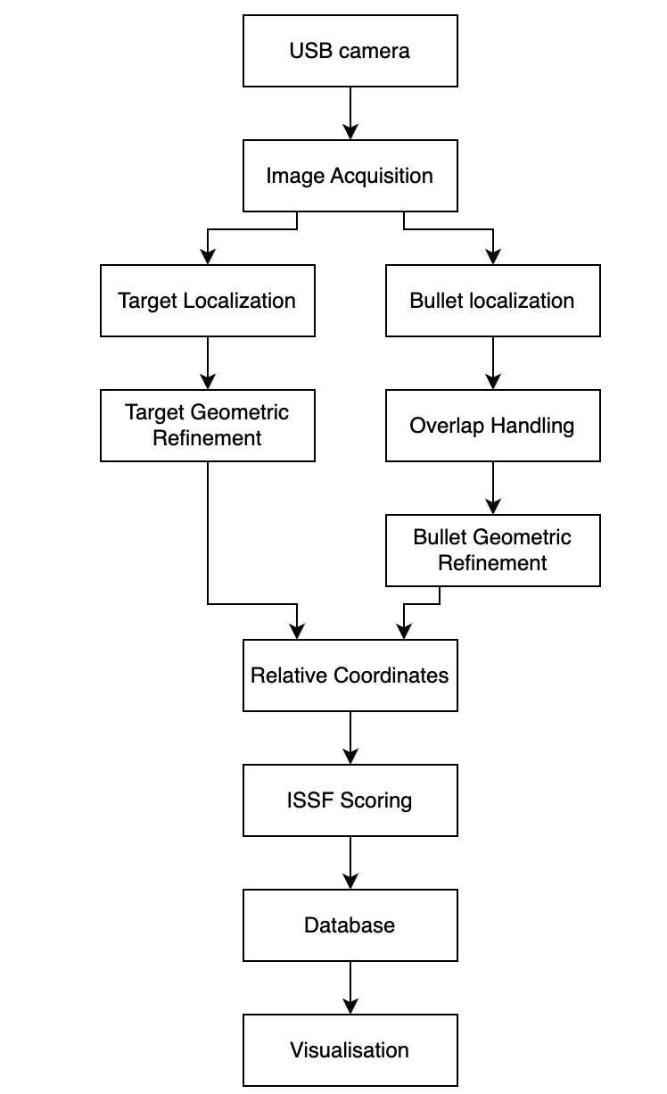
System Pipeline

