Slide 1
Strengths
Weakenesses
Opportunities
Threats
Bread making knowledge.
Favorable location of the facilities.
Sufficient forest resources.
Facilities suitable for production.
Lack of standards in processes.
Lack of sales experience
Adaptation to the regulations of the STPS.
Our product has a consolidated and potential market.
Bakeries within the same location.
Increase in input prices.

Slide 2
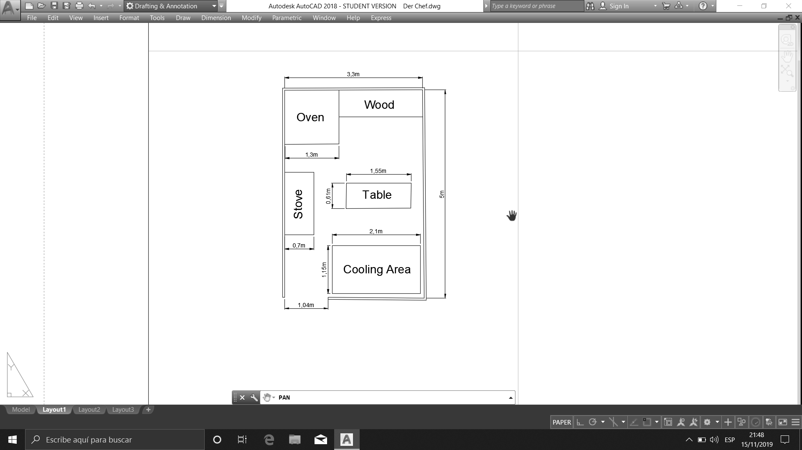
31
30
29
32
33
35
34
36
28
37
Start
02
01
03
04
05
10
09
08
07
06
11
12
13
14
15
20
19
18
17
16
21
22
23
24
25
27
26
38
38
End

