Slide 1
Book1
File created on: 15/11/24 11:13:08 AM CST

Slide 2
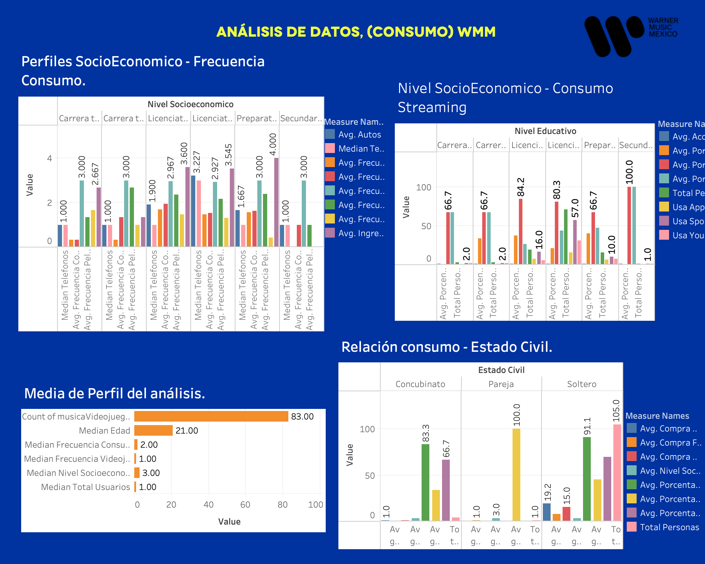

Slide 3
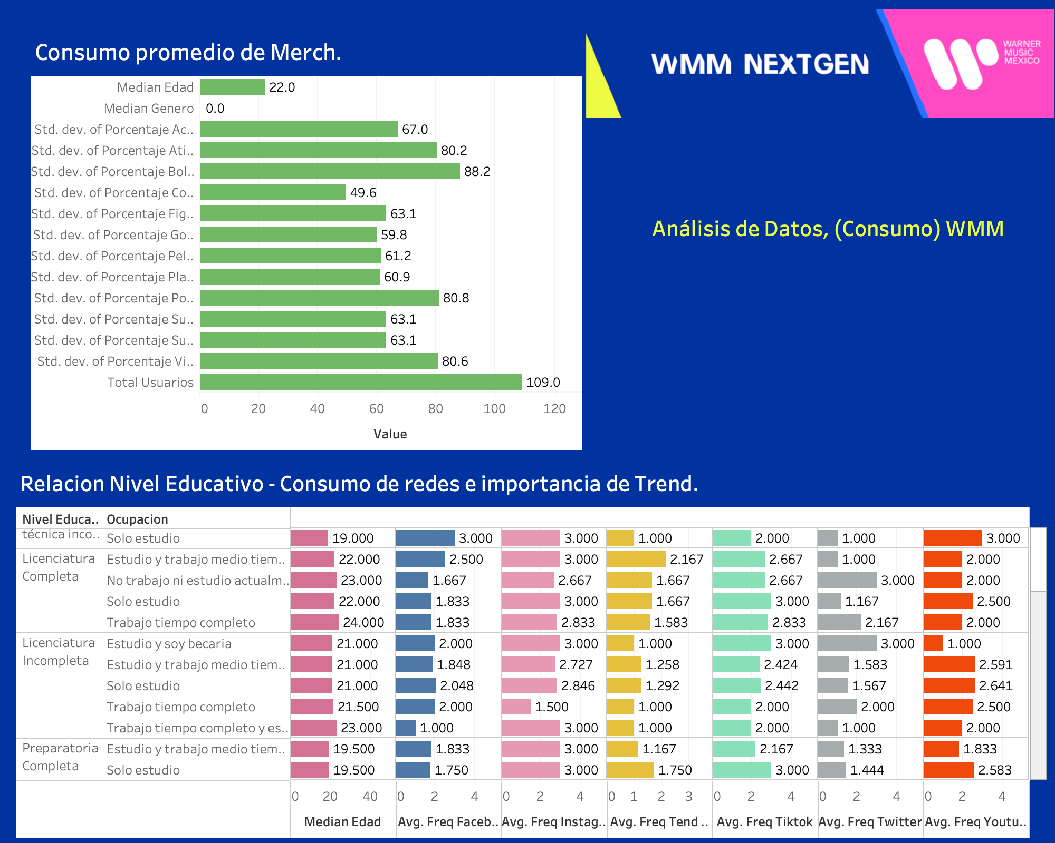

Slide 4
