Slide 1
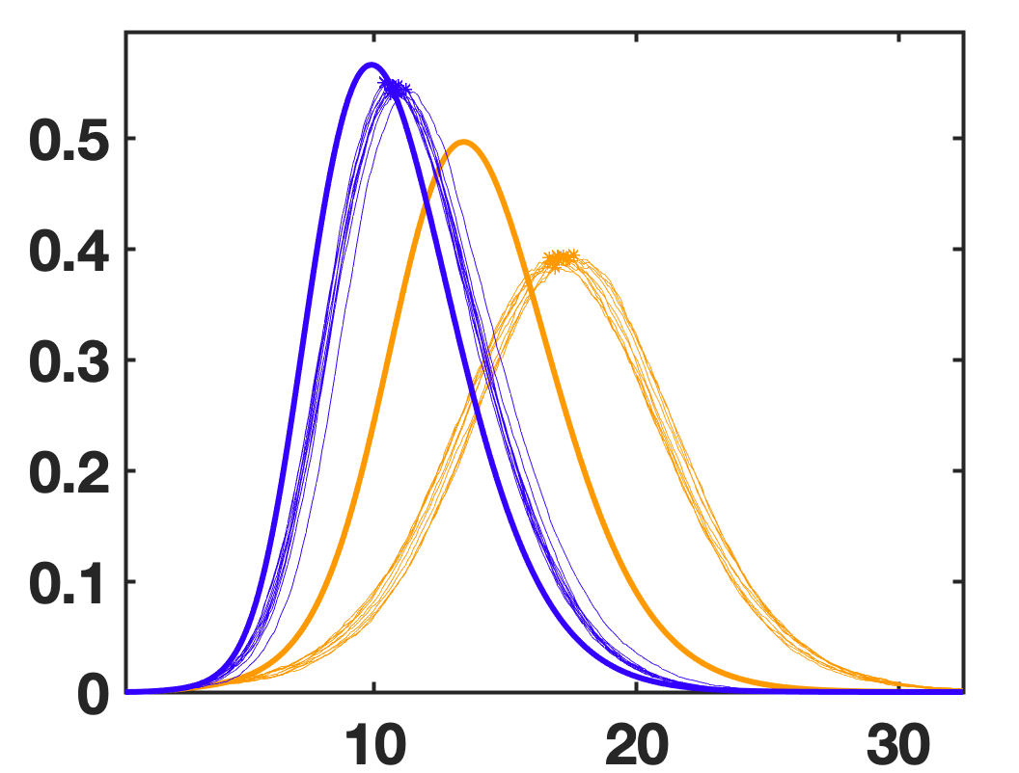
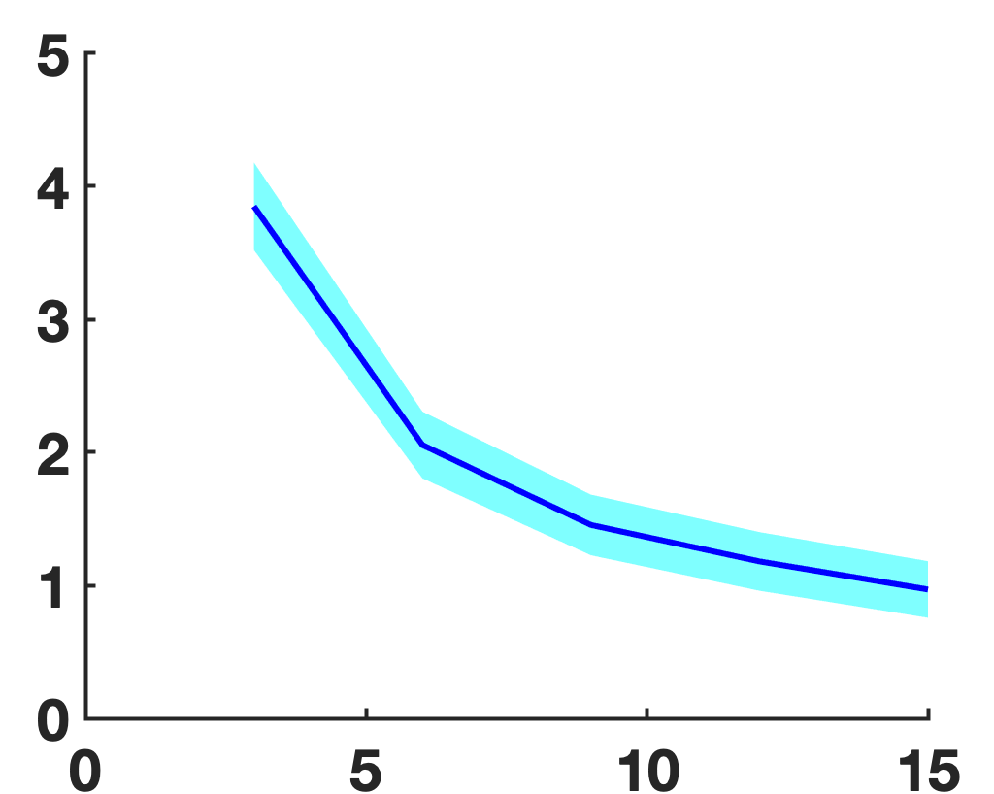
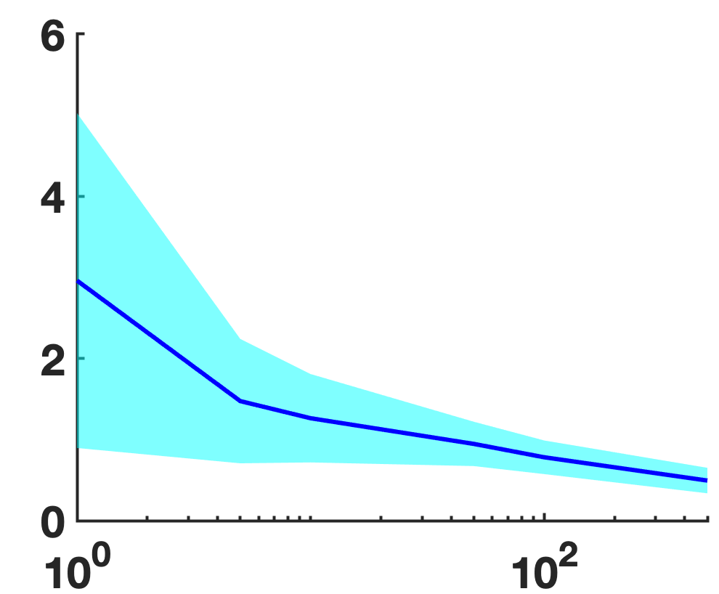
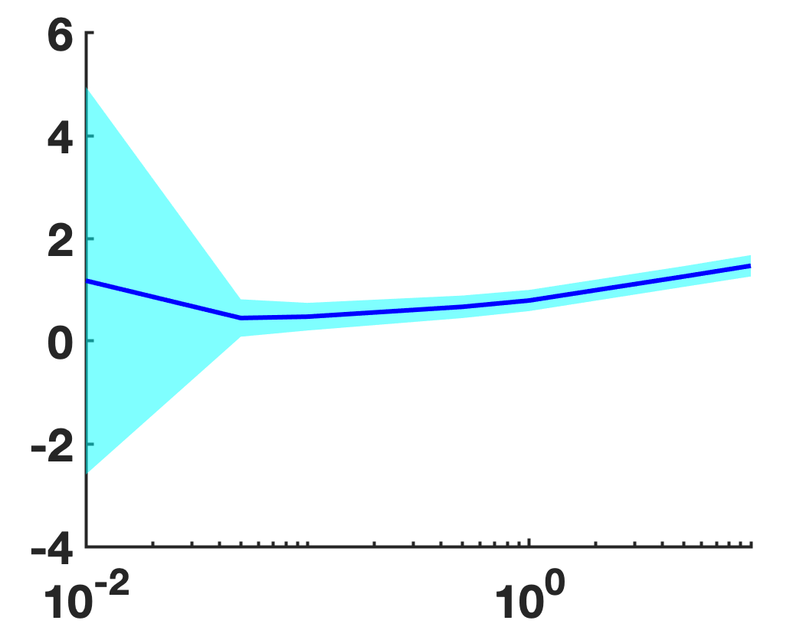
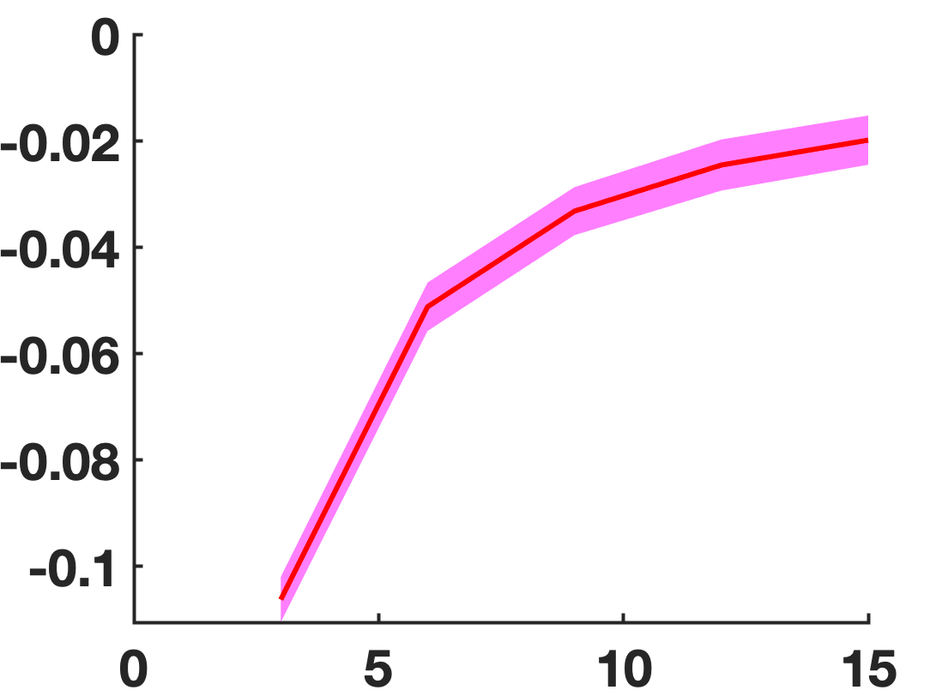
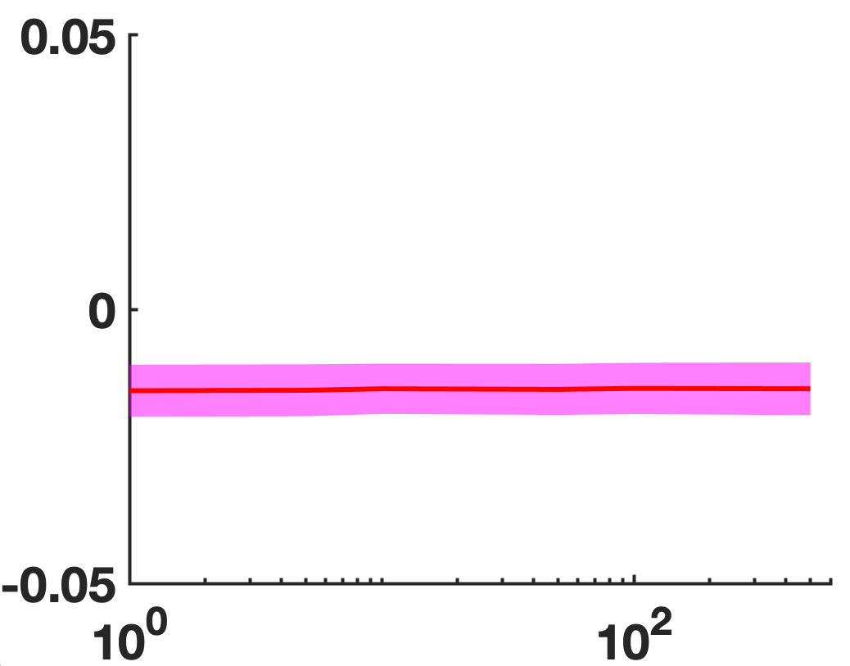
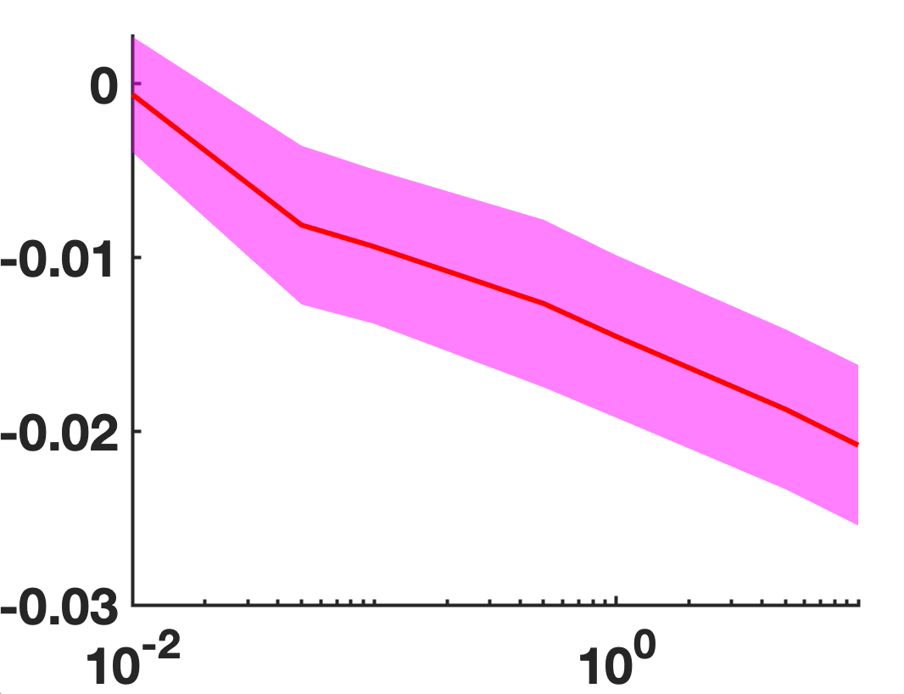
A
B
C
S
E
Time difference
Height
difference
Infected
fraction
u = 15
u = 3
R
I
D
F
H
Time [days]
Difference time at
maximum infected
fraction
Difference time at
maximum infected
fraction
Difference time at
maximum infected
fraction
E
mu [#]
G
I
N_Init [#]
beta [1/d]
Difference maximum
Infected fraction
Difference maximum
Infected fraction
Difference maximum
Infected fraction
mu [#]
N_Init [#]
beta [1/d]

Slide 2
Figure showing
distribution of beta for sigmas
Height and time perturbation of peak
Prediction error as a function of sigma
Realization of I as a function of t
Figure showing
distribution of connections for gammas
Height and time perturbation of peak
Prediction error as a function of gamma
Realization of I as a function of t
Combined effect of gamma and sigma
Herd immunity as a function of gamma beta
Heat map showing prediction error
?

Slide 3
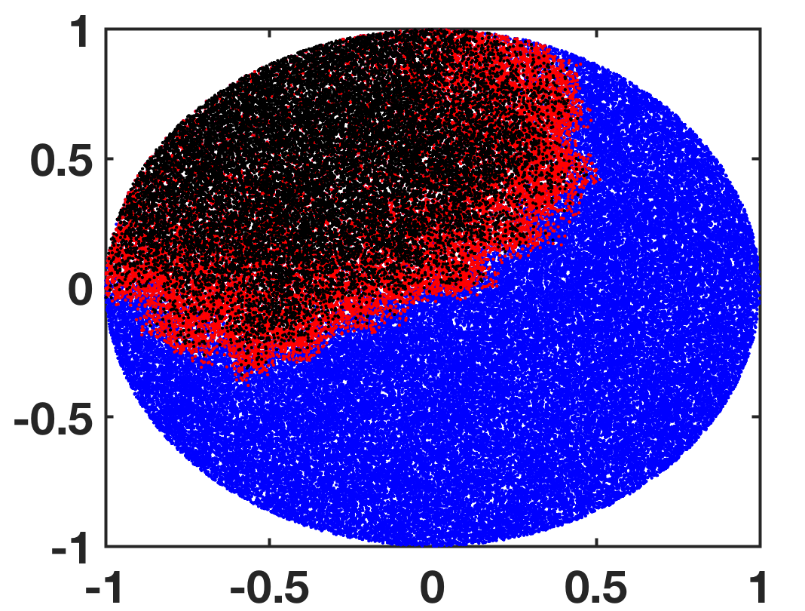
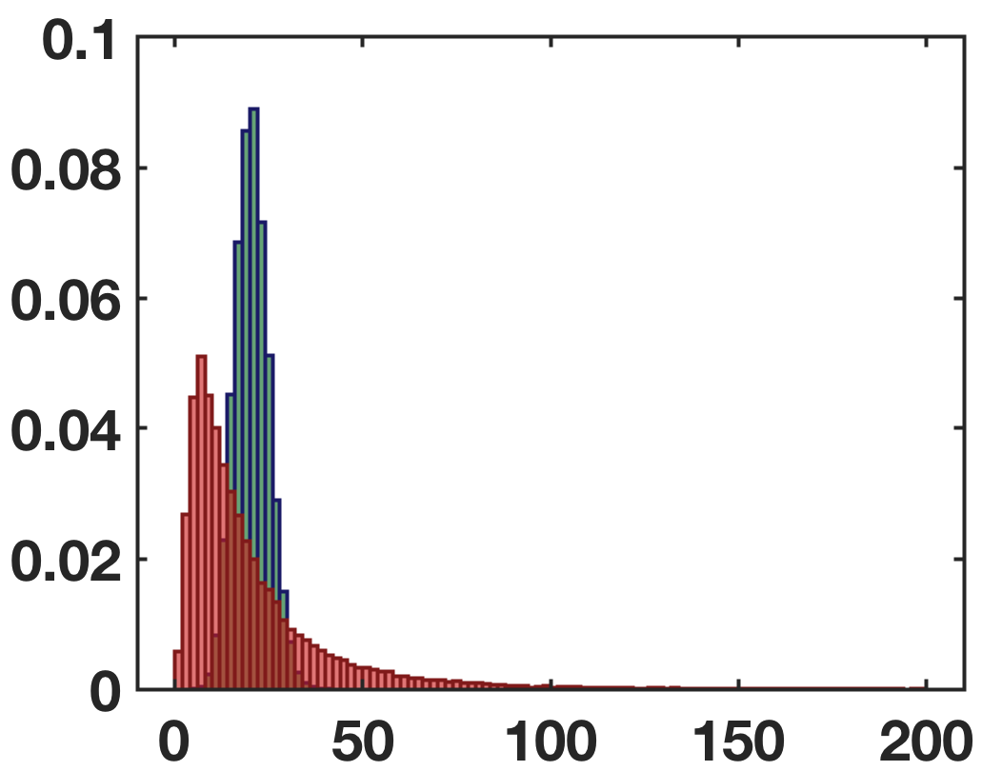
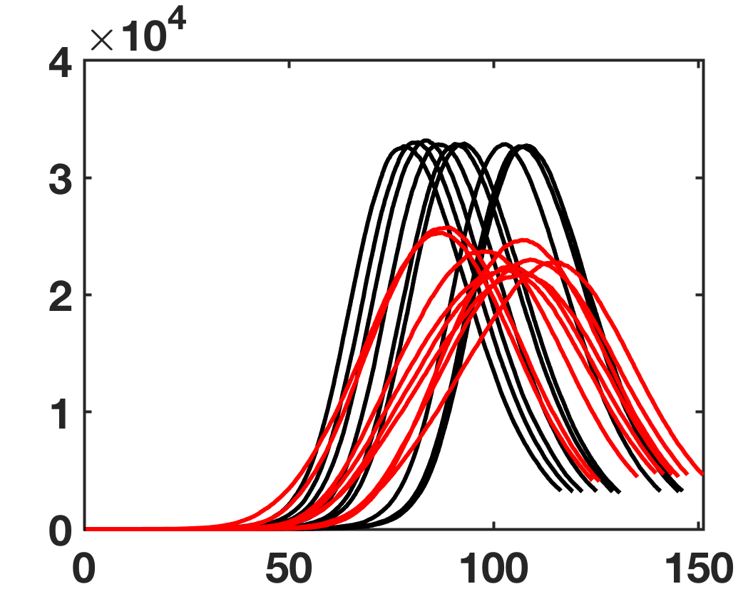
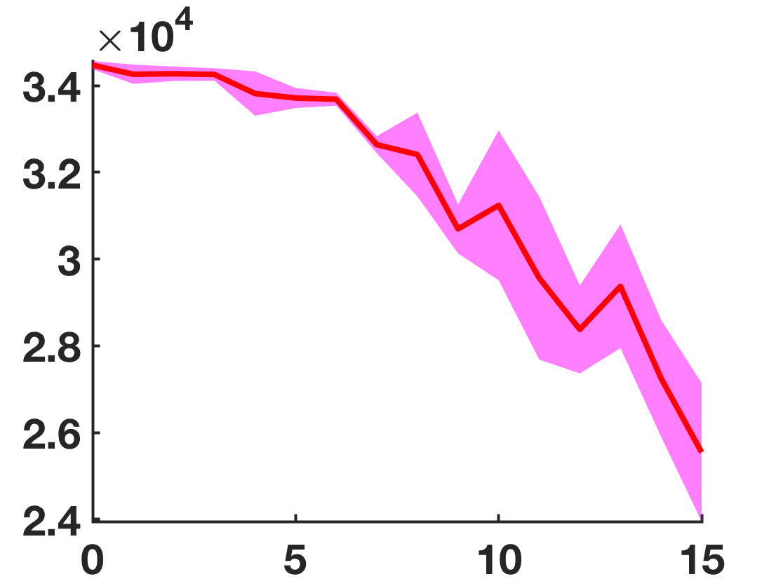
Model 1
Model 2
Peak value
No spatial
component
PDF value
Spatial
dependency
a
Model 2

Slide 4
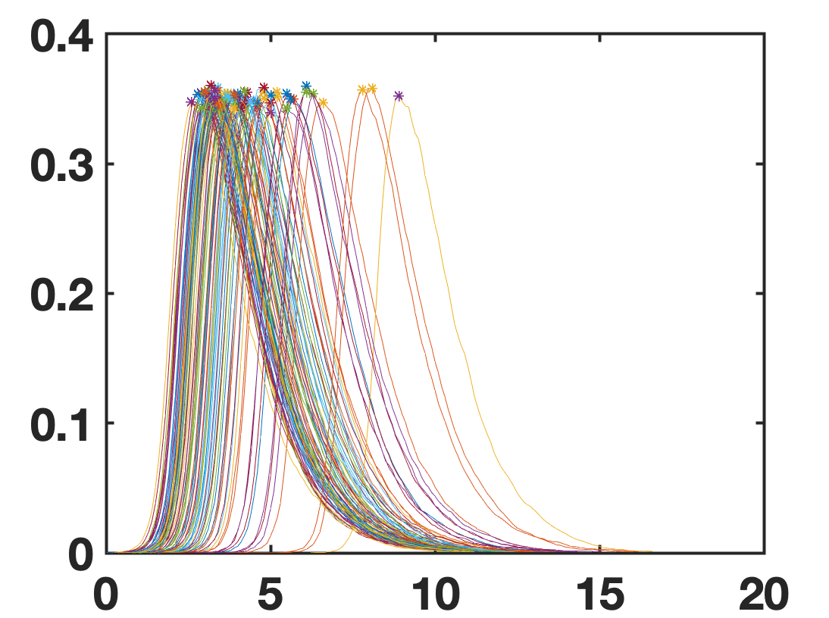
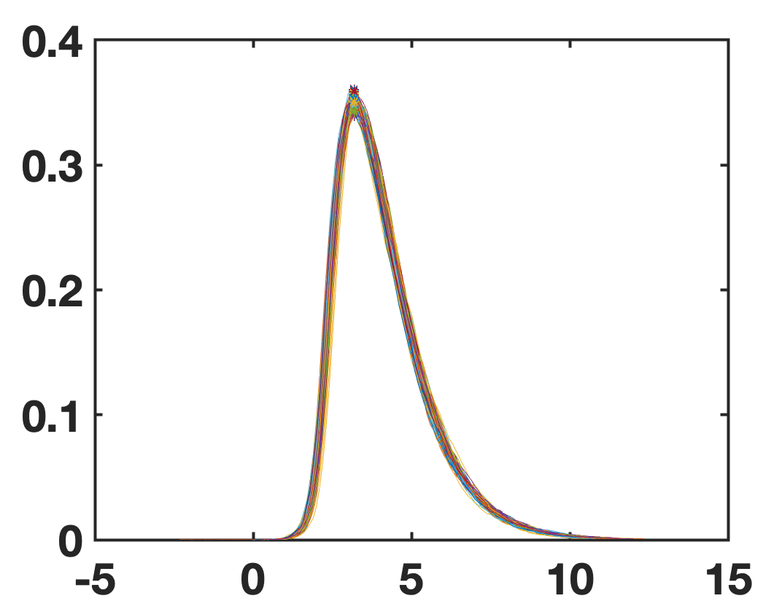
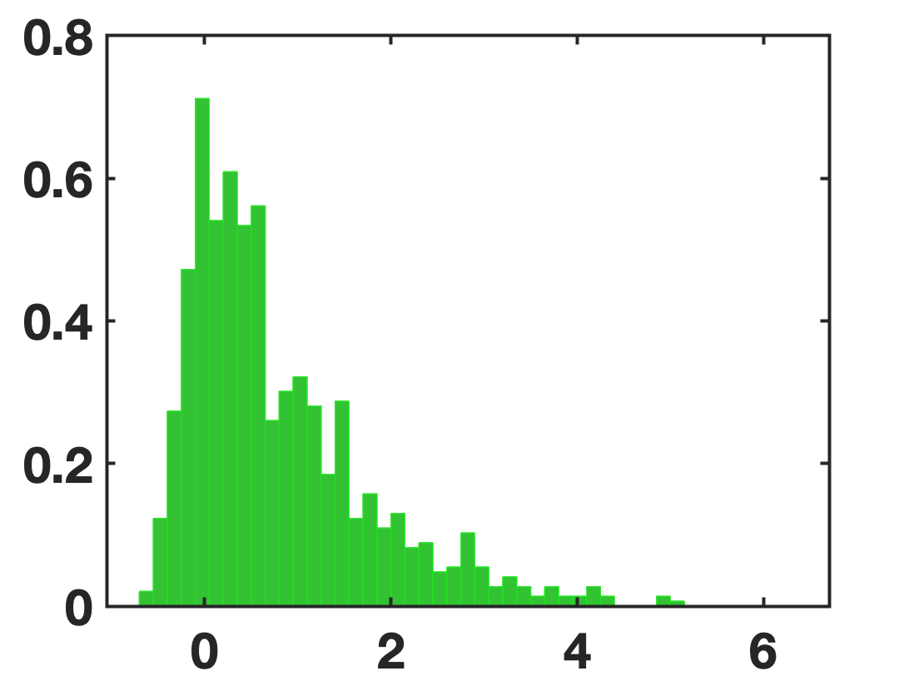
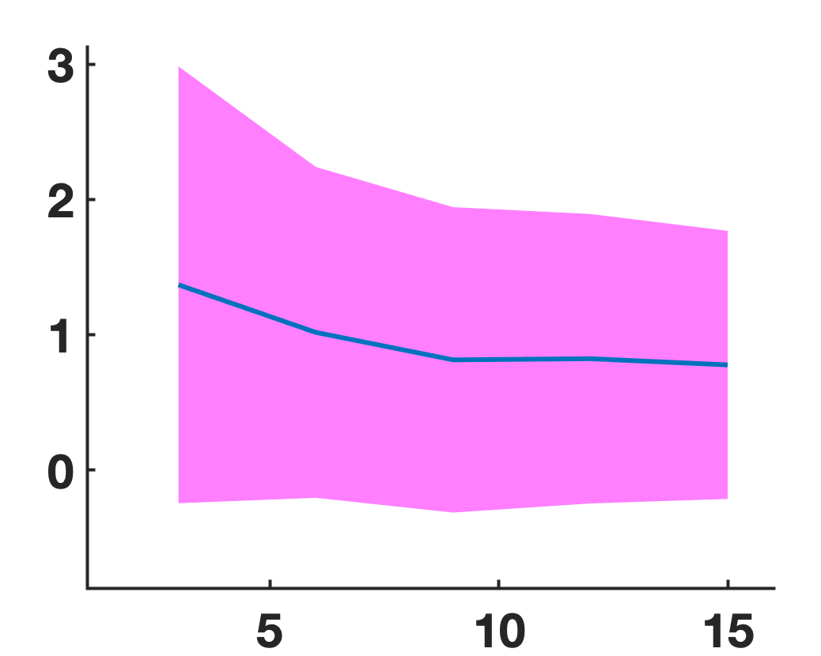
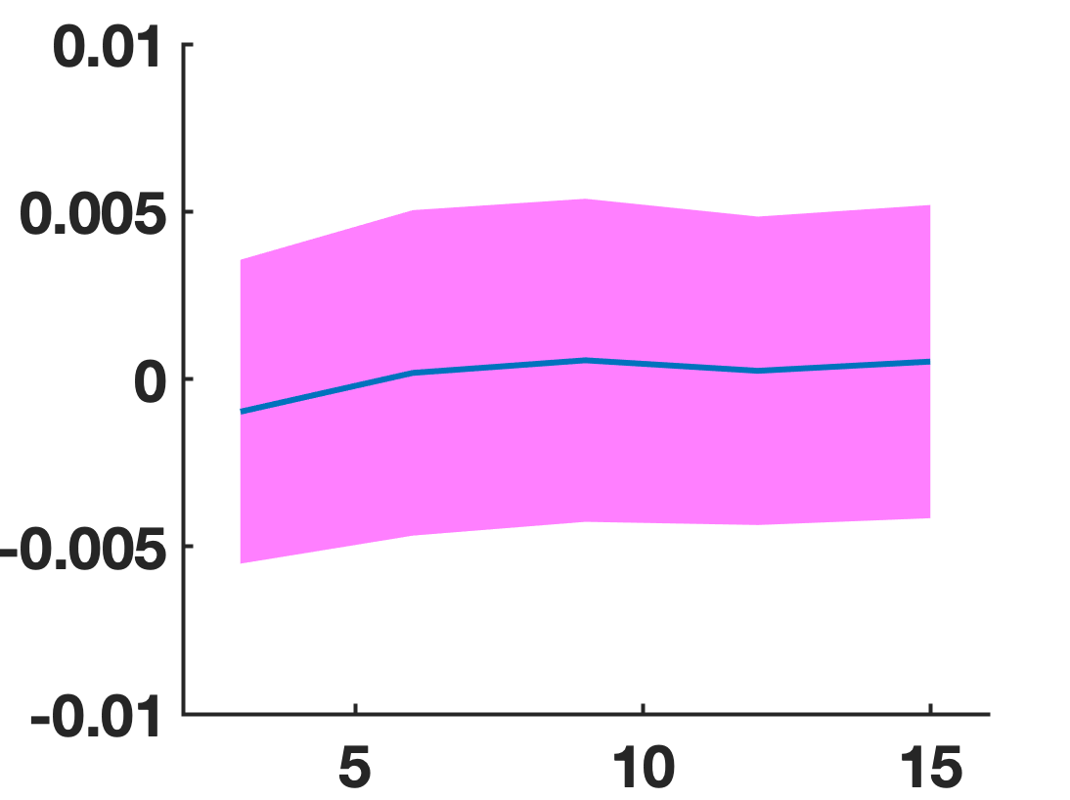
C
D
E
F
G

Slide 5
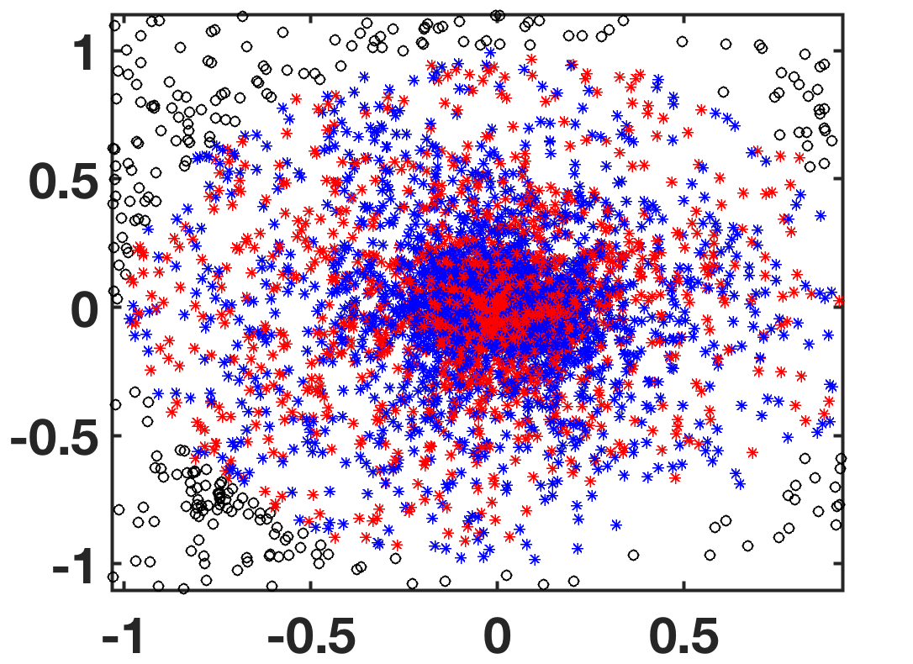
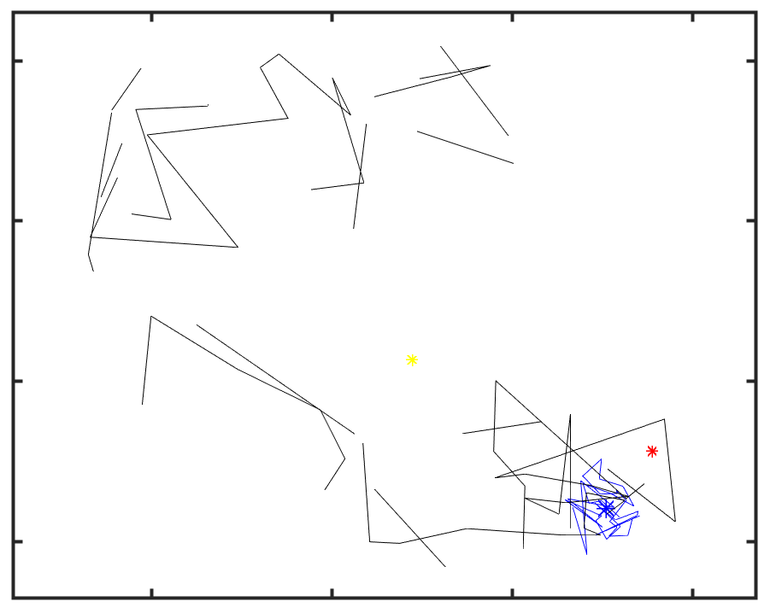
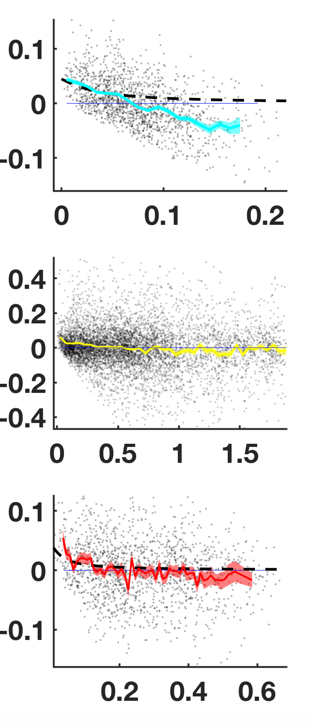
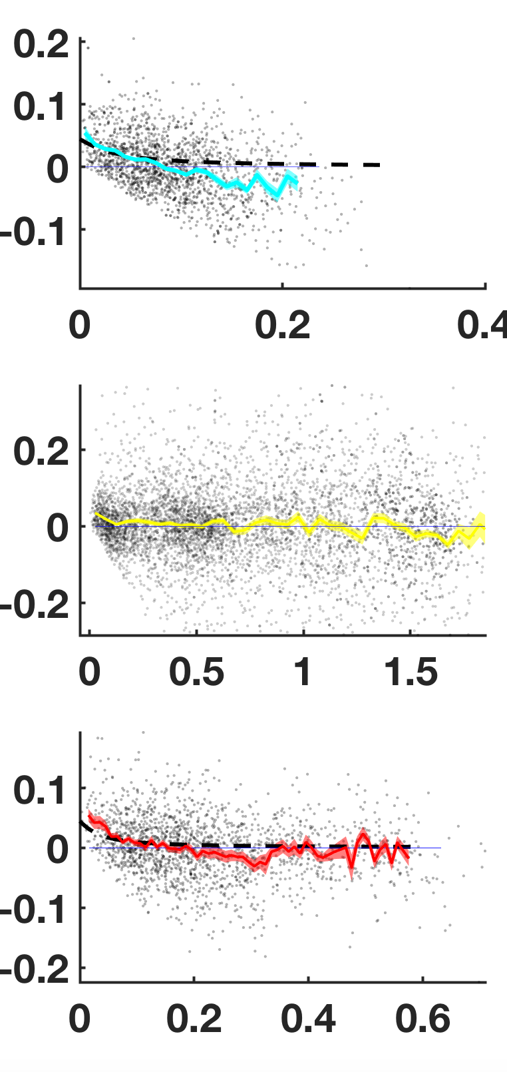
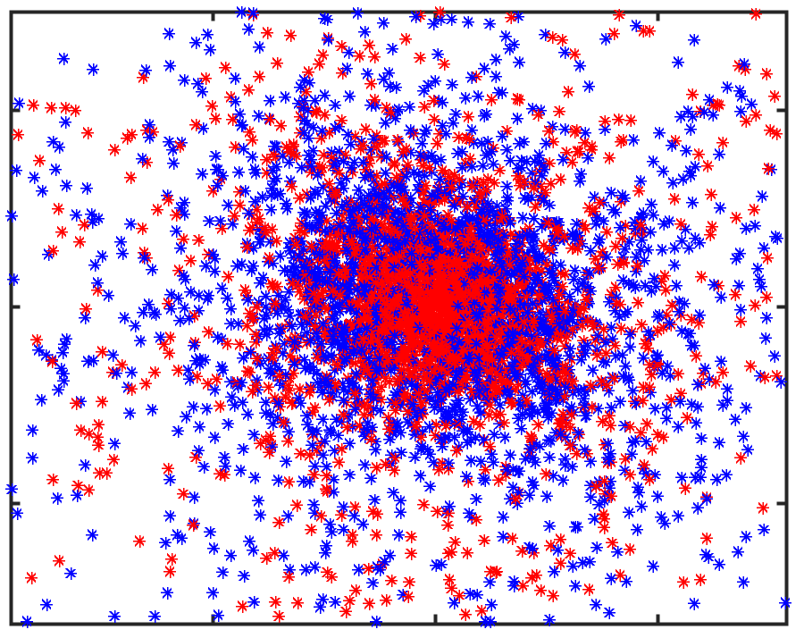
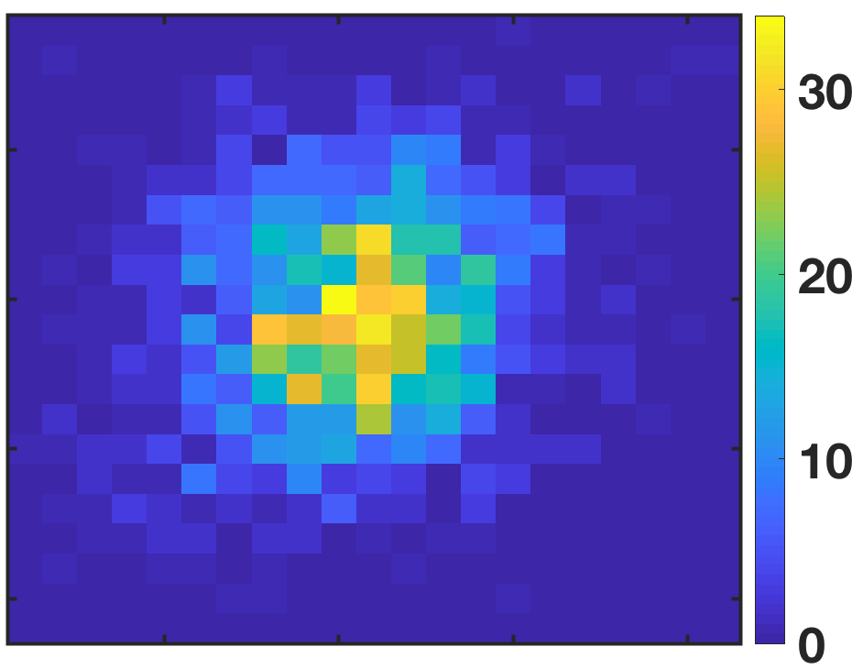
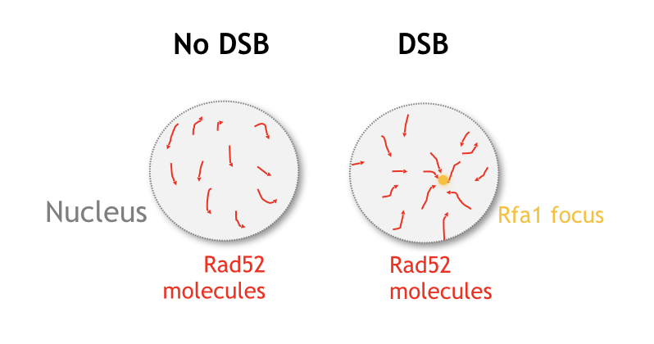
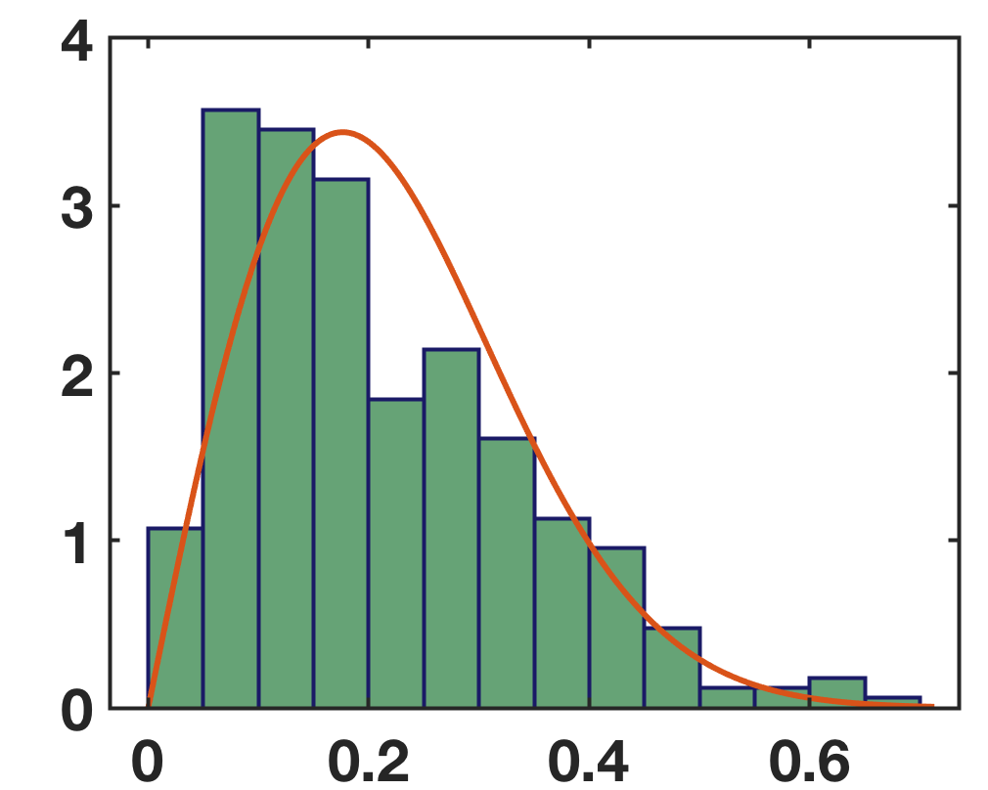
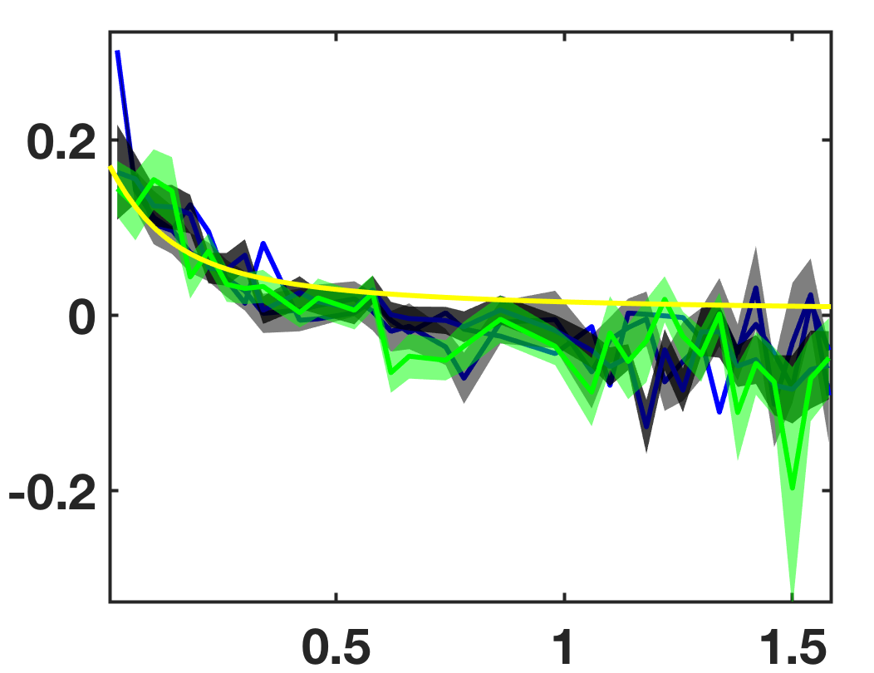
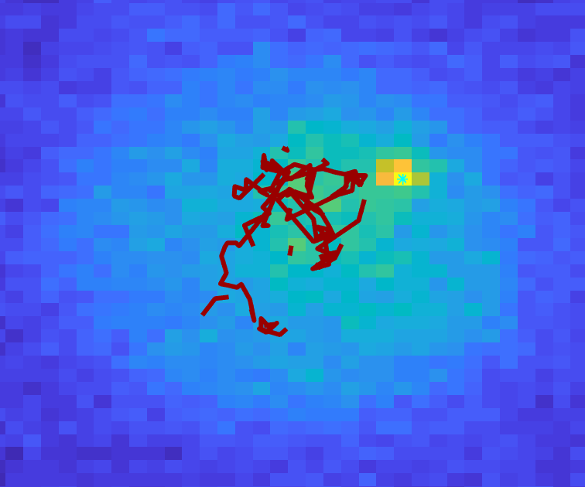
A
C
1DSB
2DSB
Representative cell
dr > 0
dr < 0
F
G
[um]
Mean value
dr [um]
dr [um]
Random
point
Mean focus
Mean
Focus
D
[um]
Mean focus
0.2
B
[um]
0
dr [um]
P1
dr [um]
dr
-0.2
P2
Center
Mean position
Mean position
E
-0.2
0
0.2
0.2
[um]
H
dr [um]
dr [um]
0
Random position
Random position
-0.2
-0.2
0
0.2
r [um]
r [um]
I
[um]
G
H
Traces of
MRE11
Position
of focus
Measured from focus
Best diffusion fit
Measured from random pos
Expected free diffusion
dr [um]
dr [um]
r [um]
r [um]

