Slide 1
EQ101 EQUELLA Digital Repository (Core Principles) Welcome
Notes:
Presenter note: Introduce yourself
Go around the group letting each person introduce themself.
Note names, roles and expectations.

Slide 2
Course outline
Course elements:
1. EQUELLA technology and terms
2. EQUELLA structure and searches
3. EQUELLA resources and lifecycle
4. Favourites and sharing resources
5. Contributing resources
6. My Resources
7. EQUELLA content and rights
8. Integrated EQUELLA
9. User Profile and Scrapbook
10. EQUELLA support, Professional Services, User Community, Training, and Repository Showcases.
11. Review

Slide 3
EQUELLA Technology and Terms

Slide 4
Technology and terms
What is EQUELLA?
Digital Repository
What is its purpose?
Management of digital content - a single storage point for learning content, research and library materials
How does it help you?
Simplifying content creation and management
Notes:
Presenter note: start with broad, simple descriptions that are easy to grasp (and generally have an association with the attendees).
EQUELLA is a storage and management system for resources.
It is the digital equivalent of a library and for this reason it is called a digital repository or sometimes a learning content management system (LCMS).
Purpose: to make everybody’s life easier by keeping track of the huge number of things that are used for course and research materials and making these things easy to find and reuse.
How does it help: Content creation is easier; providing varies functions for finding, managing and sharing from the digital repository. It can be integrated with systems currently used by educational institutions for course and content presentation.

Slide 5
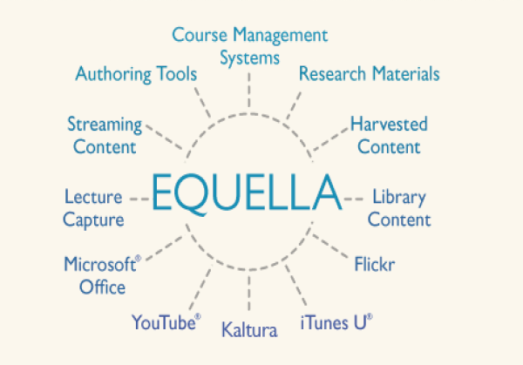
Share
Allow access to digital objects from multiple sources with EQUELLA
Notes:
The advantages of EQUELLA - Single point for managing and finding digital content
Easy object reuse and simple sharing of content
Copyright and digital rights management
Workflow, archiving and versioning of content
EQUELLA is content-centric. Institutions use EQUELLA to manage a range of internal, instructor-produced content, as well as external content from sources such as YouTube, Google Books, iTunes U, and Open Educational Resource (OER) initiatives. EQUELLA also supports a wide variety of standards such as SCORM and METS.

Slide 6
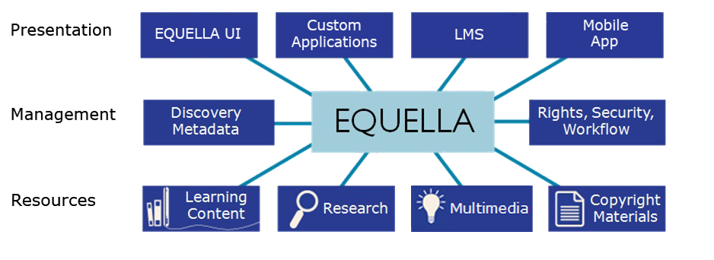

EQUELLA architecture
Upload, search and use:
Files (Word, Excel, PDF, ZIP), multimedia (movies, audio), images, Web links, YouTube videos, Google Books, iTunesU tracks, Flickr images, Kaltura media, eBooks, journals, Echo360 lectures, LTI, learning objects (IMS, SCORM, QTI, METS) and internal links to resources, files and webpages

Slide 7
Content presentation
EQUELLA is an advanced digital repository that can be integrated with content presentation software aka
Learning Management Systems (LMS)
EQUELLA can integrate with:
Pearson LearningStudio, Fronter
Moodle™, Blackboard™, Sakai™
Canvas and Angel
Notes:
EQUELLA is an advanced digital repository that can be integrated with LMSs, or Learning Management Systems.
LMSs with which EQUELLA can integrate include:
Pearson LearningStudio
Moodle™
Blackboard™
WebCT
Angel
Janison

Slide 8
Native EQUELLA
Insert native screen shot
Notes:
Two ways of accessing (viewing) EQUELLA –
Native EQUELLA that is accessed using a browser and URL.
Through an integrated presentation application LMS such as Blackboard, Moodle

Slide 9
Integrated EQUELLA
Insert screen shot of an integrated EQUELLA instance
EQU
Notes:
LMS = Blackboard , Moodle etc (write on the board - use as per institution)
They deliver the content

Slide 10
Digital content and EQUELLA
Digital content
Individual files, multi-file archives, learning objects, linked content.
Metadata
Information about content
EQUELLA resources
The fundamental EQUELLA entity
EQUELLA collections
The storage units that house resources
EQUELLA institutions
The whole repository

Slide 11
Digital content
Files
Individual documents (Word, Excel, PDF), multimedia (movies, audio), images, journal articles, e-books
ZIP archive files (unstructured content)
Links
URLs, Web pages, YouTube videos, Google Books, iTunesU tracks, Flickr images, Kaltura streaming media, LTI tools
Learning objects
IMS, SCORM, QTI and METS packages (structured and sequenced content)
EQUELLA resources
Attachments, links and packaged content stored in EQUELLA
Notes:
Digital content definition is any content that can be displayed on a computer.
Digital content = digital objects
Compound content = aggregations of atomic content (individual files) assembled into digital archive files (such as zip files) with no apparent ordering of content.
Learning objects = typically comprised of a number of different components sequenced in a particular order to deliver instructional content and facilitate learning retention through practice and assessment.

Slide 12
Where is the content stored?
Uploaded content:
Files that are directly uploaded into EQUELLA are managed and stored in EQUELLA.
External content:
A reference (link) to remote content is stored in EQUELLA but the actual digital content is stored elsewhere on the web.
Notes:
Atomic content = local content that is directly uploaded into EQUELLA for storage (Content stored in the EQUELLA filestore)
Remote content = EQUELLA stores the link (reference) to that content, but does not physically store, manage or control the content (Content stored in remote databases)

Slide 13
Metadata
Metadata is used to catalogue digital content and is basically information about an object.
Metadata is used for:
Searching
Versioning
Controlling content
Content metadata typically includes:
Title, description, keywords, author, course name, curriculum strands…
Notes:
Finding
- Sharing
- Reviewing
- Managing
Metadata can be defined as data about data.
The metadata of:
an image file can describe its size, resolution, method of creation, location, and description.
a document’s can record the title, summary, author, creation date, modification date and mime type of the document.

Slide 14
EQUELLA resources
An EQUELLA resource is:
A grouping of content
and metadata.
Content
Metadata
Content
EQUELLA resource
Notes:
Remind them that digital content is -Individual files, Multi-file archives, learning objects, remote content.

Slide 15
EQUELLA resources
Resources enter the EQUELLA repository by contribution using a wizard based web form:
Information (metadata) is entered into the form
Digital content is attached or linked to the form
A resource is created by completing a contribution form.
Notes:
Remind them that digital content is -Individual files, Multi-file archives, learning objects, remote content.
When you contribute resources to EQUELLA , you basically fill out a form which collects this metadata. The metadata is then stored in the schema file for that resource.

Slide 16
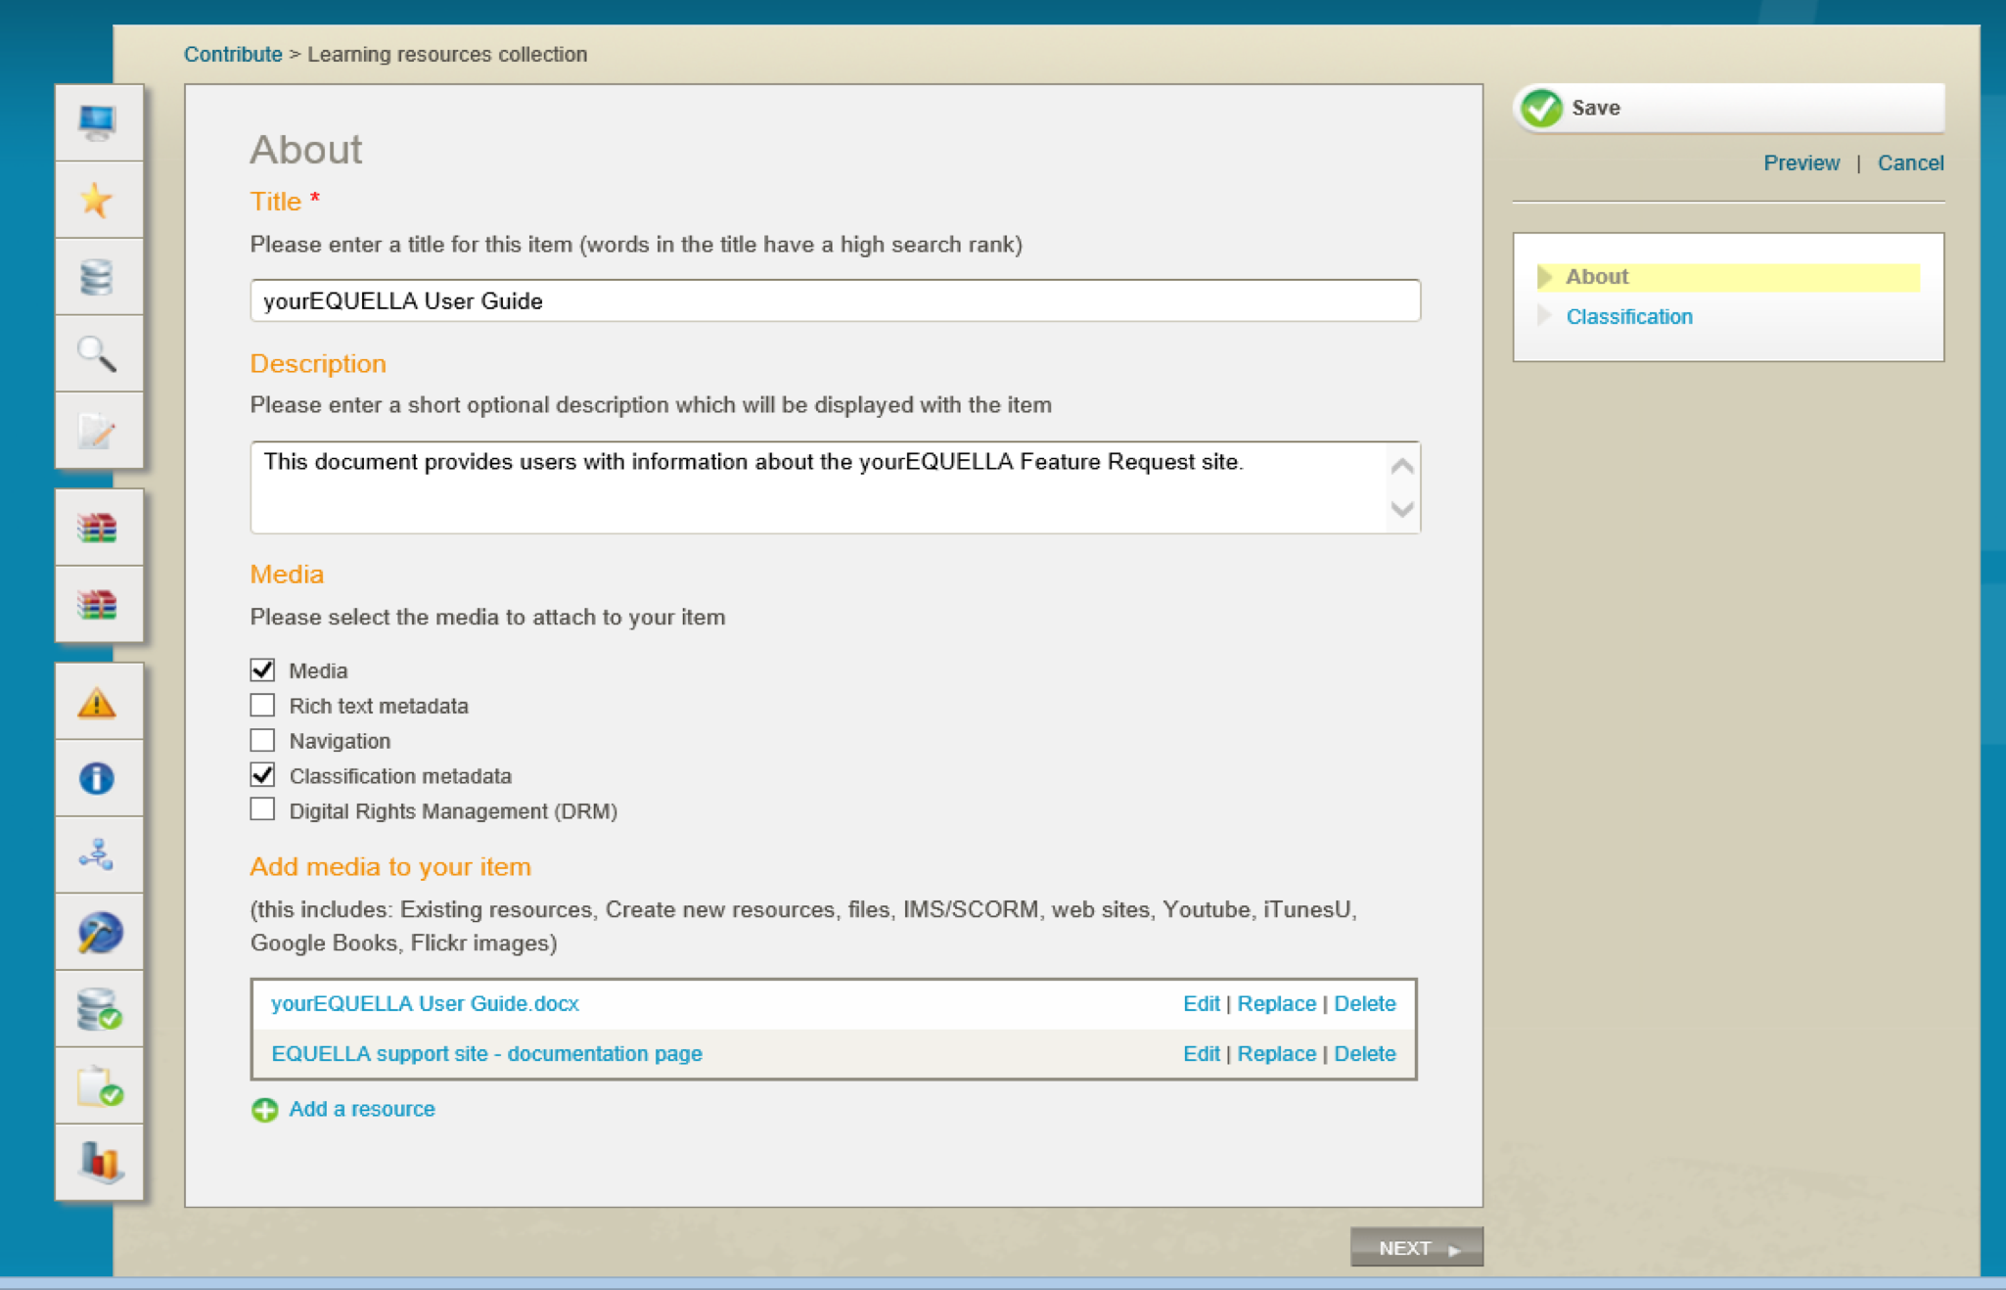
EQUELLA contribution form
Notes:
resources enter the EQUELLA repository by contribution using a wizard based web form:
Metadata is entered into the wizard
Digital content is attached or linked to the wizard
An resource is created by completing a contribution wizard.

Slide 17
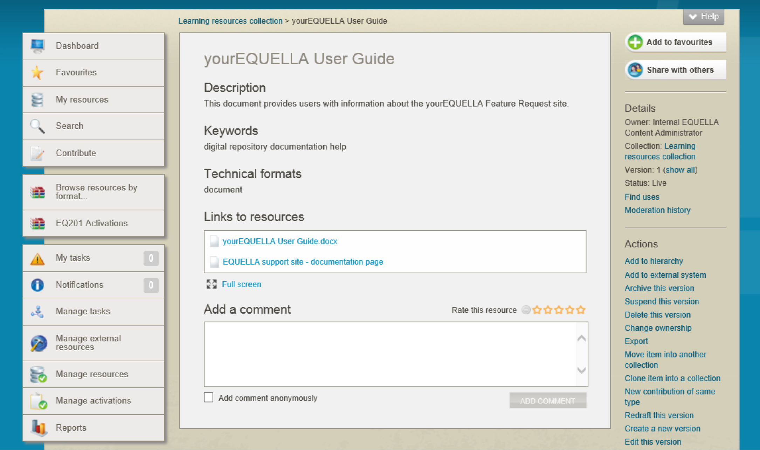
EQUELLA resource
Notes:
Remind them that digital content is -Individual files, Multi-file archives, learning objects, remote content.

Slide 18
EQUELLA Collections
Collections can be customised for the type of resources they store.
Collections provide grouping of similar content:
Images
Books and journals
Learning resources
Research
One or more collections are grouped in Categories.
Notes:
Collections are customised for the type of resource they store. They are all different

Slide 19
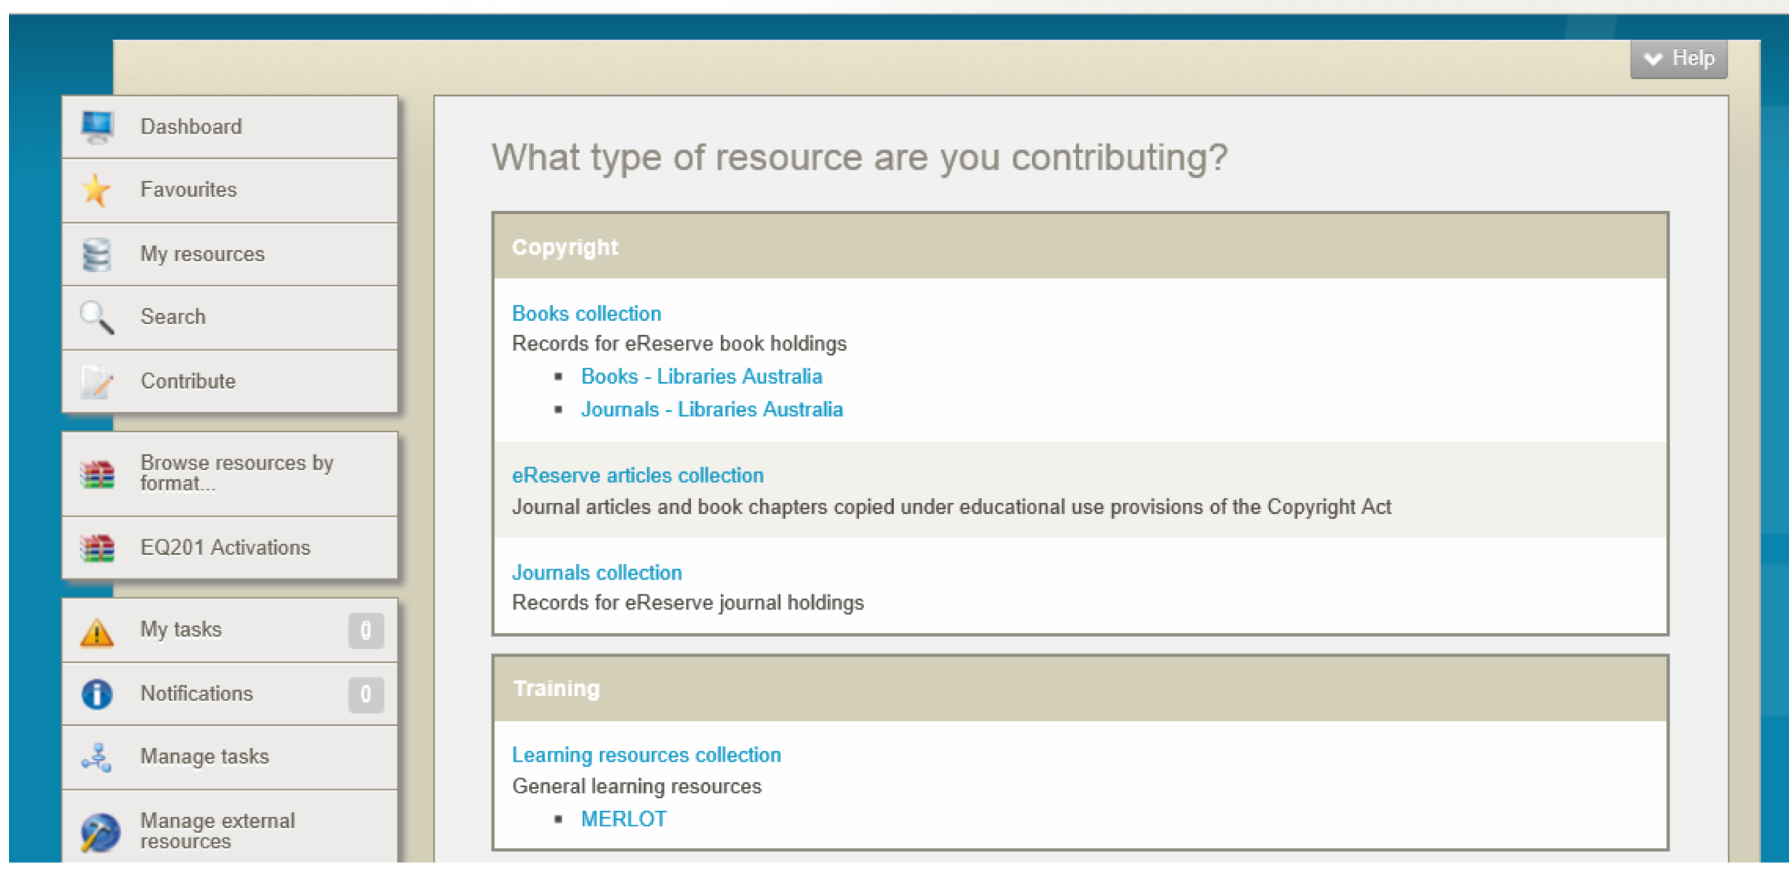
EQUELLA Collections & Categories

Slide 20
How does EQUELLA work?
Every resource that enters the repository is catalogued:
resource metadata
Users are provided with suitable permissions to:
search, view, create, manage, administer
Searches use the resource metadata to find results
Resources and their components can then be linked to courses.

Slide 21
EQUELLA Institutions
Institutions provide:
Access to stored content for:
Users
External applications and repositories
Infrastructure for managing:
Users
Digital content
Settings and the Administration Console tools for administrators to manage all aspects of EQUELLA.

Slide 22
Anatomy of an EQUELLA Repository
EQUELLA Institution
Multiple Collections
Collection
Workflow
Resources
Content
Metadata
Multiple Resources
Contribution Wizard
Security
User Management
Security
Unique URL
Administration Console
Metadata Schema

Slide 23




User access – browsers
EQUELLA can be accessed using the following supported browser applications:
Mozilla Firefox ™ latest
Google Chrome ™ latest
Microsoft Internet Explorer ™ v9, 10 and 11
Apple Safari ™ v5 or higher (Mac version only)

Slide 24
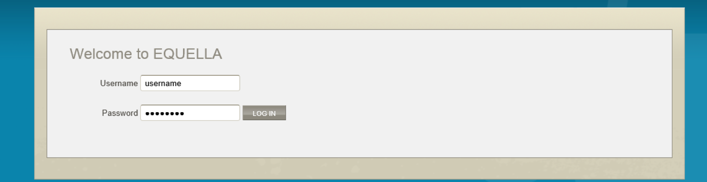
Access EQUELLA
Using a browser enter a URL:
<example url>
Each user requires a Username and Password
Notes:
Login and demonstrate the structure of EQUELLA and have participants complete the Dashboard exercises

Slide 25
EQUELLA structure and discovering content
Notes:
Discuss and demonstrate as per workbook then have the participants complete the Search exercises.

Slide 26
EQUELLA resources and lifecycle
Notes:
Use this section then discuss and demonstrate as per workbook:
resource summary section then have the participants complete the resource Summary exercises
Favourites section then have the participants complete the Favourites exercises

Slide 27
EQUELLA resources and lifecycle
EQUELLA resource lifecycle:
Content is created, uploaded or linked
Resources are created from content through contribution to a collection and enter a workflow.
Resources leave the workflow after publication and are available for use.
Resources are reviewed for currency and re-enter a workflow.
Notes:
resource states in EQUELLA:
Draft Rejected
Moderating
Live
Review
Archive

Slide 28
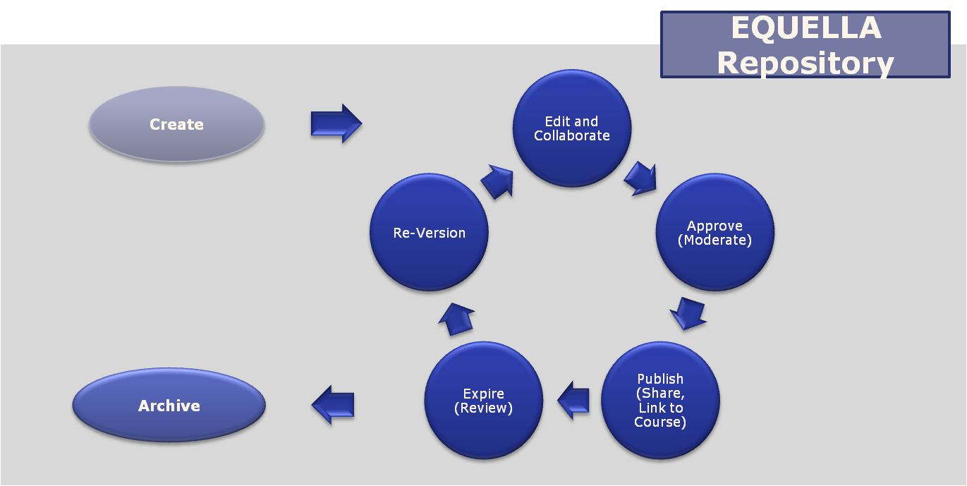
EQUELLA resource lifecycle

Slide 29
Content versioning
EQUELLA manages multiple versions of a resource.
This enables:
Content development from existing resources:
When a new version is created:
the existing resource is maintained.
updated version can be discovered.
Live versions can be linked to integrated course presentation applications (LMS):
Linked content can be updated to most current version or remain as the original version.
Notes:
EQUELLA allows a user to create new versions of resources already in the database.
This means new or updated material can be attached to an resource without losing the previous versions.
If resources or attachments are linked into a learning management system, the user then has the choice of which version to link.
EQUELLA stores multiple versions and LMS displays only one version.
The versions start at number 1 – next version is 2 and 1 will be archived etc

Slide 30
Viewing resources
EQUELLA resources comprise:
Content (files and links)
Information (metadata) for:
- Finding
- Sharing
- Reviewing
- Managing
When viewing a resource the content and information are filtered and grouped as an Resource summary page with Details, Actions, Sharing and Add to favourites options.
Notes:
EQUELLA resources comprise:
Content (attachments)
Information (metadata) for:
Finding
Sharing
Reviewing
Managing
When viewing an resource this information is filtered and grouped into tabbed collection of pages called the resource Summary.

Slide 31
Contribute resources to EQUELLA
Notes:
Discuss and demonstrate as per workbook and have participants complete the Contribute a resource exercises

Slide 32
EQUELLA resources My resources Using EQUELLA resources
Notes:
Discuss and demonstrate as per workbook and have participants complete the My Resources, EQUELLA resources and Structure exercises

Slide 33
Integrated EQUELLA Using EQUELLA through an LMS
Notes:
START WITH THIS SECTION THEN DEMONSTRATE using Moodle or Blackboard as appropriate for the institution.

Slide 34
Overview
EQUELLA is an advanced digital repository that can be integrated with content presentation software aka
Learning Management Systems (LMS)
EQUELLA can integrate with:
Pearson LearningStudio, Fronter
Moodle™, Blackboard™, Sakai™
Canvas and Angel
Notes:
EQUELLA is an advanced digital repository that can be integrated with LMSs, or Learning Management Systems.
LMSs with which EQUELLA can integrate include:
Pearson LearningStudio
Moodle™
Blackboard™
WebCT
Angel
Janison

Slide 35
Content presentation
Content presentation software (LMS) usually provide course storage and content delivery functionality:
Pros:
Materials simply uploaded and saved for each course
Cons:
Course materials difficult to manage across an institution
Difficult to manage material versions and copyright usage
Difficult to share materials
Notes:
Up until EQUELLA style digital repositories were developed course content was created in course presentation software.
This approach was simple for individual courses without copyright control.
But with the expectation of instant, complete and current course materials being made available through internet access management of materials currency became very difficult.
Issues:
-ballooning content storage – multiple duplicates in the LMS
-no workflow, versioning, reviewing or archiving of content
-lack of access to materials across multiple systems (e.g. Multiple LMS delivery tools, file servers, etc)
-poor discoverability of content once uploaded, and difficulty sharing material between courses, and between teachers

Slide 36
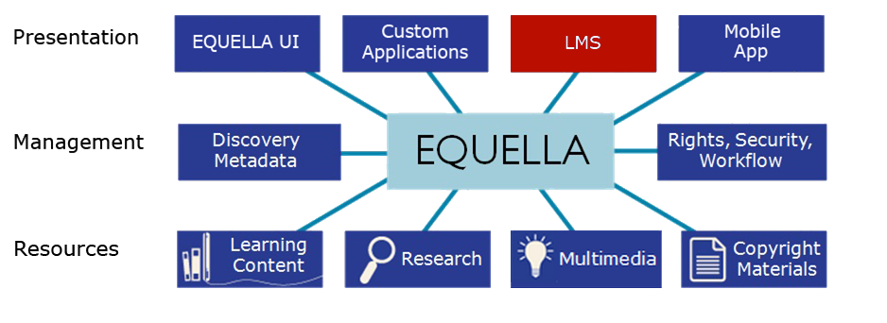
EQUELLA architecture
Upload, search and use:
Files (Word, Excel, PDF, ZIP), multimedia (movies, audio), images, Web links, YouTube videos, Google Books, iTunesU tracks, Flickr images, Kaltura media, eBooks, journals, Echo360 lectures, LTI, learning objects (IMS, SCORM, QTI, METS) and internal links to resources, files and webpages
)

Slide 37
EQUELLA Content and Rights Digital Rights Management and Copyright Management
Notes:
Use this section then discuss and demonstrate as per workbook and then have participants complete the DRM exercises

Slide 38
Content and digital rights
EQUELLA can store any form of digital content.
Recall EQUELLA resources are:
Digital content and metadata (information about the digital content)
Digital Rights Management (DRM) and compliance with copyright laws are important when using and sharing digital content.

Slide 39
Digital rights
EQUELLA records all accesses and acceptances to DRM protected materials.
Digital rights are important - they help protect an author or creator’s material from unauthorised or unacknowledged use.

Slide 40
Copyright compliance
EQUELLA can manage compliance with copyright laws.
EQUELLA manages and records the amount and use of available copyright material:
Limiting availability based on date range or course.
Providing reports for licensing or audit.
Copyright is important – it helps protect against unauthorized use of material. It also helps an author earn royalties from their work—through agencies such as Copyright Australia Limited.
Notes:
Copyright collections are covered in EQ201

Slide 41
DRM and copyright are not the same!
In EQUELLA:
DRM helps enforce digital rights acceptances and the attribution of material to its author or creator
Copyright helps enforce Copyright laws and allows educational institutions to monitor the use of copyrighted material for the purposes of teaching and research
EQUELLA enables both to be configured to help
limit access, based on institutional needs
Notes:
Refer to workbook and discuss

Slide 42
EQUELLA mobile app

Slide 43
Mobile app
The mobile app is suitable for iPad and Android tablets
Functions accessible from the EQUELLA mobile app include:
Viewing resources owned by the logged in user
Viewing notifications and tasks
Notes:
Up until EQUELLA style digital repositories were developed course content was created in course presentation software.
This approach was simple for individual courses without copyright control.
But with the expectation of instant, complete and current course materials being made available through internet access management of materials currency became very difficult.
Issues:
-ballooning content storage – multiple duplicates in the LMS
-no workflow, versioning, reviewing or archiving of content
-lack of access to materials across multiple systems (e.g. Multiple LMS delivery tools, file servers, etc)
-poor discoverability of content once uploaded, and difficulty sharing material between courses, and between teachers

Slide 44
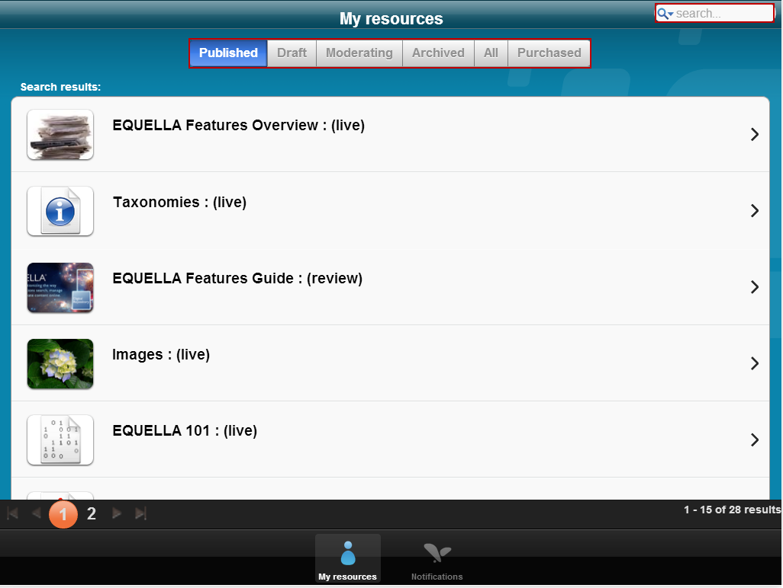
Mobile App
Notes:
mobile app for iPad and Android tablets
Functions accessible from the EQUELLA mobile app include:
Viewing resources owned by the logged in user
Viewing notifications and tasks

Slide 45
EQUELLA content exchange

Slide 46
EQUELLA content exchange
EQUELLA Content Exchange enables institutions to set up their EQUELLA as a Store, a Store front or both.
EQUELLA can be configured as a:
Store front - to register with EQUELLA Stores to access available catalogues and purchase content.
Store - to make content available for purchase to registered EQUELLA store fronts via Store catalogues.
Notes:
Up until EQUELLA style digital repositories were developed course content was created in course presentation software.
This approach was simple for individual courses without copyright control.
But with the expectation of instant, complete and current course materials being made available through internet access management of materials currency became very difficult.
Issues:
-ballooning content storage – multiple duplicates in the LMS
-no workflow, versioning, reviewing or archiving of content
-lack of access to materials across multiple systems (e.g. Multiple LMS delivery tools, file servers, etc)
-poor discoverability of content once uploaded, and difficulty sharing material between courses, and between teachers

Slide 47
EQUELLA content exchange
Notes:
EQUELLA Content Exchange enables institutions to set up their EQUELLA as a Store, a Store front or both.
EQUELLA can be configured as a:
Store front for the purpose of registering with EQUELLA Stores to access available catalogues and purchase content.
Store to make content available for purchase to registered EQUELLA store fronts via Store catalogues.

Slide 48
EQUELLA support EQUELLA professional services EQUELLA international user community
Notes:
Discuss the information contained in the workbook

