Slide 1
EQ401 EQUELLA System Administration Training

Slide 2
Course Topics and Timelines
EQUELLA support resources (Day 1)
Architectural Overview of EQUELLA (Day 1)
EQUELLA functional overview – Systems Administrator perspective (Day 1)
Student Task: Installing EQUELLA (Day 1)
Student Task: Upgrading EQUELLA (Day 1)
EQUELLA configuration files (Day 1)
Institution management (Day 1)
EQUELLA customisation (Day 2)
EQUELLA security (ACLs) (Day 2)
Error management (Day 2)
Content tools (Day 3)
Clustering (Student optional)

Slide 3
EQUELLA Support
Contact:

Slide 4
Other Resources
EQUELLA Community Site: www.equella.com
Designed to facilitate interaction amongst the EQUELLA client community
Has links to the EBI tool along with tutorials
Register at the community site

Slide 5
Overview of EQUELLA Architecture

Slide 6
Topics
What is EQUELLA?
Understanding EQUELLA – Content, Metadata, Items, Institutions
Understanding EQUELLA architectural Components

Slide 7
What is EQUELLA
Web-based Learning Content Managment System
Written in J2EE, deployed in Tomcat
Allows for easy contribution, search and retrieval of content
Integrates with most common Learning Management Systems (Moodle, Blackboard, etc).

Slide 8
What is Digital Content?
Digital content is any content that has been digitised and can be displayed on a computer. Digital content may be in the form of:
Individual documents (e.g. Text, MS Word/Excel/Powerpoint, PDF)
Multimedia files (video and audio files)
Links to websites, YouTube, streaming servers and iTunes U
Compressed archives (zip and tar files)
Learning Objects

Slide 9
Digital Content – Local vs Remote
Digital Content may be local or remote. Local content is content that is directly uploaded into EQUELLA for storage. When a user wishes to access local content, they must do so through EQUELLA.
Remote content is content that is being served from a remote location, such as other web servers, YouTube or iTunes U. EQUELLA stores the link (reference) to that content, but does not physically store, manage or control the content.

Slide 10
What is Metadata?
Metadata can be defined as data about data.
It is used in context with the data it is describing by recording information about the definition, structure and administration of its associated data. For example, the metadata of an image file may describe its size, resolution, method of creation, location, and description. A document’s metadata might record the title, summary, author, creation date, modification date and mime type of the document.

Slide 11
Purpose of Metadata
In EQUELLA, metadata provides the framework to create, organise and administer collections of digital content.
Metadata not only provides a method to describe the digital content in a collection, it also facilitates:
discovery (searching)
visibility (permissions and security)
management (workflows and lifecycle)
rights management (accessibility)

Slide 12
How is Metadata Represented in EQUELLA?
In EQUELLA, metadata is organised into a formal tree-like structure called a metadata schema.
Metadata schemas store the data values in predefined elements called nodes, each of which represents a specific attribute of the resource it is describing.
EQUELLA uses XML (Extended Markup Language) to represent its metadata schemas.

Slide 13
EQUELLA Items
In EQUELLA, an item is the smallest level of organisation of content. An item is comprised of metadata and optionally one or more attachments (digital content). An item is created by completing a contribution wizard. A contribution wizard allows users to contribute metadata and optionally upload digital content (as one or more attachments) using a web form.

Slide 14
Anatomy of an EQUELLA Item
Optional
Attachment
Metadata
Optional Attachment
EQUELLA Item
In EQUELLA, an item is comprised metadata and optionally, one or more attachments.

Slide 15
EQUELLA Collections
In EQUELLA, items are stored in ‘virtual containers’ called collections. A collection is governed by one metadata schema and the contribution wizard used to store data in the schema. Collections may be as specific or general as its designers wish. Collections may implement specific security governing access and visibility to its member items. Workflows can be imposed on collections to control item lifecycles. Collections also allow administrators the ability to manage items at a high level.

Slide 16
EQUELLA Institutions
The highest level of organisation in EQUELLA is an institution. An EQUELLA institution contains one or more collections. In addition to being able to manage collections, institution managers can control EQUELLA-wide security, users, groups, roles as well as a variety of other features via the administrative console.

Slide 17
Anatomy of an EQUELLA Repository
EQUELLA Institution
Multiple Collections
Collection
Metadata Schema
Workflow
Item
Attachment(s)
Metadata
Multiple Items
Contribution Wizard
Security
User Management
Security
Unique URL
Admin Console

Slide 18
Local vs Remote Repositories
EQUELLA is designed to free content from the platform in which it resides. To this end, EQUELLA can be set up to federate and harvest content - to and from external sources, like other EQUELLA institutions or other repositories that implement industry accepted standards and protocols.

Slide 19
Shared Ecosystem
EQUELLA
Other Repository Systems
EQUELLA
CONTENT
Protocols: DSM, ECL, SRU, Z3950, OAI/PMH

Slide 20
EQUELLA in the Enterprise
Browser
EQUELLA Application Server
Host Operating System
Database
Server
HTTP
Java Virtual Machine
HTTP
Tomcat App Server
HTTP
LMS(s)
File Share
Integration
Module
HTTP/SOAP
File Store
(Attachments)
LUCENE
Indexes
EQUELLA Config Files
Scripts/Tools

Slide 21
EQUELLA Directory Structure
conversion: For conversion service. Converts Microsoft Word, PowerPoint and Excel 2003 documents to HTML
filestore: For storage of files
Item Attachments
Custom XSLTs, Language pack files, other customisations
Branding files (images, css)
Staging Folder (temporary storage during contribution process), Institution exports and Imports
Trash folder – purged files

Slide 22
EQUELLA Directory Structure (cont’d)
freetext: For LUCENE Indexes.
learningedge-config: configuration files and select plugin configuration files
logs: logfiles for resource-centre and manager
manager: startup files, JVM configuration files, manager service and updates

Slide 23
EQUELLA Directory Structure (cont’d)
plugins: different jar files for various plugins, arranged by system area
reporting: files required for BIRT reporting integration
tomcat: the tomcat application server, tomcat configuration files and the core of EQUELLA

Slide 24
Functional Overview

Slide 25
Topics
EQUELLA requirements
LUCENE Indexing
EQUELLA Installation
EQUELLA Upgrade

Slide 26
EQUELLA Requirements
Suitable Operating System
Most UNIX and variants. Successful installations include Solaris 10, Ubuntu, CentOS, RedHat
OS X (it works, but is not currently supported due to lack of clients on this O/S)
Microsoft Windows XP, Vista, 7
GUI: EQUELLA requires a GUI for installation. There is no command-line installation.
Licence – obtain from support. You will need to know what URL(s) your institution(s) will listen to.
A suitable database back-end.
PostgreSQL 8 or higher
Oracle 9i, 10g, 11g
Microsoft SQL Server 2000, 2005, 2008
Oracle Java JDK 6. We always recommend the latest JDK.
ImageMagick 6.4+. It must’ve been compiled with the correct delegates, or it will not be able to generate thumbnails for all image types.
Filestore: commonly on the same disk/host as the EQUELLA installation, but may be remote (on a DAS/NAS SAN, NFS server, or other shared file system.)

Slide 27
Database Requirements
A dedicated database (Oracle Schema)
A username and password allowed to connect
Database Owner or permissions to create, modify, and delete tables, indexes and constraints; run select, insert, update and delete queries
UTF-8 encoding for character data
See installation documents for individual database requirements

Slide 28
ImageMagick
At the time of this writing, RedHat Linux does not have a suitable ImageMagick distribution, and must be built from source
If ImageMagick is installed, check it with the command:
Look at the version line for the version, and the DELEGATES line to find which image formats it supports
identify –list configure

Slide 29
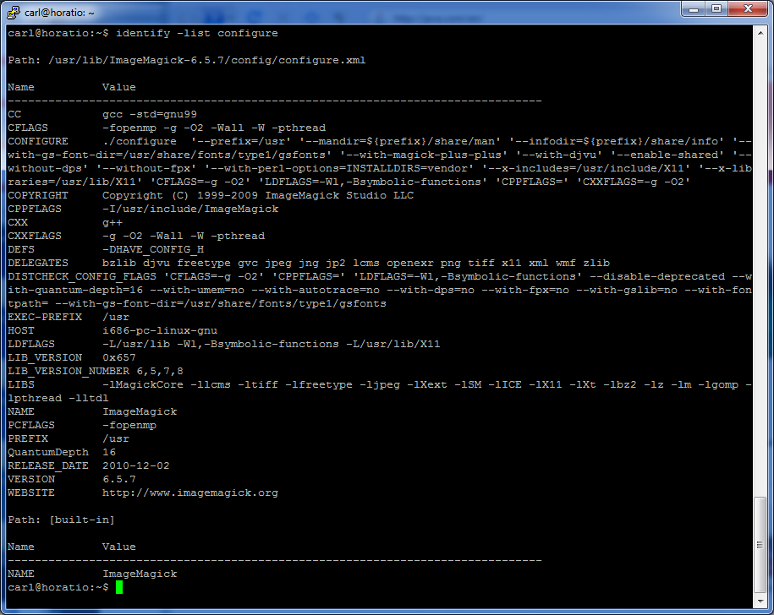
ImageMagick (cont’d)

Slide 30
EQUELLA Hardware Requirements
Highly variable – depends upon usage profiles, size of repository, types of learning objects
Typically a quad-core XEON, 12GB of RAM and adequate disk space for the filestore
See the hardware sizing document for more details

Slide 31
Student Exercise
Install EQUELLA
Install an institution
Upgrade EQUELLA

Slide 32
EQUELLA Configuration Files

Slide 33
Topics
Locations of EQUELLA configuration files
Learn what each configuration file controls

Slide 34
Configuration File Locations
$EQUELLA/learningedge-config
$EQUELLA/learningedge-config/plugins/*
$EQUELLA/manager
$EQUELLA/tomcat/conf

Slide 35
$EQUELLA/learningedge-config
Contains:
c3p0.properties
en-stopWords.txt
hibernate.properties
learningedge-log4j.properties
mandatory-config.properties
optional-config.properties
quartz.properties
upgrade-log.xml
plugins folder

Slide 36
Tips
Please read the comments before altering configuration files
Many paths will still use forward slashes, even on Windows hosts
Many configuration options are commented out (like clustering), and will not need to be uncommented unless a value other than default is desired
Some files should only be altered under the advice of an EQUELLA Consultant, EQUELLA support or a developer.
Always back up your files before altering them

Slide 37
c3p0.properties
Used for jdbc (database) connection pooling
We recommend that this is not changed without consultation with an EQUELLA consultant or developer
The only “tweak-able” configuration is:
Default is 100
Database servers may require changes if this number is raised. Consult your DBA
Can affect maximum concurrent and active users, but is not a 1:1 ratio of users to maxPoolSize.
c3po.maxPoolSize = 100

Slide 38
en-stopWords.txt
Words that the LUCENE index will ignore
Affects free text searches as well as power searches

Slide 39
hibernate.properties
Contains all variables for jdbc connections For example (PostgreSQL):
hibernate.connection.driver_class = org.postgresql.Driver
hibernate.dialect = com.tle.hibernate.dialect.ExtendedPostgresDialect
hibernate.connection.url = jdbc:postgresql://<dbhostname>:<dbport>/<dbname>
hibernate.connection.username = <dbuser>
hibernate.connection.password = <dbpassword>
Written by the installer
Can be changed if you move your database

Slide 40
learningedge-log4j.properties
Configures logging for EQUELLA Resource Centre
The only configuration parameter you should set is:
log4j.appender.FILE.File=<path to log files>application.html
Always use forward slashes, even on Windows hosts

Slide 41
mandatory-config.properties
Configures static features of EQUELLA
Tomcat location
Path to the file store
Path to Java
The URL that the institution manager listens to
Path to the LUCENE indexes
Path to the LUCENE stopwords file
Name of cluster group (if clustered)
Path to the reporting workspace (for BIRT reporting)
Paths to the plugins

Slide 42
optional-config.properties
Configures optional features in EQUELLA:
Enable/disable conversion service
Path to the conversion service jar file
Configures EQUELLA installed behind a reverse proxy
Configures parts of clustering (if clustered)
Node ID
Multicast Address
Multicast Port
Multicast Connection String

Slide 43
optional-config.properties – special configurations
These configurations work in conjunction with Scheduled Tasks. Configure with care!
To change the default setting for removing deleted items, add:
com.tle.core.tasks.RemoveDeletedItems.daysBeforeRemoval = <new value in days>
To change the default setting for removing old audit logs, add:
com.tle.core.tasks.RemoveOldAuditLogs.daysBeforeRemoval = <new value in days>
To change the default setting for removing old error logs, add:
com.tle.core.tasks.RemoveOldErrorLogs.daysBeforeRemoval = <new value in days>

Slide 44
quartz.properties
Governs the scheduled tasks in EQUELLA
Also used to turn on/off clustering
Other than clustering, do not change this file

Slide 45
upgrade-log.xml
Logs upgrades
Do not remove – the upgrade manager reads this

Slide 46
plugins/com.tle.core.freetext/optional.properties
Controls LUCENE options
# Synchronisation Timer. The number of minutes between synchronisation attempts.
#freetextIndex.synchroiseMinutes = 5
# Uncomment to ignore apostrophes in searches
#freetextIndex.analyzerClass = com.tle.freetext.TLEAnalyzer
# Index item attachments (defaults to true)
#textExtracter.indexAttachments = true
# Index IMS package contents (defaults to true)
#textExtracter.indexImsPackages = true
# Indicates if default search terms should be performed with an implicit AND or OR.
# Defaults to OR
#freetextIndex.defaultOperator = OR

Slide 47
plugins/com.tle.core.imagemagick/config.properties
Controls path to ImageMagick
Set by the installer
Set to the parent of where the “convert” utility is
Always uses forward slashes, even on Windows hosts
imageMagick.path = C:/Program Files/ImageMagick-6.6.7-Q16

Slide 48
plugins/com.tle.mycontent/filters.xml
Controls the search filters in “My Content”
Should not be configured, unless adding additional MIME types

Slide 49
plugins/com.tle.web.homepage/optional.properties
Hides the task box on the homepage when there are no tasks to display.
Defaults to False

Slide 50
plugins/com.tle.web.htmleditor.tinymce/editoroptions.txt
May be used to set TinyMCE editor options
Not usually configured

Slide 51
plugins/com.tle.web.institution/defaultBadge.jpg
Default badge for each EQUELLA institution in the institution manager
If an institution’s look and feel has been customised, the customisation is displayed

Slide 52
plugins/com.tle.web.viewitem/largeimageviewer/optional.properties
Controls when the large image viewer processes files
AUTO_TILE_AFTER_CONTRIBUTION: automatically generates different zoom levels after contribution
PROMPT_AFTER_CONTRIBUTION: generates a link after contribution to execute the large image viewer process
PROMPT_ONLY_WHEN_VIEWING: only prompts to execute the large image viewer process if the image attachment is being viewed
Note: the large image viewer process only needs to be run once on an image
If bulk-uploading images, ensure that AUTO_TIME_AFTER_CONTRIBUTION is not set, otherwise it will slow the system down

Slide 53
Auditing Controls
All options for auditing writes to the audit_log_entry table
plugins/com.tle.web.fedsearch/mandatory.properties
NONE: do not audit federated searches
NORMAL: log the federated search query string
plugins/com.tle.web.search/mandatory.properties
NONE: do not log search query strings
NORMAL: log the search (and power search ID, if applicable) query string
plugins/com.tle.web.viewitem/mandatory.properties
NONE: no audit trail
NORMAL: logs every item summary and attachment view (very verbose!)
SMART: logs item summary and attachment views on a per user session basis (less verbose, more memory intensive)

Slide 54
$EQUELLA/manager/config.properties
Configures the manager process
Port number to listen to
Username and password to EQUELLA’s upgrade server (to get updates)
Proxy information, if the manager is behind a proxy

Slide 55
$EQUELLA/manager/log4j.properties
Configures the manager’s logging
Only use this to configure the location of the log

Slide 56
$EQUELLA/manager/config.properties
Configures the manager process
Port number to listen to
Username and password to EQUELLA’s upgrade server (to get updates)
Proxy information, if the manager is behind a proxy

Slide 57
$EQUELLA/manager/manager.conf
Configures the path to Java for the manager process
Configures the startup options (heap size, etc) for the JVM when it starts the manager process
Configures the logging for starting/stopping the manager process
Configures the Windows Service Name of the manager process when installing the manager in services

Slide 58
$EQUELLA/manager/tomcat.conf
Configures the path to Java for the tomcat process
Configures the startup options (heap size, etc) for the JVM when it starts the tomcat process
Configures the logging for starting/stopping the tomcat process
Configures the Windows Service Name of the tomcat process when installing the tomcat in services

Slide 59
$EQUELLA/manager/users.properties
Contains the username/password to login to the manager, when it is running

Slide 60
$EQUELLA/tomcat/conf/server.xml
Configures tomcat
Server port (must be unique to that installation, if running multiple EQUELLAs on the same host)
Configures the HTTP connector
Can use this to configure HTTPS in Tomcat (not recommended)
Can use this to configure the AJP connector if running Apache in front of EQUELLA
Is modified for clustering configs
Note: no other files in the $EQUELLA/tomcat/conf directory should be modified

Slide 61
Institution Manager

Slide 62
Topics
How to back up EQUELLA Institutions
How to edit/enable/disable EQUELLA Institutions
Other institution manager features

Slide 63
Institution Manager’s URL
Configured in mandatory-config.properties file
May be its own URL
Some organisation’s internet-facing EQUELLAs only let the institution manager listen to localhost for greater security
Accessed via:
http://<configured url>/institutions.do?method=admin

Slide 64
Institution Management
Create new institutions
Disable existing institutions (disallows any login)
Edit existing institutions (only the URL, the filestore location is fixed upon creation)
Clone existing institutions
Delete existing institutions (also erases it’s filestore)
Export existing institutions (backup)

Slide 65
Exporting EQUELLA Institutions
If the institution’s attachment folder is less than ~10GB, you may export with attachments
Note: if it is over 1.5GB, then only export in Google Chrome. The export will crash Firefox and IE
If the institution’s attachment folder is greater than 10GB, export without attachments
Copy the attachments folder manually to its new home

Slide 66
Exporting EQUELLA Institutions (cont’d)
Best practice is to disable the institution first, but this is not required
If you don’t care to save the audit trail, don’t export the audit logs.
This can really slow things down if it has never gotten purged.
On highly active institutions, this could exceed a million rows
To exclude options, move the option from the left box to the right box.
Typically, only the audit logs and the Item Attachments are excluded. Excluding other options may result in unstable institutions when they’re re-imported.

Slide 67
Exporting EQUELLA Institutions (cont’d)
Institutions are first exported to the staging folder
Once everything is converted, EQUELLA tars and gzips the institution for download
If you don’t want to use a browser to download an institution, you can find it in the staging folder and tar/gzip it yourself. This is unsupported, however ...
But it has gotten consultants out of trouble several times ☺

Slide 68
Importing EQUELLA Institutions
Simply navigate to an institution import, and click “Import”
It unpacks the institution into the staging folder
Then it give you the option to exclude certain parts of the institution, similar to an institution export.
You do not need to exclude Item Attachments or Audit logs if they were excluded from the export
Once imported, you will be prompted to configure the filestore path and the institution’s URL. You may also change the password for TLE_ADMINISTRATOR here

Slide 69
Editing an Institution
May change the institution’s name
May change the institution’s URL
May change the password for the TLE_ADMINISTRATOR user
May change the institution’s time zone
May not change the filestore path

Slide 70
Server Settings
May set a server message, which appears whenever anyone logs into EQUELLA.
May set the System Password – this is the password for the Institution Manager
May update the licence here

Slide 71
Downloads
Downloads for the current EQUELLA version’s:
Blackboard Building Block
Blackboard Vista and CE Powerlink
Moodle Module
Legacy Moodle Modules
Angel Integration
EQUELLA Integration Pack (Documentation and examples for EQUELLA SOAP API and JavaScript API)
EQUELLA Harvester

Slide 72
Thread Dump
Shows EQUELLA Tomcat JVM thread activities at the time of the page load
Refresh the page to get a more current thread dump
Useful for developers to help troubleshoot problems

Slide 73
Cluster Health
Shows the health of the cluster (if configured)
Download the EQUELLA Cluster Tool
Helps to configure/troubleshoot clustering problems

Slide 74
EQUELLA Internal Systems Administration

Slide 75
Topics
TLE_ADMINISTRATOR Login & Functions
Themes
MIME Type Configuration
Logged in users
Google Analytics
Systems Settings
Federated Searches
User Management

Slide 76
TLE_ADMINISTRATOR Login
Special Local Account
Has special configurations (by default)
Password is set in the institution

Slide 77
Customisation Area
Download/upload the EQUELLA theme
Assign the URL for the badge
<insert image of badge example>

Slide 78
Theme Modifications
Download the Theme
Only make changes to customer.css
Place custom graphics in the correct paths
Tip: Use Firebug (Firefox plugin)
When re-zipping the theme, ensure it is not contained in a top level folder

Slide 79
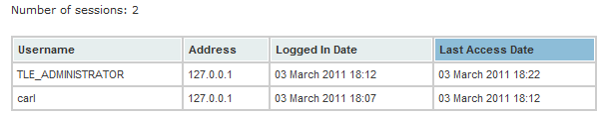
Logged In Users
See who has recently logged into that institution

Slide 80
MIME Type Configuration
Allows you to add/modify/remove MIME type handling in EQUELLA
Descriptive name and icon
Multiple text extractors to index items
Multiple viewers, and choose a default viewer
Add a template for embedding objects in the HTML editor

Slide 81
MIME Types – Details Tab
Description: Describe the MIME type
MIME Type (mandatory): enter the MIME type being configured
Extensions: configure the file extensions for the MIME type
Current Icon: set an icon. Removal of a custom icon causes the system to revert to the default

Slide 82
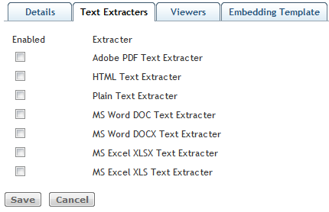
MIME Types – Text Extractors Tab
Options to index items that are included in searches

Slide 83
MIME Types – Viewer Tab
Allows the configuration of viewers for the MIME type
Only the appropriate type of viewer will show up, depending on the MIME Type. Eg:
image/xxx:
Download File
File Viewer
Large Image Viewer
Pretty Photo
View as JPEG Image
text/xxx
Download File
File Viewer

Slide 84
MIME Types – Viewers
Download File: forces the user to save rather than view the file
Download Package: for downloading IMS packages. This option is only available for equella/ims-package type and is not available in the Navigation Builder control.
File Viewer: displays the item in the current browser window or native application.
Large Image Viewer: displays all image types allowing the user to easily view very large, detailed images.
Pretty Photo: displays image/jpeg, image/png and image/gif types in a gallery style allowing the user to iterate through the images. This viewer option is not available in the Navigation Builder control.
External Link Viewer: displays eternal links in EQUELLA. This option is only available for equella/link type.
Embedded Movie Player: displays video/x-flv type in a flash video viewer.
IE Mov Popup Fix Viewer: displays all video/* types in a new IE6 or IE7 browser window.
HTML Conversion: allows .doc, .xls or .ppt files to be converted to HTML. (Note: Office 2007 is not supported.)
View as JPEG image: displays all the larger image formats (e.g. image/bitmap, image/x-portable-graymap) as a JPG. This viewer option is not available in the Navigation Builder control.

Slide 85
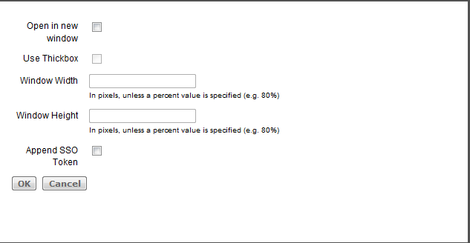
MIME Types – Viewers (cont’d)
Some viewers (image, video) have configuration options:

Slide 86
Viewer SSO Token
Check to add a single sign-on token to that EQUELLA Institution. During contribution, when a file of that type is uploaded (e.g. wmv file), hovering over the link on the item’s confirmation page or summary page shows the token appended to the URL on the bottom bar of the browser

Slide 87
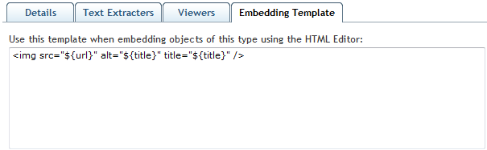
MIME Types – Embedding Template Tab
The Embedding Template Tab allows you to allocate the MIME types that can be embedded in the HTML editor. See the .gif, .jpeg, .png, and quicktime types as examplse

Slide 88
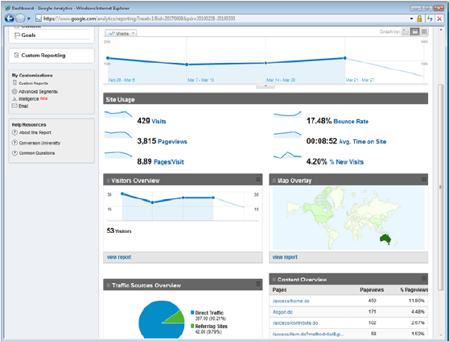
Google Analytics
Requires a Google Account
Then add the Google Analytics account ID to EQUELLA
Provides metrics for traffic and site development

Slide 89
System Settings
In the Administration Console
Set of plug-ins that configure how EQUELLA behaves
Several will not be covered in this training due to functionality deprecation or specialised topics
Assembler DRM References (Assembler is deprecated)
Assembler File Types (Assembler is deprecated)
Assembler Links (Assembler is deprecated)
Course Defaults (CAL specific – requires knowledge of CAL setup)
Curriculum Settings (Requires Curriculum server)
LMS Export Options (Assembler is deprecated)
Remote Caching Settings (Requires Active Cache)

Slide 90
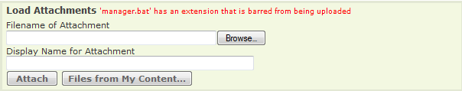
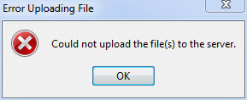
System Settings: Banned File Extensions
Prohibits files from being uploaded
Defaults are for .bat, .com, .exe, .scr, .shs, .vps files
Attachment Control error
File Manager control error

Slide 91
System Settings: FreeText Engine
Manually control indexing for the repostory
Forces a reindex of all items in the repository
If a thesaurus is supplied, index that as well
If indexing of web pages attached to items in the repository is desired, index that as well
If indexing of web pages linked to the web pages attached to items is desired, index that as well
Note: indexing web pages, and their children will have a performance impact

Slide 92
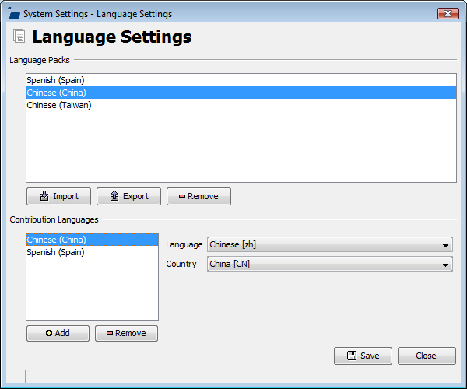
System Settings: Language Settings
Enables the use of multiple languages in EQUELLA
Requires Language Packs – contact Support
Users can select their preferred language in the ‘edit my details’ link on the main page of EQUELLA

Slide 93
System Settings: Login Notice Editor
Enables a customised login notice to be displayed when logging into the native EQUELLA interface (not displayed in an integration)
An empty login notice box effectively disables the login notice

Slide 94
System Settings: Login
Series of controls for configuring login and authentication
Enable SSL: forces a redirect to https for the login page. Requires SSL to be configured either in Tomcat (not advised), Apache or an SSL gateway
Leaving the Administration Console running while testing this feature is highly recommended

Slide 95
System Settings: Login (cont’d)
Login by IP Address
Used to provide a “guest” login – no password required
Must have a “guest” user configured
May have an automatic login, or a link displayed on the login page
May restrict to an IP address range, or to specific IP addresses
Options are:
Do not allow user to edit their details
Do not allow user to save searches
Hide task notifications
Do not store DRM acceptances

Slide 96
System Settings: Mail Server
Configures EQUELLA to send out automatic emails for contribution notification or workflow escalation
Mail server must allow relay from EQUELLA host(s)

Slide 97
System Settings: OAI Identifier
OAI identifiers are persistent identifiers that are URNs ensuring that OAI items can be uniquely identified.
Identifier is accessed by: http://<host>/<context>:<port>/p/oai?verb=Identify
Used for dynamic collections and harvesting

Slide 98
System Settings: Quick Contribute
Only valid in integrations (Blackboard, Moodle)
Enables a “Quick Contribute” control to upload a resource and link it back to the course without a contribution process
Must have a nominated collection
Would be typically used with a moderation workflow to fill in metadata later

Slide 99
System Settings: Scheduled Tasks
EQUELLA’s built in “Cron” tasks
Cron format: see http://www.quartz-scheduler.org/docs/tutorials/crontrigger.html
Tasks:
Calculate MD5 hashes: ensures no two attachments are the same
Check Escalation: checks escalation settings on items in workflow
Check for Deleted Users: check user management tool for users flagged for deletion and removes them. Prevents occurrence of “unknown user” in moderation tasks and group lists
Check Moderation: notifies users when an active workflow moderation task has had a change to the group members that is stopping it moving to the next moderation task. For example, a user is notified when an item that is being moderated reaches a task that requires unanimous agreement from group members to move to the next step, but a group member has left the organisation.
Check Review: checks for items that need to be set to review in collections which have a review period specified
Check URLs: checks URLs as specified by the URL Checking plugin

Slide 100
System Settings: Scheduled Tasks (cont’d)
EQUELLA’s built in “Cron” tasks
Generate Missing Thumbnails
Generate Thumbnails Forcefully
Notify of New Items – searches for new items that require notification after contribution and performs notification
Remove Deleted Items: Purges items that have been set to a “Deleted” status
Remove Expired Security: stop access to items when the specified access period has expired

Slide 101
System Settings: Scheduled Tasks (cont’d)
EQUELLA’s built in “Cron” tasks
Remove Old Audit Logs: removes old audit logs as configured in optional-configuration.properties file; or 7 days (default)
Remove Old Error Logs: removes old audit logs as configured in optional-configuration.properties file; or 7 days (default)
Remove Staging Areas: removes temporary files in the staging area
Update Item Size: updates the size of item attachment files. Helps to track system quotas

Slide 102
System Settings: Searching
In 4.0, a checkbox allowed regular users to search for non-live items, and this functionality could not be removed
In 4.1, that functionality became configurable

Slide 103
System Settings: Shortcut URL
Allows a shortcut to be configured so that the EQUELLA server responds and redirects to the configured URL
Used by appending /s/<shortcut name> to the Institution URL

Slide 104
System Settings: URL Checking
Allows EQUELLA to verify the URLs attached to items
URLs found to be bad (by the settings) will be disabled and the item owner emailed after the configured number of attempts
Requires Mail Server to be configured
Advanced scripting can be used to modify which response codes identify bad URLs

Slide 105
System Settings: User Quota
Configures the amount of storage available to EQUELLA users
After quota is exceeded, users will experience an error when trying to upload more data
Quotas can be configured on Users, Groups or Roles

Slide 106
System Settings: Version Selection
Institution-wide setting for resource version selection within an integration
Force selection to be the resource version the user is viewing—(default option) displays the originally linked resource.
Force selection to always be the latest live resource version—displays the latest version of the originally linked resource.
Select the resource version the user is currently viewing—allows the user to choose between the originally linked resource and the latest version of that resource. When this option is selected an Always Use Latest checkbox is displayed on the item’s summary page with the checkbox un-checked. The user can change the selection to the latest version by checking the checkbox.
Always use the latest live resource version—allows the user to choose between the originally linked resource and the latest version of that resource. The user can change the selection to the originally linked version by un-checking the checkbox.

Slide 107
Federated Searches
Allows users to search other repositories
Supported Repositories are:
DSM, ECL, Edna (MERLOT, GEM, VOCED, Australian Government Information, ABC Online, Picture Australia), Google, LORN, SRW, Z39.50
Typically, the greatest problems to configuring a federated search are firewall issues.
Know the host and port
If required, ensure you have accurate account information
Know what the output format is. You may need an input transformation (XSLT)

Slide 108
User Management
EQUELLA has local users, groups and roles
Authentication may be integrated with LDAP (including Microsoft Active Directory), replicated datastore, CAS, External Authentication (Shibboleth, ISA)

Slide 109
Local Groups
May be hierarchical
Inheritance goes up:
Parents do not inherit users from child groups!
Child groups inherit users from parent groups!
Cannot assign LDAP groups to local groups

Slide 110
Roles
May have users, local groups, ldap groups, network ranges, http referrers, and SSO connections as members
Three “special” users:
everyone: literally everyone. If a function does not require authentication (like view item), you do not need to be logged in if assigned to everyone
Logged in users: like everyone, except that you must be logged in
Guest users: Can configure a guest user which does not require a password to login
Roles may not have other roles as members
Roles may be configured with “Match Any”, “Match All”, “Match None” to get complex memberships
Best practice dictates that permissions are assigned to roles

Slide 111
Suspensions
May suspend user accounts without removing them

Slide 112
Shared Secrets
Allows SSO into EQUELLA without native logins
Requires an Identifier and Shared Secret
Requires a properly configured integration (like an LMS)
May prefix or postfix usernames to disambiguate
May be configured to only work from an:
IP address range (CIDR Notation)
HTTP Referrer
May allow the creation of a local user account if one doesn’t already exist in the system

Slide 113
EQUELLA Security and ACLs

Slide 114
Topics
EQUELLA Security Overview
EQUELLA ACLs

Slide 115
Security Best Practices
EQUELLA ACLs work much like firewall ACLs
Keep a permissions spreadsheet as an audit of your security permissions. Update the spreadsheet when you make security changes
In the absence of an explicit “Grant”, there is an implicit “Revoke”
The ACL closest to an object is the one that fires
ACLs are applied “Downwards” from the Institution level all the way down to an item level
Don’t forget that there is item status ACLs and item metadata ACLs
ACL overrides are applied upwards. A higher level override takes precedence to a lower level override
When new ACLs are introduced, typically their default will not be set (an implicit revoke). Perform a security audit after each upgrade.
Grant at the highest level possible
Minimise Revokes wherever possible
Use Overrides sparingly
If you make mistakes and lock yourself out, the TLE_ADMINISTRATOR user is your failsafe
Map users to groups and groups to roles. Always grant permissions to roles.
Keep your security as simple as possible

Slide 116
Some Concerns
Changing item permissions cause an immediate reindexing on the affected collection
Changing anything in a collection with DRM causes an immediate reindexing of that collection
Therefore, make your changes in batches and only save when necessary.

Slide 117
Ways to view permissions
From the Administration Console -> Security Manager
Viewing an object in the Administration Console and clicking on its “security” tab
You can find individual items in the Items folder in the Security Manager
The different views have different ways of allocating security

Slide 118
EQUELLA Logs and Error Management

Slide 119
Logs Location
Resource Centre (EQUELLA)
By default (change in $EQUELLA/learningedge-config/learningedge-log4j.properties)
Manager
By default: (change in $EQUELLA/manager/log4j.properties)
$EQUELLA/logs/resource-centre/<DATE>/application.html
$EQUELLA/logs/equella-manager/<DATE>/services.html

Slide 120
Other Logs
$EQUELLA/logs/tomcat.txt
$EQUELLA/logs/manager.txt
These log up the startup of wrapper, which in turn starts the service
Useful for start up problems, like port-binding errors and Java errors
These logs do not rotate. Watch their size!

Slide 121
Common Errors
java.sql.SQLException: Connections could not be acquired from the underlying database!
Cause:
EQUELLA cannot establish a connection to the it’s configured database using the credentials stored in the /path/to/EQUELLA/learnignedge-config/hibernate.properties file.
Resolution:
Check and test the connection details in the hibernate.properties file independently of EQUELLA. If cannot connect test the communication between the database server and the EQUELLA server/node (if the database server resides on a separate box). If this fails you will then need to check the status of the database service; they may need restarting. If the EQUELLA still cannot connect the database and the credentials have been confirmed please create a Support ticket with logs and troubleshooting results.

Slide 122
Common Errors
INFO | jvm 1 | 2011/01/12 21:30:28 | java.net.SocketException: Too many open files
Cause:
By default in Linux, each process may have 1024 file handles, and if exceeded, the process will crash. A process’s open file handles includes all of its linked libraries, open sockets (connections), all the actual files it is handling, its temporary files, etc. A bare-naked start up of EQUELLA where no-one has yet logged in or done anything uses about 300-400 file handles.
Resolution:
Increase the number of file descriptors available to Tomcat in the $EQUELLA/manager/tomcat file. To increase to 10000, insert at the beginning of the file (around line 12):
ulimit –n 10000

Slide 123
Common Errors
java.lang.OutOfMemoryError PermGen space
Cause:
Tomcat is running out of memory due to lack due to lack of configured memory.
Resolution:
Increase the following setting the /path/to/EQUELLA/manager/tomcat.conf file
wrapper.java.additional.9=-XX:MaxPermSize=256m

Slide 124
Common Errors
Exception in thread "Thread-33" java.lang.OutOfMemoryError: Java heap space
Cause:
Tomcat is running out of heap (memory) due to lack of configured memory
Resolution:
Increase the following setting the $EQUELLA/manager/tomcat.conf file
wrapper.java.additional.8=-Xmx512m

Slide 125
Common Errors
Error indicates that EQUELLA is exceeding the connection limit for Oracle.
Cause:
The default maximum connection pool size is 100 for EQUELLA, and is configurable in the c3p0.properties file in the learningedge-config folder. The Oracle connection limit is configured on the Oracle database. They will need to be roughly the same value (the Oracle database connection limit should probably be a bit larger).
Resolution:
Increase the following setting the $EQUELLA/learningedge-config/c3p0.properties file
c3p0.maxPoolSize = <number>

Slide 126
Common Errors
Error in wizard:
An Error occurred in the Wizard (with corresponding error in the logfile) Reason: Compilation produced 1 syntax errors. ERROR: missing ; before statement line 5: <Some error>; (column 15) or com.dytech.edge.exceptions.WorkflowException: org.mozilla.javascript.WrappedException: Wrapped java.lang.NullPointerException (saveOperation#975): Wrapped java.lang.NullPointerException (saveOperation#975) .
Cause:
If there are errors in the save script, they will both be reported to the user on save, and in the logs. Usually, they are cryptic and do not indicate exactly where they are.
Resolution:
Remove the javascript and add it line by line.
Log each javascript operation using the logger function
Note:
Sometimes there will not be an error reported to the user, but will appear in the log.

Slide 127
Troubleshooting with VisualVM
Only perform this action when requested by support
Add in $EQUELLA/manager/tomcat.conf file:
Note: These will be the last lines of the “wrapper.java.additional.<number>. Ensure that all of the numbers are sequential
Then in $JAVA/bin directory (the one configured in your tomcat.conf file), run jVisualVM
wrapper.java.additional.14=-Dcom.sun.management.jmxremote.port=8086
wrapper.java.additional.15=-Dcom.sun.management.jmxremote.ssl=false
wrapper.java.additional.16=-Dcom.sun.management.jmxremote.authenticate=false

Slide 128
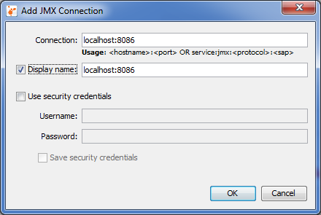
JVisualVM – JMX Connection
Create a new JMX connection, and use the port number configured in the tomcat.conf file

Slide 129
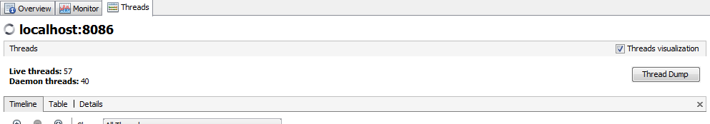
JVisualVM – Thread Dump
While the system is under load (active users) and the problems are being exhibited, click on Thread Dump. Save them to a file and email them through to support

Slide 130
EQUELLA Bulk Importer (EBI)

Slide 131
What is the EBI
Easy bulk importation of items into EQUELLA
Uses a spreadsheet for metadata

Slide 132
EBI Requirements
Windows XP, Vista, 7; OS X 10.4 +; Linux
EQUELLA 4.0 +
Python 2.5
CSV File
Attachments
Knowledge of the target collection
Login to EQUELLA with correct privileges

Slide 133
EBI Fields
Field | Required/Optional | Description
Institution URL | Required | The URL of the EQUELLA institution in this field.
Username and Password | Required | A valid username/password that has CREATE_ITEM privileges in the target collection
Collection | Required | The target collection for the bulk contribution
CSV | Required | The file path to a CSV of metadata and attachment file locations
Save Item XML | Optional | Check this box to save the test XML files created when performing test runs
Row Filter | Optional | Allows you to restrict your rows to be processed

Slide 134
EBI Buttons
Test/Get Collections: Retrieves a list of collections that the user can contribute to
Browse: Allows you to browse your computer to select the CSV input file
Reload CSV: Reloads the specified CSV’s values
Test Import: Tests an import without contributing
Start Import: Starts the import process

Slide 135
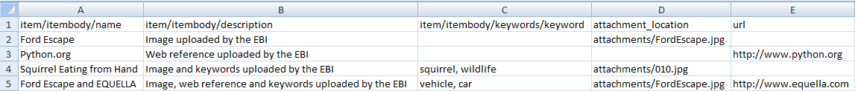
CSV File Format
Target metadata nodes and special columns (attachment or URL columns) across the header row
Values in subsequent rows

