Slide 1
EQ201 EQUELLA Content Administrator Training Welcome
Notes:
Presenter note: Introduce yourself
Go around the group letting each person introduce themself.
Note names, roles and expectations.

Slide 2
Course outline
Course elements:
1. Content Management
Searching and indexing
resource structure and XML
2. Moderation Workflow
3. Bulk Resource Management
4. Content, Rights and Copyright Collections
5. Bulk upload options
6. Reports
7. User details
8. EQUELLA support

Slide 3
EQUELLA Content Management
1
Notes:
This section of the course describes important aspects of EQUELLA content management.

Slide 4
Overview
EQUELLA manages content using the following processes:
Contribution—allows documents and multimedia material to be imported and created.
Search indexing—to catalogue materials to make them discoverable.
User role/privilege assignment—identify all key users and their roles including content managers.
Collection privilege assignment—assign roles and responsibilities for workflow review processes.
Notes:
Contribution is how resources are created.
Search indexing is the process used to catalogue all the resources in EQUELLA and creates an index of search terms for each resource.
User role/privilege assignment—Authors, copyright collection managers, content managers.
Collection privilege assignment—Workflow privileges.

Slide 5
Fundamental elements
The management processes are supported in EQUELLA by:
Metadata
Fundamental to contributing and cataloguing EQUELLA resources.
Access control lists (ACL) and privileges:
Fundamental to the user role and resource type management.
Notes:
While these users won’t be configuring users they should have an understanding of how privileges and ACLs affect resources and users.

Slide 6
Contribution
Content management begins with resource contribution.
During contribution information about the resource is entered and content is added.
So how do you determine what information to collect?
Notes:
The questions leads to the prerequisites for the collection discussed in the next slide.

Slide 7
Information
The information required for managing content depends on the content and how it is to be used:
Are the resources to be shared with other repositories?
Are the resources only for internal use?
Are the resources copyright?
Are digital rights assigned?
Notes:
The answer to each question will define what type of information to collect:
Is the content to be shared with other repositories? — if the answer is yes then you will have to gather information and store it in a suitable form.
Is the content for internal use?— this can simplify the information collected.
Is the content copyright?—if yes then copyright information will have to be gathered.
Are digital rights assigned?—if yes then DRM information will have to gathered and stored.

Slide 8
Metadata
The information collected during contribution is in fact metadata and its fundamental purpose is to make content discovery and management easier.
Managing content in large repositories requires organisation:
Information stored without structure makes it difficult to distinguish what the information is, text could represent a name, description or author.
Notes:
Information stored without organisation almost makes the information valueless. As text could represent anything.

Slide 9
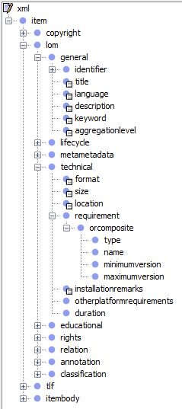
How is metadata stored in EQUELLA?
Organisation of metadata is controlled by the metadata template called a metadata schema:
A tree-like structure that defines the information to be stored.
Each repository resource gets a copy of this schema filled with its own information.
Schemas are written using XML (Extensible Markup Language)
Notes:
Reinforce the idea that metadata schemas are about organising the information.
There is nothing mysterious about a schema each node is a label for the information it holds. EQUELLA uses these labels to find the information.
There are many ways to organise information so there are many schemas.
For those offended by the misuse of latin, we know schemas should be schemata but this would confuse everybody that wasn’t so well educated.

Slide 10
Common schemas
To simplify sharing of content with other repositories standard schemas have been developed such as:
Learning object metadata (LOM) —http://www.imsglobal.org/metadata/
Dublin Core (DC)—
http://dublincore.org/
Typically schemas only implement part of these schemas as they are extensive with parts that are not relevant to all organisations.

Slide 11
Metadata and searching
Metadata:
Provides the means for finding EQUELLA content.
Is used to catalogue content into an index using a process called indexing.
The index associates search terms with the location of content in the repository.
Notes:
Metadata is used to find resources in the repository.
An index is created, this is very similar to a book index where words and the pages they appear on are listed.
So to find the page you want you look in the index for the word you want and turn to the page. It certainly beats having to search every page for the word.
In computing it also greatly simplifies searching.

Slide 12
EQUELLA searching
EQUELLA provides a range of searches each configured for a specific purpose.
Searches can be accessed through:
EQUELLA⎯search the whole repository, controlled sections or your resources.
Integrated applications⎯such as Fronter, Moodle or Blackboard.
Notes:
Some search the whole repository, or controlled sections and some only your content.
Basic search - keyword
Guided Search - collection
Advanced Search - advanced
Federated Search – external repositories
My Content search - personal
My Favourites search - bookmark
My Searches - saved
Browse the repository - organised
Task List search – task oriented
My resources
YouTube
Google Books
ITunesU
Through the Resource Selector or HTML Editor during contribution.

Slide 13
EQUELLA indexing
EQUELLA indexing is:
The process of cataloguing resources for searching.
Controlled by options associated with a schema node:
Searchable by Free Text
Index for Advanced Searches
Selecting either or both options will include the metadata stored in this node in the index, so it is available for a suitably configured search.
Notes:
Indexing can be a significant system load for large systems and the number and type of nodes indexed may need review if performance is noticeably degraded.

Slide 14
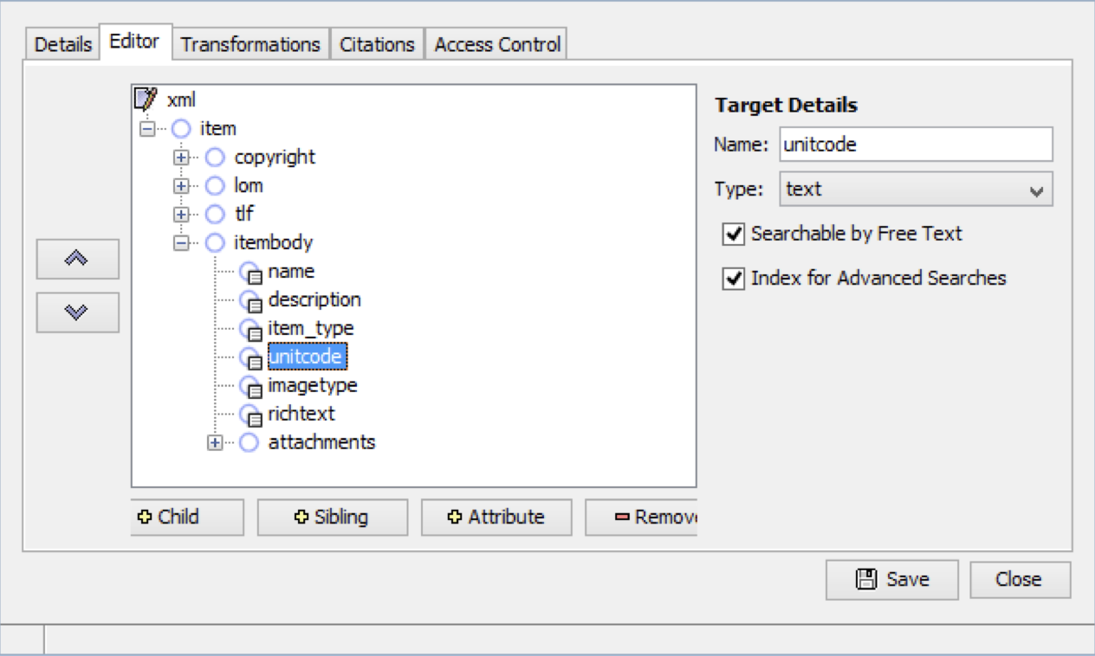
Schema node indexing
Notes:
Select either or both to include the node in the index. Searches can then use this content in search results.

Slide 15
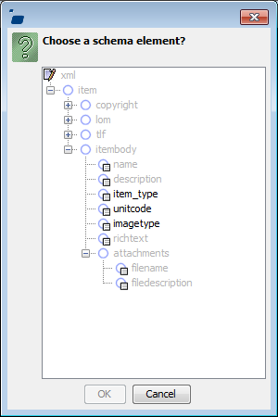
Schema node indexing
Notes:
Only nodes indexed for power search are then available for selection. (this is how a schema is viewed in the Digital Repository.)

Slide 16
EQUELLA resources
EQUELLA resources are:
Metadata
Content—attachments (documents) and links (media and video)
The previous section discussed how metadata can be organised and used
The next section describes how resources are stored.

Slide 17
Contribution
EQUELLA resources are created by contribution.
During contribution each resource is given a copy of the collection metadata schema filled with both information:
from the contribution wizard
added by EQUELLA.
EQUELLA creates a URL for the resource.
Notes:
Each wizard control is linked to a schema node where the information entered in the control is stored.

Slide 18
EQUELLA URLs
EQUELLA resource URLs comprise the:
Name of the EQUELLA server (e.g. http://myequella.someplace.edu/)
EQUELLA institution name or code created by the organisation when EQUELLA is installed (e.g. learning/)
Unique ID of the resource (e.g. resources/5b0dbc71-b444-3789-d6e5-dce072993c5e/)
Version number (e.g. 2/).
cont’d
Notes:
Discuss resource version numbers e.g.
Archived /1
Live /2
Draft /3
MENTION VERSION 0 – when using a link will always give the latest version.

Slide 19
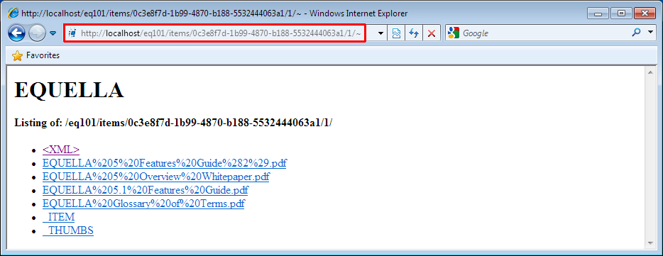
Viewing resource XML
EQUELLA resource XML, attachments and XSLTs can be viewed by inserting a tildé character ‘~’ after the version number.
Selecting <XML> displays the resource XML document.
Notes:
Entering this URL into a browser displays the resource page providing links to the constituent parts of the resource.

Slide 20
Viewing resource XML
Viewing resource XML can be useful for:
Troubleshooting; and
Checking differences between versions of an resource.
The displayed XML will be a combination of:
Entered metadata; and
System generated metadata.

Slide 21
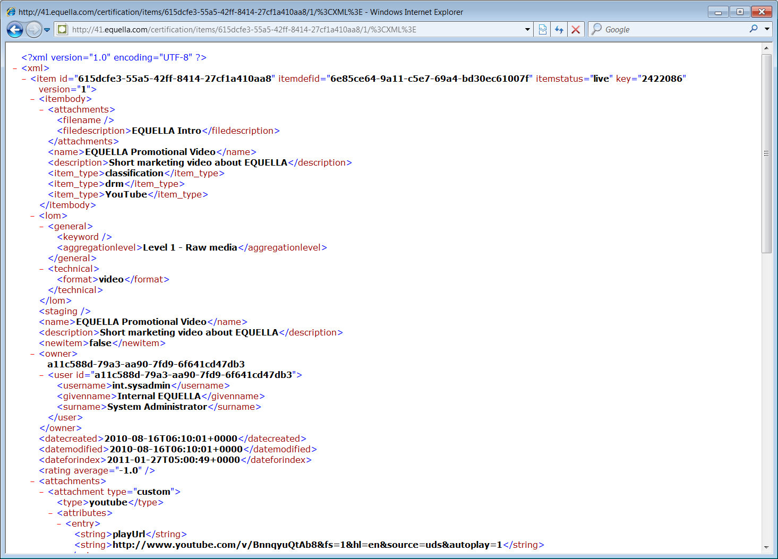
resource XML

Slide 22
System generated XML
The system generated XML nodes are appended to the resource metadata schema and cannot be accessed when editing a schema.
System generated XML contains system related information such as:
resource ID
version number
date of creation or editing
workflow steps

Slide 23
System generated XML
An example of system generated XML attributes:
<resource id="7a9204a1-22be-957c-7408-963c1c07bbef" resourcedefid="b4c2ddf0-b647-db8b-1e0d-d899d851724a" resourcestatus="live" key="30219" version="1">
An example of system generated XML elements:
<datecreated>2010-01-27T16:49:30+1100</datecreated>
<datemodified>2010-01-28T11:08:40+1100</datemodified>
<dateforindex>2010-04-09T09:09:17+1000</dateforindex>
Notes:
Demonstrate ~ and <XML>

Slide 24
EQUELLA Moderation Workflow
2

Slide 25
Access control lists and privileges
The security privileges and access control lists (ACL):
Are fundamental to the user role and resource type management.
Control every aspect of EQUELLA and how it can be used by users.
Notes:
The participants don’t need to understand the ACL in detail but having an overall view of how privileges control access to contribution wizards, schemas and collections is important.

Slide 26
Access control lists (ACL)
ACLs define the resources and functionality available to EQUELLA users by granting or revoking privileges.
ACLs provide a hierarchy of inherited privileges enabling:
Institution ACL⎯to be applied to all collections, resources or users.
Collection ACL⎯to be applied to all resources in the collection.
Resource ACL⎯to be applied to specific resources.
Role ACL⎯to be applied to all users associated with that role.
Simple and powerful control over resources and users.
Notes:
ACL precedence can be very detailed so simply provide a summary.

Slide 27
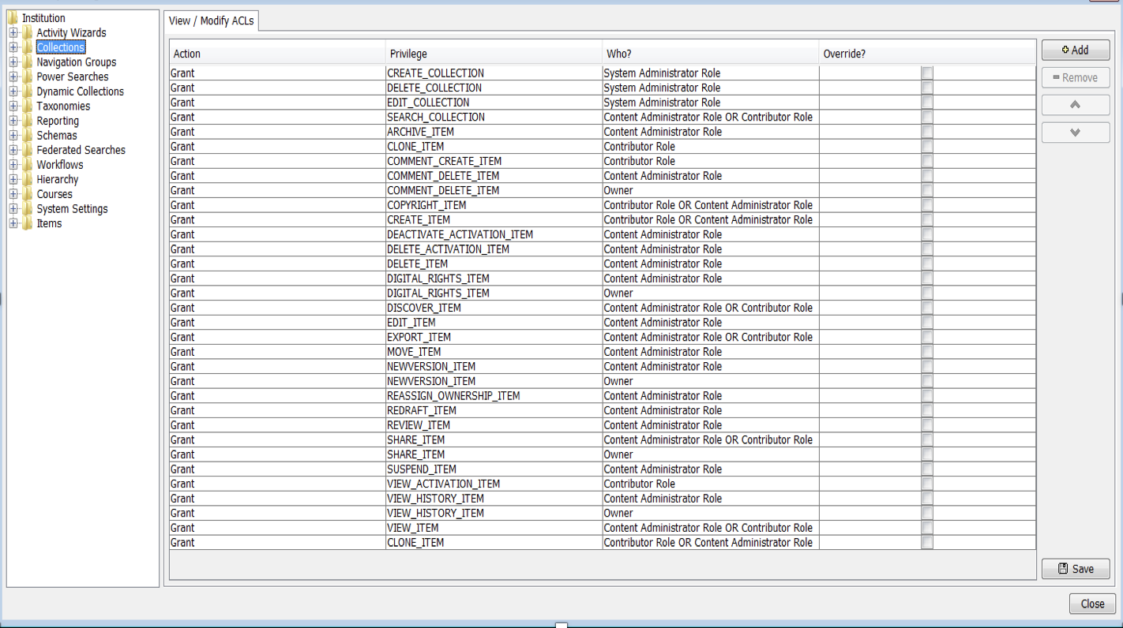
An EQUELLA ACL
Notes:
Discuss that most lists are grant as this is simpler to maintain.
The inherited ACL can be overriden at any level for individual privileges.

Slide 28
Content management role assignment
To play a role in content management users must have suitable privileges.
Typically users are assigned to a suitably configured user group that is then assigned to an EQUELLA role by a system administrator .

Slide 29
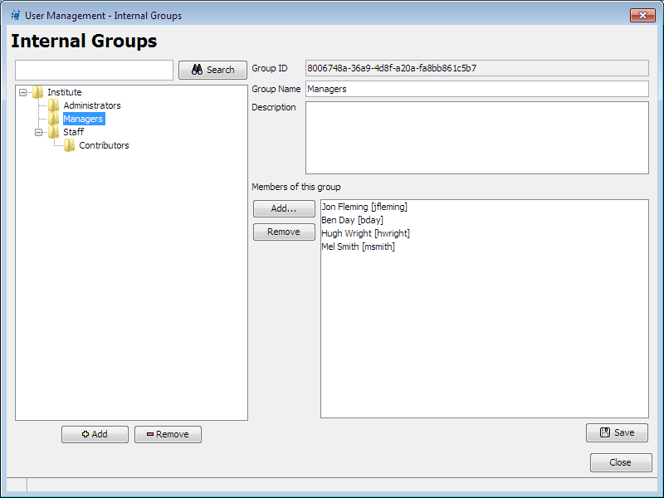
Group assignment
Users are put into Groups

Slide 30
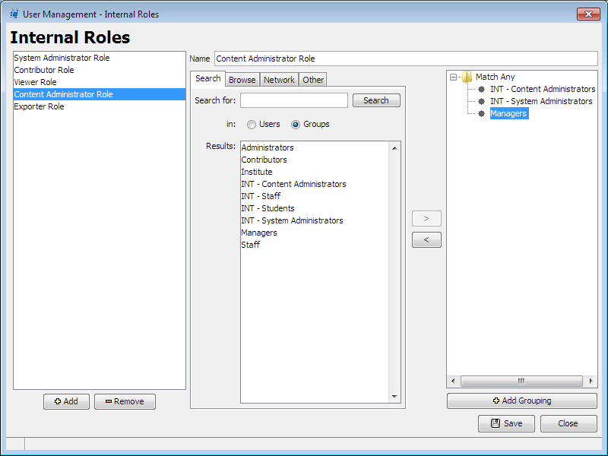
Role assignment
Groups are assigned to Roles

Slide 31
Content management roles
Content management is a collaborative processes typically involving roles such as:
Creator—responsible for creating or editing content.
Editor—responsible for refining content to organisational standards.
Publisher—responsible for releasing content for use.
The interaction between the various content management roles is coordinated by a workflow.
Notes:
Content management is about collaboration. It is a large job and requires successful interaction between the roles listed.
The role collaboration is coordinated using a workflow.

Slide 32
Workflow overview
Workflows are associated with a collection and can be a simple one-step review or complex multi-step editorial and technical reviews that contain multiple publication paths.
Resources contributed to a collection with a workflow will enter the workflow when:
The resource is contributed .
A new version of the resource created.
The resource is reviewed.

Slide 33
Resource States
Moderation resource states indicate a resource’s progress through the workflow.
The resources have the status:
Moderating⎯after entering the workflow for the first time or being re-drafted into the workflow.
Rejected⎯after being sent back to the original contributor (rejected from the workflow).
Review⎯after a designated period has elapsed.

Slide 34
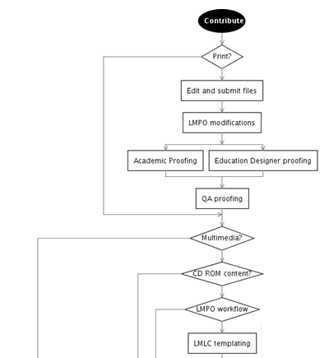
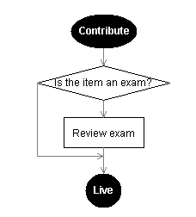
Workflows
Workflows can be:
very simple
extremely complex
Notes:
Workflow progress is displayed using the workflow diagram displayed by selecting the Show Moderation Progress link on moderations Tasks page.

Slide 35
EQUELLA Bulk Resource Management
3
Notes:
Discuss and demonstrate as per workbook and have participants complete the Bulk resource Management exercises

Slide 36
EQUELLA Content, Rights and Copyright Collections
4

Slide 37
Management of Rights
EQUELLA has the following functionality to assist in the
management of rights:
DRM (Digital Rights Management)
Custom Metadata
Copyright Compliance

Slide 38
Digital Rights Management (DRM)
EQUELLA manages licensed content using DRM and provides options for:
DRM license display.
DRM agreements for licensed content (EQUELLA does not enforce any agreement conditions).
Restricting access.
Notes:
DRM may be configured to restrict access based upon:
IP address (or range of IP addresses)
Users or Groups of users
Number of allowable accesses (within EQUELLA)
A specific date range (within EQUELLA)

Slide 39
Custom Metadata Rights
EQUELLA can be configured to grant access based on
metadata.
Useful for:
Open Source
Creative Commons
Custom Metadata Rights will not display license terms; or
enforce attribution, copying or distribution.

Slide 40
Copyright Compliance
EQUELLA can be configured to manage content protected
by copyright:
Using the Copyright Law educational institution
provisions.
Reporting on copyright content use.
EQUELLA cannot enforce copying, modification,
distribution or attribution once content has
been downloaded to a user’s computer.

Slide 41
EQUELLA Copyright Compliance
EQUELLA provides copyright extensions for collection definitions that allow institutions to manage materials that have been copied under:
Part VB of the Australian Copyright Act 1968 (as amended).
The Copyright, Designs and Patents Act 1988 (United Kingdom (UK) copyright law).
And can produce appropriate reports for the:
Copyright Agency Limited (CAL)
The Copyright Licensing Agency (CLA)

Slide 42
EQUELLA Copyright Extensions
EQUELLA functionality also includes the ability to:
Activate specific sections of books and journals (book chapters and journal articles) for particular periods of time against a course.
Track content usage and the number of enrolled users against the activated resources.

Slide 43
What is Enforced?
For example CAL default settings allow:
10% or 1 chapter for books
With provision for multiple sections.
1 journal article per journal issue
- Exception: All articles on the same topic are allowed.
EQUELLA can be configured to not display material unless:
Content is activated against a course.
The date is inside the activation period.
Notes:
In comparison for CLA –
The following default restrictions are applied:
Books—up to 5% or one chapter.
Journals—up to 5% or one article.
Conference proceedings—up to 5% or one paper of one set.
Judicial proceedings—up to 5% or one report of a single case.
Short stories or poems—up to 5% or one short story or poem of not more than 10 pages.

Slide 44
Configuration Options
CAL/CLA can be configured to:
Display custom errors for:
Activations that will violate copyright law.
Content that is accessed outside the activation period.
Restrict activation to a single portion per holding.
Set the Part VB percentage.
Enforce the % rule per course, rather than on all courses (default).
Display a custom agreement when users access copyright materials.
Override the percentage at the time of activation.
Notes:
Demonstrate adding a holding resource through Remote Repository, portion resource with an attachment and link to holding resource.
Activate and discuss Courses through native EQUELLA and LMS/VLE.
Manage activations through resource summaries and Manage Activations link.

Slide 45
EQUELLA Reports
5
Notes:
Discuss and demonstrate as per workbook and have participants complete the Report exercises

Slide 46
EQUELLA Bulk upload options
6
Notes:
This section describes how data can be imported into EQUELLA
Use this power point section

Slide 47
Overview
The three options for bulk loading data into EQUELLA include:
EBI (EQUELLA Bulk Importer).
Java import/export utilities.
Custom programming by a consultant to client specifications.
Notes:
EQUELLA resources can be individually created via the contribution wizard and they can be bulk uploaded from, for example, legacy databases

Slide 48
What is EBI?
The EBI (EQUELLA Bulk Importer):
Creates EQUELLA resources from data contained in a csv file.
Allows users to specify how EQUELLA uses the CSV file.
It can read in and import attachments – either files or URLs, including multiple attachments for the same resource.

Slide 49
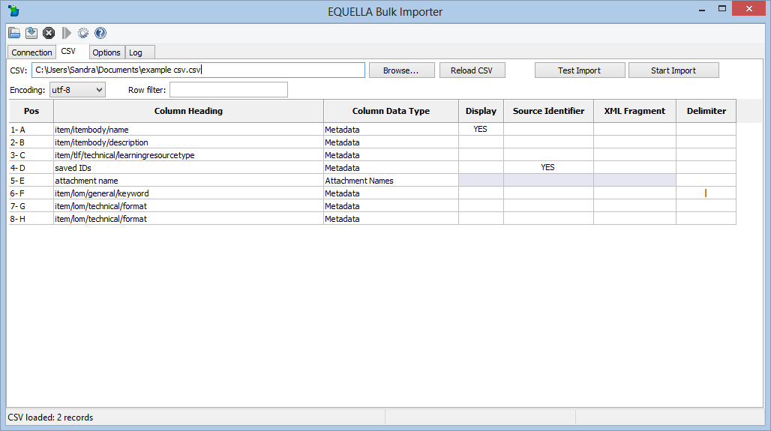
EBI

Slide 50
Java utilities
There are two utilities that allow resources, or resources plus attachments, to be exported and imported:
Export tool - exports records from a collection as XML files plus linked attachments. The original resources and attachments remain in the original collection.
Import tool - reloads exports into another EQUELLA collection – perhaps on a different server – as long as both schemas match.

Slide 51
Custom programming
Custom programming gives an organisation or institution great flexibility in exporting and importing data from legacy systems to EQUELLA.
Python (an open source computer language) is the preferred scripting language for these activities.
Python uses SOAP calls which can manipulate existing EQUELLA XML or create and upload new XML.
Python scripts can also be used to upload attachments.

Slide 52
User Details
7
Notes:
Discuss and demonstrate as per workbook and have participants complete the User Details exercises

Slide 53
EQUELLA Support
8
Notes:
Discuss and demonstrate as per workbook

