Slide 1
Database Benchmarking
In Industry 4.0
By christian navolskyi

Slide 2
Contents
Benchmarks
LDBC
XDABench
HPC Scalable Graph Analysis Benchmark
Graphtheory

Slide 3
The Linked Data Benchmark Council: a Graph and RDF industry benchmarking effort [1]
Four main elements
Data schema
Workload
Performance metrics
Execution rules
Choke Points
Used as design element
Semantic Publishing Benchmark
Fed with RDF metadata
Notes:
Choke Points – 28 are defined, examples are: exploiting functional dependencies in group-by, foreign-key joins with a low match ratio, and discovering correlation among key attributes in a clustered index

Slide 4
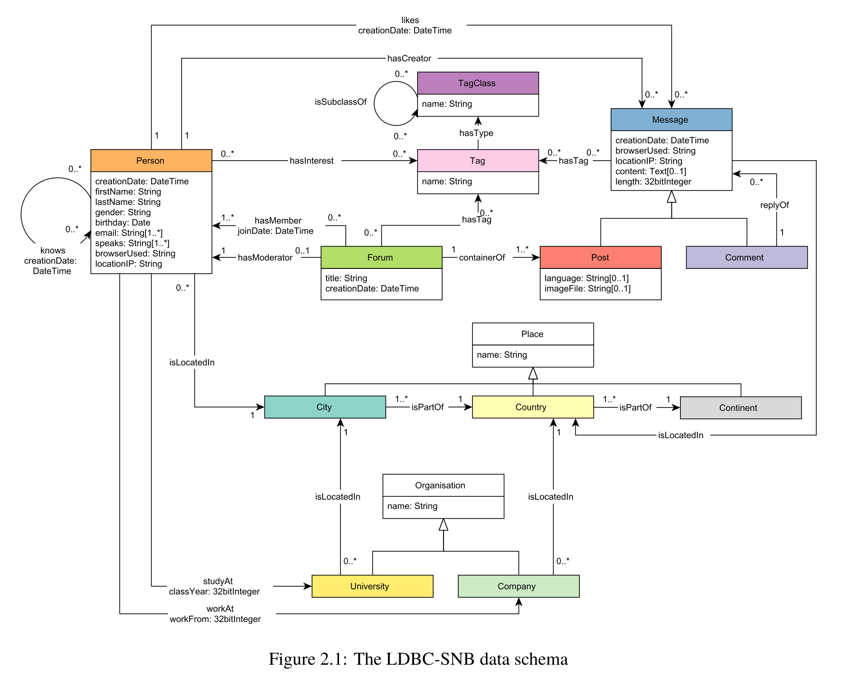
LDBC Social Network Benchmark [2]
Datastructure – Made for social networks
Platforms
From Relational over RDF to Graph
Designed for modularity

Slide 5
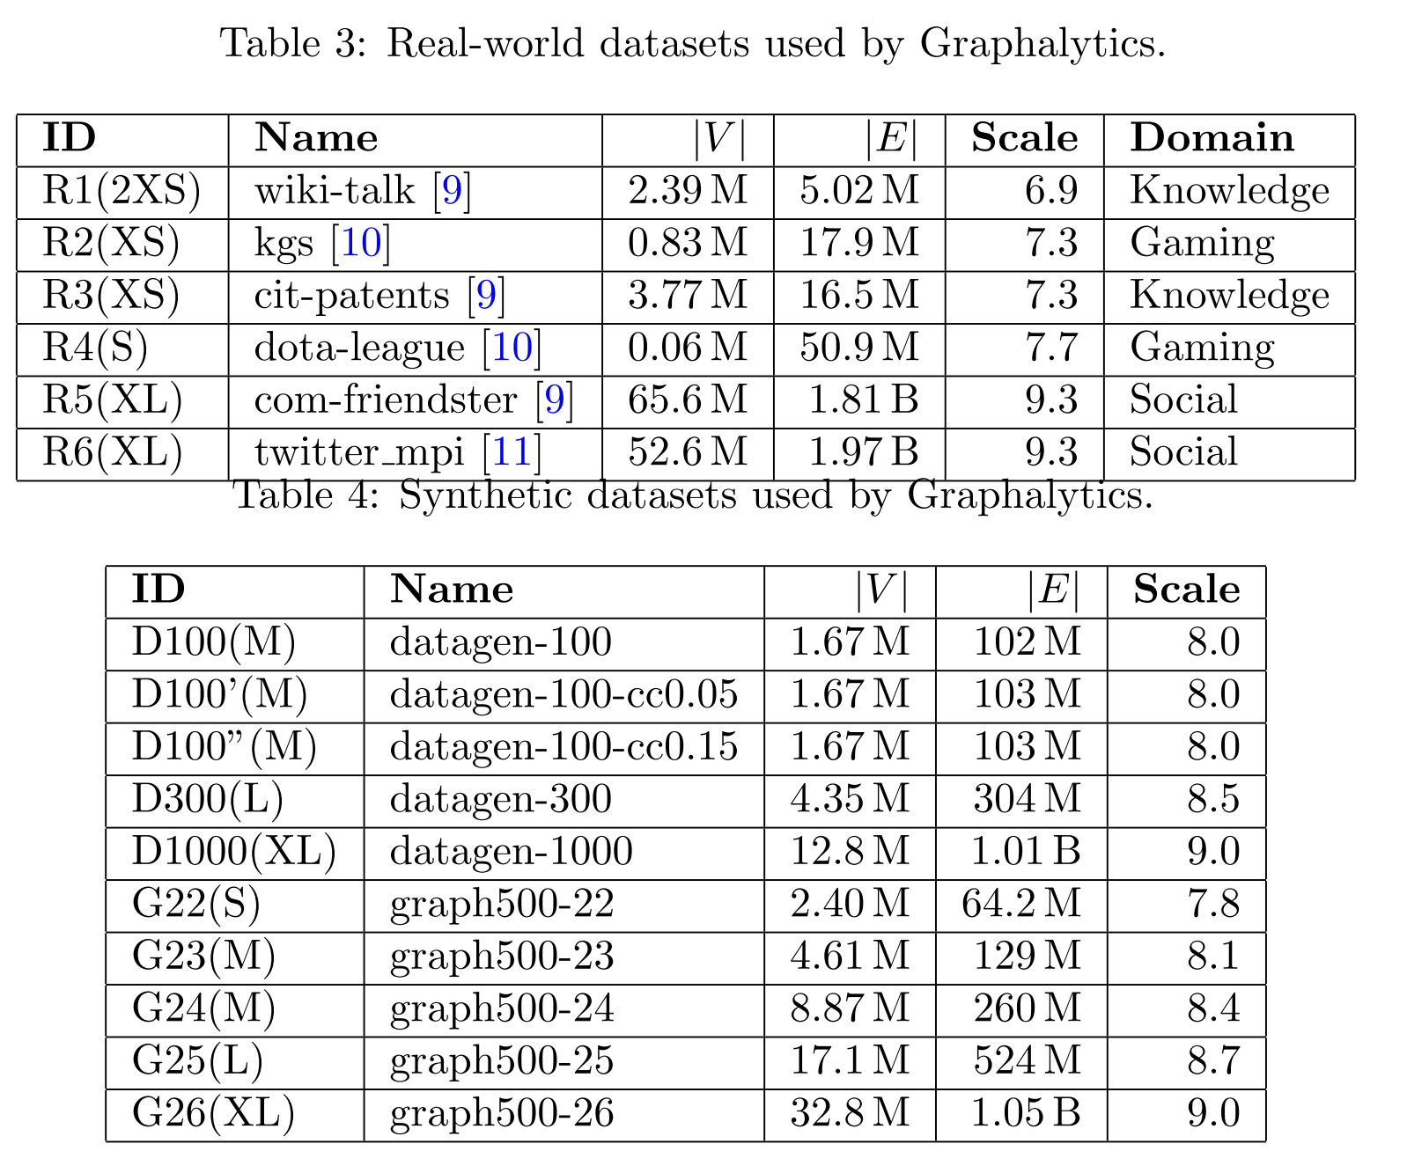
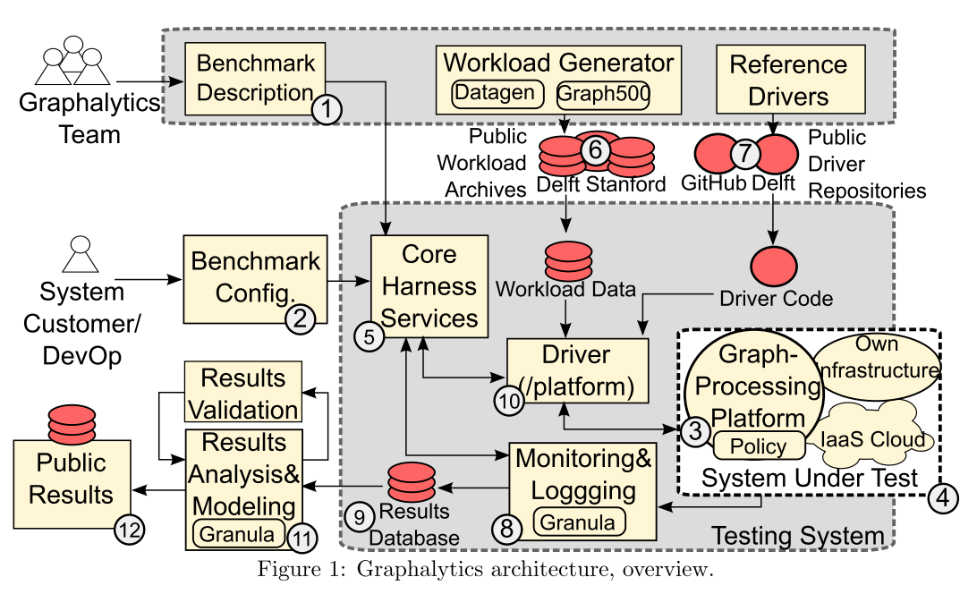
LDBC Graphalytics: A Benchmark for Large-Scale Graph Analyses on Parallel and Distirubuted Platforms, a Technical Report [3]
Directed and undirected graphs
Can use labels on vertices and edges
Adjustable local clustering coefficient

Slide 6
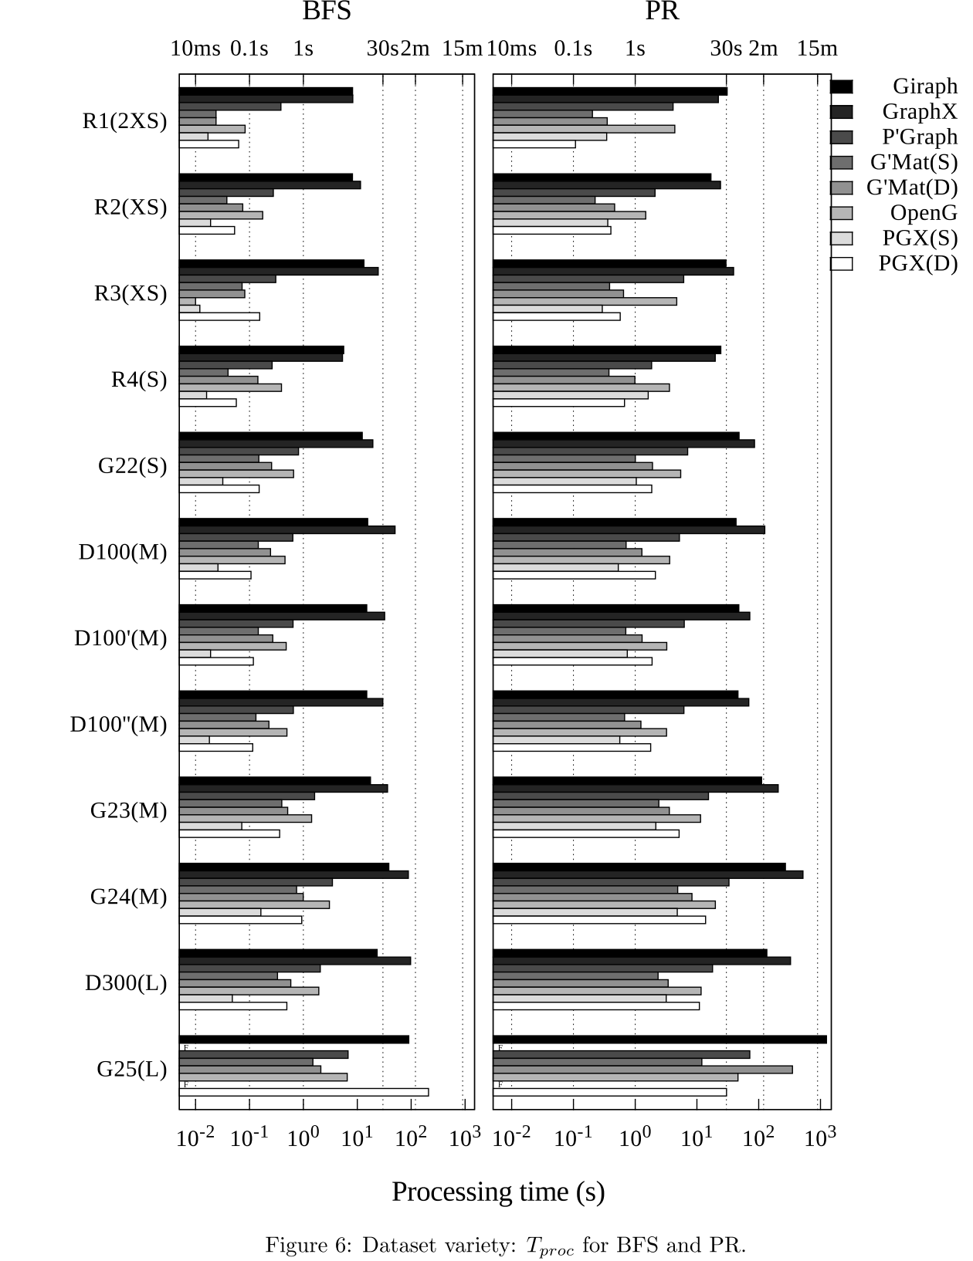
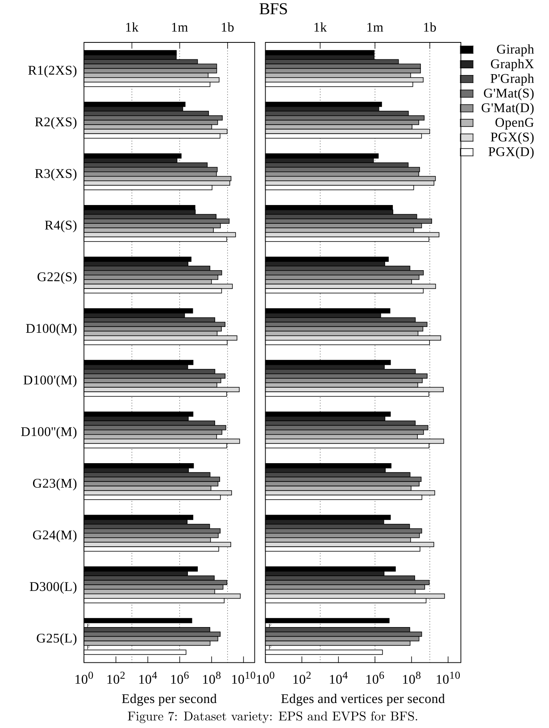
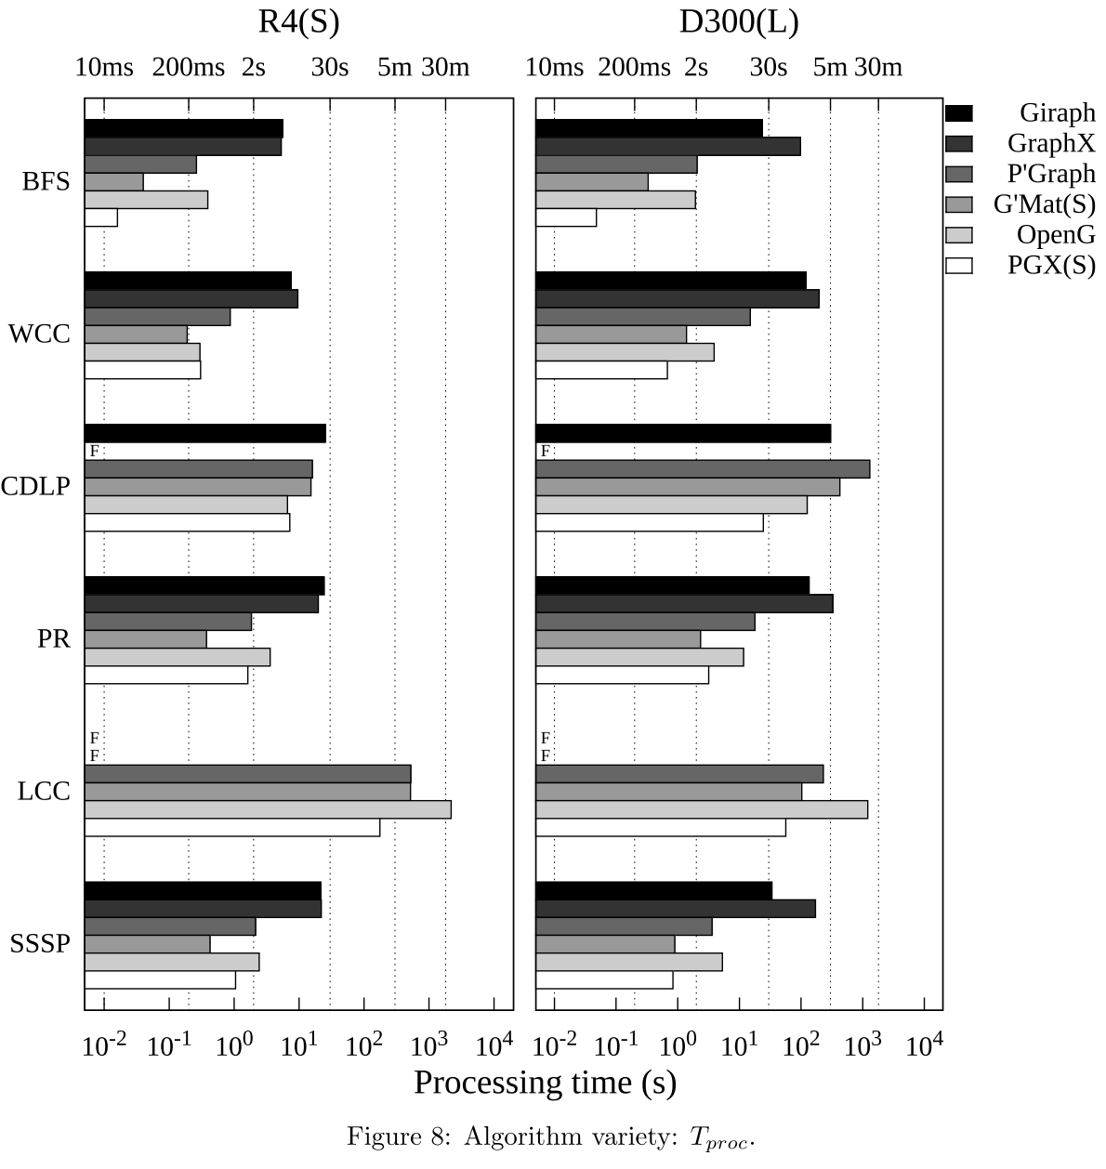
LDBC Graphalytics: A Benchmark for Large-Scale Graph Analyses on Parallel and Distirubuted Platforms, a Technical Report [3]
Distributed and non-distributed

Slide 7
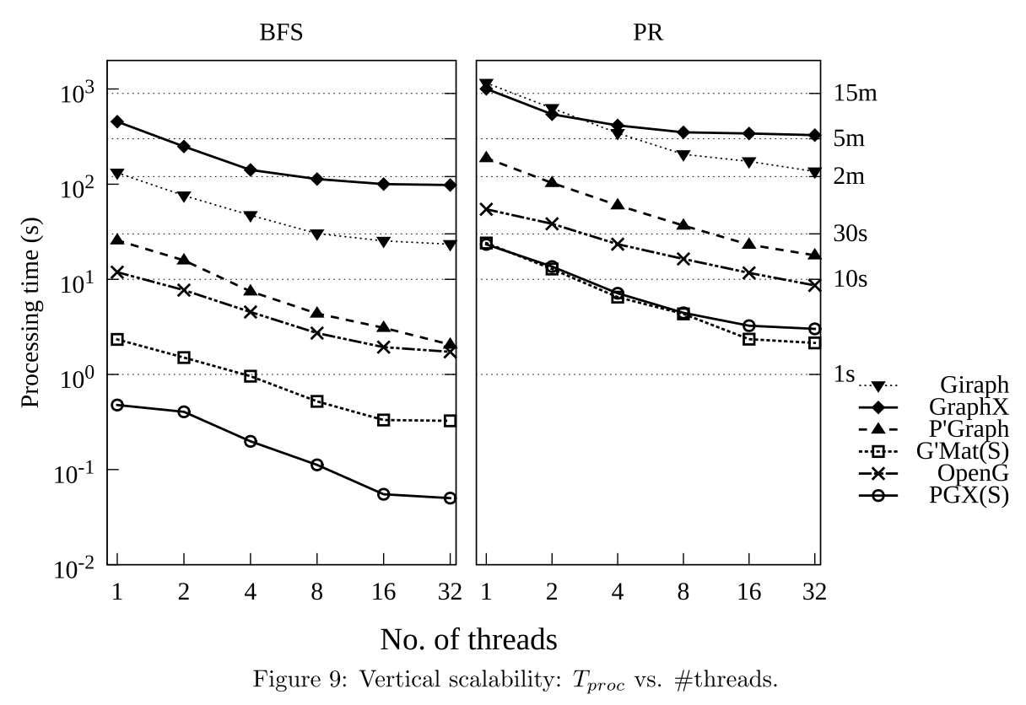
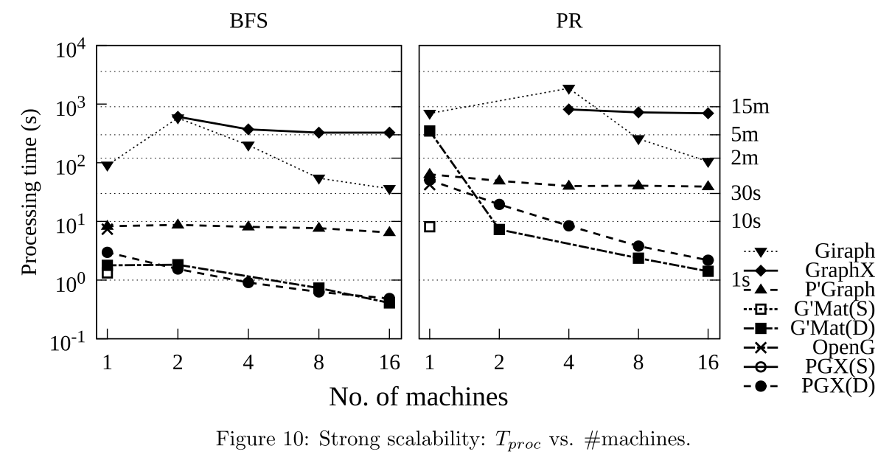
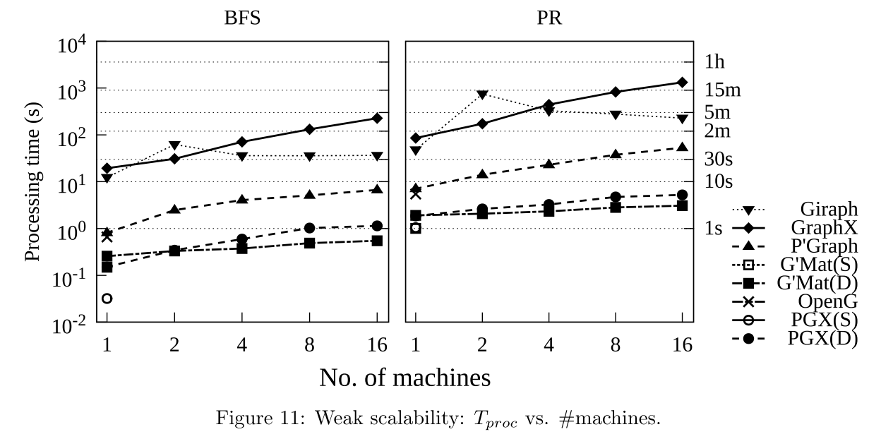
LDBC Graphalytics: A Benchmark for Large-Scale Graph Analyses on Parallel and Distirubuted Platforms, a Technical Report [3]

Slide 8
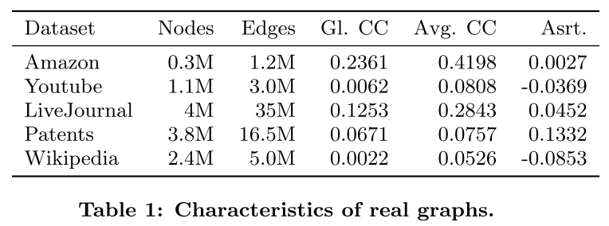
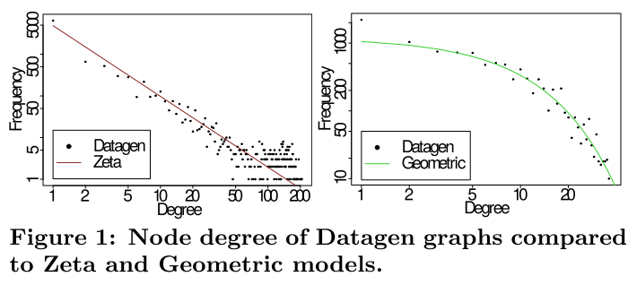
Graphalytics: A Big Data Benchmark for Graph-Processing Platforms Mihai [4]
Based on LDBC
Working on including Benchmarks for RDF semantic web data
Includes benchmarking harness to execute all combinations of datasets, platforms and algorithms
Datagen:
Multiple degree distributions
Different structural characteristics
target average clustering coefficie
Positive or negative assortativity

Slide 9
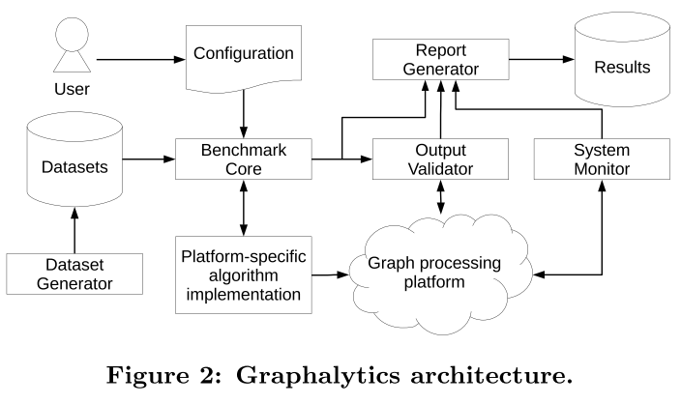
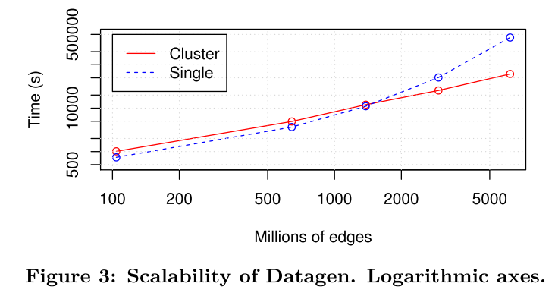
Graphalytics: A Big Data Benchmark for Graph-Processing Platforms Mihai [4]
Benchmarking harness
Dataset
Algorithms
Platforms
performance evaluation process
result collection and reporting
Datagen
Only social network graphs used

Slide 10
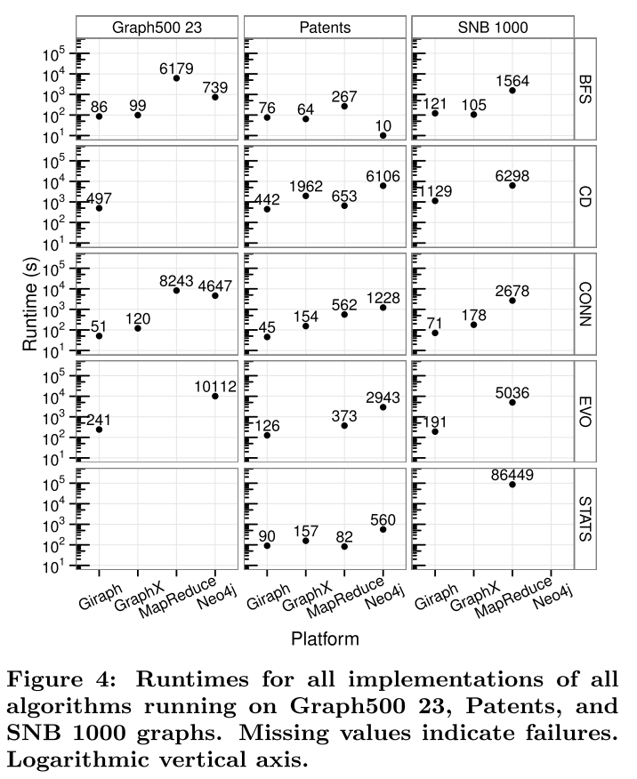
Graphalytics: A Big Data Benchmark for Graph-Processing Platforms Mihai [4]
Algorithms
general statistics (STATS) – calculate local clustering coefficient
breadth-first search (BFS)
connected components (CONN)
community detection (CD) – detect groups which are strongly intraconnected but loosely interconnected
graph evolution (EVO) – evolution after the forest fire model

Slide 11
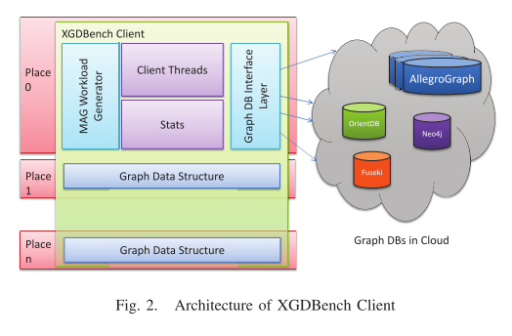
XGDBench: A Benchmarking Platform for Graph Stores in Exascale Clouds [6]
Separate from LDBC
Focus on distributed, parallel systems – written in X10
Based on MAG
Multiplicative Attribute Graph
Synthetic graph model for attributed graphs
Creates undirected graphs in XGDBench
Not only vertices and relationships but also attributes of these
Designed for testing graph databases working in exascale clouds
Use of social network graphs – use case for exascale systems

Slide 12
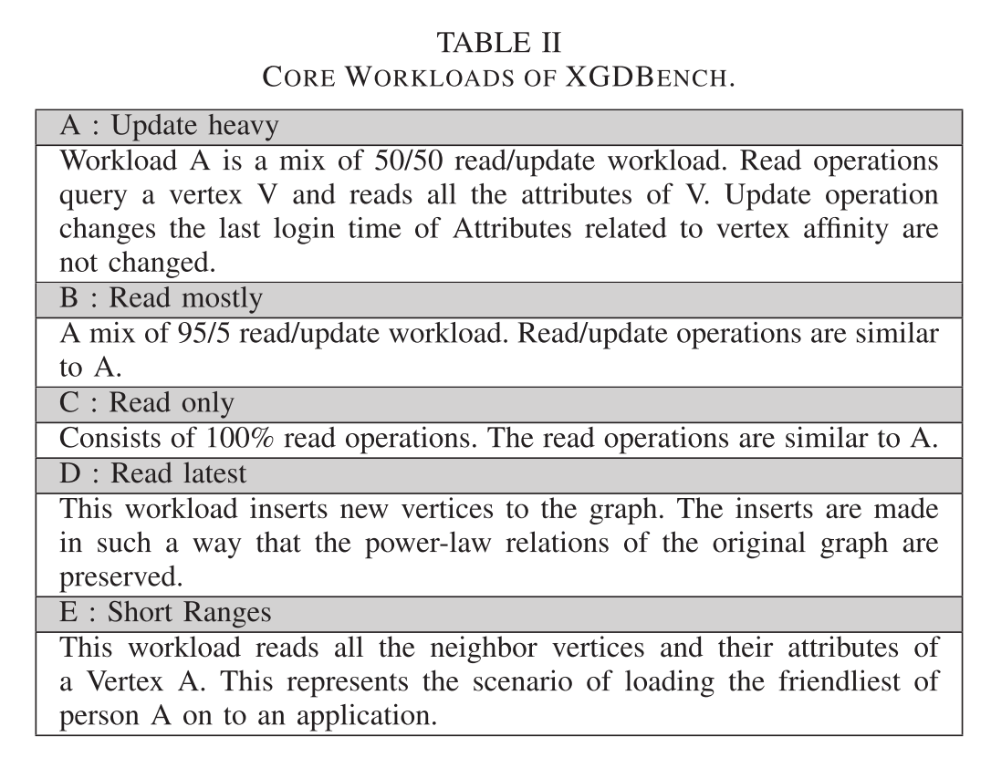
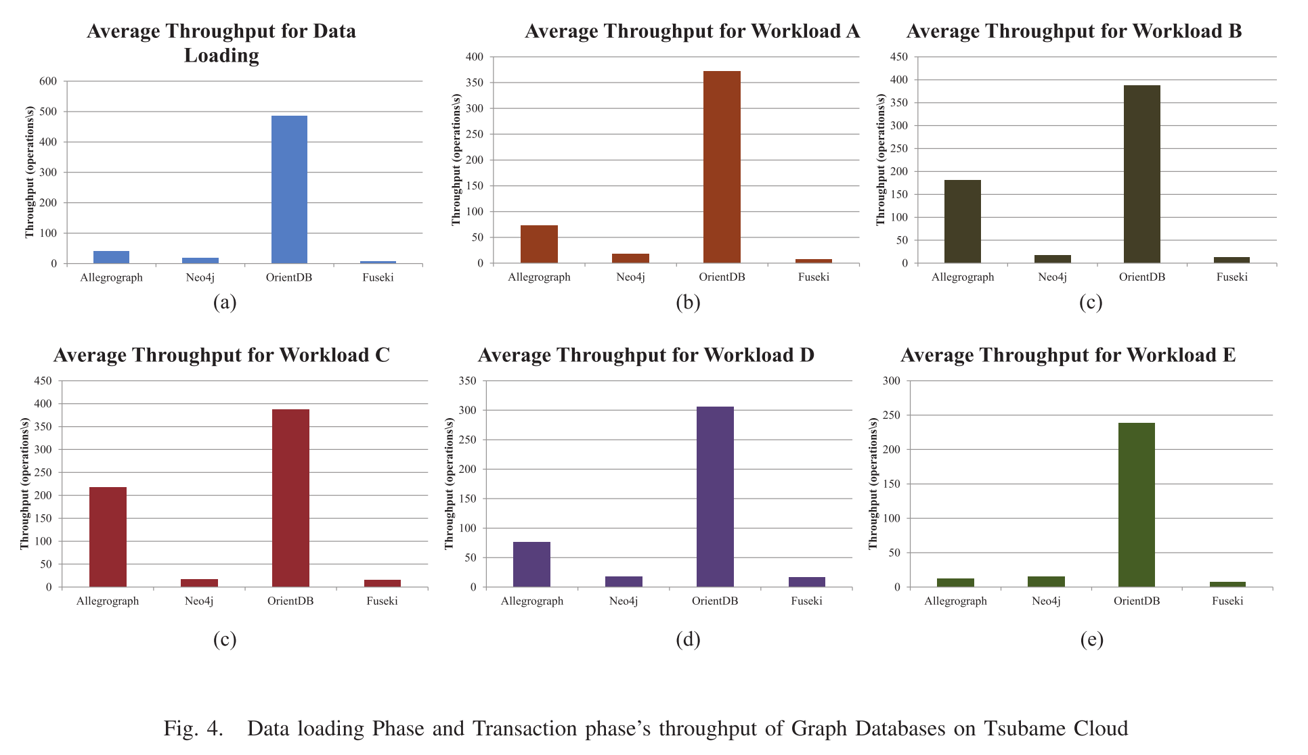
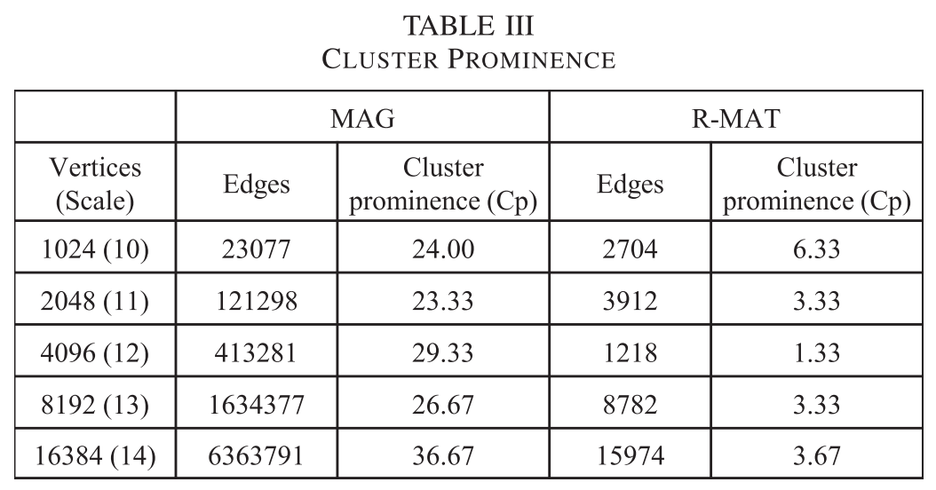
XGDBench: A Benchmarking Platform for Graph Stores in Exascale Clouds [6]
Designed with more read then write
Notes:
Sowas sollte auch bei mir rauskommen
Hexastore, welche noch? - mit Semantic Data
Fuseki, Neo4j, OrientDB
Hypothese: Resultate der Sozialen Graphen sind anwendbar auch Industrie 4.0 Graphen.
Wenn ähnliche Resultate -> Wahrscheinlich dass es so ist.
Delta: Andere Graph und anderer Workload + Hexastore
Wie sieht der Graph aus?
Wie ist der Workload? – Immer wieder neue Daten hochladen (ca. 50 Knoten)
Zusätzlich Queries machen (gibt es das schon in einem anderen Paper)
Workload F: Nur updates
Wie soll der Benchmark aussehen
Graph-Datenbank in Docker vorbereiten
Workshop: Wie sollten Industrie 4.0 Daten aussehen.
Wie sollte es aussehen?
Wie sieht der Social Graph aus?
Email ans Team (Andrei, Matthias, Nicolas) wie sehen die Daten aus und ihr Wissen. Vormittags ab 10 ca

Slide 13
HPC Scalable Graph Analysis Benchmark [7]
Datagenerator
Directed, weighted graph
Uses R-MAT (no Attributes considering [6])
Different kernels/testing algorithms
Kernel 1 - Graph construction, create graph from tuples (start, end, weight)
Others do computations
Validation
Comparing against tuples

Slide 14
Graphtheory
Found nothing concrete
Are two Graphs homomorph? - NP-complete
“… node degree distribution or structural properties like the clustering coefficient or the degree of assortativity, as these can severely affect the performance of the systems under test.” [4]
Trees are easier to process than cyclic graphs
But non the less, there are no write tests

Slide 15
References
[1] Angles, R., Boncz, P., Larriba-Pey, J., Fundulaki, I., Neumann, T., Erling, O., … Toma, I. (2014). The Linked Data Benchmark Council: a Graph and RDF industry benchmarking effort. SIGMOD Record, 43(1), 27–31. Retrieved from http://renzoangles.net/files/sigmodrecord2014.pdf
[2] LDBS Social Network Benchmark. (n.d.). Retrieved from http://ldbc.github.io/ldbc_snb_docs/ldbc-snb-specification.pdf
[3] Iosup, A., Hegeman, T., Ngai, W. L., Heldens, S., Pérez, A. P., Manhardt, T., … Boncz, P. (n.d.). LDBC Graphalytics: A Benchmark for Large-Scale Graph Analysis on Parallel and Distributed Platforms, a Technical Report. Retrieved from http://www.ds.ewi.tudelft.nl/fileadmin/pds/reports/2016/DS-2016-001.pdf

Slide 16
References
[4] Capotă, M., Hegeman, T., Iosup, A., Prat-Pérez, A., Erling, O., & Boncz, P. (2015). Graphalytics. Proceedings of the GRADES’15 on - GRADES’15, 1–6. https://doi.org/10.1145/2764947.2764954
[5] Jordan, M. (2016). Benchmarking von Graphdatenbanken.
[6] Dayarathna, M., & Suzumura, T. (2012). XGDBench : A Bench m arking Platfor m for Graph Stores in Exascale Clouds, 3–10.
[7] Bader, D. A., Feo, J., Gilbert, J., Kepner, J., Koester, D., Loh, E., … Robinson, E. (2009). HPC Scalable Graph Analysis Benchmark. Retrieved from http://www.graphanalysis.org/benchmark/GraphAnalysisBenchmark-v1.0.pdf

