Slide 1


PhageAcr: Identification of Anti-CRISPR proteins
Bioinformatics Project 2023/2024
Master’s in Bioinformatics, University of Minho
Presentation:
Christian Neitzel (PG52526)
Project Supervisors:
Fernanda Vieira
Hugo Oliveira
Óscar Dias
5th of June 2024

Slide 2
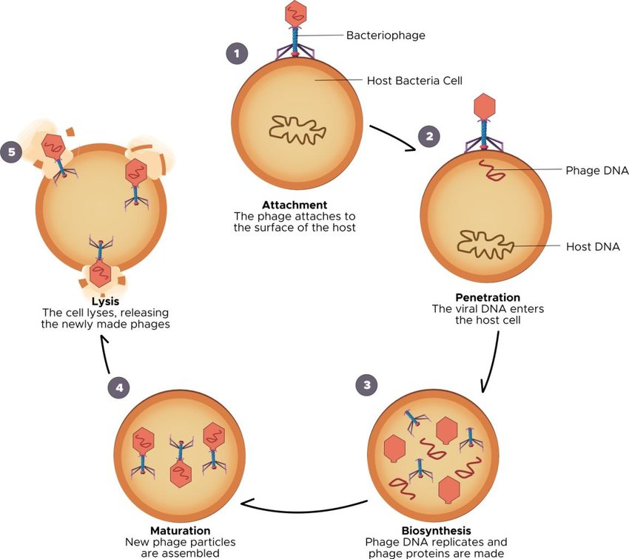
Introduction
Biological Context
- Infections on Bacteria
Bacteriophages (phages) – Viruses that infect bacteria.
Bacterial Defenses – Bacteria evolved to have a series of systems of defenses, one of which being the CRISPR-Cas.
- CRISPR-Cas
Identifies, cleaves into fragments and modifies the viral genome and incorporates them within the DNA of the bacteria;
Optimizes the host’s defenses against future infection attempts.
- Consequence: Anti-CRISPR
Bacteriophages evolved a system of proteins that inhibits the CRISPR-Cas – the Anti-CRISPR.
Leading to an increase of the complexity and diversity of CRISPR-Cas and Anti-CRISPR systems.
Figure 1: Representation of the lytic life cycle of a bacteriophage infecting a bacteria
(Source: DOI: 10.3934/microbiol.2020014).
Notes:
Os Bacteriófagos (ou fagos) são vírus que infetam bactérias, injetando o seu genoma viral num hospedeiro para que ela produza novas partículas de fagos, resultando na eventual morte da bactéria. Para combater contra estes vírus, as bactérias evoluíram uma série de sistemas de defesa, uma delas sendo o CRISPR-Cas.
O CRISPR-Cas constitui uma série de proteínas que identificam, fragmentam e modificam o genoma viral em “spacers” que são sucessivamente incorporadas no próprio DNA da bactéria. Estes spacers otimizam as defesas do hospedeiro contra o vírus no caso de futuras tentativas de injeção.
Como consequência, o CRISPR-Cas levou a que os bacteriófagos evoluíssem os seus sistemas para contra agirem o CRISPR-Cas, sendo estes os Anti-CRISPR, que são proteínas que inibem os CRISPR-Cas, novamente permitindo a infeção viral.
Estes desenvolvimentos das bactérias e dos bacteriófagos levaram ao aumento da complexidade e diversidade tanto dos sistemas CRISPR-Cas quanto dos Anti-CRISPR, promovendo uma constante evolução e adaptação de ambos os lados.

Slide 3
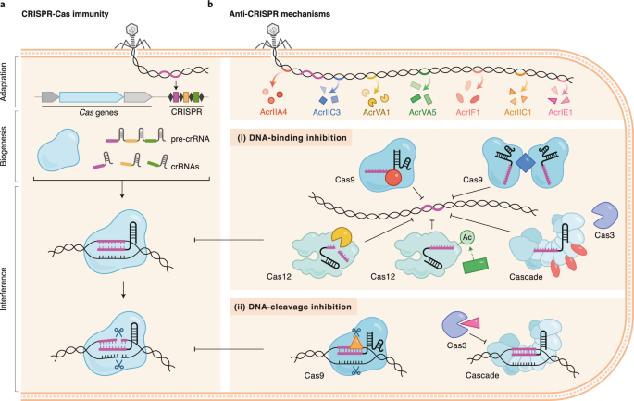
Introduction
Bioinformatic applications
- Sequence Analysis and Homology Search
Tools such as BLAST allow us to compare known Anti-CRISPR sequences with new genomes.
- Anti-CRISPR protein predictions using Machine Learning
Algorithms that analyse and compare the physico-chemical characteristics (features) between sequences to predict new Anti-CRISPR proteins.
- Databases
Creation of databases dedicated to known Anti-CRISPR sequences facilitate the access and analysis of the data by the scientific community.
Figure 2: General mechanisms behind CRISPR-Cas (left) and Anti-CRISPR (right)
(Source: DOI: 10.3934/microbiol.2020014).

Slide 4
Objectives
Review literature;
Build a dataset of Anti-CRISPR protein sequences from existing databases;
Explore different Machine Learning strategies, applications and models to predict Anti-CRISPR sequences;
Perform tests and comparisons to check the efficiency of different Machine Learning models;
Search for potencial optimizations of our used tools in order to improve Anti-CRISPR sequence prediction accuracy.

Slide 5
Methods
Dataset acquisition for Machine Learning and data analysis
- Positive Dataset
- Source Databases:
- Anti-CRISPRdb
- CRISPRminer
- Anti-CRISPR Assembly
- NAs and invalid values were treated
- Dataset columns:
- ID, Sequence, Organism, Family, Type, Size and Protein_Acr
 | Positive Dataset | Negative Dataset
Target data | - Must be confirmed Anti-CRISPR protein sequences. | - Must be phage protein sequences; - Functions must not be similar to Anti-CRISPR functions.
Source Databases | Anti-CRISPRdb CRISPRminer Anti-CRISPR Assembly | Phage Artificial Neural Networks (PhANNs)
Specific data selection | - | expandedDB: Structural proteins
Pre-processing | NaNs and invalid values treated, duplicates removed | Previously pre-processed by the authors
Dataset columns | ID, Sequence, Organism, Family, Type, Size and Protein_Acr | ID, Sequence, Organism, Structure, Size and Protein_Acr
Target column | Protein_Acr | Protein_Acr
Target column value | 1 | 0
- Negative Dataset
- Source Database:
- Phage Artificial Neural Networks (PhANNs)
- Data classifications:
- Structural proteins
- Regulatory proteins
Notes:
Dataset Positivo
Recorremos a bases de dados de proteínas Anti-CRISPR previamente identificadas por outros trabalhos, sendo estes: Anti-CRISPRdb, CRISPRminer e Anti-CRISPR Assembly.
Dataset Negativo
Para a obtenção do dataset negativo, recorreu-se à base de dados PhANNs, esta base de dados classifica sequências de proteínas de fagos como estruturais, que apresentam funções estruturais, e regulatórias, que apresentam funções de regulação.
Como as proteínas Anti-CRISPR inibem o sistema CRISPR-Cas, elas tratam-se de proteínas regulatórias e não estruturais, por este motivo, o conjunto de dados negativos deve conter proteínas estruturais, garantindo uma clara distinção entre os dois grupos no Machine Learning.
--
Dataset acquisition
- Positive Dataset
- Bases de dados utilizadas
- Anti-CRISPRdb
- CRISPRminer
- Anti-CRISPR Assembly
- Tratamento de NAs e de valores inválidos ou inconsistentes
- Colunas utilizadas e criadas
- ID, Sequence, Organism, Family, Type, Size and Protein_Acr
- Negative Dataset
- Base de dados utilizada
- Phage Artificial Neural Networks (PhANNs)
- Classificação dos dados
- Proteínas estruturais
- Proteínas regulatórias

Slide 6
Methods
Sequence redundacy removal tools
Group similar sequences based on a specified identity threshold into “clusters”;
Form clusters of sequences, with each cluster having a representative sequence;
Removes redudant sequences, simplifying the datasets.
Tools used:
CD-HIT (Cluster Database at High Identity with Tolerance)
MMseqs2 (Many-against-Many Searching)
Propythia
Tool that allows the analysis of protein sequences;
Allows the acquisition of the sequences’ physico-chemical features;
The features will allow us to make protein function prediction and protein classification.
Notes:
CD-HIT (Cluster Database at High Identity with Tolerance) – comparações a partir de um algoritmo de short word filtering, determina similaridade sem elaborar alinhamentos de sequências.
MMseqs2 (Many-against-Many Searching) – comparações a partir de duas fases de alinhamento:
Pré-filtragem: Identifica correspondências e calcula as similaridades entre sequências através de um alinhamento inicial.
Alinhamento: Elabora um alinhamento vetorizado de Smith-Waterman para garantir precisão.
Propythia
Ferramenta para a análise de sequências de proteínas, permitindo a obtenção das suas características (features) físico-químicas. Para obter estas features, aplicamos a função “get_all_physicochemical()” à coluna “Sequences”, resultando na aquisição de colunas numéricas representativas das propriedades importantes das sequências.
As features irão nos permitir fazer a previsão de funções proteicas e a classificação de proteínas.

Slide 7
Methods
Machine Learning Methods
- Models used
- Decision Tree (DT);
- Random Forest (RF);
- Support Vector Machine (SVM);
- eXtreme Gradient Boosting (XGBoost).
- Model preparation
- Training set = 70%
- Portion of the dataset that the models will train from.
- Validation set = 10%
- Intermediate performance method;
- Evalutates model performance during training;
- Enables hyperparameter adjustments during model training in order to obtain the best performance;
- Helps avoid Overfitting.
- Test set = 20%
- Tests the model’s ability in making predictions on data that it has never seen before.
Hyperparameter Optimization
Tests the model on different parameters and selects the parameters with the best performing Machine Learning abilities.

Slide 8
Results

Slide 9
Resulting datasets and their shapes
Non-Redundant (nr) output dataset shapes:
 | CD-HIT output | MMseqs2 output
Positive dataset shape | 1122 rows × 7 columns | 1106 rows × 7 columns
Negative dataset shape | 57379 rows × 6 columns | 58286 rows × 6 columns
The chosen sequence identity threshold for both CD-HIT and MMseqs2 was 0.9 (90% sequence identity)
Joining positive and negative datasets:
Random selection of n rows from the negative dataset nr output where n is the number of rows in positive dataset output
Propythia output dataset shapes and selection of sets for Machine Learning:
 | CD-HIT output | MMseqs2 output
Full dataset shape | 2244 rows x 26 columns | 2212 rows x 26 columns
Training Set | 1570 rows | 1547 rows
Validation Set | 225 rows | 222 rows
Test Set | 449 rows | 443 rows

Slide 10
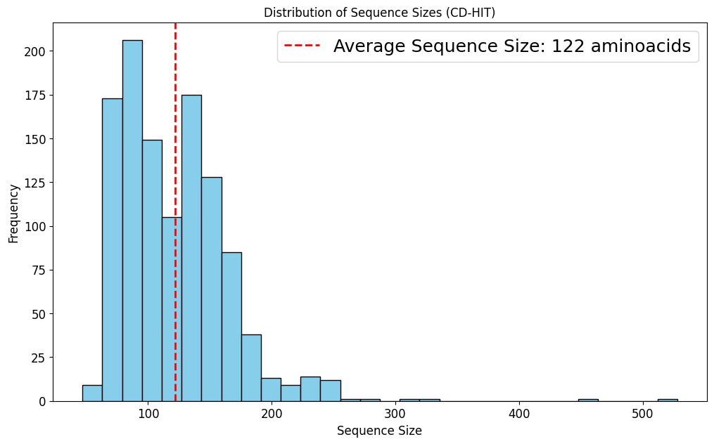
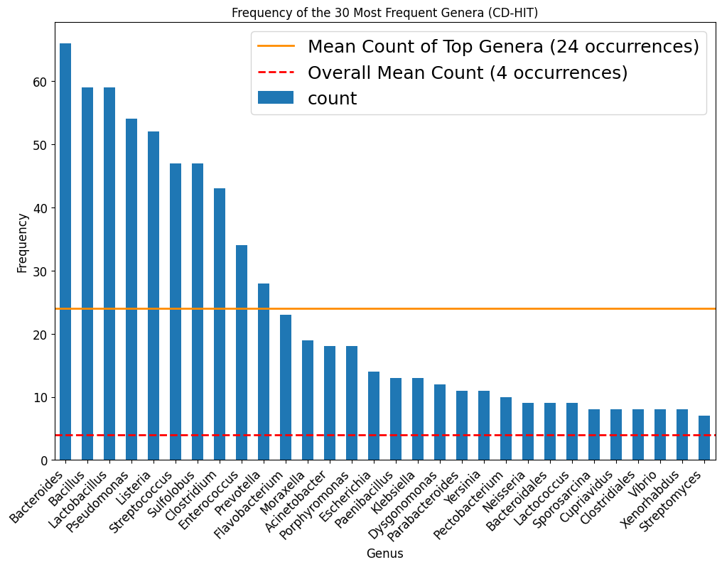
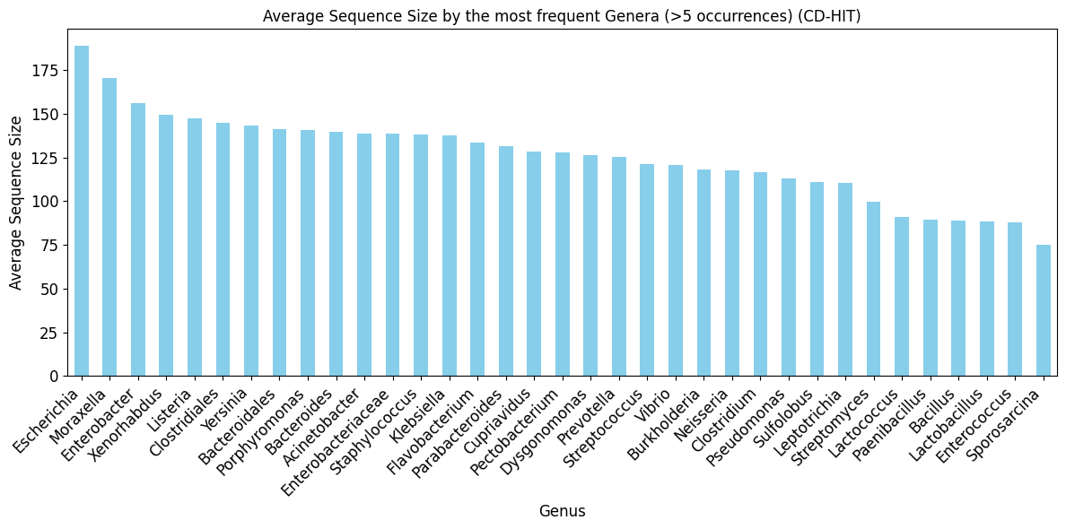
General data analysis of the non-redundant sequences (CD-HIT output)
Notes:
Analise genérica dos dados

Slide 11
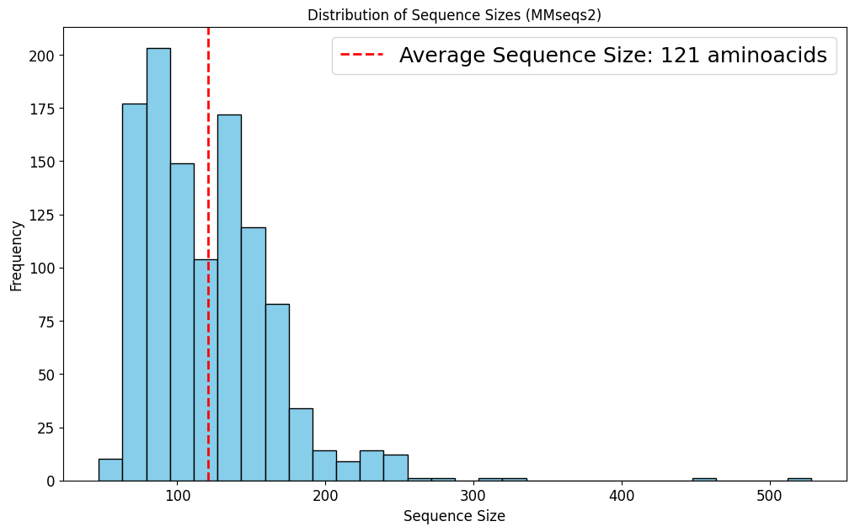
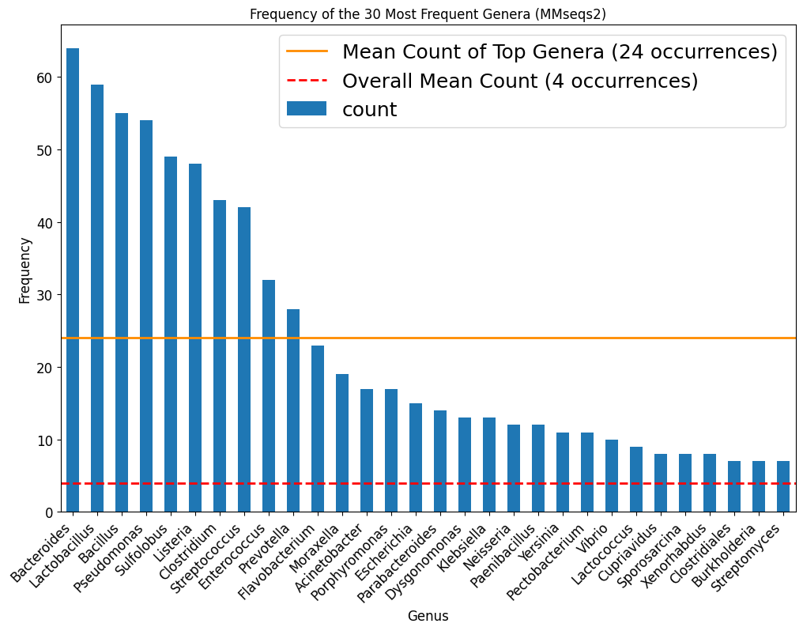
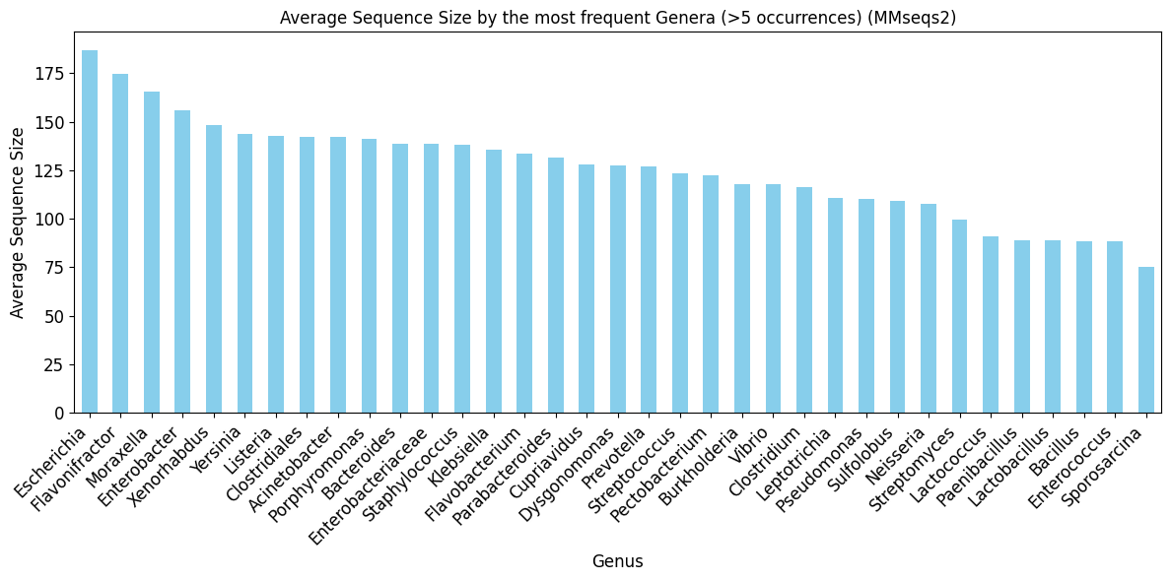
General data analysis of the non-redundant sequences (MMseqs2 output)

Slide 12
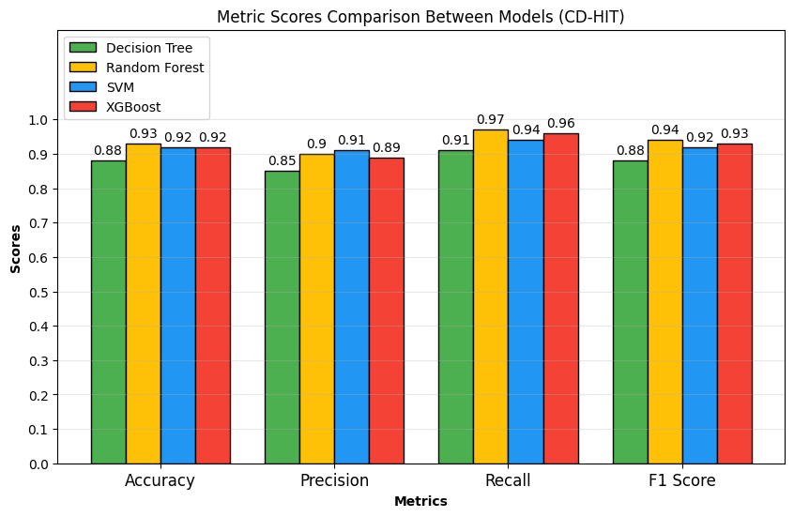
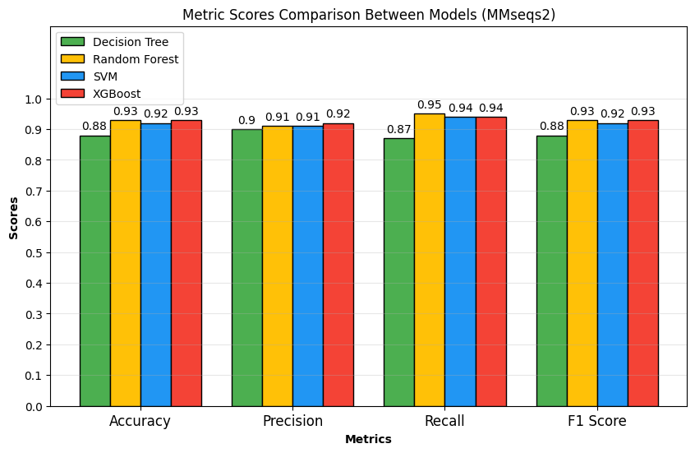
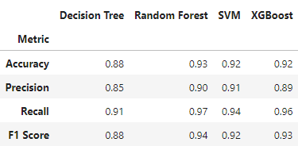
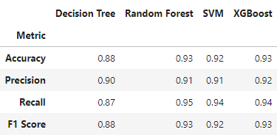
ML model metrics comparisons in CD-HIT and MMseqs2
CD-HIT
MMseqs2

Slide 13
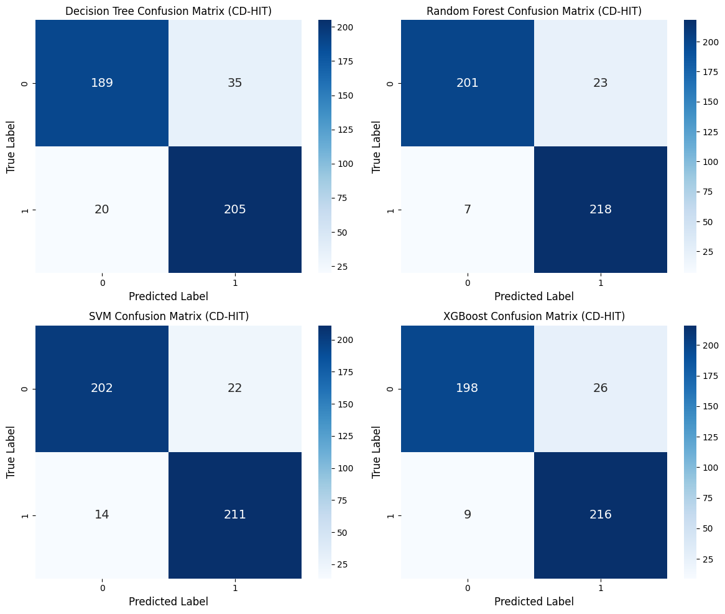
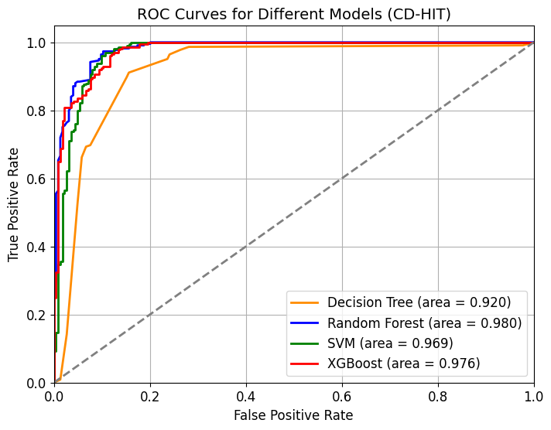
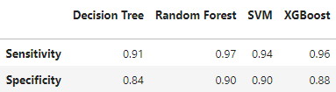
ML Model Confusion Matrices and ROC Curves from CD-HIT output

Slide 14
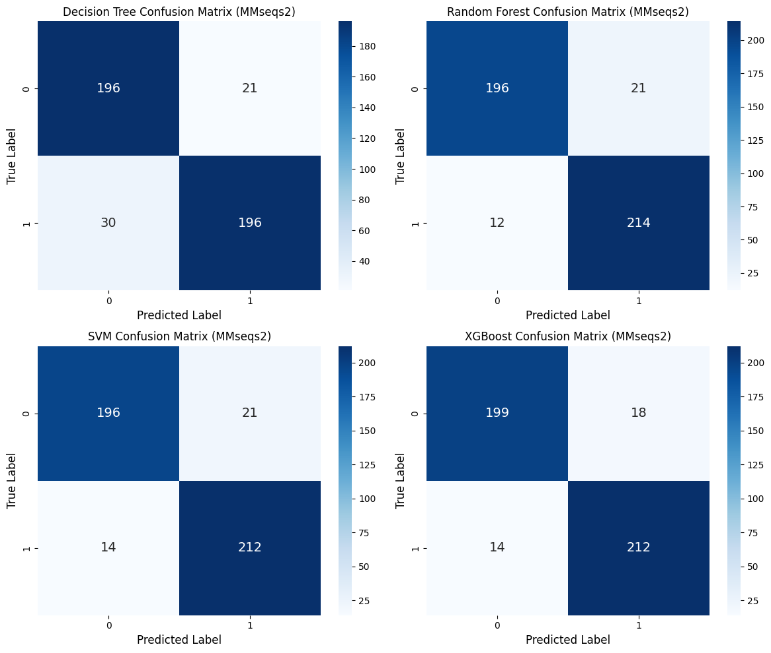
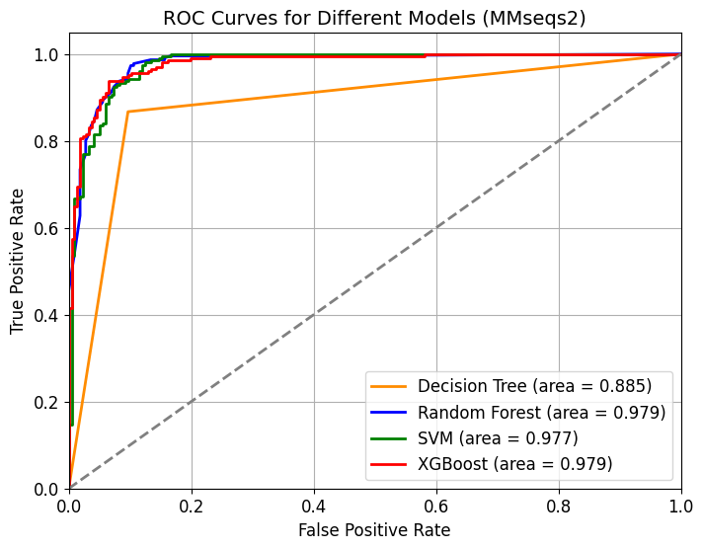
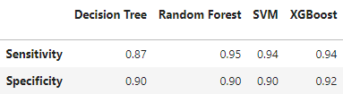
ML Model Confusion Matrices and ROC Curves from MMseqs2 output
Notes:
ROC Curve do DT pode ser característica do próprio modelo DT (curvas do DT não são muito smooth)

Slide 15
Conclusion
Comparative analysis of the models revealed that CD-HIT, as well as MMseqs2, reveal similar performance for Machine Learning efficiency;
Of the obtained results, Random Forest delivered the best overall results between the nr outputs of CD-HIT and MMseqs2, however its efficiency can be influenced by the nature of the randomly selected datasets and ML sets.
Future approaches to consider:
Increase dataset size;
Apply built-in Propythia functions that provides more sequence features;
Search for potencial strategies and optimizations that enhance model performance;
Try out and make comparisons between more models.
Notes:
CD-HIT e MMseqs2 não apresentam grandes diferenças
Considerações futuras:
Tacticas para melhorar modelos (parâmetros e hyperparametros)
Testar mais modelos
optimizações

Slide 16
Bibliography
Tavakoli, K., Pour-Aboughadareh, A., Kianersi, F., Poczai, P., Etminan, A., & Shooshtari, L. (2021). Applications of CRISPR-Cas9 as an Advanced Genome Editing System in Life Sciences. BioTech, 10(3), 14. https://doi.org/10.3390/biotech10030014
Asmamaw, M., & Zawdie, B. (2021). Mechanism and Applications of CRISPR/Cas-9-Mediated Genome Editing. Biologics : Targets & Therapy, 15, 353–361. https://doi.org/10.2147/BTT.S326422
Adesanya, O., Oduselu, T., Akin-Ajani, O., Adewumi, O. M., & Ademowo, O. G. (2020). An exegesis of bacteriophage therapy: An emerging player in the fight against anti-microbial resistance. AIMS Microbiology, 6(3), 204–230. https://doi.org/10.3934/microbiol.2020014
Marino, N. D., Pinilla-Redondo, R., Csörgő, B., & Bondy-Denomy, J. (2020). Anti-CRISPR protein applications: Natural brakes for CRISPR-Cas technologies. Nature Methods, 17(5), 471–479. https://doi.org/10.1038/s41592-020-0771-6
Eitzinger, S., Asif, A., Watters, K. E., Iavarone, A. T., Knott, G. J., Doudna, J. A., & Minhas, F. ul A. A. (2020). Machine learning predicts new anti-CRISPR proteins. Nucleic Acids Research, 48(9), 4698–4708. https://doi.org/10.1093/nar/gkaa219
Yu, L., & Marchisio, M. A. (2020). Types I and V Anti-CRISPR Proteins: From Phage Defense to Eukaryotic Synthetic Gene Circuits. Frontiers in Bioengineering and Biotechnology, 8. https://doi.org/10.3389/fbioe.2020.575393
Dong, C., Wang, X., Ma, C., Zeng, Z., Pu, D.-K., Liu, S., Wu, C.-S., Chen, S., Deng, Z., & Guo, F.-B. (2022). Anti-CRISPRdb v2.2: An online repository of anti-CRISPR proteins including information on inhibitory mechanisms, activities and neighbors of curated anti-CRISPR proteins. Database, 2022, baac010. https://doi.org/10.1093/database/baac010

Slide 17
Bibliography
Zhang, F., Zhao, S., Ren, C., Zhu, Y., Zhou, H., Lai, Y., Zhou, F., Jia, Y., Zheng, K., & Huang, Z. (2018). CRISPRminer is a knowledge base for exploring CRISPR-Cas systems in microbe and phage interactions. Communications Biology, 1, 180. https://doi.org/10.1038/s42003-018-0184-6
Bondy-Denomy, J., Davidson, A. R., Doudna, J. A., Fineran, P. C., Maxwell, K. L., Moineau, S., Peng, X., Sontheimer, E. J., & Wiedenheft, B. (2018). A Unified Resource for Tracking Anti-CRISPR Names. The CRISPR Journal, 1(5), 304–305. https://doi.org/10.1089/crispr.2018.0043
Cantu, V. A., Salamon, P., Seguritan, V., Redfield, J., Salamon, D., Edwards, R. A., & Segall, A. M. (2020). PhANNs, a fast and accurate tool and web server to classify phage structural proteins. PLoS Computational Biology, 16(11), e1007845. https://doi.org/10.1371/journal.pcbi.1007845
Li, W., & Godzik, A. (2006). Cd-Hit: A Fast Program for Clustering and Comparing Large Sets of Protein or Nucleotide Sequences. Bioinformatics (Oxford, England), 22, 1658–1659. https://doi.org/10.1093/bioinformatics/btl158
Steinegger, M., & Söding, J. (2017). MMseqs2 enables sensitive protein sequence searching for the analysis of massive data sets. Nature Biotechnology, 35(11), 1026–1028. https://doi.org/10.1038/nbt.3988
Sequeira, A. M., Lousa, D., & Rocha, M. (2022). ProPythia: A Python package for protein classification based on machine and deep learning. Neurocomputing, 484, 172–182. https://doi.org/10.1016/j.neucom.2021.07.102

