Slide 1
Handling Execution
Overruns
Core question
How can a hard real-time system stay safe when a task suddenly needs more execution time than expected?
Hard real-time control systems • CBS/CBShd • Prototype simulation
Christian Percival
Electronic Engineering • Hochschule Hamm-Lippstadt

Slide 2
What is an execution overrun?
A timing problem: the task may still compute the correct result, but it uses more CPU time than the system planned for.
Overrun = actual execution time exceeds the normal/reserved budget
formal idea: cᵢ > cᵢⁿ and overrun amount = cᵢ − cᵢⁿ
Normal execution
Execution overrun
actual runtime
normal part
extra time
budget
budget
Finishes inside budget → next tasks can run as planned.
Uses CPU time that was not planned → can delay other jobs.
2

Slide 3
Different ways to handle execution overruns
Each method makes a different safety/efficiency tradeoff
WCET-based
Normal-only
Fallback / degrade
CBS / CBShd
Reserve enough time for the worst case.
Schedule using typical execution time. Good as a fast baseline, but unsafe if hard frames happen in hard real-time.
Use previous result, skip frame, or lower quality. Useful when approximate output is acceptable and safe.
(Constand Bandwidth Server)
Reserve bandwidth and postpone deadlines when budget is exceeded.
[1][3][4]
[1]
[1][3]
[1][2]
Key: choose the handler according to task criticality, dependency, and acceptable performance loss.
Handling Execution Overruns • Seminar Project
Christian Percival • Hochschule Hamm-Lippstadt
3

Slide 4

Optimal idea: isolate the overrun, do not let it spread
CBS/CBShd intuition: budget, bandwidth, and controlled deadline postponement
Task starts
Budget used?
If exhausted
Postpone deadline
Other tasks protected
Processor bandwidth
In my simulation
Qₛ = CPU budget Tₛ = server period Uₛ = Qₛ / Tₛ
Qₛ = 0.5 ms, Tₛ = 2 ms Uₛ = 0.25 → 25% image-task bandwidth
The overrun is not eliminated — it is isolated and paid for by the overrunning task.
Sources: Caccamo et al. describe local overrun handling and CBShd; Abeni & Buttazzo introduce CBS resource reservation. [1][2]
Handling Execution Overruns • Seminar Project
Christian Percival • Hochschule Hamm-Lippstadt
4

Slide 5
What I implemented: Visual-tracking Overrun Demo
A small image-processing task creates controlled normal, hard, and worst-case paths
Generate images
Small window
Medium window
Full image search
Measure runtime
Easy
Medium
Hard
Missing
Object found in small predicted window ≈ 0.15 ms average
Expanded search window ≈ 0.35 ms average
Full-image search path ≈ 8.00 ms average
Full image searched; object not found ≈ 7.82 ms average
Important: this is a timing simulation, not a kernel-level CBS implementation.
Handling Execution Overruns • Seminar Project
Christian Percival • Hochschule Hamm-Lippstadt
5

Slide 6
Implementation architecture
Five scripts generate the workload, measure runtimes, and simulate handling strategies
1
generate_images.py
Creates 1920×1080 easy / medium / hard / missing frames
2
overrun_demo.py
Searches for red object and logs execution time
3
plot_results.py
Creates workload and overrun plots
4
scheduler_simulation.py
Compares WCET, NormalOnly, and OverrunHandled
5
cpu_timeline_single_frame.py
Visualizes NormalOnly, WCET, CBS, and CBShd behavior
Handling Execution Overruns • Seminar Project
Christian Percival • Hochschule Hamm-Lippstadt
6

Slide 7
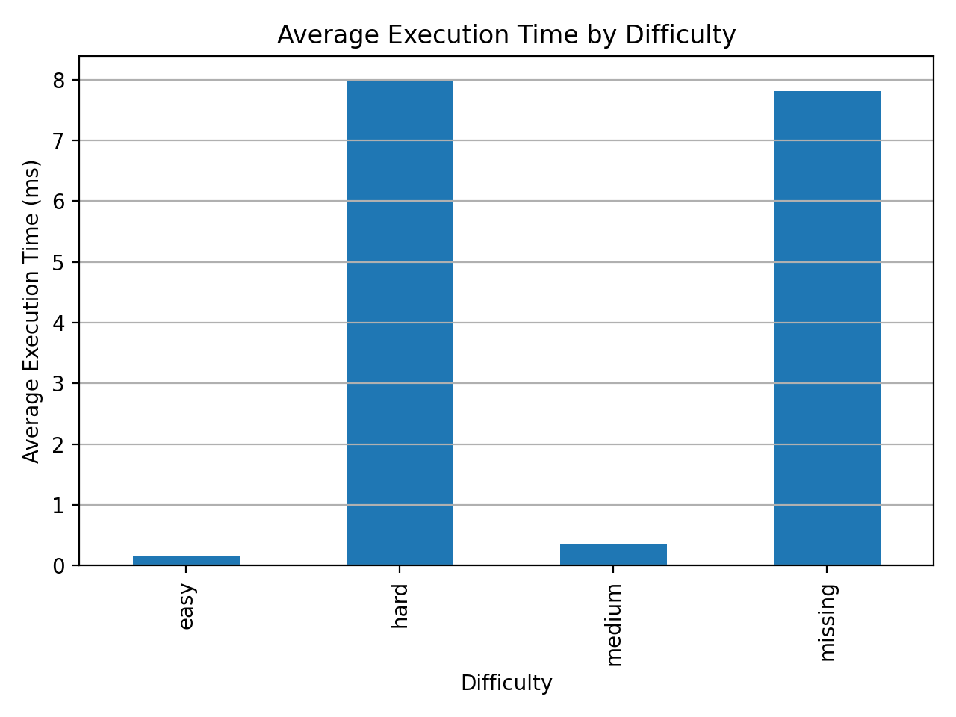
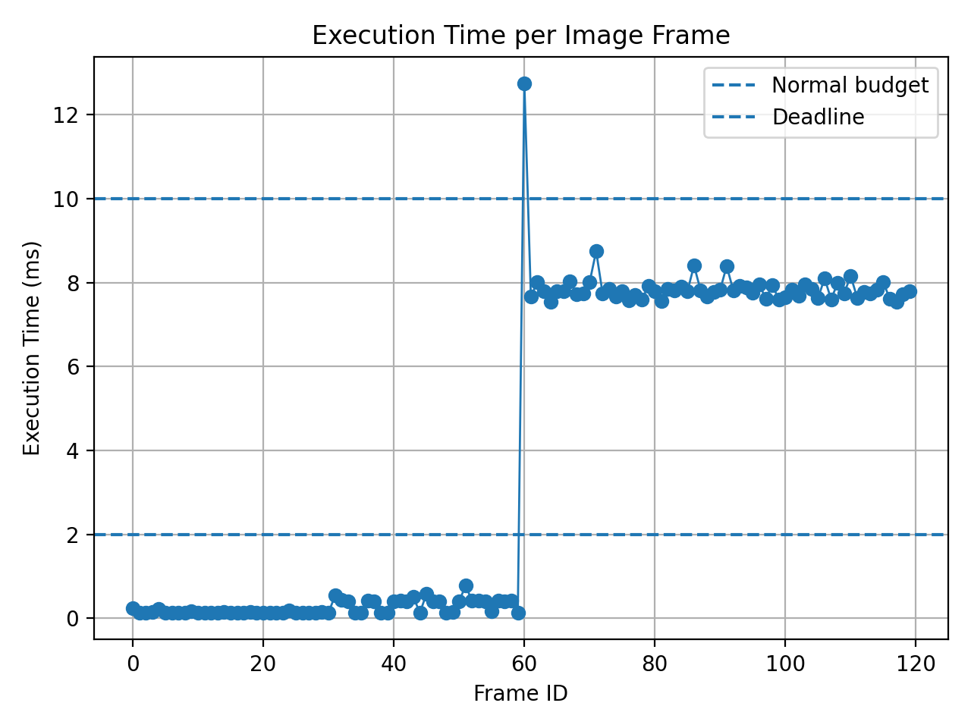
Measured workload: runtime depends on input difficulty
This is where the execution overruns come from in the prototype
0.15 ms
8.00 ms
7.82 ms
12.75 ms
60
easy avg.
hard avg.
missing avg.
measured WCET
hard/missing overruns
Handling Execution Overruns • Seminar Project
Christian Percival • Hochschule Hamm-Lippstadt
7

Slide 8
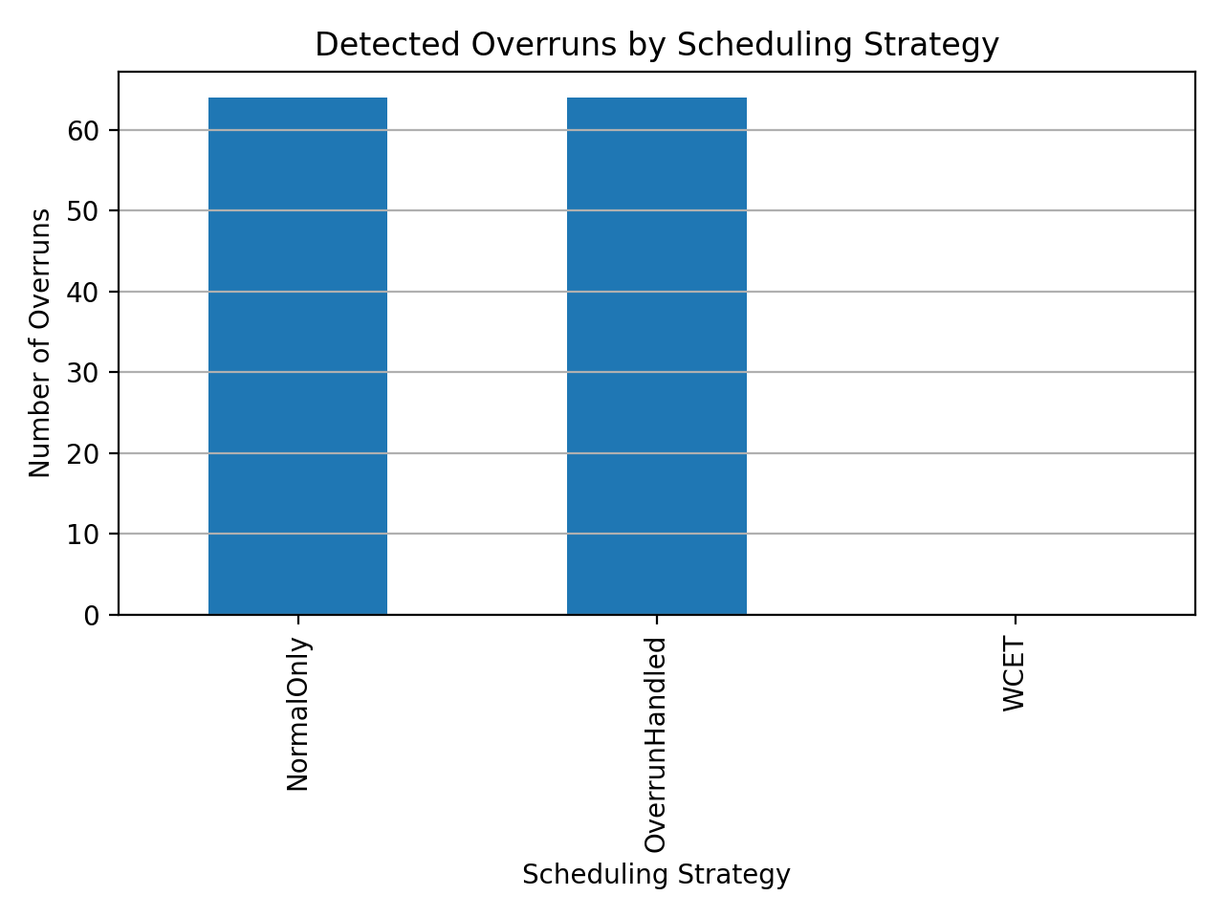
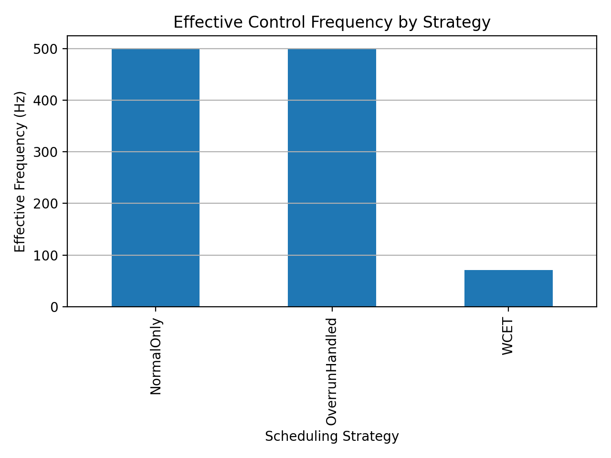
Scheduling strategy comparison
Same measured runtimes, different scheduling assumptions
Nominal Task Frequency by Strategy
Handling Execution Overruns • Seminar Project
Christian Percival • Hochschule Hamm-Lippstadt
8

Slide 9
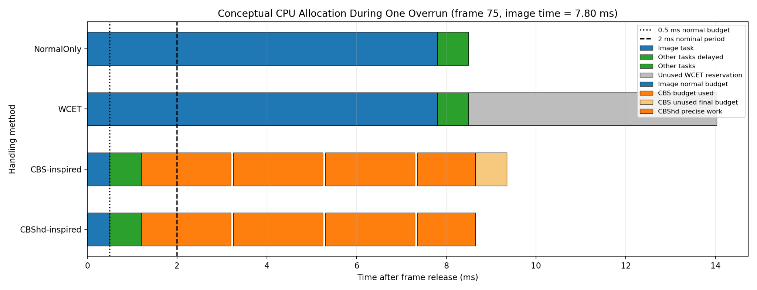
Conceptual CPU allocation during one overrun
The same overrun is treated differently by each handling method
NormalOnly
WCET
CBS
CBShd
Image runs to completion → other work delayed.
Safe, but reserves for worst case → unused time.
Controls overrun using budget blocks.
Final allocation only matches remaining work.
Handling Execution Overruns • Seminar Project
Christian Percival • Hochschule Hamm-Lippstadt
9

Slide 10
Which handler is best used where?
Handler choice depends on criticality, dependencies, and acceptable delay
WCET-based scheduling
CBS / CBShd handling
Fallback / degraded output
Best for safety-critical or sequentially dependent tasks where the next step must receive a deterministic result. Useful for actuator/control chains and hard end-to-end deadlines.
Best for variable workloads such as perception, tracking, or mixed criticality tasks where occasional delay is acceptable but interference must be bounded.
Best when the system can safely use previous data, skip a frame, or lower computation quality to keep the control loop alive.
Important dependency rule
If Task B cannot run without Task A’s result, overrun handling must be designed for the whole chain: WCET analysis, fallback output, or dedicated CPU/bandwidth may be required.
Evidence: WCET-based guarantees are the classical hard real-time approach; CBS provides resource reservation without jeopardizing guaranteed hard tasks; Caccamo et al. use CBS/CBShd to optimize control performance while maintaining schedulability. [1][2][3][4]
Handling Execution Overruns • Seminar Project
Christian Percival • Hochschule Hamm-Lippstadt
10

Slide 11
Limitations and connection to FreeRTOS / UPPAAL
What the prototype proves — and what it does not claim
What it proves
What it does not claim
Course connection
The same workload leads to very different deadline behavior depending on how the scheduler accounts for overruns.
It is not a kernel-level CBS/CBShd implementation and does not provide hard real-time guarantees in Python.
FreeRTOS can approximate budget checks using tasks/priorities/delays; UPPAAL can model and verify deadline-miss behavior.
Final takeaway
Overruns are not eliminated. They are isolated and accounted for so timing behavior remains controlled.
Without handling, other tasks pay the cost. With CBS/CBShd, the overrunning task pays through controlled budget/deadline behavior.
Handling Execution Overruns • Seminar Project
Christian Percival • Hochschule Hamm-Lippstadt
11

Slide 12
References supporting the design choices
Sources behind the claims about where each handler is useful
[1] M. Caccamo, G. Buttazzo, L. Sha, “Handling Execution Overruns in Hard Real-Time Control Systems,” IEEE Transactions on Computers, 2002. — Main source for local overrun handling, CBShd, control performance, and schedulability under worst case.
[2] L. Abeni, G. Buttazzo, “Integrating Multimedia Applications in Hard Real-Time Systems,” RTSS, 1998. — Introduces CBS resource reservation: soft/variable tasks served without jeopardizing guaranteed hard tasks.
[3] G. C. Buttazzo, Hard Real-Time Computing Systems: Predictable Scheduling Algorithms and Applications. — Background for WCET, hard real-time predictability, utilization, EDF, and overload handling.
[4] C. L. Liu, J. W. Layland, “Scheduling Algorithms for Multiprogramming in a Hard-Real-Time Environment,” JACM, 1973. — Foundational real-time scheduling model and schedulability concepts.
[5] T. P. Baker, “Stack-Based Scheduling of Real-Time Processes,” Real-Time Systems, 1991. — Resource sharing/SRP background for bounding blocking when tasks share resources.
Handling Execution Overruns • Seminar Project
Christian Percival • Hochschule Hamm-Lippstadt
12

