Slide 1
SEMINAR • Handling Execution Overruns
Handling Execution
Overruns
Concepts, CBS/CBShd intuition, and a small image-processing simulation
Normal task
Overrun
Handled
Christian Percival • Hochschule Hamm-Lippstadt
Main message: WCET is safe but pessimistic; controlled overrun handling keeps better normal-case performance.

Slide 2
Handling Execution Overruns
1
What is an execution overrun?
Task runs longer than expected budget
Core question:
How can we keep high normal-case task frequency without letting rare overruns break hard timing?
2
Why is it dangerous?
It can steal CPU time and cause missed deadlines
3
How can it be handled?
Bandwidth reservation + deadline postponement
4
What did I implement?
Image-processing task + scheduler simulation
5
What did the results show?
WCET safe but slow; normal-only fast but unsafe; handled strategy adaptive
Christian Percival • Hochschule Hamm-Lippstadt
Handling Execution Overruns • 10 min seminar

Slide 3
What is an execution overrun?
A task exceeds its expected or reserved execution budget
Not an overrun:
Overrun:
Finishing earlier than WCET just means unused reserved time.
Actual execution time exceeds the normal/reserved budget.
actual
reserved WCET time
budget
extra time
Formal idea
overrun if cᵢ > cᵢⁿ and overrun amount = cᵢ − cᵢⁿ
where cᵢⁿ is the normal computation budget and cᵢ is the actual execution time.
Christian Percival • Hochschule Hamm-Lippstadt
Handling Execution Overruns • 10 min seminar

Slide 4
Why overruns matter in hard real-time control
One long job can break timing guarantees if it is not isolated
Hard real-time: a late result can be wrong, not just slow.
WCET guarantees are safe, but often pessimistic when worst case is rare.
Normal-case scheduling improves responsiveness, but overruns can cause deadline misses.
Safety
Efficiency
requires bounded interference
requires avoiding unused WCET time
Unsafe normal-only timeline
Control quality
benefits from higher sample frequency
overrun delays next jobs
Goal: isolate overruns without forcing every job to run at WCET frequency.
Christian Percival • Hochschule Hamm-Lippstadt
Handling Execution Overruns • 10 min seminar

Slide 5
How the optimal idea works: budget + deadline control
Constant Bandwidth Server intuition, with CBShd improving partial overrun handling
Budget Qs
Period Ts
Bandwidth Us=Qs/Ts
Deadline postponement
how much CPU time the task may consume
how often budget is replenished
long-term CPU share
lowers priority after budget is exhausted
Normal case
Overrun case
Task completes within budget → deadline unchanged → high responsiveness.
Budget exhausted → deadline postponed → task cannot steal unlimited CPU time.
This is the key: handle the extra time locally, instead of letting it disturb every task.
Christian Percival • Hochschule Hamm-Lippstadt
Handling Execution Overruns • 10 min seminar

Slide 6
1. Guarantee Task A by WCET analysis
2. Use a fallback result, such as the previous valid result
3. Use degraded computation, such as lower image resolution
4. Allocate dedicated CPU/core/bandwidth to the chain
5. Analyze the whole chain as one end-to-end deadline
Christian Percival • Hochschule Hamm-Lippstadt

Slide 7
My software implementation: visual-tracking overrun demo
Synthetic images create controlled normal, hard, and worst-case execution paths
Generate images
Search small window
Search medium window
Search full image
Measure runtime
red circle positions
normal case
medium case
hard / missing
CSV + plots
Experiment cases
easy
small window
≈0.15 ms
Implementation note
This is not a kernel-level CBS. It is a measurement + scheduling simulation that makes the timing tradeoff visible.
medium
medium window
≈0.35 ms
hard
full image
≈8.00 ms
missing
full image
≈7.82 ms
Christian Percival • Hochschule Hamm-Lippstadt
Handling Execution Overruns • 10 min seminar

Slide 8
Implementation architecture
Four small scripts: generate, measure, plot, simulate
generate_images.py
Creates 1920×1080 images with easy / medium / hard / missing cases
overrun_demo.py
Searches for red object and records execution time with time.perf_counter()
plot_results.py
Generates runtime and overrun plots from runtime_log.csv
scheduler_simulation.py
Compares WCET, NormalOnly, and OverrunHandled strategies
Simplified overrun rule
if execution_time > normal_budget: deadline += (execution_time − normal_budget) / bandwidth
Christian Percival • Hochschule Hamm-Lippstadt
Handling Execution Overruns • 10 min seminar

Slide 9
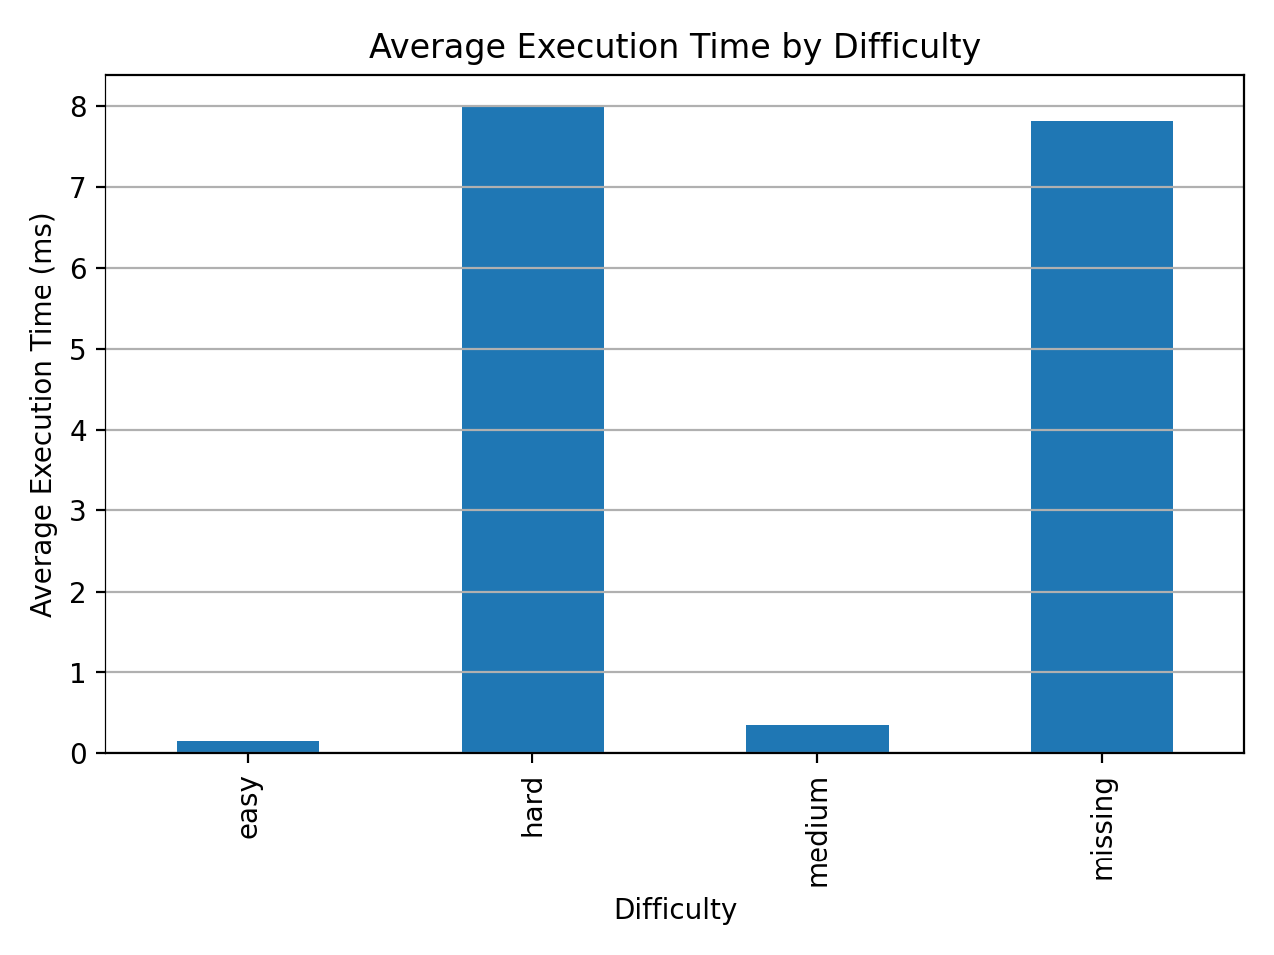
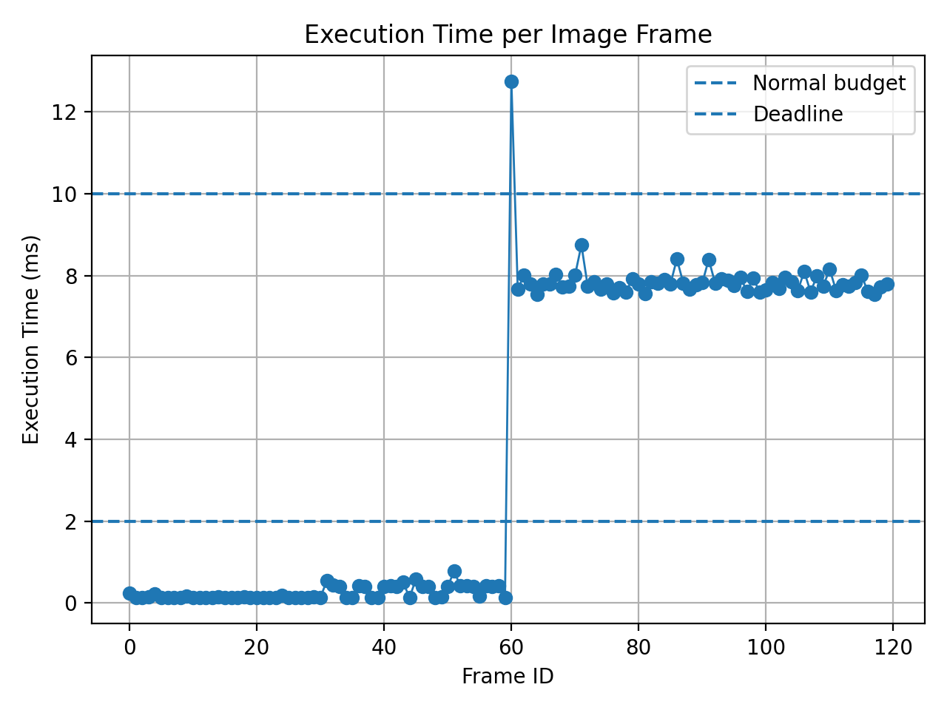
Measured workload: input difficulty creates runtime variability
This is the source of overruns in the prototype
0.15 ms
8.00 ms
7.82 ms
12.75 ms
60
easy avg.
hard avg.
missing avg.
measured WCET
hard/missing overruns
Measured using generated 1920×1080 images; each difficulty has 30 frames.

Slide 10
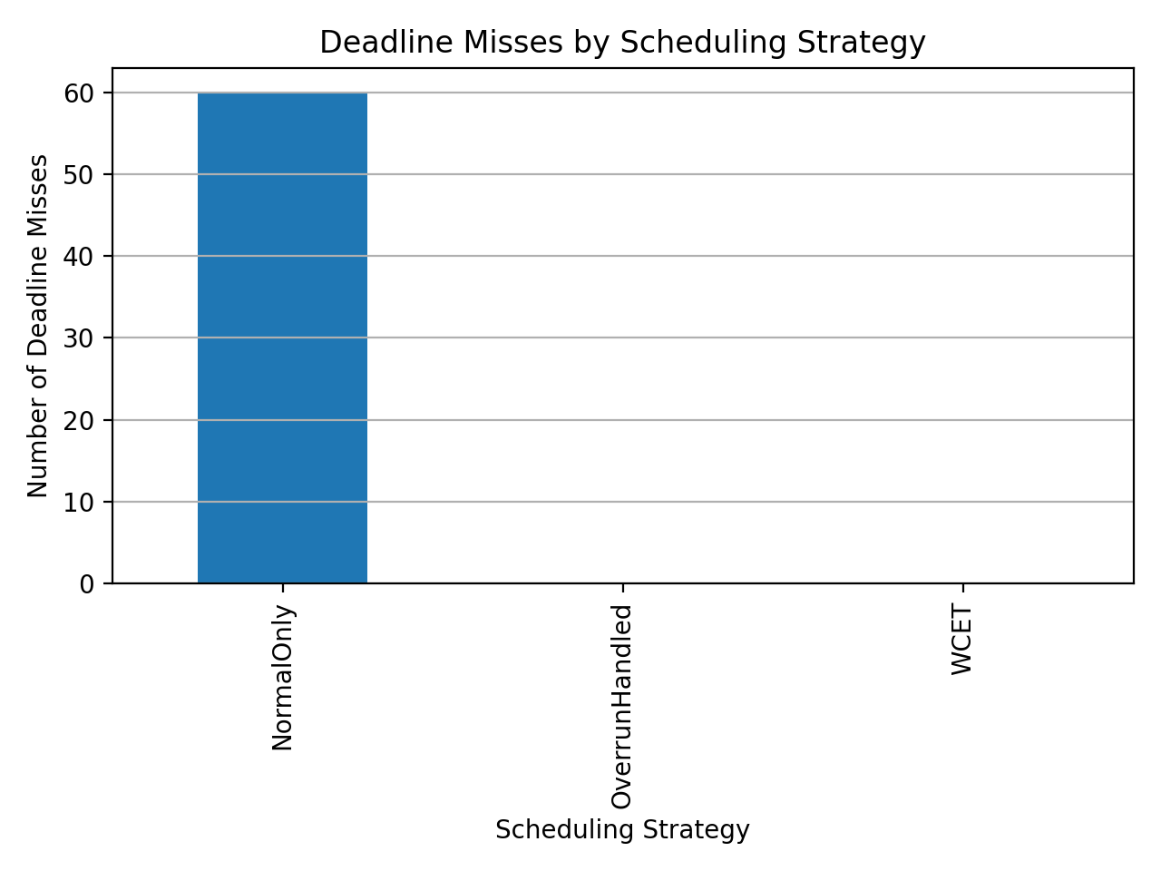
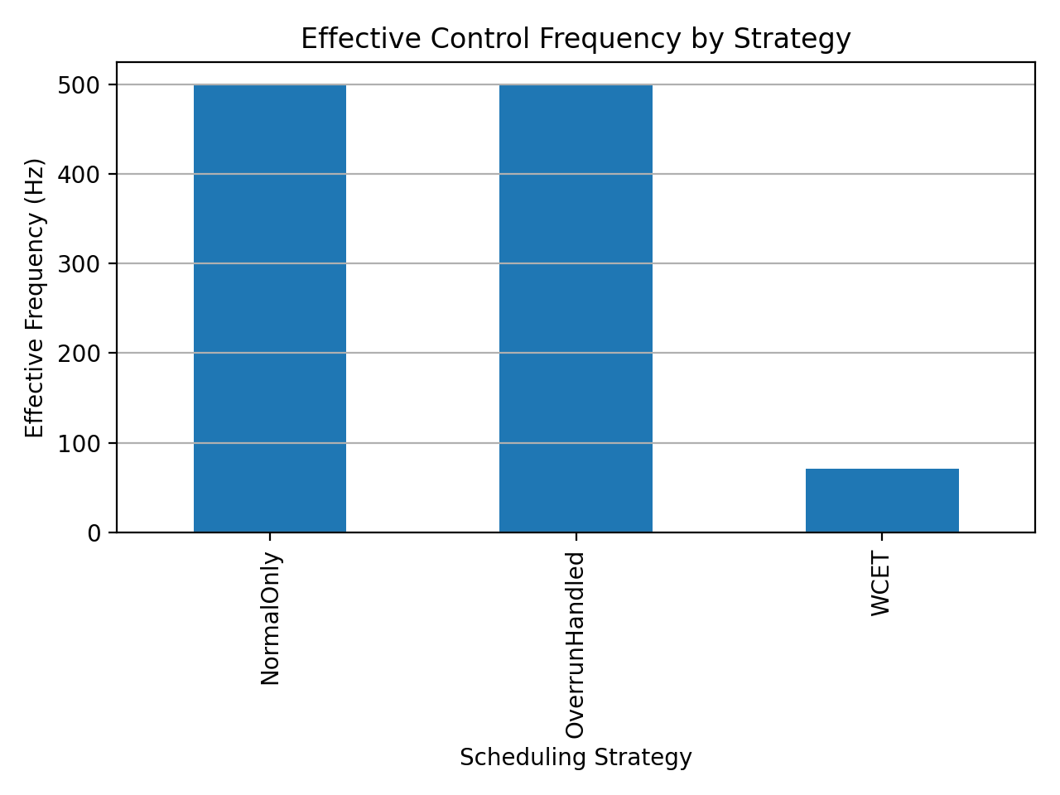
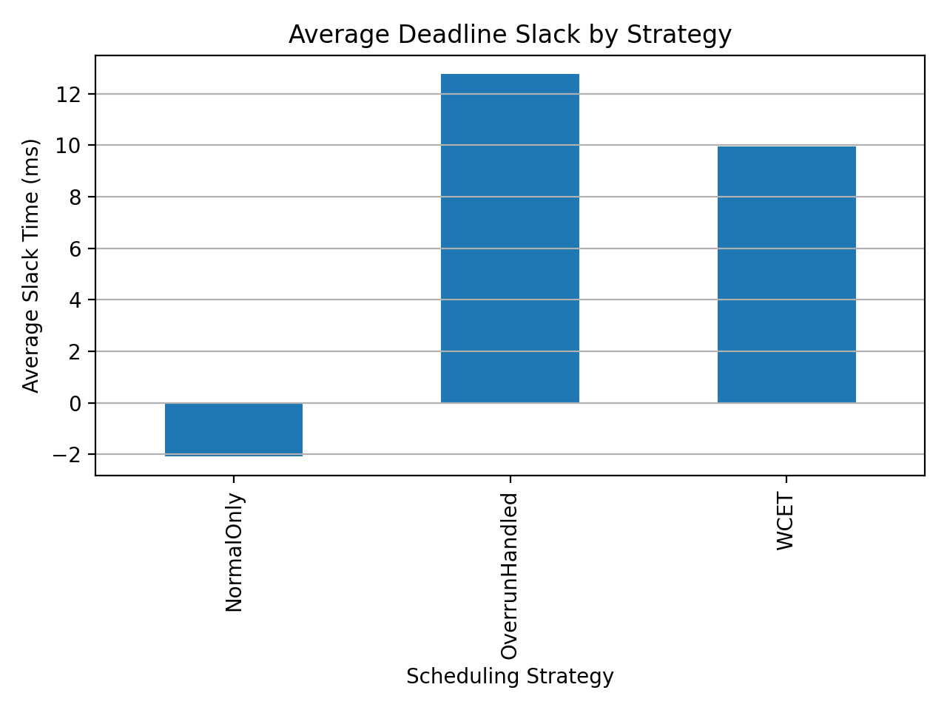
Scheduling strategy comparison
Same measured runtimes, different scheduling assumptions
Interpretation
WCET has no deadline misses, but runs at only 71.3 Hz because period must cover worst case.
NormalOnly keeps 500 Hz, but misses 60 deadlines when hard/missing images appear.
OverrunHandled keeps the 500 Hz nominal period and extends deadlines during overruns in this simulation.
Christian Percival • Hochschule Hamm-Lippstadt
Handling Execution Overruns • 10 min seminar

Slide 11
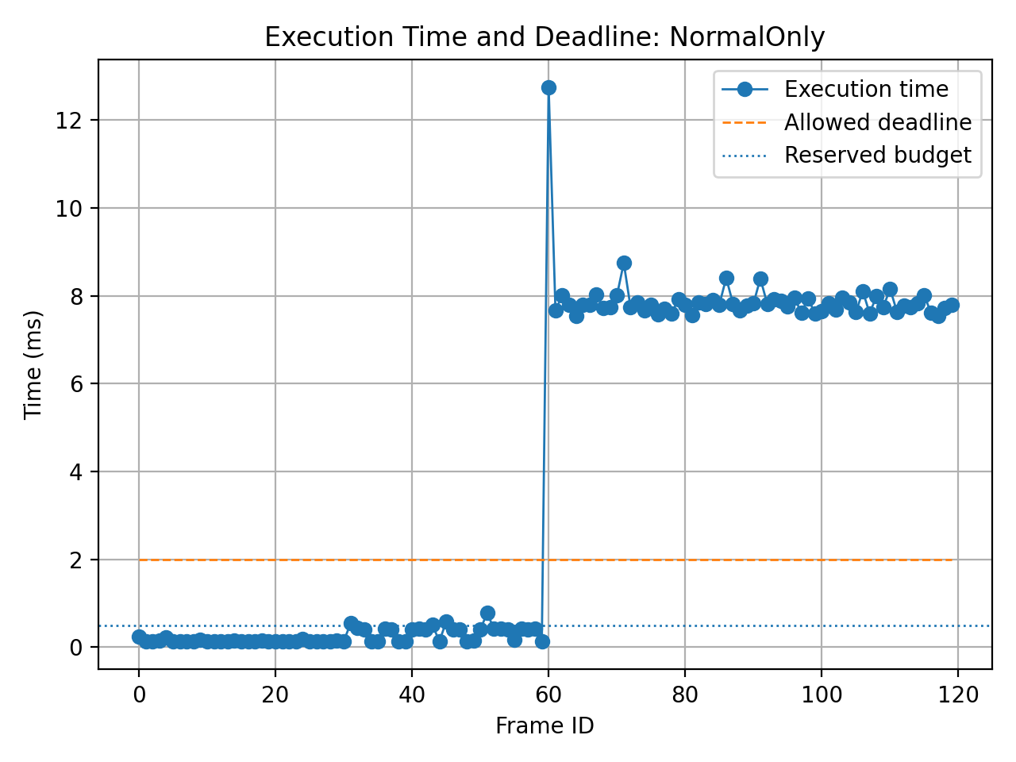
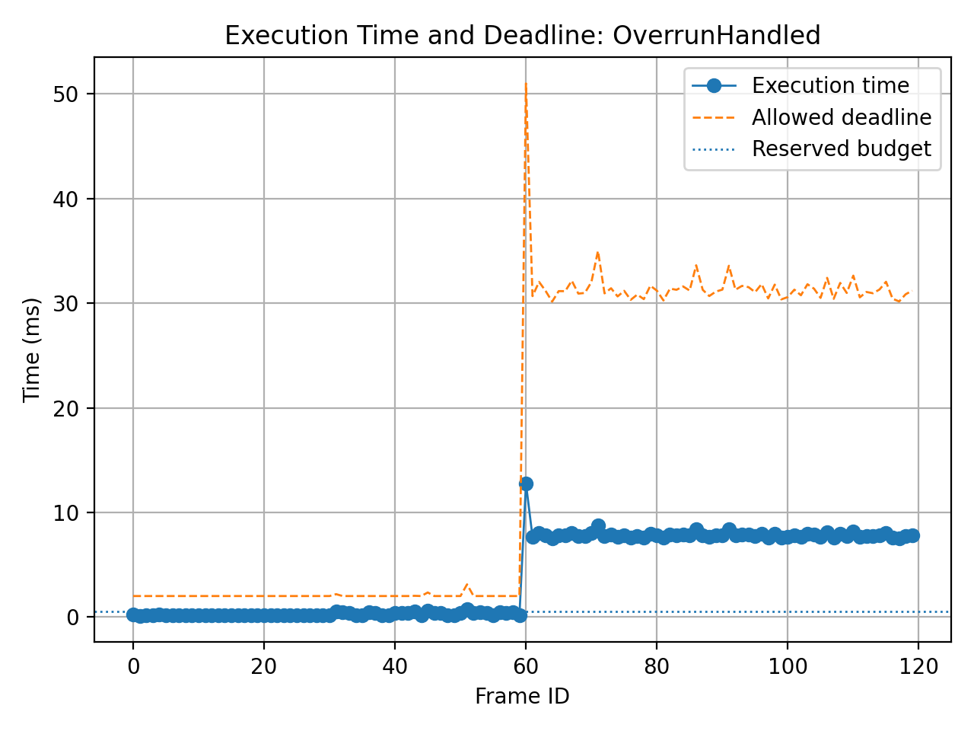
Why the handled strategy helps
It does not make the task faster — it changes what the scheduler does when the budget is exceeded
NormalOnly: hard/missing frames exceed the 2 ms deadline.
OverrunHandled: budget is exceeded, but deadline is extended locally.
Christian Percival • Hochschule Hamm-Lippstadt
Handling Execution Overruns • 10 min seminar

Slide 12
What is the optimal solution?
Not one fixed period for everything — combine normal-case speed with bounded overrun handling
WCET only
Normal only
CBS/CBShd-style handling
✓ Safe, simple
✓ Fast normal-case response
✓ Balances efficiency and protection
⚠ Pessimistic; lower sampling frequency
⚠ Unsafe during hard frames
⚠ Requires scheduler support and overhead analysis
Optimal idea for variable workloads: reserve bandwidth, detect budget exhaustion, postpone deadlines only when needed.
Christian Percival • Hochschule Hamm-Lippstadt
Handling Execution Overruns • 10 min seminar

Slide 13
Limitations, learning outcome, and discussion
What this demo proves — and what it does not claim
The prototype is a simulation, not a kernel-level hard real-time scheduler.
Timing results depend on Python, Windows/Linux scheduling, CPU load, and OpenCV behavior.
A real system would need validated WCET, kernel support, and resource-sharing analysis.
But the demo clearly shows the tradeoff: WCET safety vs normal-case frequency vs adaptive handling.
Key references
[1] Caccamo, Buttazzo, Sha — Handling Execution Overruns in Hard Real-Time Control Systems, 2002
[2] Buttazzo — Hard Real-Time Computing Systems, 4th ed., 2024
[3] Abeni & Buttazzo — Constant Bandwidth Server, RTSS 1998
[4] Liu & Layland — EDF and scheduling foundations, 1973
Final takeaway
Overruns are not eliminated; they are isolated and accounted for so that timing behavior stays controlled.
Christian Percival • Hochschule Hamm-Lippstadt
Questions?

