Slide 1
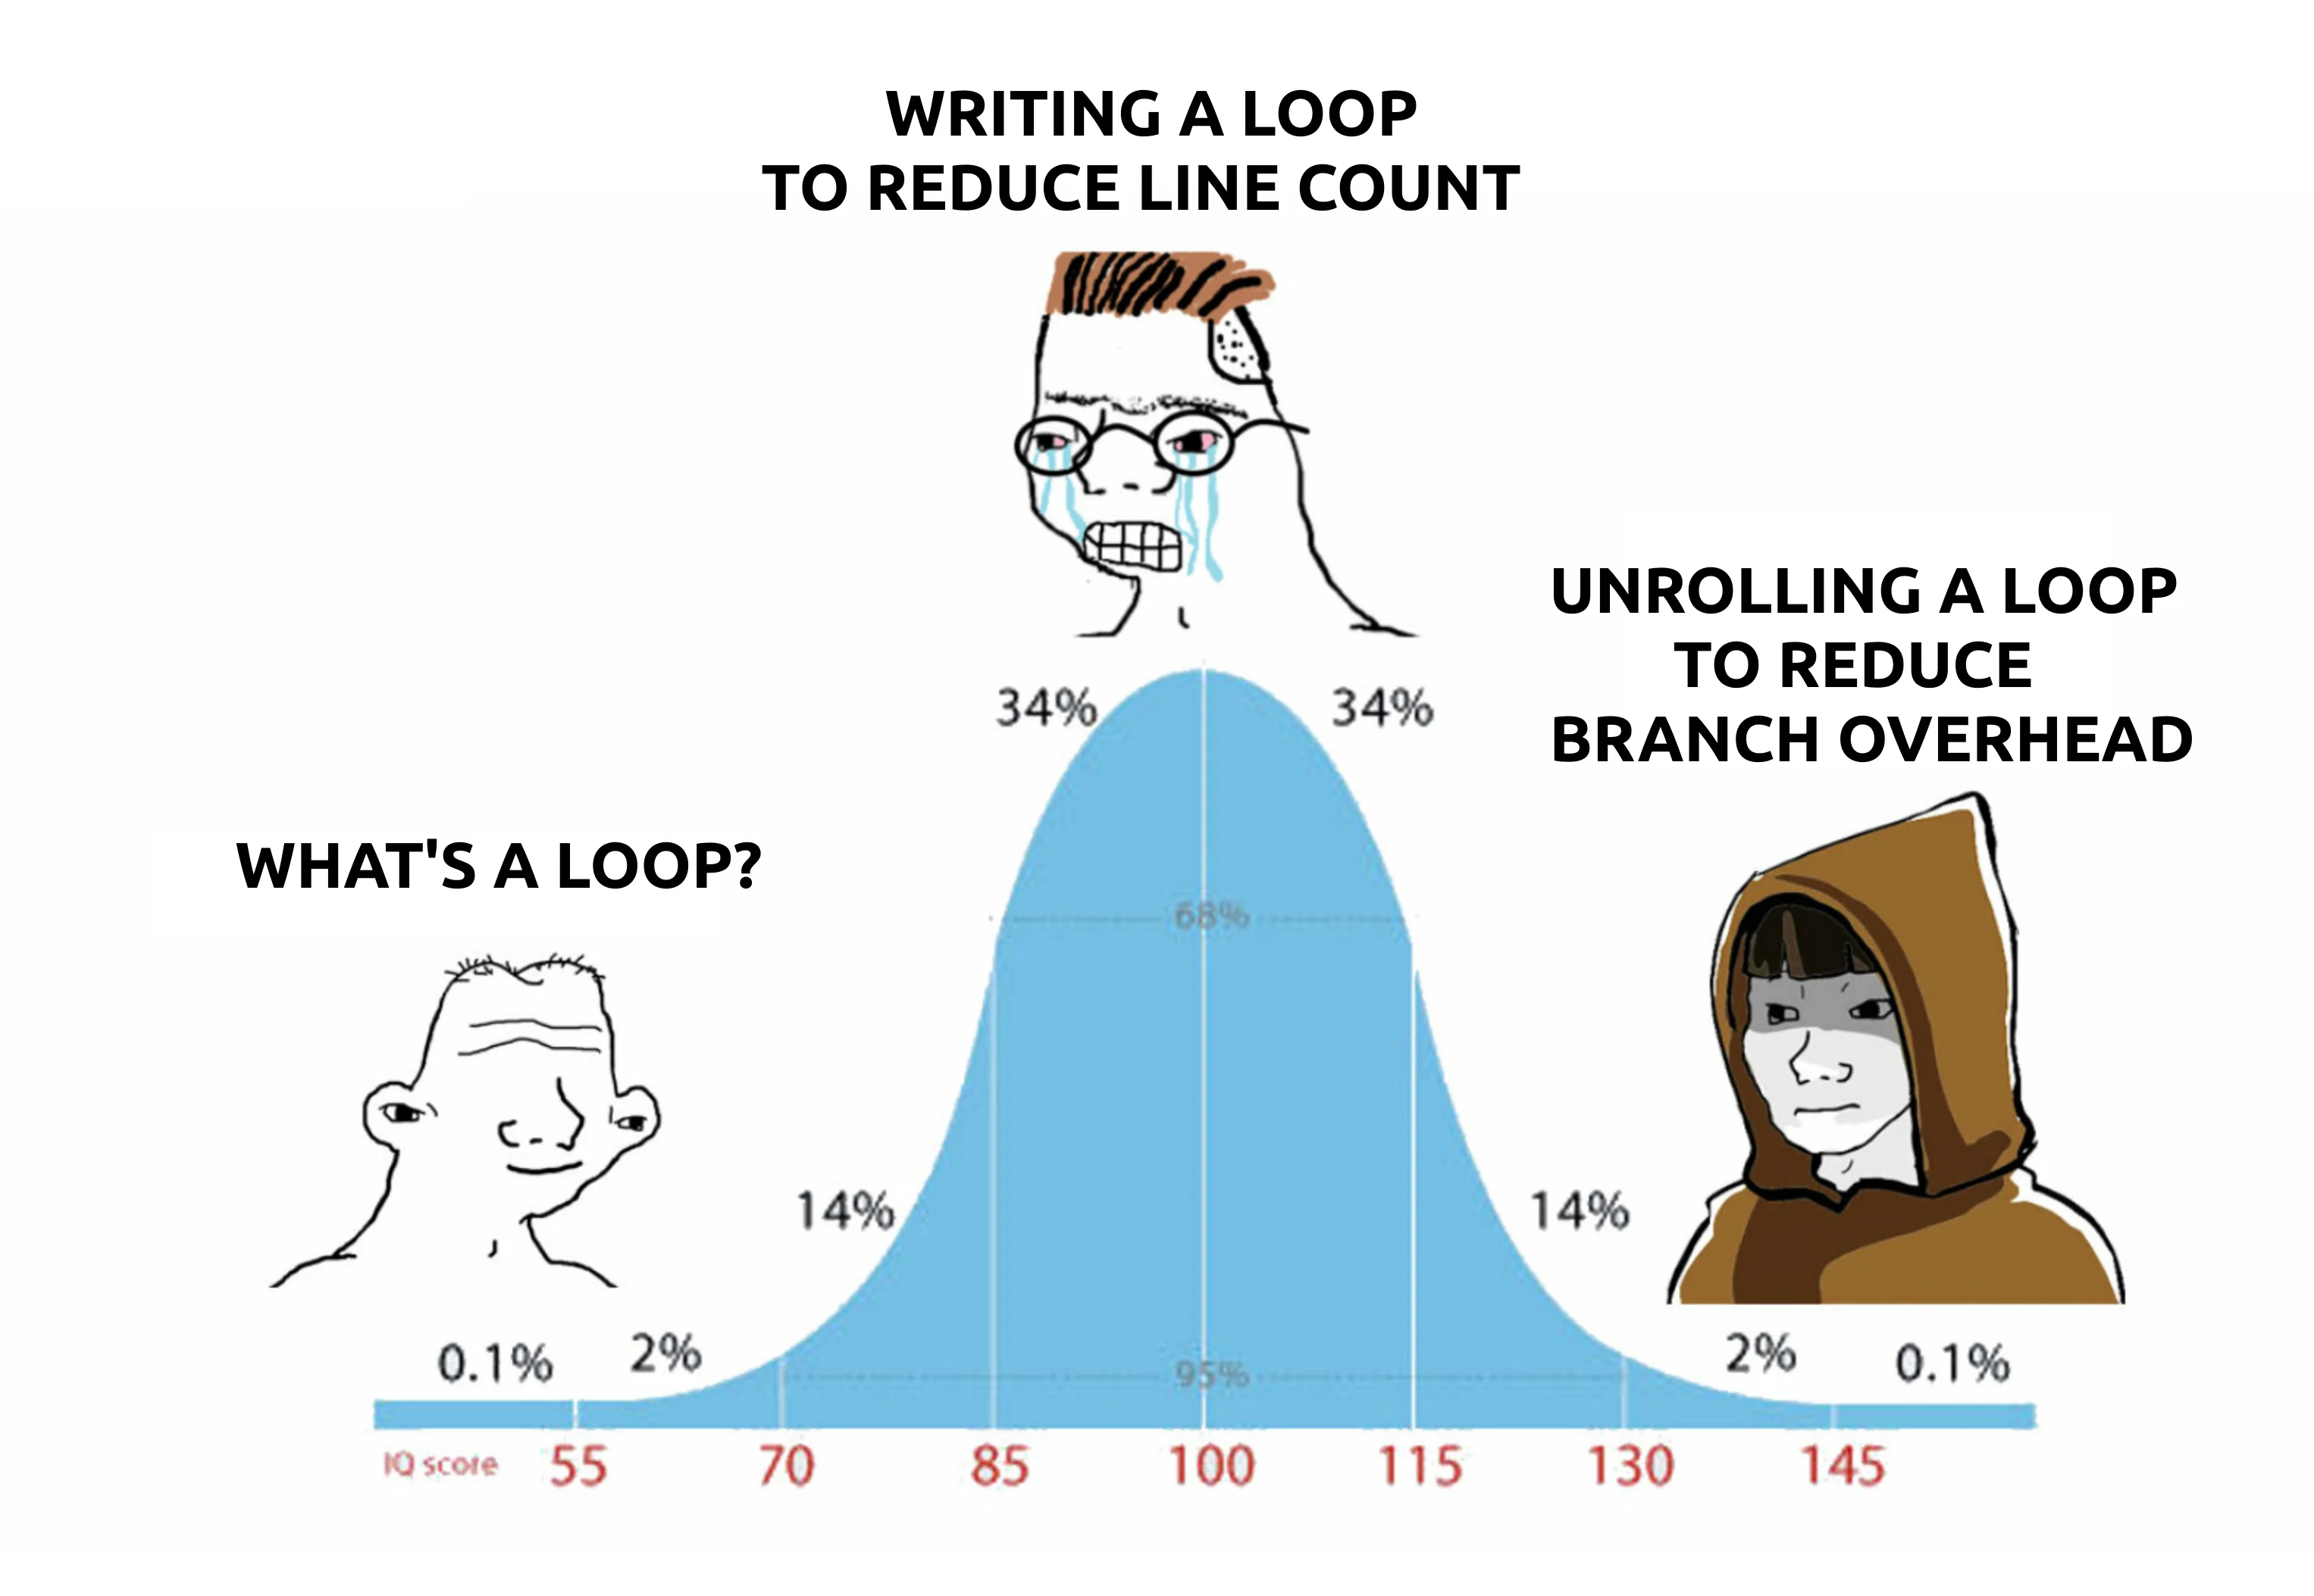
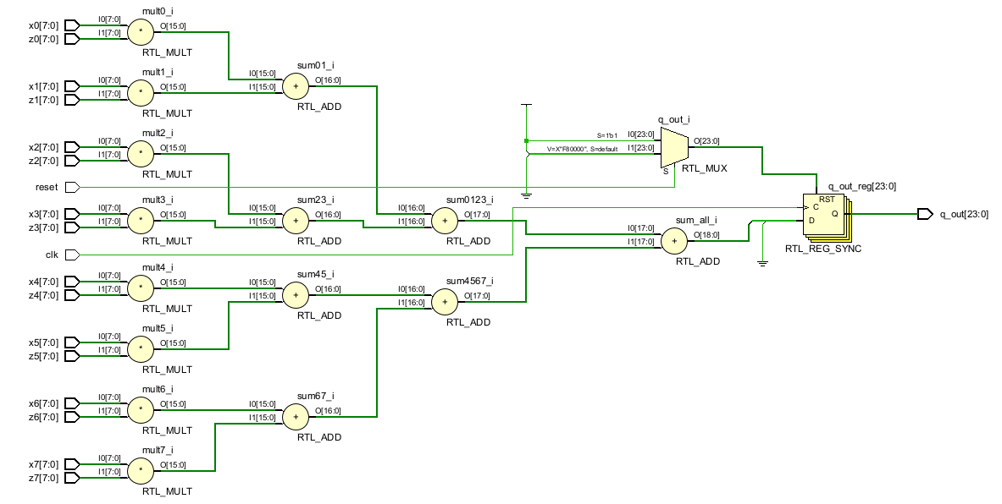
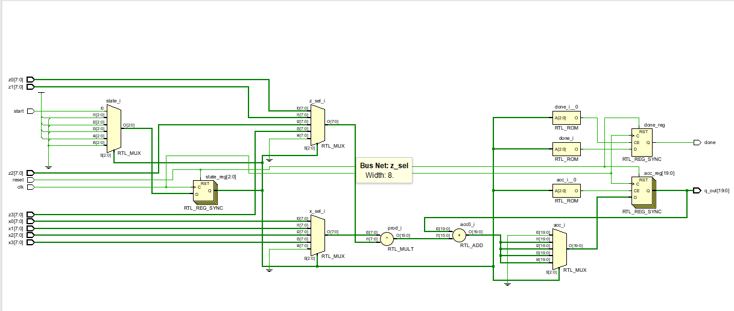
Loop Unrolling in High-Level Synthesis
Seminar presentation
Christian Percival
Hochschule Hamm-Lippstadt • Electronic Engineering
C/C++ → RTL
Latency
Resources
Notes:
Introduce the topic: loop unrolling as a common optimization, but in HLS it changes generated hardware, not just software code. Mention that the deck includes your own Vitis HLS experiment and Vivado RTL schematic visualizations.

Slide 2
What is loop unrolling?
The same computation is grouped into fewer loop iterations.
for (int i = 0; i < 32; i += 4) {
q += x[i] * z[i];
q += x[i+1] * z[i+1];
q += x[i+2] * z[i+2];
q += x[i+3] * z[i+3];
}
for (int i = 0; i < 32; i++) {
q += x[i] * z[i];
}
Rolled loop
32 iterations
Unrolled factor 4
8 grouped iterations
Loop unrolling duplicates the loop body so that multiple iterations become visible at once.
In HLS, this can expose parallelism, but it can also require more hardware.
Notes:
Explain the basic idea using code only. Do not yet go deep into hardware. Then transition: in HLS, this high-level transformation has physical consequences.

Slide 3
What changes in High-Level Synthesis?
HLS turns the loop into a hardware architecture.
High-Level Synthesis flow
C/C++
Scheduling
Binding
Datapath
FSM/RTL
HLS = High-Level Synthesis
Converts C/C++ into hardware.
Datapath = hardware that performs calculations
Controller/FSM = hardware that controls when operations happen
RTL = Register Transfer Level, a hardware description using registers and logic
Notes:
Define HLS and the terms that appear in the Vitis reports. This makes the later experimental slides understandable.

Slide 4
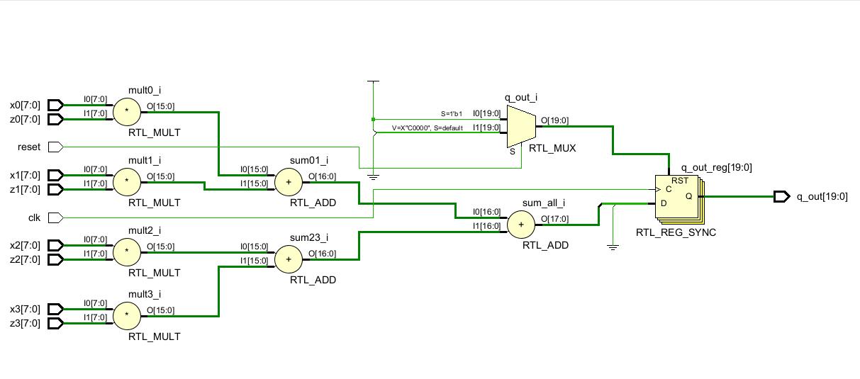
Unroll factor 4
4 multipliers + adder tree

Slide 5
Why controller delay can increase:
Loop unrolling increases the operation/control problem seen by HLS.
Higher unroll
factor
More Data Flow
More HW/control
steps
More state
bits
FSM/MUX
delay grows
Unrolling makes the loop body larger. The HLS controller must coordinate more operations. This can increase: - operations to schedule - control signals - FSM states/state bits - MUX/resource-selection logic
Notes:
This slide connects your experiment back to the assigned paper. The implementation measures resources and timing as indirect evidence because modern HLS tools may not isolate pure controller delay.

Slide 6
Prototype and experiment setup
A small Vitis HLS experiment was used instead of only a planned Python model.
Measured from Vitis HLS reports:
- latency
- Interval/II = clock cycles between starting new loop iterations
timing slack
Hardware:
- DSPs
- LUTs
- flip-flops
#define N 32
int dot_product(int x[N], int z[N]) {
int q = 0;
loop_main:
for (int i = 0; i < N; i++) {
#pragma HLS UNROLL factor = u
q += x[i] * z[i];
}
return q;
}
Prototype: Unrolling only helps when the hardware can support it
Notes:
This is your own prototype. Emphasize that you used C simulation for correctness first, then C synthesis reports for latency/resources/timing.

Slide 7
Experiment A: normal memory results
Unrolling helped at first, then resource limitations cancelled the benefit.
ns
Unroll factor
Factor Latency Interval/II
1 370 ns 1
2 210 ns 1
4 220 ns 2
8 220 ns 4
16 220 ns 8
32 220 ns n/a
Key observation
Factor 2: big improvement
Factors 4–16: latency plateau
Factor 32: negative slack
Notes:
Explain II: initiation interval, how often a new loop iteration can start. The result shows that more unrolling is not always faster if II increases.

Slide 8
Experiment B: array partitioning
Giving HLS more parallel memory access changes the result.
ns
Unroll factor
With complete array partitioning:
Array partitioning means more parallel memory access. Unrolling only helps if the hardware architecture can feed the parallel operations.
Factor 4: latency improved from 220 ns to 130 ns.
Factor 32: latency reached 50 ns.
The cost was much higher DSP, FF, and LUT usage.
Notes:
Explain that partitioning x and z breaks the memory bottleneck, allowing II to stay low and more DSPs to be used. But resources grow heavily.

Slide 9
Results summary
The best choice depends on memory architecture and resource budget.
Experiment u Lat(ns) II DSP FF LUT Slack
normal 1 370 1 3 311 166 +0.44
normal 2 210 1 6 573 229 +0.44
normal 4 220 2 6 832 508 +0.09
normal 16 220 8 6 979 816 +0.09
normal 32 220 n/a 6 1025 978 -0.53
partitioned 4 130 1 12 1159 671 +0.44
partitioned 8 90 1 24 2203 1007 +0.09
partitioned 16 80 1 48 4486 2457 +0.09
partitioned 32 50 n/a 60 4234 2150 +0.09
Important result
The lowest latency is not free: partitioned full unrolling reached 50 ns, but used 60 DSPs and thousands of FF/LUT resources.
The most efficient factor may be factor 2 or factor 4 depending on whether the goal is low resource usage or low latency.
Notes:
This slide lets you answer direct questions about numbers. Mention that the normal memory rows demonstrate the bottleneck; partitioned rows show what happens when the bottleneck is reduced.

Slide 10
RTL visualization: what unrolling becomes
Vivado schematics illustrate the structural growth.
Rolled
Unroll factor 4
Unroll factor 8
1 multiplier + FSM
4 multipliers + adder tree
8 multipliers + larger tree
The rolled schematic looks more complex because of control, but it reuses less arithmetic hardware. The unrolled schematics look cleaner but duplicate hardware.
Notes:
Use this slide to bridge visuals to resource numbers. It also answers why a visually simpler circuit can be more resource-expensive.

Slide 11
Key findings
What the prototype proves about HLS loop unrolling.
1
Unrolling exposes parallelism.
2
HLS can only use that parallelism if memory and resources support it.
3
Normal memory hit a bottleneck, trip count fell, but interval increased.
4
Partitioning enabled lower latency, but resource usage increased strongly.
Notes:
This slide is the conclusion before the conclusion. Pause here and connect directly back to the research question.

Slide 12
Conclusion
Loop unrolling in HLS is a hardware trade-off.
Reduces
Latency
Duplicates
hardware
Increases resource usage
Increases controller Timing/complexity
Final answer: choose the unroll factor that gives useful speedup while still meeting resource and timing limits.
Notes:
End by saying your experiment confirms the paper’s main idea: maximum unroll is not automatically optimal. The right factor is timing/resource-aware.

Slide 13
References
Main paper, related work, and tool references.
S. Kurra, N. K. Singh, and P. R. Panda, “The Impact of Loop Unrolling on Controller Delay in High Level Synthesis,” DATE, 2007.
V. Sarkar, “Optimized Unrolling of Nested Loops,” ICS, 2000.
S. Carr and K. Kennedy, “Improving the Ratio of Memory Operations to Floating-Point Operations in Loops,” ACM TOPLAS, 1994.
A. Koseki et al., “A Method for Estimating Optimal Unrolling Times for Nested Loops,” ISPAN, 1997.
G. R. Gupta, M. Gupta, and P. R. Panda, “Rapid Estimation of Control Delay from High-Level Specifications,” DAC, 2006.
V. H. Allan et al., “Software Pipelining,” ACM Computing Surveys, 1995.
AMD, Vitis High-Level Synthesis User Guide UG1399; Intel, oneAPI FPGA Handbook; Bambu HLS Framework; LegUp 2021.1 Documentation.
Notes:
Mention that the main scientific argument is centered on Kurra et al.; tool references support the implementation section.

