Slide 1

C E

Slide 2
ACE

Slide 4
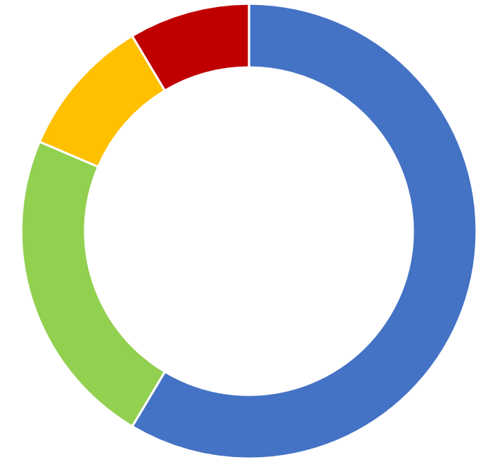
pris
n

Slide 5
c
perate

