Slide 1
Morphological Image Reconstruction
Taylor Doell, Matt Dyke,
Christian Sieh
CSC442 Image Processing

Slide 2
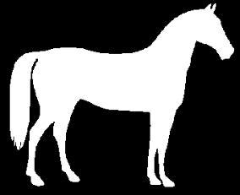
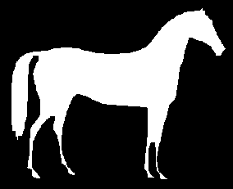
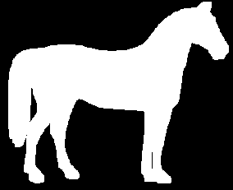
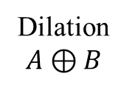
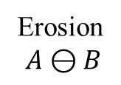
Erosion/Dilation
Erosion
$$A⊖B$$
Dilation
$$A⊕B$$

Slide 3







Opening/Closing
Opening $A∘B=(A⊖B)⊕B$
Closing $A⋅B=(A⊕B)⊖B$
Erosion
Dilation
Dilation
Erosion

Slide 4
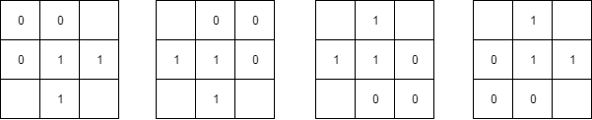
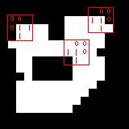
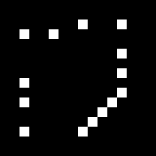

Hit-or-Miss
$$A⊛B=\left(A⊖B_{1}\right)∩\left(A^{c}⊖B_{2}\right)$$
$=\left(A⊖B_{1}\right)−\left(A⊕\hat{B_{2}}\right)$

Slide 5
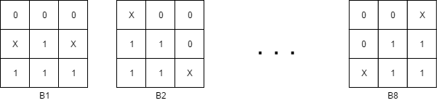

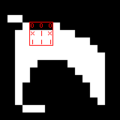
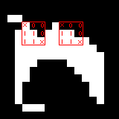





Thinning
$$A⊗\{B\}=(\left(…\left(A⊗B_{1}\right)⊗B_{2}\right)…)⊗B_{n}$$
$$A⊗B_{1}$$
$$A⊗B_{2}$$
$$(\left(…\left(A⊗B_{3}\right)⊗B_{4}\right)…)⊗B_{8}$$

Slide 6
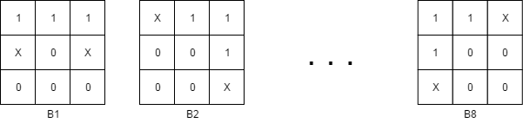
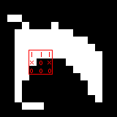
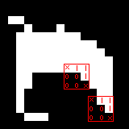





Thickening
$$A⊙\{B\}=(\left(…\left(A⊙B_{1}\right)⊙B_{2}\right)…)⊙B_{n}$$
$$A⊙B_{1}$$
$$A⊙B_{2}$$
$$(\left(…\left(A⊙B_{3}\right)⊙B_{4}\right)…)⊙B_{8}$$

