Slide 1
Morphological Image Reconstruction
Taylor Doell, Matt Dyke,
Christian Sieh
CSC442 Image Processing

Slide 2
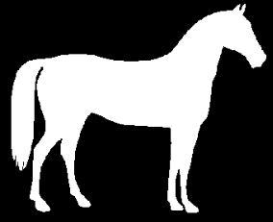
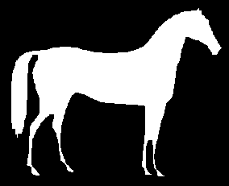
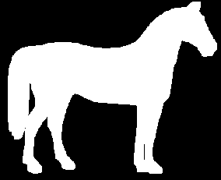
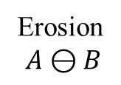
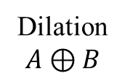
Erosion/Dilation
Erosion
$$A⊖B$$
Dilation
$$A⊕B$$

Slide 3







Opening/Closing
Opening $A∘B=(A⊖B)⊕B$
Closing $A⋅B=(A⊕B)⊖B$
Erosion
Dilation
Dilation
Erosion

Slide 4
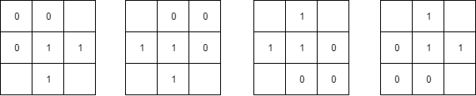
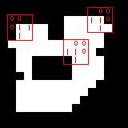

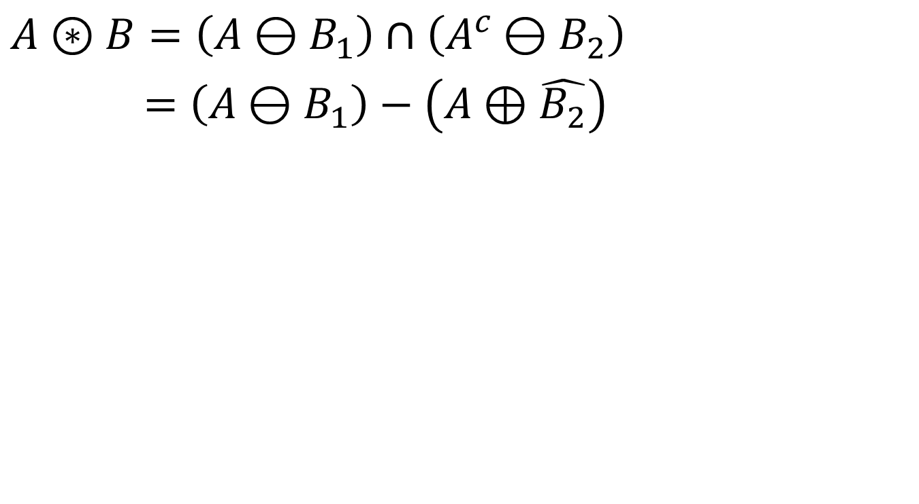
Hit-or-Miss
$$A⊛B=\left(A⊖B_{1}\right)∩\left(A^{c}⊖B_{2}\right)$$
$=\left(A⊖B_{1}\right)−\left(A⊕\hat{B_{2}}\right)$

Slide 5
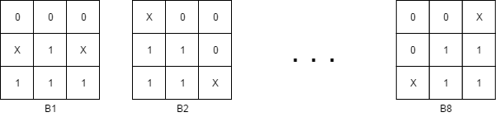

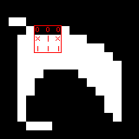
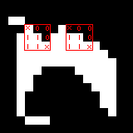




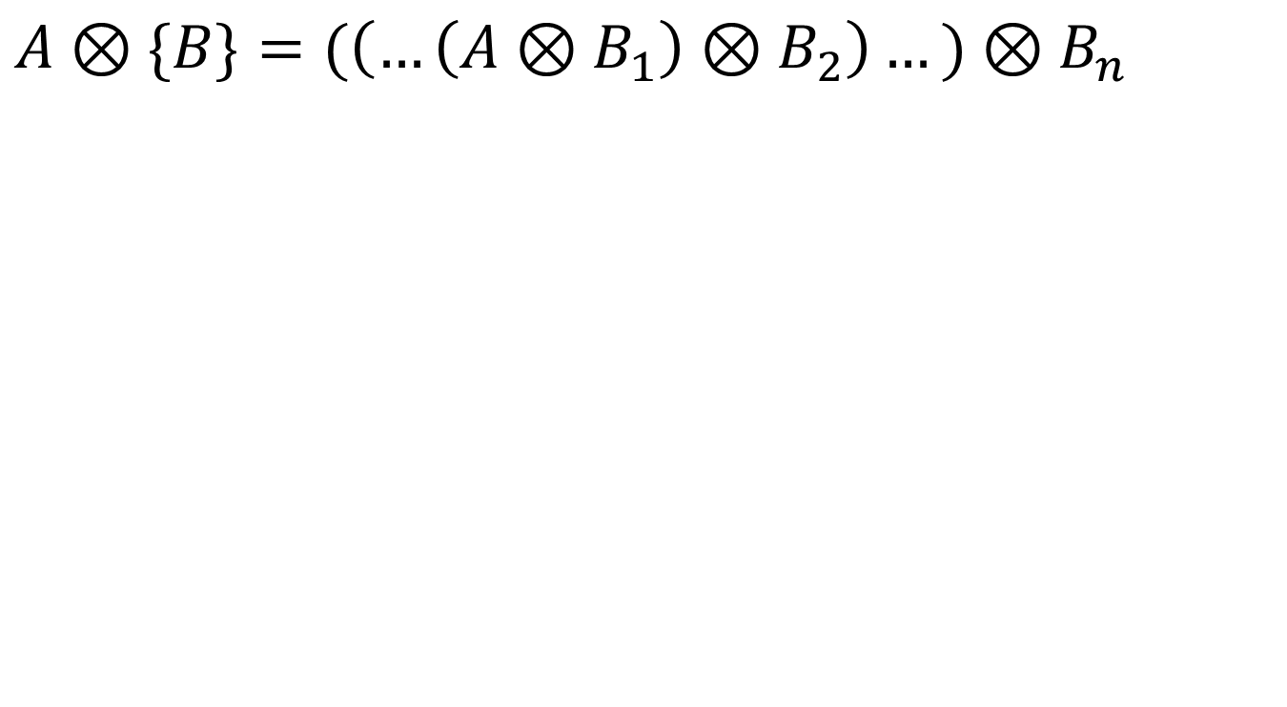
Thinning
$$A⊗\{B\}=(\left(…\left(A⊗B_{1}\right)⊗B_{2}\right)…)⊗B_{n}$$
$$A⊗B_{1}$$
$$A⊗B_{2}$$
$$(\left(…\left(A⊗B_{3}\right)⊗B_{4}\right)…)⊗B_{8}$$

Slide 6
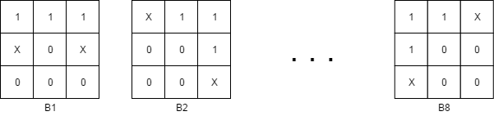
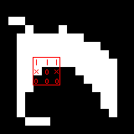
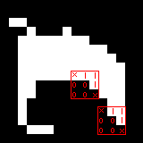




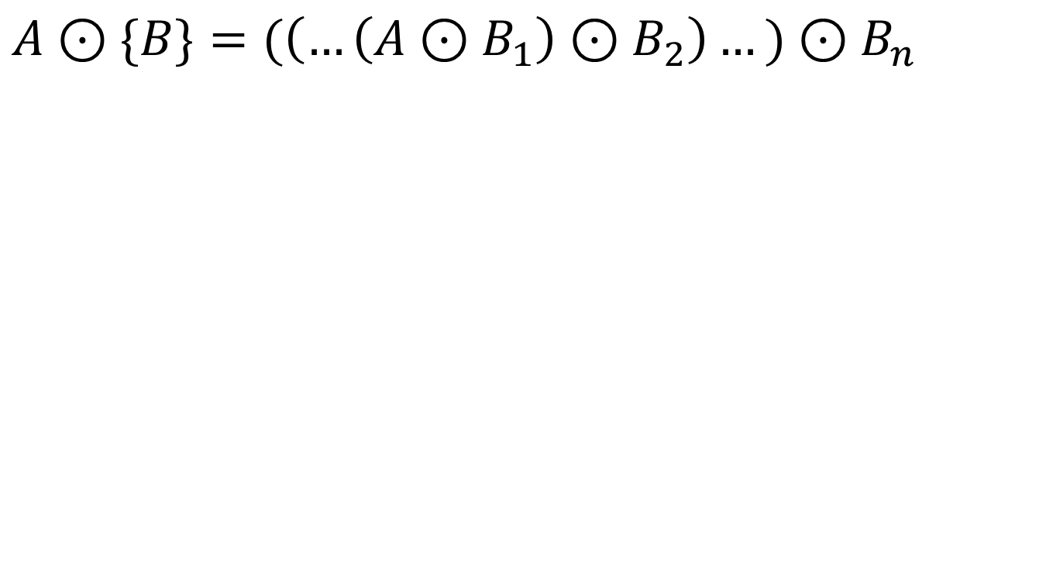
Thickening
$$A⊙\{B\}=(\left(…\left(A⊙B_{1}\right)⊙B_{2}\right)…)⊙B_{n}$$
$$A⊙B_{1}$$
$$A⊙B_{2}$$
$$(\left(…\left(A⊙B_{3}\right)⊙B_{4}\right)…)⊙B_{8}$$

Slide 7
Skeletonizing
Repeated thinning's
Until image shows no change

Slide 8
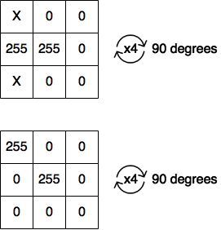
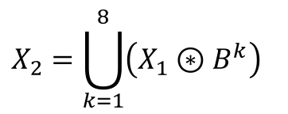



Pruning
Removes short branches
Complement to the skeletonizing
$$X_{1}=A⊗\{B\}$$
$$X_{2}=\bigcup_{k=1}^{8}{\left(X_{1}⊛B^{k}\right)}$$
$$X_{3}=\left(X_{2}⊕H\right)∩A$$
$$X_{4}=X_{1}{∪X}_{3}$$

Slide 9


Pruning

Slide 10
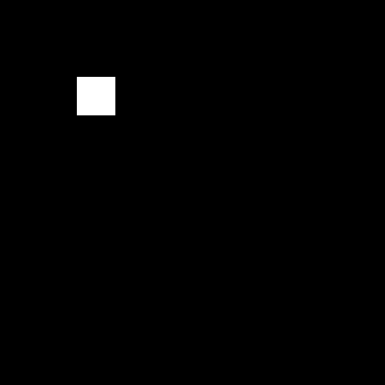
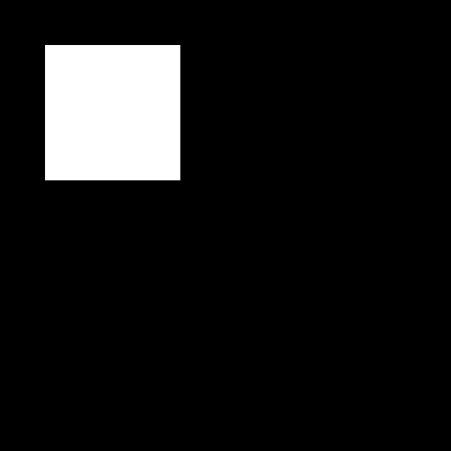


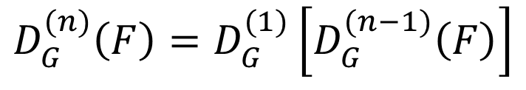


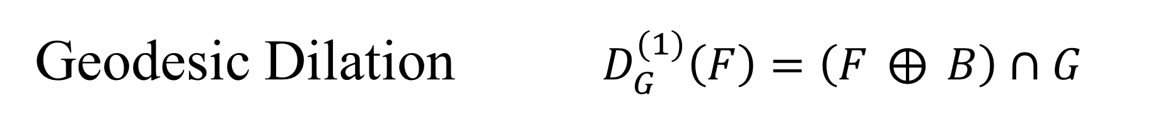
Geodesic Dilation $D_{G}^{(1)}\left(F\right)=\left(F ⨁{ }B\right)∩G$
Marker - F
Dilate
$$∩$$
$$D_{G}^{(1)}\left(F\right)$$
$$D_{G}^{(n)}\left(F\right)=D_{G}^{(1)}\left[D_{G}^{(n−1)}\left(F\right)\right]$$
Mask - G

Slide 11





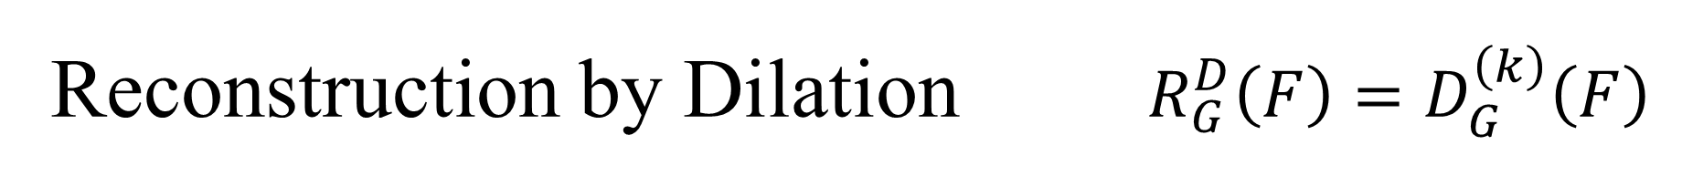



Reconstruction by Dilation $R_{G}^{D}\left(F\right)=D_{G}^{\left(k\right)}\left(F\right)$
Marker - F
$$D_{G}^{(1)}\left(F\right)$$
$$D_{G}^{(2)}\left(F\right)$$
$$D_{G}^{(3)}\left(F\right)$$
$$D_{G}^{(6)}\left(F\right)$$
$$D_{G}^{(5)}\left(F\right)$$
$$D_{G}^{(4)}\left(F\right)$$

Slide 12



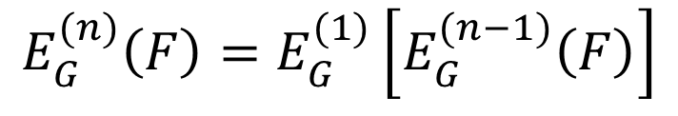

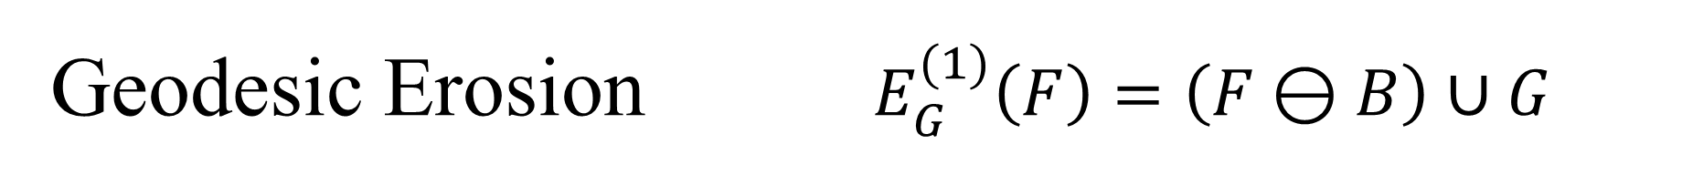
Geodesic Erosion $E_{G}^{(1)}\left(F\right)=\left(F⊖B\right)∪G$
Marker - F
Erode
$$∪$$
$$E_{G}^{(1)}\left(F\right)$$
$$E_{G}^{(n)}\left(F\right)=E_{G}^{(1)}\left[E_{G}^{(n−1)}\left(F\right)\right]$$
Mask - G

Slide 13



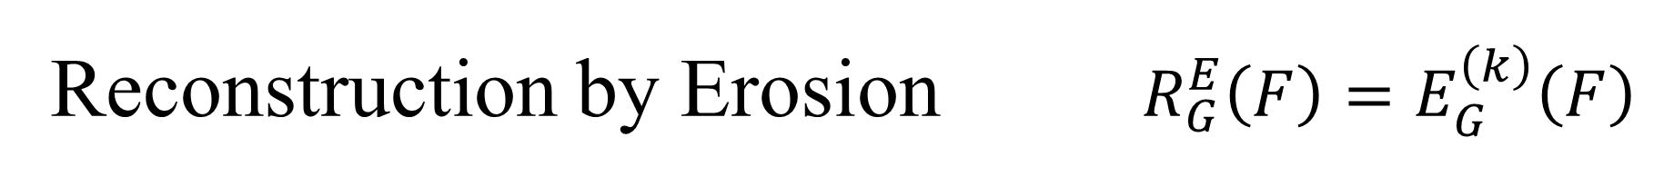
Reconstruction by Erosion $R_{G}^{E}\left(F\right)=E_{G}^{\left(k\right)}\left(F\right)$
Marker - F
$$E_{G}^{(1)}\left(F\right)$$
$$E_{G}^{(2)}\left(F\right)$$
$$E_{G}^{(3)}\left(F\right)$$

Slide 14
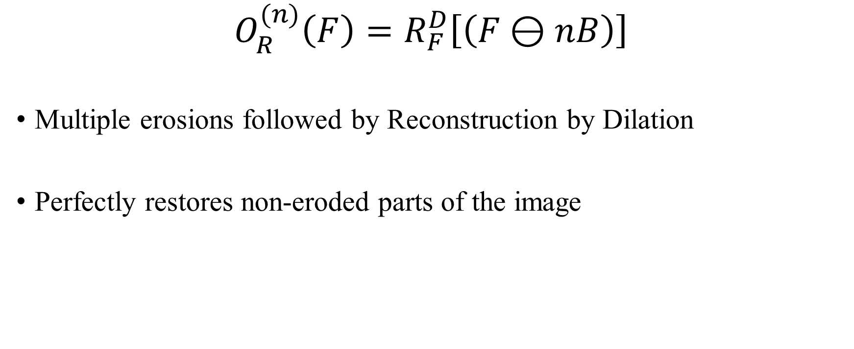
Opening by Reconstruction
$$O_{R}^{(n)}\left(F\right)=R_{F}^{D}\left[\left(F⊖nB\right)\right]$$
Multiple erosions followed by Reconstruction by Dilation
Perfectly restores non-eroded parts of the image

Slide 15
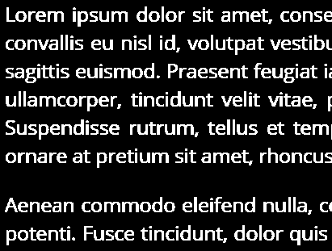
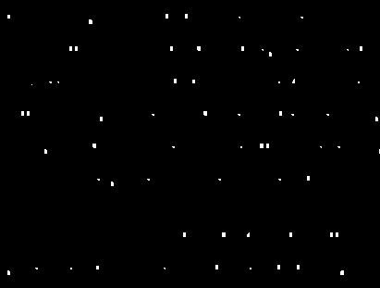
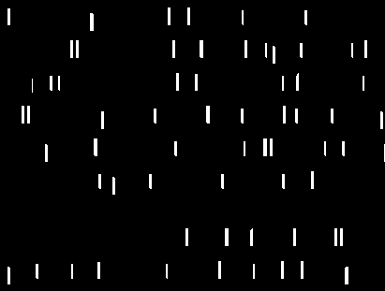
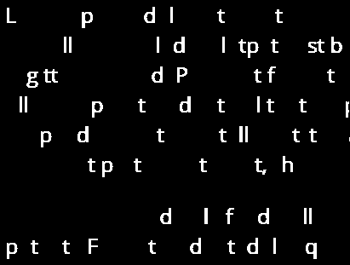
Erode
1x15 SE
Standard Opening
Opening by
Reconstruction

Slide 16











Filling Holes
Let I be a binary image with a hole in it. Then
$$F\left(x,y\right)=\left\{\begin{aligned}1−I\left(x,y\right) \text{if} \text{on} \text{border} \\ 0 \text{otherwise} \end{aligned}\right.$$
The result image with the hole filled will be $H={\left[R_{I^{c}}^{D}\left(F\right)\right]}^{c}$
$$I$$
$$I^{c}$$
$$F$$
$$F⨁B∩I^{c}$$
$$H$$

Slide 17
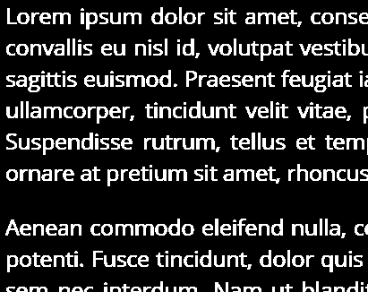
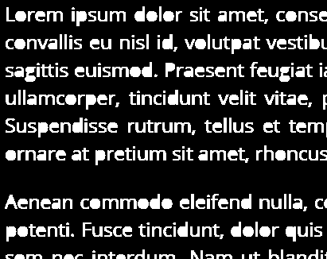

Slide 18
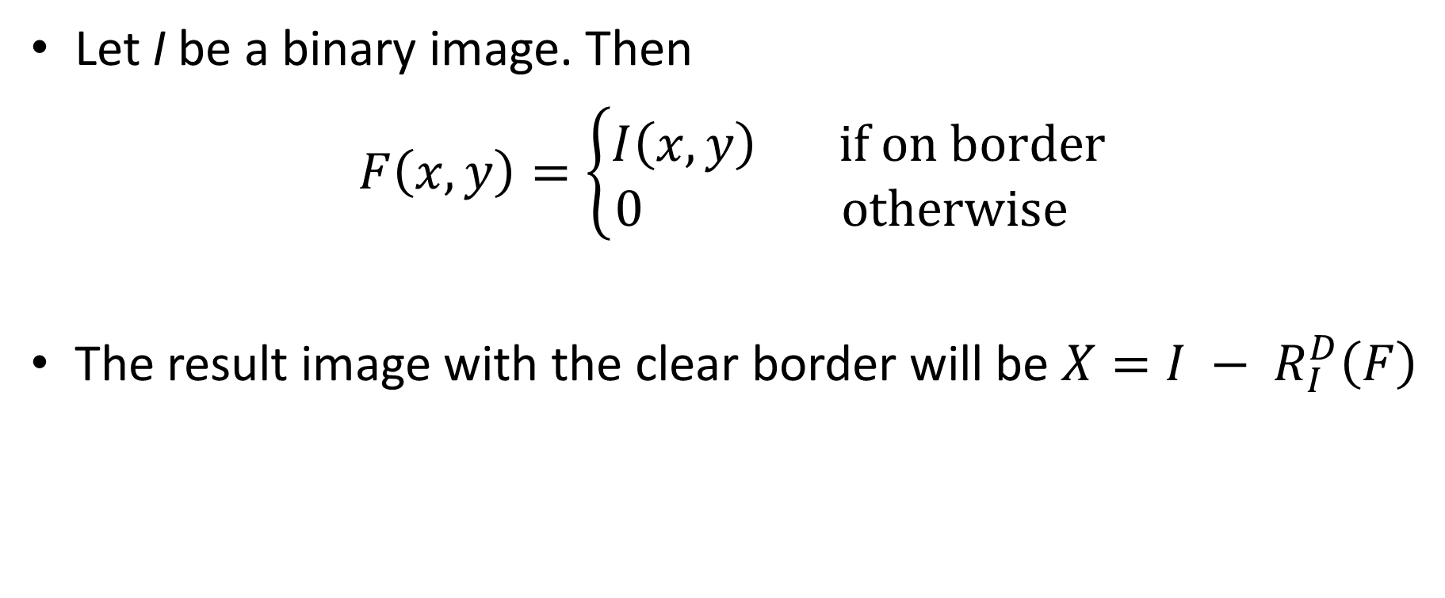
Boundary Clearing
Let I be a binary image. Then
$$F\left(x,y\right)=\left\{\begin{aligned}I\left(x,y\right) \text{if} \text{on} \text{border} \\ 0 \text{otherwise} \end{aligned}\right.$$
The result image with the clear border will be $X=I − R_{I}^{D}\left(F\right)$

Slide 19
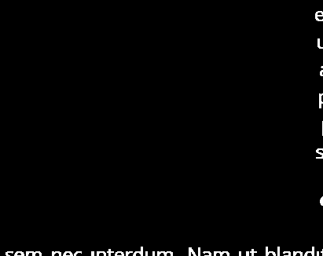
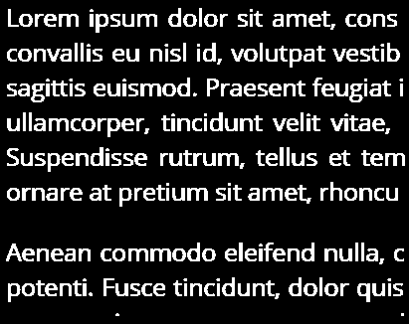


$$R_{I}^{D}\left(F\right)$$
$$I−R_{I}^{D}\left(F\right)$$

Slide 20
Questions?

