Slide 1
Morphological Image Reconstruction
Taylor Doell,
Matt Dyke,
Christian Sieh

Slide 2
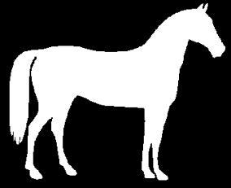
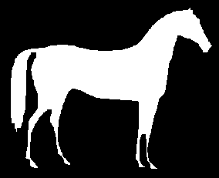
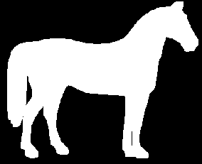
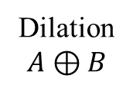
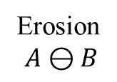
Erosion/Dilation
Erosion
$$A⊖B$$
Dilation
$$A⊕B$$

Slide 3







Opening/Closing
Opening $A∘B=(A⊖B)⊕B$
Closing $A⋅B=(A⊕B)⊖B$
Erosion
Dilation
Dilation
Erosion

Slide 4

Hit-or-Miss
$A⊛B=\left(A⊖B_{1}\right)∩\left(A^{c}⊖B_{2}\right)$ $=\left(A⊖B_{1}\right)−\left(A⊕\hat{B_{2}}\right)$

Slide 5
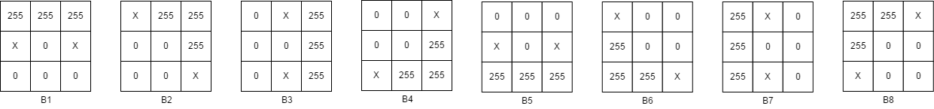
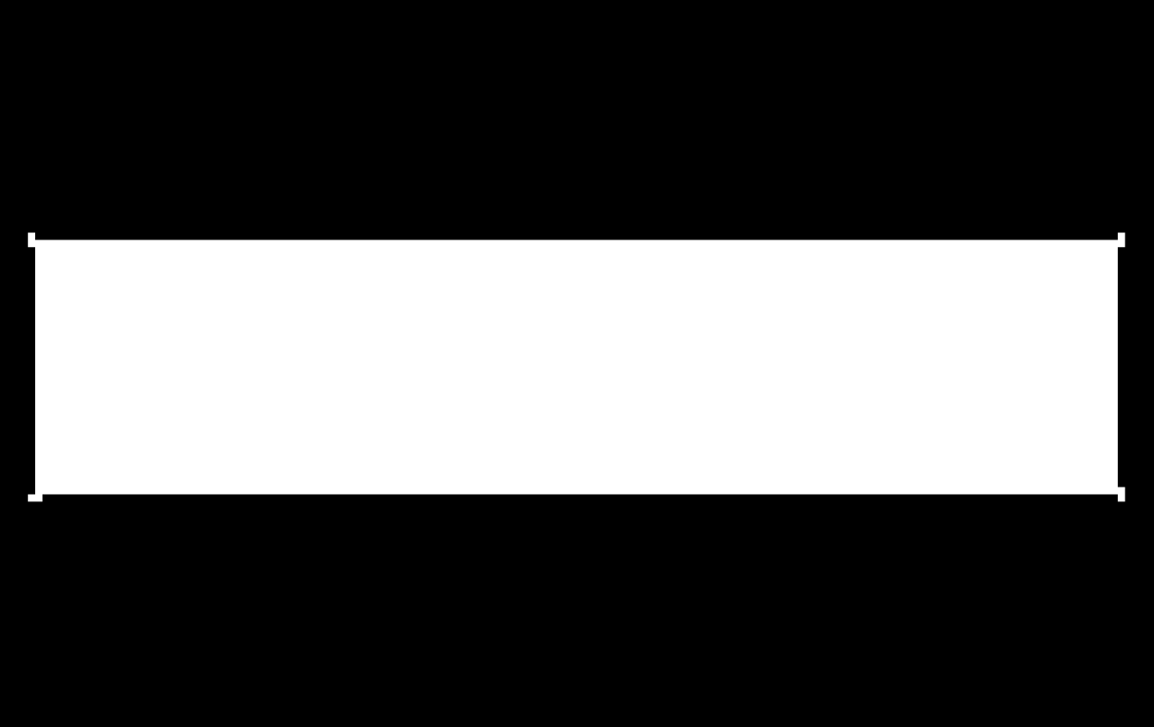

Thinning
$$A⊗\{B\}=(\left(…\left(A⊗B^{1}\right)⊗B^{2}\right)…)⊗B^{n}$$

Slide 6

Thickening
$$A⊙\{B\}=(\left(…\left(A⊙B^{1}\right)⊙B^{2}\right)…)⊙B^{n}$$

