Slide 1
PHYS4150 Tutorial
Yu Ziyang
yzy1996@connect.hku.hk
Room 418, CYM Physics Building
20190911

Slide 2
Course GitHub page
https://github.com/scarecrowyu/PHYS4150-2019:
Lecture note
Tutorial material
Homework related information
Course notification
etc.

Slide 3
Course information
Course contents
Assessment method and weighting:
Assignments (20%)
Examination: 2-hour written exam (40%)
Presentation (15%)
Project report (25%)
Recommended reading material:
Lecture notes
Samuel S.M. Wong: Computational Methods in Physics and Engineering (World Scientific)
N.J. Giordano and N. Nakanishi: Computational physics (Pearson Education Inc. ).

Slide 4
Tutorial Session time slots
Every Friday from 10:30 to 11:20.
Additional tutorial session (may change in future):
11 Sep 2019
25 Sep 2019
9 Oct 2019
30 Oct 2019
20 Nov 2019
Time : 11:30-12:20, Venue: T4 Meng Wah Complex for the first 4 session, and 522, Physics Building for the last session.
Bring your computer to class every tutorial session.

Slide 5
Programming language
HKU provided us the MATLAB and Simulink license this year, so we can just get access to it easily.
MATLAB is a compiler independent tool and doesn’t require any compiler to execute like as C, C++. Easy to install.
MATLAB is convenient and has a large community.

Slide 6
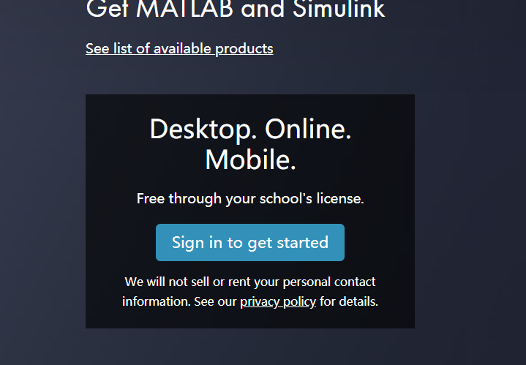
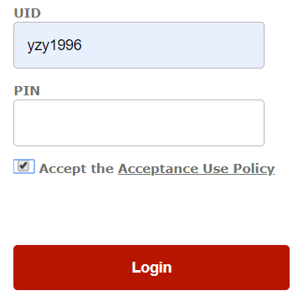
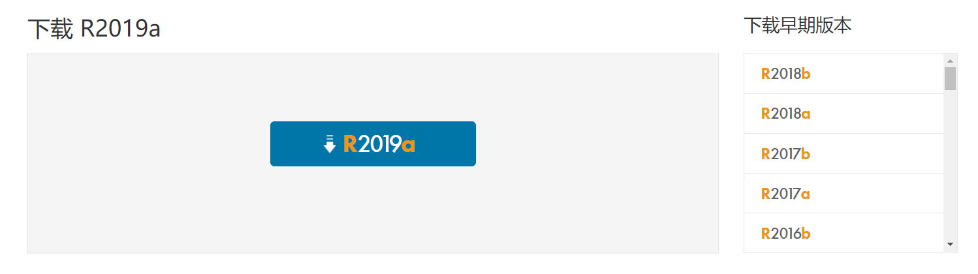
Download and Install MATLAB with HKU campus license
https://www.mathworks.com/academia/tah-portal/the-university-of-hong-kong-40755386.html

Slide 7
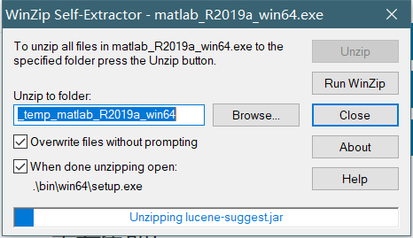
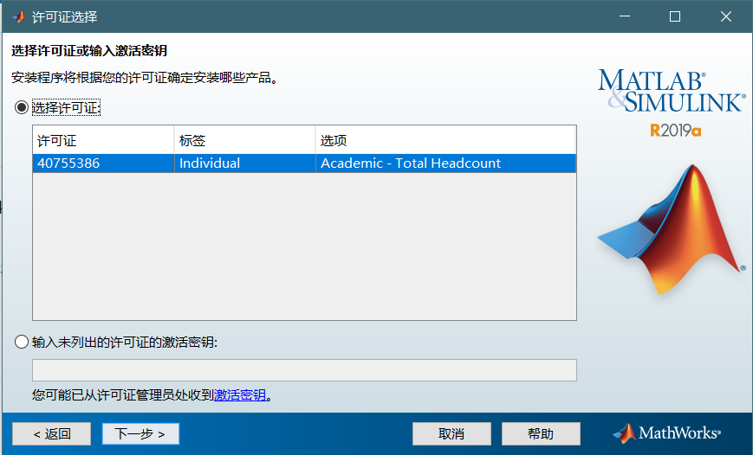
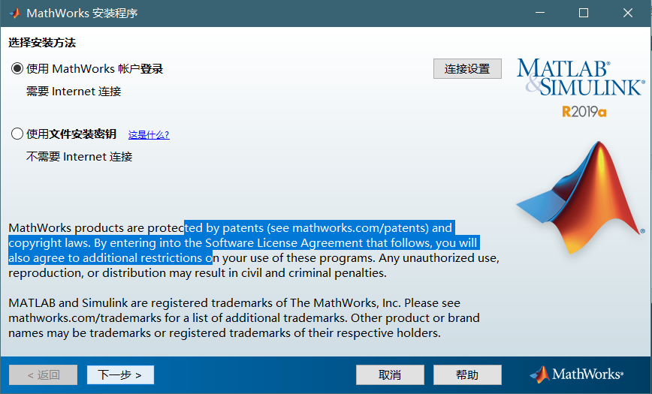

Slide 8
Getting started with MATLAB
The official document are listed on: https://ww2.mathworks.cn/help/matlab/index.html

Slide 9
Doc and help
Doc(‘sin’)
Doc(‘linspace’)
Doc(‘for’)
Doc(any function you are not familiar)

Slide 10
Task
Go through MATLAB official document ‘get started’.
The website is: https://www.mathworks.com/help/matlab/learn_matlab/desktop.html
(ungraded and nothing to submit)

