Slide 1





NIAGARA SUMMIT 2016 HYATT REGENCY, NEW ORLEANS MAY 15-17, 2016

Slide 2

PRE-EVENT
Rapid Driver Development with NDriver
Robert Adams Software Engineer - Tridium
Notes:
Greetings
I have worked Tridium for over 18 yrs - when I started we were developing r1
So I have been a part of the various evolutions of our product
I have developed a number of drivers including the Lonworks integration. I created ndriver – to make my life. I hope will also make yours easier.
In this session we will look at how to create a custom driver leverage functionality of ndriver.

Slide 3

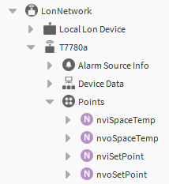
Driver Framework
Niagara can integrate anything
Core Niagara Driver Framework model
BNetwork
BDevice
BProxyPoints
Extensions
Notes:
We can integrate anything into Niagara
Do you have the protocol to talk to the device
Does it have data that can be expressed as Numeric/Boolean/String/Enum
Our customers need a consistent means to connect to various types of devices and access data in those devices
All the complexities of integrating to those devices should be hidden as much as possible from the end user
Niagara Drivers provide the functionality needed accomplish this
Core Niagara Driver Framework establishes a standard way to model devices and their data
Here we see a snippet of the component tree showing a lonworks network which uses this model
BNetwork models access to the particular field bus
BDevice models access to individual devices
Proxy Points normalize data
Various extensions to points or devices that provide support for other functions like alarm, histories
This abstraction has proven sufficient to model the vast array of particular field buses we encounter
The core Niagara Driver Framework is a high level view of devices and their data within a Niagara station

Slide 4
Extending the Driver Framework
Diversity of field buses
BasicDriver / DevDriver
NDriver
Tridium has been using NDriver internally
DevDriver and BasicDriver deprecated in N4
Recommend porting to NDriver
Notes:
As we began developing drivers we quickly saw that we were duplicating code for a number of the transport and linklayer functions. There was an opportunity to extend fw to implement common functionality
The various field buses are diverse but share common features
The message format and content is always different
There are common patterns for messaging
Response/response, acked, unacked, fragmented
A few basic choices for the physical transport layer cover the majority of fieldbus we have encountered
We made extensions to the driver framework to implement some of the common features.
We added Basic Driver and later Dev Driver
These served there purpose and customer build many drivers based on them.
We learned from our experience working with these extensions and continued experienced integrating other fieldbuses and later created Ndriver.
NDriver
Tridium has been using Ndriver internally for number of years
We recommend building new drivers on ndriver
DevDriver and basicDriver are deprecated but present in N4
We recommend porting drivers build on basicDriver and devDriver to ndriver

Slide 5
PRE-EVENT
NDriver Overview
Notes:
Lets take a high level look at Ndriver

Slide 6
Features
Customizable communication stack implementations
Easily extensible
Linklayer implementations
Keeps auto manager support from devDriver
Notes:
Features
Ndriver is an extension of the driver framework that provides customizable communication stack implementations. This customization is accomplished by overriding apis on BCommConfig and the message classes
Create an easily extensible framework
Easy to add new link layer implementations
Easy for developers to customize – does not constrain the user
Linklayer implementations
Serial, Udp, Tcp, Http
Other linklayer options can be added in the future
Keeps the auto manager support from devDriver
Provide a basic device and point manager view ( they are optional) (remember details will be later)

Slide 7
Overview
Application Layer
Application layer
Your code
NComm
NComm
Transport layer functions
Comm access
LinkLayer
Linklayer
Wraps low level driver support
Notes:
Overview (keep this brief – don’t repeat points from following slides)
To describe ndriver I use a 3 layer abstraction
Application layer
Where custom code goes – the driver specific functionality
What ever features you desired to configure or control the network of devices accessed by your driver.
Could be minimal – assume a functioning network
Could be full of featured like Lonworks or Bacnet.
Applications make use of the communication APIs.
NComm
NComm is the heart of ndriver
Implements transport and network layers functionality
Exposes access points to the application and interfaces with the link layer
Link layer
Provide a wrapper to hide complexities of native driver objects
Provides a common interface to ncomm for the various linklayer protocols

Slide 8
Application Layer
Application Layer
Adds minimal application layer functionality
Support auto manager views
NComm
LinkLayer
Notes:
Ndriver adds minimal application layer functionality
Support is provided for adding auto manager views – developers using the ndriver wizard can configure there driver to add auto views for device/point managers – can have none – can configure it these will support discovery
Adds an async worker to BNetwork – this is used so that operations requiring com access can run on a separate thread (this has been a common feature in most internally developed drivers)

Slide 9
NComm
Application Layer
Access points
Transport layer functions:
Transactions manager
Message timeout & retries
Message fragmentation
Calls application layer listeners
Concrete class
NComm
LinkLayer
Notes:
Provides the application layer access to communication services
SendRequest() - Sends messages and receive response
SendMessage() – sends message and returns
Registers listeners to receive incoming message
Implements transport layer functions:
Transaction management
Supports request/response messages, acknowledged messages, unacknowledged messages
Supports message timeout and retries
Supports sending and receiving fragmented messages
Supports registration of custom listeners for unsolicited messages and will route unsolicited messages to those listeners
NComm is a concrete class. It is not directly extensible. Its behaviours are customized by NMessage and CommConfig overrides. (Described later)

Slide 10
Link Layers
Application Layer
Implements ILinkLayer
Access native linklayer objects
Customization
Special functionality
Serial tunneling support
NComm
LinkLayer
Notes:
All link layers implement the ILinkLayer interface. Exposes a consistent api to NComm
Access native bus specific linklayer objects
for example the tcp/udp link provides access to java.net network objects
Serial provides access to com ports through Niagara’s serial platform service
It should be noted that the streaming protocol link (serial, tcp) layers always require customization. This is needed to provide message framing. (Described later)
Let me mentions a special functions supported in the serial link layer
SerialLinkLayer has apis to allow driver to support tunneling.
Serial tunneling allows a proprietary client application to communicate through a virtual serial port which tunnels traffic through a Jace to access devices on the connected field bus. A tunnel session requires that the virtual connection take over the serial port while active.

Slide 11
BCommConfig
Link Layer parameters
Houses message factories
Child of BNetwork
Manages lifecycle
FW - started() and stopped()
FW - changed()
BComm
Config
Application Layer
NComm
LinkLayer
Notes:
Performs a number of key functions to support the comm stack.
All comm stack implementations have an instance of BCommConfig
Exposes any configuration parameters needed for the particular link layer objects
Creates NMessage and LinkMessage factories
Usually Slotted under BDeviceNetwork - ( this is not a requirement, there are some exceptions
Your application objects will use BCommConfig to access NComm
It is a BComponent so it receives the fw life cycle call backs and uses these to manage the comm stack life cycle:
On started() will create NComm and linklayer instances.
On stopped() will shut down any comm resources
on fw changed() callback BCommConfig will make a verifySettings() call to NComm and linklayer to
linklayer will check for any changes that require update to link resources. If necessary will close and recreate these resources.
An example would be a on serial driver a change to the baudrate would result in an update to the serial port parameters. A change to com port selection would cause a restart
You will make few changes to BComConfig for you driver. In most cases the output of the wizard will be sufficient

Slide 12
Http
Application Layer
Http is a special case
does not use NComm
wrapper for net/HttpConnection
api consistent with NComm
HttpComm
net/HttpConnection
Notes:
IHttp is a special case
does not use NComm
a wrapper around objects in niagara net module to provide an api consistent with NComm
HttpComm implements the IComm just like NComm – this provides the lifecycle support. It has sendRequest() api but no sendMessage()

Slide 13
Auto Managers
Device & Point Manager
Customize with slotfacets
Optional
Mechanisms to support discovery
Notes:
A quick note on auto manger support – this was kept from devDriver.
It allows the quick creation of device and point manger views that are sufficient for most drivers.
These are customized by adding slotfacets to properties that are to show up in the manger views
You can still create your own if these are not sufficient
The auto mangers have mechanisms to support discovery.

Slide 14
Diagnostics
Spy & Statistics
Logging support
NMessage toTraceString()
Notes:
Ndriver has a number of diagnostic supports build in.
Spy & Statistics
Logging
Override NMessage toTraceString to provide a readable representation of message

Slide 15
PRE-EVENT
Developing with NDriver
Notes:
lets look at how to

Slide 16
Getting there quickly
Run the wizard
Implement messages
Customize mangers
Add you own functionality
Notes:
Always start with the wizard
Must always implement message classes and message factory
Must implement link layer message if streaming protocol
You may need to make so customizations to support you Auto manager classes for discover
Add functionality to your driver till your hearts content

Slide 17
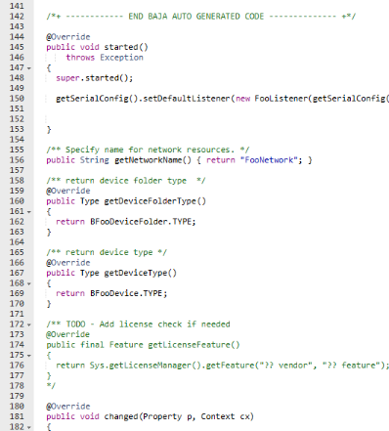
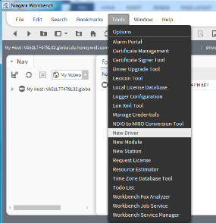
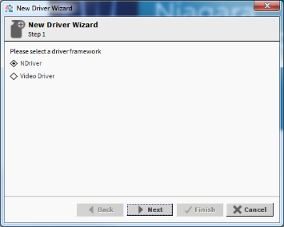
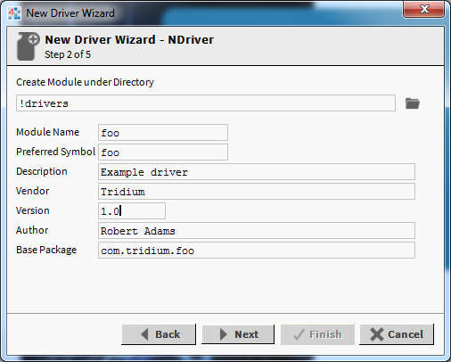
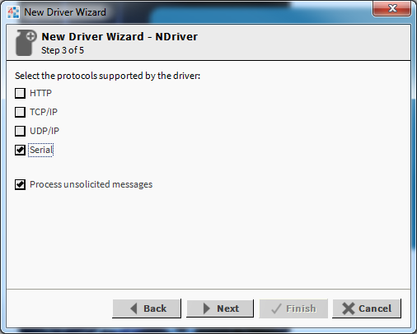
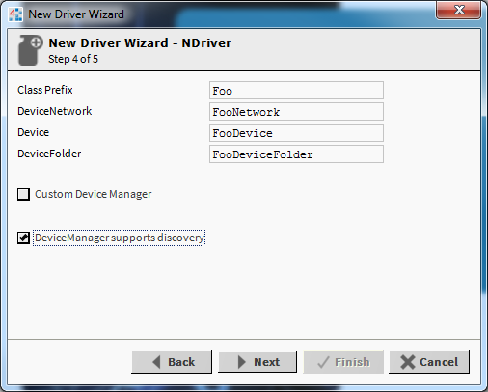
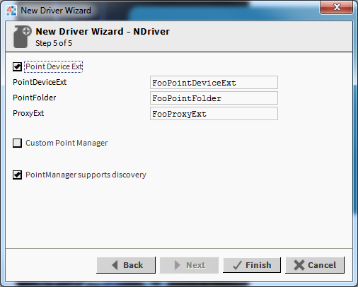
NDriver Wizard
Notes:
A quick walk through of the wizard
Access through tool bar
Select Ndriver
Fill in a name and vender for class path and class names
Select link layer
Custom manager will not include automanager
Well end up with set of class that should compile a number of TODO to quide you

Slide 18
Message Flow
Driver Application
ICommListener
NMessage
NMessage
NMessage
NComm
Link Message
Link Message
Link Layer
Notes:
First lets do basic overview of message flows
Lets look at the flow of a request response message
NMessage instance created by application
This will be passed to NComm which set up a transaction
You NMessage is used to crate a linkMessage which is sent to the linklayer and onto the wire
Response received by link
The LinkMessage will be converted to NMessage
NComm will math this to the original request
Return response to app
Lets look at the flow of an incoming message
The same steps of receive and creating NMessage
NMessage routed to a listener registered by the application

Slide 19
NMessage / LinkMessage
public class FooMessage extends NMessage {
int fooMsgType = MY_TYPE;
int tag;
int prop1;
float prop2;
fromInputStream (InputStream is)
toOutputStream (OutputStream os)
}
NMessage
Set of values
Many class
from/to stream methods
LinkMessage
Byte array
Single class
setMessage/receive
public class FooSerialLinkMessage extends LinkMessage
{
byte[] data;
setMessage (NMessage msg)
receive (InputStream is)
}
Notes:
NMessage is the application level view of the message
It contains set of attributes representing the data fields in your message.
LinkMessge is used by the linkLayer to send/receive the byte representation of the message to the wire
It wraps the byte data
You will likely create a hierarchy of NMessage base of your design preferences
I typically create a hierarchy based on how the messages decode
A base class that decodes the message fixed header
Etc …
There will be a single LinkMessage type
LinkMessage wraps a byte array representation of the message. It is used by the linklayer.
NMessage creation:
Instances of outgoing messages are created by you application code.
Instance of incoming messages are created by your custom message factor
Link message creation:
They are created solely by the Ndriver linkMessage factory. This allows for certain optimisations as I can maintain a pool of messages and reuse them
NMessage has two apis used to support conversion from/to LinkMessage byte array
LinkMessage has two apis to support obtaining the byte data from NMessage or the lower level objects

Slide 20
Typed Streams
public class TypedInputStream extends java.io.ByteArrayInputStream
{
public boolean readBoolean() public int readUnsigned8() public int readUnsigned16()
public long readUnsigned32() public int readSigned8() public int readSigned16() public int readSigned32() public long readSigned64() public int readBit(int byteOffset, int bitOffset, int bitCount) public int readSignedBit(int byteOffset, int bitOffset, int bitCount) public boolean readBooleanBit(int byteOffset, int bitOffset, int bitCount) public String readString() public String readCharArray(int len) public float readFloat() public double readDouble()
}
public class TypedOutputStream extends java.io.ByteArrayOutputStream { public void writeBoolean(boolean b) public void writeUnsigned8(int i) public void writeUnsigned16(int l) public void writeUnsigned32(long i) public void writeSigned8(int i) public void writeSigned16(int l) public void writeSigned32(int i) public void writeSigned64(long lval) public void writeByteArray(byte[] byteArray) public void writeByteArray(byte[] byteArray, int count) public void writeCharArray(String str, int count) public void writeString(String str) public void writeBit(int val, int byteOffset, int bitOffset, int bitCount) public void writeSignedBit(int val, int byteOffset, int bitOffset, int bitCount) public void writeFloat(float value) public void writeDouble(double value)
}
Notes:
Before we look at some code snippets let me introduce to Type Streams
Again this is something that a I created to make my life simpler
I use these in the NMessage from/to stream api
These are byteArray streams with read/write primitive apis
Handles bit fields – even signed bit (who would use signed bit field – I obviously encountered it some where – if the guilty party is here raise your hand are here raise your hand)
There is an outputStream version with symmetrical apis
It makes the code more readable – I find much easier to catch errors (that’s a u8 and used u16)

Slide 21
Customizing NMessage
//
// Set x,y coordinate in device
//
FooMove msg = new FooMove();
msg.setX(10);
msg.setY(23);
msg.setTag(getNextTag());
msg.setAddress(myAddress());
FooMoveResp resp = ncomm().sendRequest(msg);
public boolean toOutputStream(OutputStream out)
throws Exception
{
TypedOutputStream tout = new TypedOutputStream();
tout.writeUnsigned8(msgType);
tout.writeUnsigned8(msgTag);
tout.writeSigned16(xCord);
tout.writeSigned16(yCord);
tout.toOutputStream( out );
}
App
NMessage
NComm
Link Message
Link Layer
Notes:
Lets go back to our message flow and l look at examples of the customization on NMessage
This a code fragment from an application class which will send a message
Set custom data
Set tag
Set Address
Send to ncomm
A link message is obtained which gets the byte representation of the nmessage with a callback to NMessage
Lets look at the processing of the incoming message
…
The main point here is that particular driver implementation completes this functionality with overrides of NMessage subclasses

Slide 22
NMessage Basics
public class FooMessgeFactory
{
public NMessage makeMessage(LinkMessage lm)
throws Exception
{
TypedInputStream tin = new TypedInputStream(lm.getByteArray());
int type = tin.readUnsigned8();
// tin.reset();
FooMessage msg;
switch(type)
{
case FOO_WRITE_RESP:
msg = new FooWriteResp();
msg.fromInputStream(tin);
return msg;
….
public void fromInputStream(InputStream in)
throws Exception
{
TypedInputStream tin = (TypedInputStream)in;
x = tin.readUnsigned8();
y = tin.readSigned16();
z = tin.readFloat();
b3 = tin.readBit(7,5,3);
b2 = tin.readBit(7,3,2);
}
Boolean isResponse() { return true; }
App
NMessage
NComm
Factory
Link Message
Link Layer
Notes:
Lets look at the processing of the incoming message
…
The main point here is that particular driver implementation completes this functionality with overrides of NMessage subclasses.

Slide 23
LinkMessage
public boolean receive(InputStream in)
{
OutputStream os = getOutputStream();
// Read byte data from input stream
while(!done)
{
int x = in.read();
if(x<0) return false; // Check for end of stream
char n = (char)x;
if(n==BEGIN_CHAR) read=true; // Search for beginning of message
if(!read) continue;
// Check for end
if(n==END_CHAR) done=true;
// Write char to stream
os.write(n);
}
return true;
}
public boolean setMessage(NMessage msg) { byte[] b = new byte[MAX_LINK_MSG_LEN]; TypedOutputStream to = new TypedOutputStream(b); msg.toOutputStream(to); int msgLen = to.size(); OutputStream os = getOutputStream(); os.write(BEGIN_CHAR); for (int i = 0; i < msgLen; ++i) { os.write(b[i]); } os.write(END_CHAR); return false;
}
Notes:
Custom code is needed for streaming protocols
For a message based protocol like UDP no linkMessage customizing is needed.
This code fragment is an example of receive() override to mark the beginning and end characters in the stream
This code fragment for the outgoing side that adds the beginning and end markers
This is a very simple example and the code will not compile – it had fit on slide.
This is the point in the code where you handle link message particulars like adding a crc code or escape characters.

Slide 24
CommConfig
public class BFooSerialCommConfig extends BSerialCommConfig
{
/** Override to allow only 1 outstanding transaction. */
public int getMaxOutstandingTransactions() { return 1; }
/** Always need message factory. */
public IMessageFactory makeMessageFactory(){
return new NfooMessageFactory();
}
/** Provide custom LinkMessage factory. */
protected NLinkMessageFactory makeLinkMessageFactory()
{
return new NLinkMessageFactory(512)
{
protected LinkMessage createLinkMessage()
{
return new NfooLinkMessage(512);
}
};
}
}
Notes:
This is an example BCommConfig object
The getMaxOutstandingTransactions has been overridded to return 1
All other code is as generated by the wizard

Slide 25
Message Fragmentation
Can send/receive fragmented message
Outgoing fragmented through NMessage.toOutputStream()
return true while more fragments remain to be written
Incoming messages must implement IFragmentable and override NMessage.isFragmentable()
Implement getHash() and merge() apis
Notes:
Message fragmentation is supported on the send or receive side.
For outgoing messages this is handled in NMessage.toOutputStream
When we output a message to be fragmented toOutputStream will only write data for one fragment to the stream at a time and then return true as long as we have additional data to write.
For incoming messages the process is a bit more complicated. Any message type that can be received in fragments must implement IFragmentable.
This interface has a getHash to allow us to match fragments for the same message and a merge() api to append the latest fragment.
The main thing to remember is fragmentation implemented by customization of your NMessage subclasses

Slide 26
Auto Managers
@NiagaraType @NiagaraProperty(name = "prop1", type = "BFooType", defaultValue = "new BFooType()"
) // include slot with edit and readonly flag set @NiagaraProperty (name = "prop2", type = "BFooType", defaultValue = "new BFooType()", facets = { @Facet("SfUtil.incl(SfUtil.MGR_EDIT_READONLY)") } ) // include slot with edit and unseen flag set and additional slotfacets @NiagaraProperty (name = "prop3", type = "BFooType",
defaultValue = "new BFooType()", facets = { @Facet(name = BFacets.UNITS, value = "BUnit.getUnit(\"fps\")"), @Facet (name = BFacets.MIN, value = "1"), @Facet (name = BFacets.MAX, value = "30"), @Facet (name = BFacets.RADIX, value = "10"), @Facet ("SfUtil.incl(SfUtil.MGR_EDIT_READONLY)") } )
class BMyDevice
{
}
Notes:
This is a code fragment that demonstrates how to add slot factets that will designate properties to add to device manager view
It uses the annotation scheme that is new N4

Slide 27

Example Driver
Notes:
Lets look at an example driver I did to demonstrate the ease of developing Ndriver.
This is for sphero hobby robot ball
Took about 8 hours to find and digest the protocol, create a driver that would move the ball (Disclaimer – once I started trying to enhance the UI minimally I burned up more time –but that’s beside the point)

Slide 28
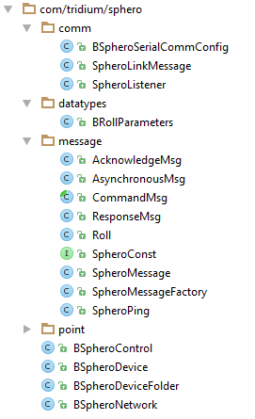
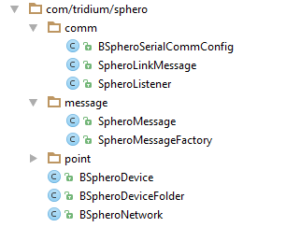
Generated vs Implemented

Slide 29
Message Hierarchy
NMessage
SpheroMessage
CommandMsg
ResponseMsg
AsynchronousMsg
Ack
Roll
PingMsg

Slide 30
Implementation
Sphero Messages
CommandMsg, ResponseMsg, Roll, SpheroPing, AsynchronousMsg, AcknowledgeMsg
BSpheroLinkMessage
Implementes receive() and setMessage() for message framing and checksum
BSpheroMessageFactory
Translate incoming Link Messages to NMessages
BSpheroSerialCommConfig
Max Outstanding Transactions fixed to 1

Slide 31
Documents
NDriver Comm Guide
NDriver Wizards Guide
NDriver Managers Guide
NDriver Design Patterns Guide
To access:
https://software.niagara-central.com
Login
Search for ndriver
See link to Niagara Ndriver Technical Documents
PRE-EVENT

