Slide 1
Required Workshop Content
If you have not already, go to
http://www.github.com/ChristianWeeks/d3-LessonPlan
and download the files by clicking Download ZIP on the right hand side. Extract them to a folder of your choosing.
If you are familiar with git, you may also clone the repository using the command
git clone https://github.com/ChristianWeeks/d3-LessonPlan.git

Slide 2
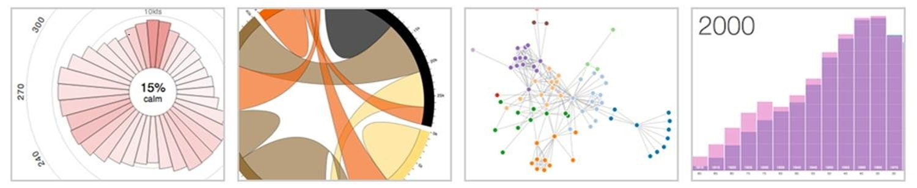
Introduction to Data Visualization on the Web using D3.js

Slide 3
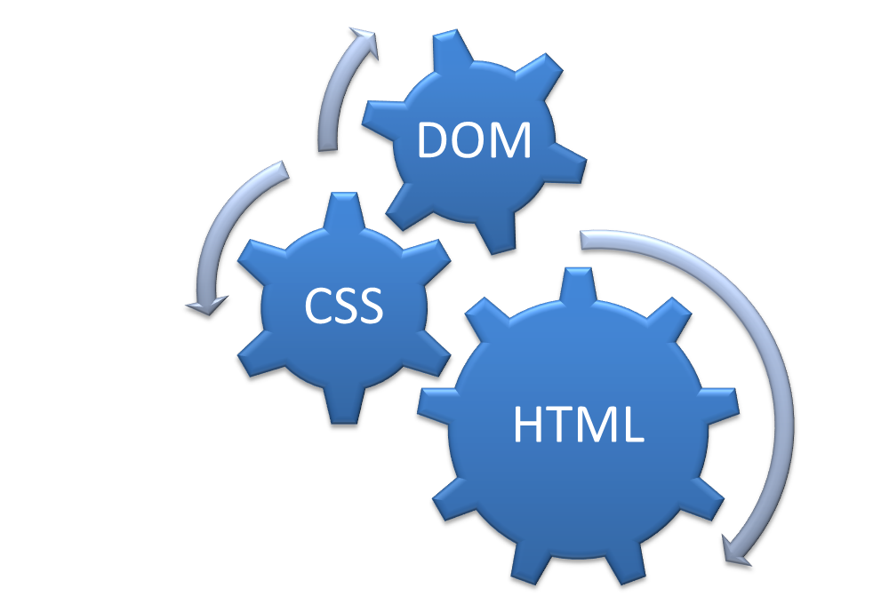
Building Blocks
Familiarity with HTML, the DOM, and CSS

Slide 4
Building Blocks (cont’d)
Familiar with HTML, the DOM, and CSS
Minor Programming Experience
<html>
<head>
<title>My title</title>
</head>
<body>
<h1>My header</h1>
<p>Hello World!</p>
</body>
</html>

Slide 5
Building Blocks (cont’d)
Familiar with HTML, the DOM, and CSS
Have a little programming experience already
Have written in JavaScript before
<script
type="text/javascript">
</script>

Slide 6
About D3.js
Data Driven Documents
D3.js is a JavaScript library for visualizing documents based on data.
Is just one option for information visualization in the browser
Can be used for any form of visualization, but most often used with Info Vis
http://d3js.org/
Notes:
D3 helps you bring data to life using HTML, SVG and CSS. D3’s emphasis on web standards gives you the full capabilities of modern browsers without tying yourself to a proprietary framework, combining powerful visualization components and a data-driven approach to DOM manipulation.
D3.js is just one option for information visualization in the browser, and allows you to build a wide variety of rich interactive elements in your website
6

Slide 7
About D3.js
Insightful Visual Representation
Data
Data Type | Value
Boring | …
Boring | …
Boring | …
D3.js
Notes:
D3 helps you bring data to life using HTML, SVG and CSS. D3’s emphasis on web standards gives you the full capabilities of modern browsers without tying yourself to a proprietary framework, combining powerful visualization components and a data-driven approach to DOM manipulation.
D3.js is just one option for information visualization in the browser, and allows you to build a wide variety of rich interactive elements in your website
7

Slide 8
Examples
2012 Election County Political Shifts
US Gay Marriage Laws, State by State
2012 Paths to the Presidency
Live Global CyberAttacks

Slide 9
Developer Tools
Developer Tools are used to analyze and debug web code. They are built into almost all major web browsers.
All print statements and errors are printed here
To Access:
Chrome:
Chrome Menu → Tools
→ Developer Console
Or:
(CTRL + Shift + I)
(CTRL + Shift + J)
FireFox:
Menu → Tools
→ Developer → Web Console
Or:
(CTRL + Shift + K)
IE:
(F12)
(Don’t use IE over FireFox or
Chrome)

Slide 10
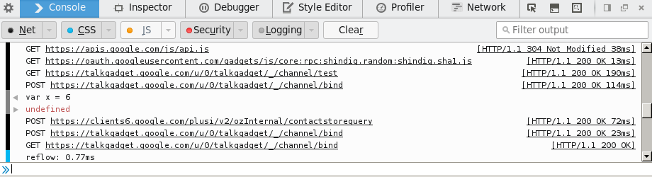
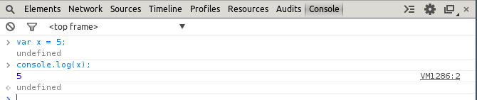
Developer Tools (cont'd)
Two main tabs we will work with:
Elements / Inspector– displays raw, up to date html
Console – Acts similar to a terminal – errors and print statements are
written here. Allows scripts to be written directly in web browser
Firefox
Chrome

Slide 11
Javascript Resources
CodeAcademy Tutorial
HTML Dog Tutorial
General Javascript, HTML, DOM Reference
Mozilla Javascript Reference

