Slide 1
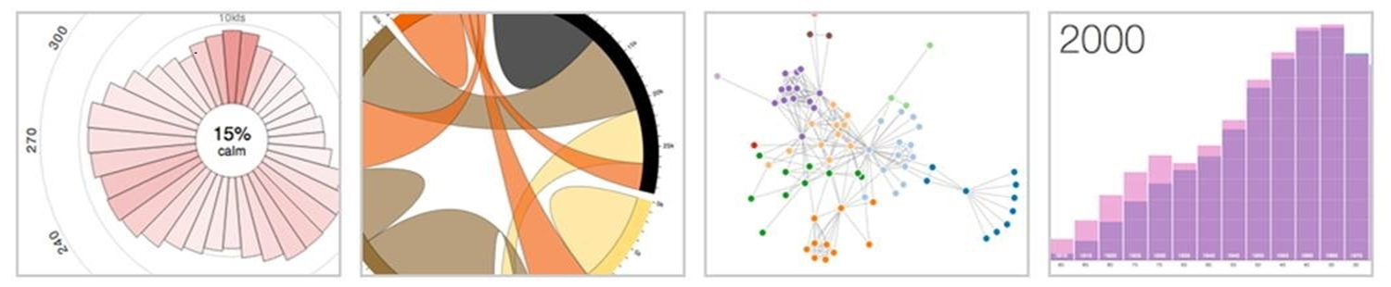
Introduction to Data Visualization on the Web using D3.js

Slide 2
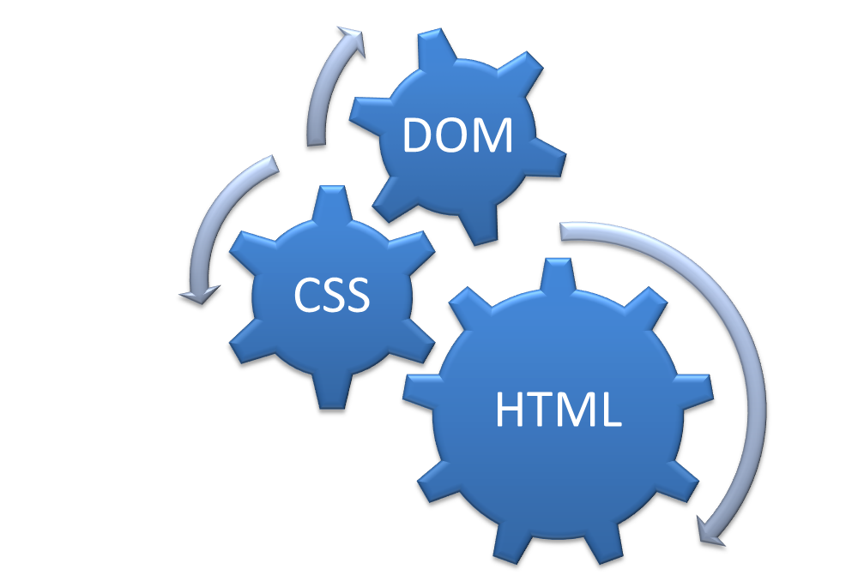
Assumption #1
Familiar with HTML, the DOM, and CSS

Slide 3
Assumption #2
Familiar with HTML, the DOM, and CSS
Have a little programming experience already
<html>
<head>
<title>My title</title>
</head>
<body>
<h1>My header</h1>
<p>Hello World!</p>
</body>
</html>

Slide 4
Assumption #3
Familiar with HTML, the DOM, and CSS
Have a little programming experience already
Have heard of jQuery or written some JavaScript before
<script
type="text/javascript">
</script>

Slide 5
<number>
About D3.js
Data Driven Documents
D3.js is a JavaScript library for visualizing documents based on data.
Is just one option for information visualization in the browser
Can be used for any form of visualization, but most often used with Info Vis
http://d3js.org/
Notes:
D3 helps you bring data to life using HTML, SVG and CSS. D3’s emphasis on web standards gives you the full capabilities of modern browsers without tying yourself to a proprietary framework, combining powerful visualization components and a data-driven approach to DOM manipulation.
D3.js is just one option for information visualization in the browser, and allows you to build a wide variety of rich interactive elements in your website
<number>

Slide 6
Examples
2012 Election County Political Shifts
Building Hamiltonian Graphs
US Gay Marriage Laws, State by State
2012 Paths to the Presidency

Slide 7
Developer Tools
Developer Tools are essential for analyzing and debugging code in web development.
Built into all major web browsers
To access:
Chrome:
Chrome Menu → Tools → Developer Console
Or:
(CTRL + Shift + I)
(CTRL + Shift + J)
FireFox:
Menu → Tools → Developer → Web Console
Or:
(CTRL + Shift + K)
IE:
(F12)

Slide 8
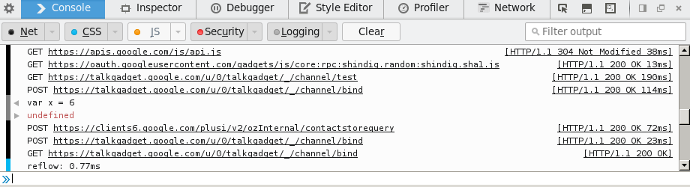
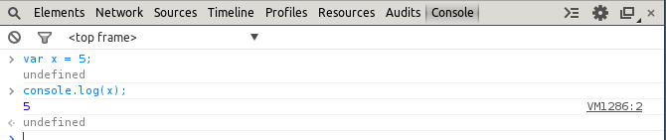
Developer Tools (cont'd)
Two main tabs we will work with:
Elements / Inspector– displays raw, up to date html
Console – Allows scripts to be written directly in web browser
Firefox
Chrome

Slide 9
Javascript Syntax Briefer
Syntactically similar to C family of languages – conditionals, loops, functions, comments follow similar syntax
If Statements:
if(conditional == true){
…
}
else{
…
}
For Loops:
for(i = 0; I < 100; ++i){
…
}
Functions:
function pointlessAdd(a, b){
var c;
c = a + b;
return c;
}

Slide 10
Javascript Syntax Briefer (cont'd)
Javascript is a weakly typed language, meaning variable types are mutable and syntax errors are sometimes forgivable
Don't forget your semicolons!
Variable Declaration and Types
var a; //undefined
var b = 5; //number
var c = true; //boolean
var d = “Hello!” //string
b = d; //No error! b is now a string

Slide 11
Javascript Syntax Briefer (cont'd)
Javascript is a weakly typed language, meaning variable types are mutable and syntax errors are sometimes forgivable
Don't forget your semicolons!
Variable Declaration and Types
var a; //undefined
var b = 5; //number
var c = true; //boolean
var d = “Hello!” //string
b = d; //No error! b is now a string

Slide 12
Javascript Syntax Briefer (cont'd)
Declaring Arrays
var empty = new Array(); //creates an array of size 0
var empty2 = [];
var empty3 = new Array(5); //creates an empty array of size 5 (values are undefined)
var notEmpty = [5]; //creates an array of size 1 with a value of 5
var notEmpty2 = [1, 2, 3, 4, 5]; //array of size 5 with initialized values
console.log(notEmpty[0]); //5
console.log(notEmpty2[3]); //4

Slide 13
Javascript Syntax Briefer (cont'd)
Declaring Objects
var empty = {}; //creates a new empty object
var empty2 = new Object(); //same as above
Var car = {};
car.make = “Nissan”; //adding attributes
car.model = “Maxima;
car.year = “1998”;
Var car = { make: “Nissan”,
model: “Maxima”,
year: “1998”};

