Slide 1




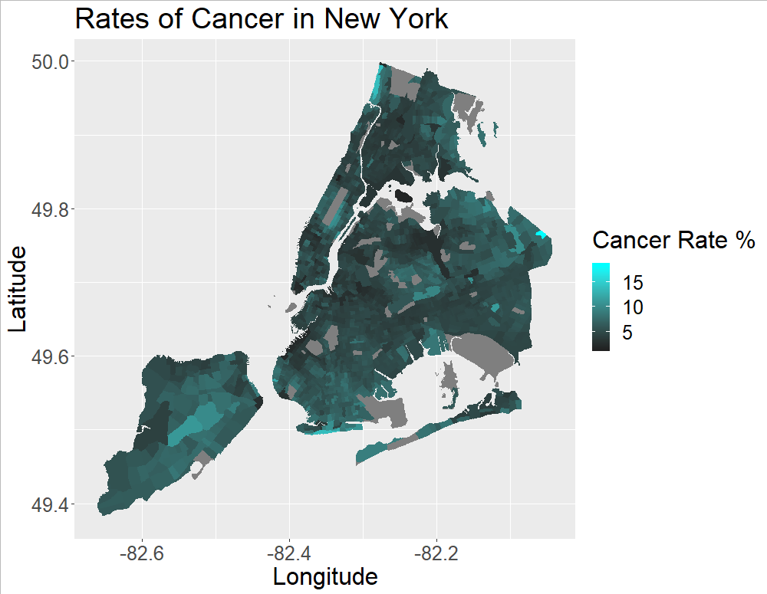
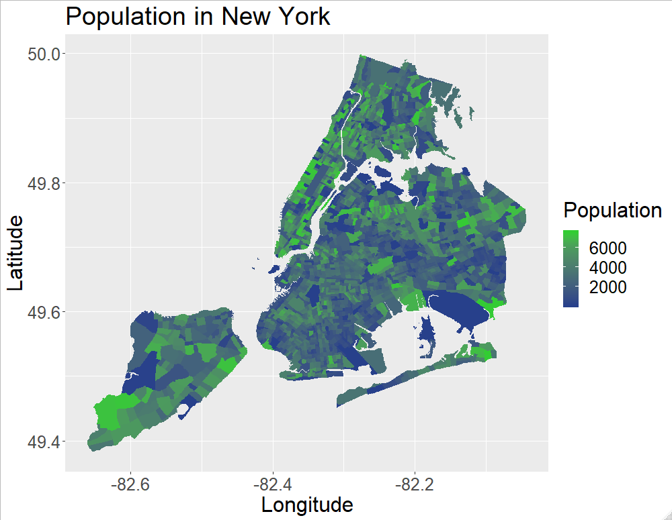

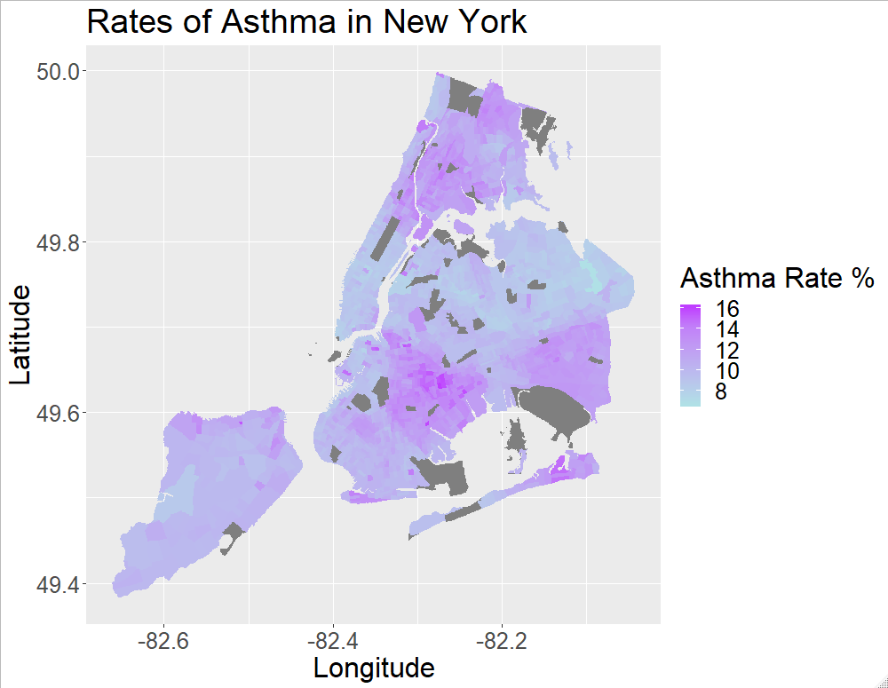
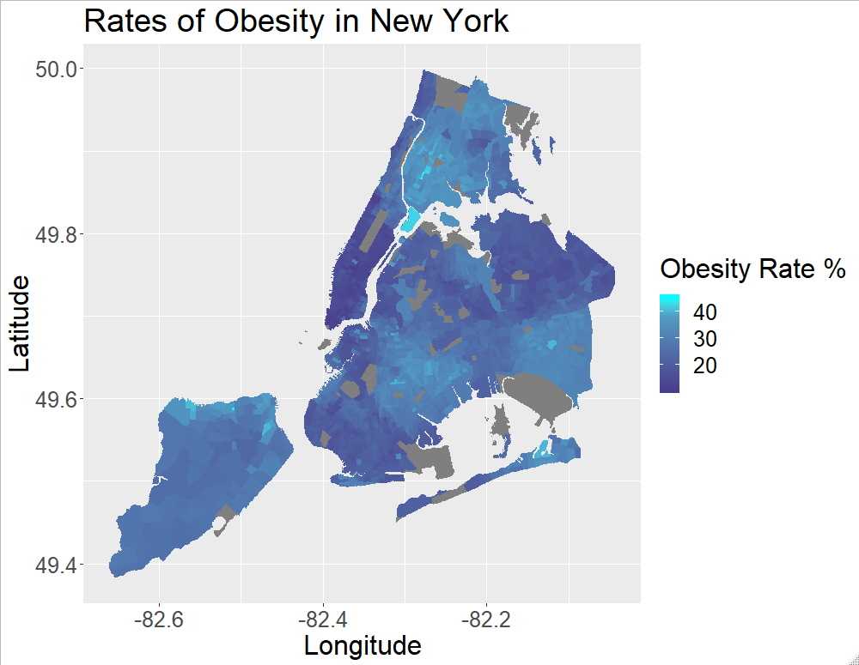
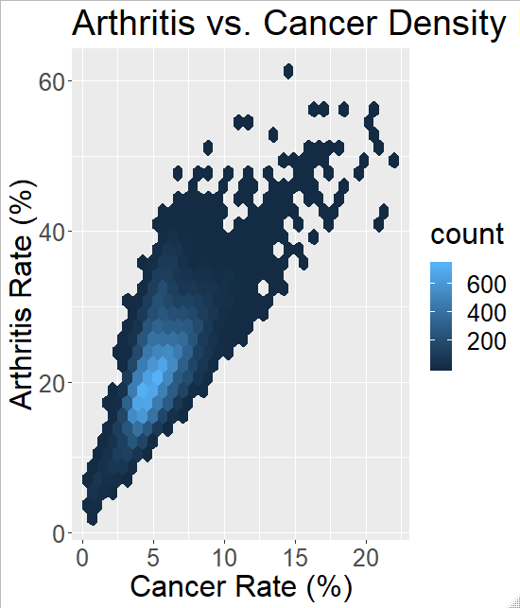
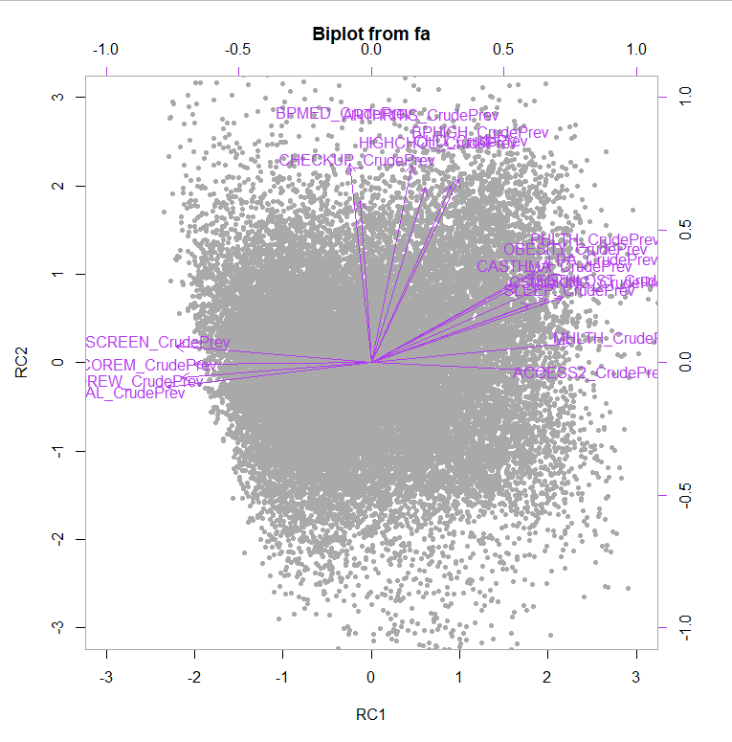
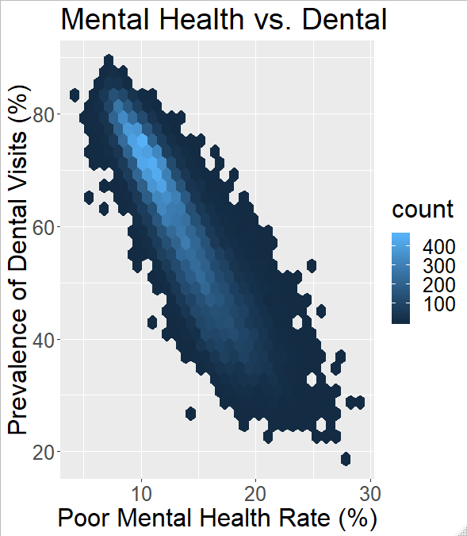

The Influence of Population on Disease in U.S. Cities
Christian Wesselborg ^{(wessec@rpi.edu)}
(Rensselaer Polytechnic Institute 110 8th St., Troy, NY, 12180 United States)
Abstract
Data Exploration
Urban populations are dense. Concentration of living spaces, contact and exposure to chemicals and pollutants occur in higher concentration where humans build cities. Businesses and consumers demand goods, food, cars, and energy. When this happens on a condensed scale, pollution accumulates. Los Angeles, Beijing, and far more suffer from poor air quality. Poor air quality may have an effect on pulmonary illness rates such as asthma. Chemical pollutants may contribute to disease rates such as cancer. The collective effect of these carcinogens, irritants, and particulates may be a general increase in the prevalence of health conditions in United States cities that have large, dense populations. This project will use population as a proxy for general pollution and chemical exposure that high population cities may have.
By analyzing data on disease rates in cities across the United States an insight into correlations, links, and relationships may be discovered. With this information city planners as well as city officials may make better decisions regarding the government of cities for the benefit of the people who live in them. The CDC collects the rates of illnesses and other measures of public health in the 500 cities data set used in this project.
2
3
Background
4
5
Figure 1: Los Angeles suffers from smog that settles in the valley.
Figure 2-5: Examples of variables using New York as a model city. Population does not seem to correlate with the example variables. Asthma and obesity share a very similar distribution. Investigating the underlying factors that contribute to this correlation are explored in the model.
Data Set
Model Development
500 Cities: Census Tract-level Data (GIS Friendly Format), 2018 release
Data collected 2015-2016, population from 2010
Provided by the CDC, updated December 4, 2018
27,000 observations of 27 variables related to health conditions and disease
Supplementary data set with spatial data can be used to construct maps
Age Variables:
Arthritis
Blood pressure medication
Coronary Heart Disease
High Blood Pressure
High Cholesterol
Stroke
Cancer
Chronic Kidney Disease
Socio-economically disadvantaged group variables:
Dental care
Mental health
Colon screening
Teeth loss
Women’s core health, preventative services
Low physical activity
Men’s core health, preventative services
Poor physical health
Access to health care
Smoking
Cholesterol screening
Obesity
Sleep deprivation
Asthma
Hypothesis
A city with higher population will have a higher prevalence of health conditions proportional to the population. Exploring the 500 cities data set from the CDC will provide the information to conclude on the hypothesis.
Figure 6: Arthritis rate against cancer rate.
Method
Figure 8: A biplot to represent the factor analysis. A result that separates the variables, arrows, at 90 degree intervals is indicative of a successful result. Note that this representation does not include every variable in the final factor analysis in order to represent the result in a visually meaningful way and highlight the outcome of the model.
Clean data:
Combine into total city level data
Explore the data:
Map generation and regressions
Develop a model:
Principal Component Analysis
Glossary:
RPI – Rensselaer Polytechnic Institute
TWC – Tetherless World Constellation at
Rensselaer Polytechnic Institute
CDC – Center for Disease Control and Prevention
Github Repository
Figure 7: Dental visit rate against mental health.
Conclusions
Population does not appear to be a clear contributing factor of disease rates in U.S. cities, but a strong conclusion can not be made with this data set.
Including population density, wealth, age, and likely more would be necessary in future work investigating this topic.
The two primary factors of illness and the health variables tested for are, age, and a disadvantaged, under-covered, under-treated group.
This was corroborated by the combined city data providing a similar result.
A third factor was observed that grouped mammography rate and pap-test rate.
Acknowledgments:
Professor Thilanka Munasinghe
Center for Disease Control and Prevention
Figure 1 - https://www.nlc.org/sites/default/files/field/image/la-smog.jpg

