Slide 1

Parallel Programming -Final Project- N-Body Simulation
Team 20
Team Leader: 113062529 鄭凱元
Team Members: 113062580 林宇凡 113062627 陳奕安

Slide 2

Outline
Introduction
Implementation
Serial CPU Optimization
OpenMP
Hybrid (MPI + OpenMP)
NVIDIA CUDA Implementations
Shared Memory
Structure of Arrays
Block Size Tuning
Experiments, Profiling & AMD HIP Porting

Slide 3
Introduction
Problem: N-Body Simulation. Compute all-pairs gravitational forces between N particles and update positions/velocities over T timesteps.
Computational Complexity:
Per timestep: O(N²) force evaluations.
Whole simulation: O(T · N²).
End-to-end runtime includes Compute + Memory Traffic + I/O (Trajectory Dump).

Slide 4
Introduction
Goal of this Project:
Speedup the simulation on CPU using:
Serial CPU Optimizations (baseline improvements)
OpenMP (threaded)
MPI + OpenMP (distributed + threaded hybrid)
Speedup the simulation on GPU using:
Naïve NVIDIA GPU GTX 1080 Optimizations (baseline improvements)
Shared Memory
Structure of Arrays
AMD MI100 Porting

Slide 5

Implementation
Program Structure (Common Pipeline)
Input / initialization: Parse N, total_time, dt, dump_interval, allocate bodies & buffers.
Core compute: compute_acceleration() : all-pairs force accumulation O(N²).
Time integration: step_leapfrog() : update v($t+\frac{1}{2}$ ) (Velocity) → x($t+1$) (Position) → a($t+1$) (Acceleration) → v($t+1$) (Leapfrog).
Trajectory output: Periodic CSV dump (controlled by dump_interval ).

Slide 6
Implementation
Execution Environments
CPU demo: Origo Cluster
GPU demo: Apollo Cluster
Input/Output
Input:
Simulation parameters (N: number of particles, total_time: total simulated time, dt: time step size, dump_interval: output frequency (in timesteps))
Initial state (Position, Velocity, Mass) (per particle)
Output:
Trajectory data (Positions and velocities of all particles over time).

Slide 7
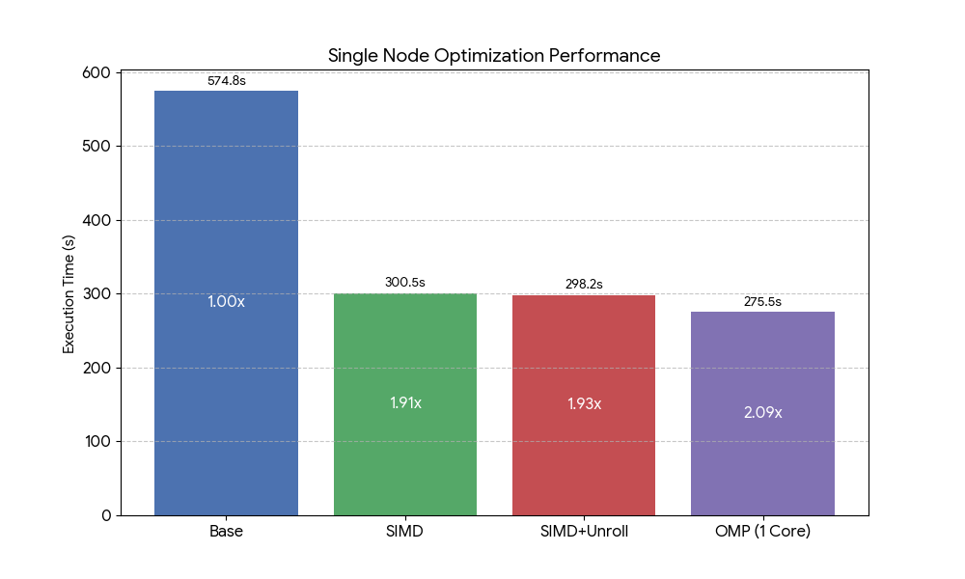
Serial CPU Optimization
Base
Naive serial implementation, AoS DataStruct.
Used as baseline (1.00×).
SIMD
Use vector instructions (SSE2) to compute multiple interactions per iteration.
Improve instruction-level parallelism.
~1.9× speedup.
SIMD + Unroll
Further loop unrolling to reduce loop overhead.
Better instruction scheduling and pipeline utilization.
Slight additional speedup over SIMD.
OMP (1 Core)
Enable OpenMP but restrict to single thread.
Performance slightly better due to compiler optimization.

Slide 8
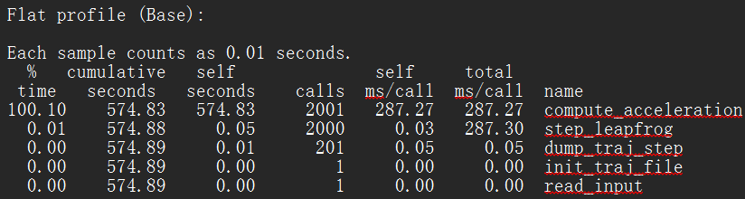
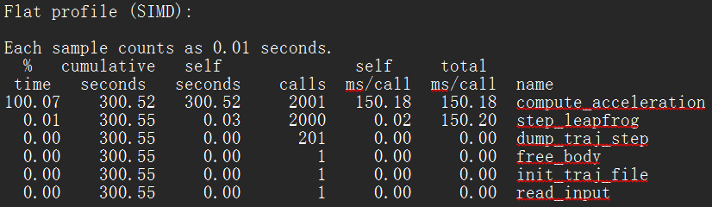
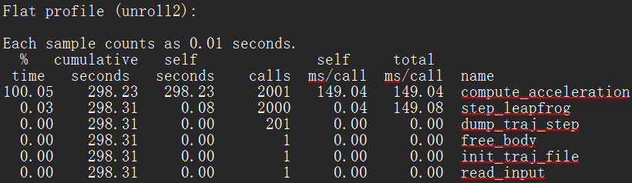
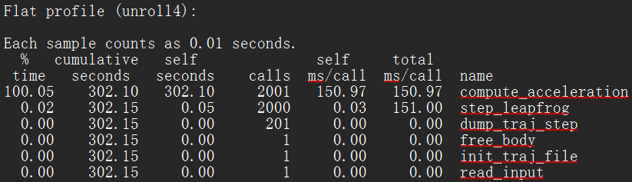
Profiling (N = 4096)
Profiler: gprof
Observation:
compute_acceleration() dominates runtime. Other components are negligible.
Key Takeaways:
Performance improvement comes almost entirely from optimizing the O(N²) force computation.
Loop unrolling shows diminishing returns beyond a certain point

Slide 9
Speedup Table
Version | Time (s) | Step Speedup | Cumulative Speedup | 說明
Base | 574.83 | — | 1.00x | Baseline (原始版本)
SIMD | 300.52 | 1.91x | 1.91x | 加入 SSE 向量化
SIMD + Unroll | 298.23 | 1.01x | 1.93x | 額外進行 Loop Unrolling (提升微小)
OMP (1 Core) | 275.50 | 1.08x | 2.09x | OpenMP (-c1)

Slide 10
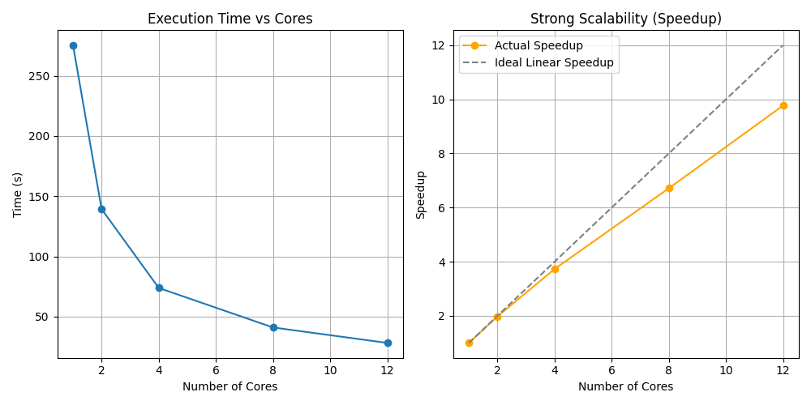
OpenMP Strong Scalability
Execution Time
Runtime decreases significantly as core count increases
From ~275 s (1 core) to ~28 s (12 cores)
Speedup
Achieves near-linear speedup up to moderate core counts
~9.8× speedup on 12 cores (ideal: 12×)
Reasons
Workload dominated by O(N²) compute_acceleration
Minimal synchronization and OpenMP overhead
Limitations
Deviation from ideal scaling due to
Memory bandwidth contention
OpenMP scheduling and synchronization overhead
Setup
Fixed problem size (N = 4096)
Vary number of CPU cores (1 → 12)
Measure strong scalability

Slide 11
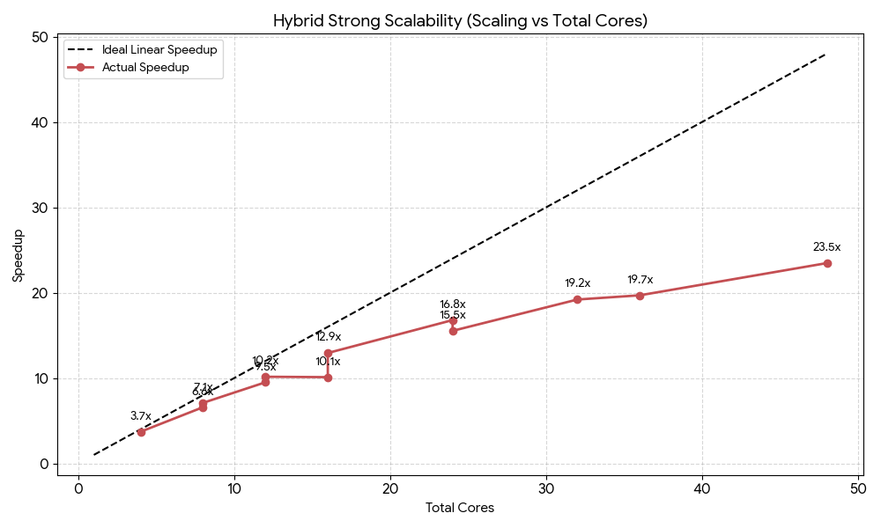
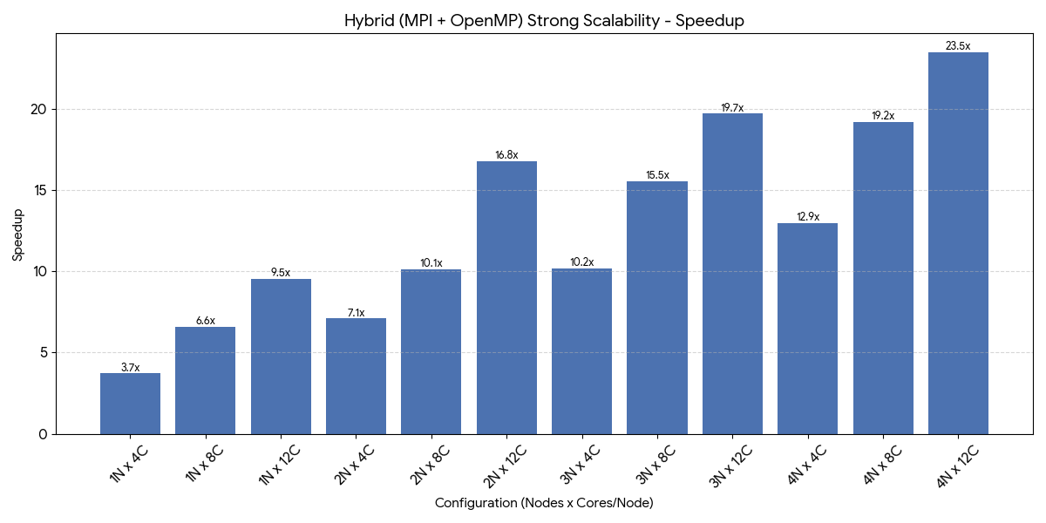
Hybrid Strong Scalability
Configuration | Total Cores | Time (s) | Speedup | Efficiency | 說明
1N x 4C | 4 | 74.20 | 3.71x | 92.8% | 單節點基準
1N x 8C | 8 | 41.83 | 6.59x | 82.3%
1N x 12C | 12 | 28.99 | 9.50x | 79.2% | 單節點最強效能
2N x 4C | 8 | 38.83 | 7.10x | 88.7% | 跨節點 (低通訊壓力)
2N x 8C | 16 | 27.26 | 10.11x | 63.2%
2N x 12C | 24 | 16.41 | 16.79x | 70.0% | 雙節點滿載
3N x 4C | 12 | 27.14 | 10.15x | 84.6%
3N x 8C | 24 | 17.74 | 15.53x | 64.7%
3N x 12C | 36 | 13.99 | 19.69x | 54.7% | 效率開始下降 (通訊佔比增高)
4N x 4C | 16 | 21.30 | 12.93x | 80.8%
4N x 8C | 32 | 14.35 | 19.20x | 60.0%
4N x 12C | 48 | 11.74 | 23.47x | 48.9% | 最高效能 (Peak Speedup)

Slide 12
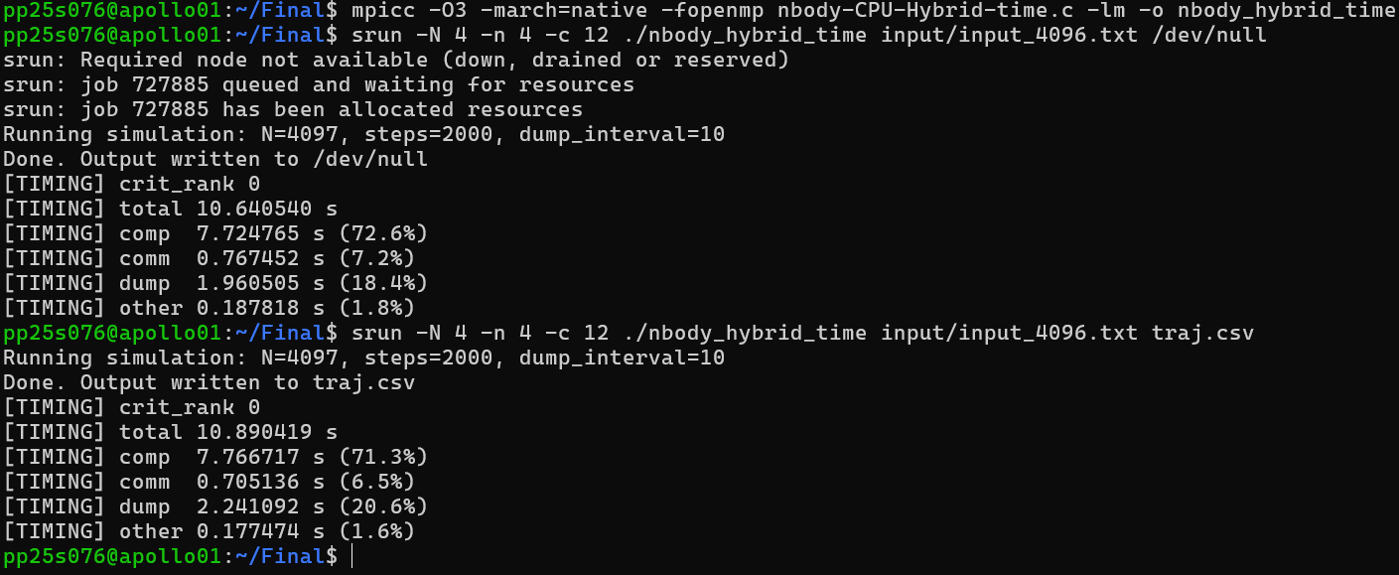
Execution Time Breakdown (MPI + OpenMP, N = 4096)

Slide 13
CUDA and GPU Implementations
Baseline Version (Baseline)
Baseline w/ Shared Memory using Tiled Block of Size 256 (SM, B=256)
SM w/ Structure of Arrays Memory Storage Pattern (SoA, B=256)
SoA w/ Tiled Block Size Tuning (SoA, B=64)
CUDA version directly ported to AMD HIP version (AMD-Ported)
Profiled w/ nvprof at N = 2048

Slide 14
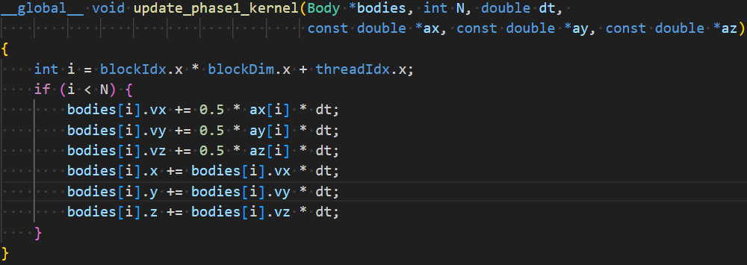

GPU Baseline
Update v($t+\frac{1}{2}$ ) (Velocity) → x($t+1$) (Position) → a($t+1$) (Acceleration)
→ v($t+1$) (Leapfrog).

Slide 15
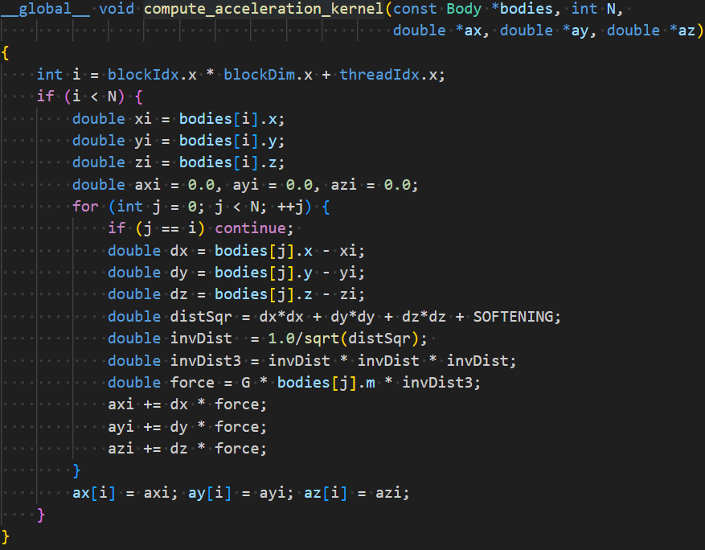

GPU Baseline
Update v($t+\frac{1}{2}$ ) (Velocity)
→ x($t+1$) (Position)
→ a($t+1$) (Acceleration)
→ v($t+1$) (Leapfrog).

Slide 16
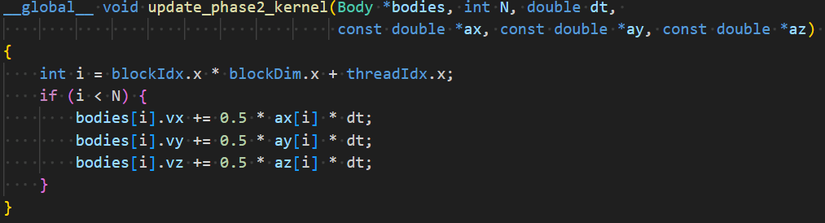

GPU Baseline
Update v($t+\frac{1}{2}$ ) (Velocity) → x($t+1$) (Position) → a($t+1$) (Acceleration) → v($t+1$) (Leapfrog).

Slide 17
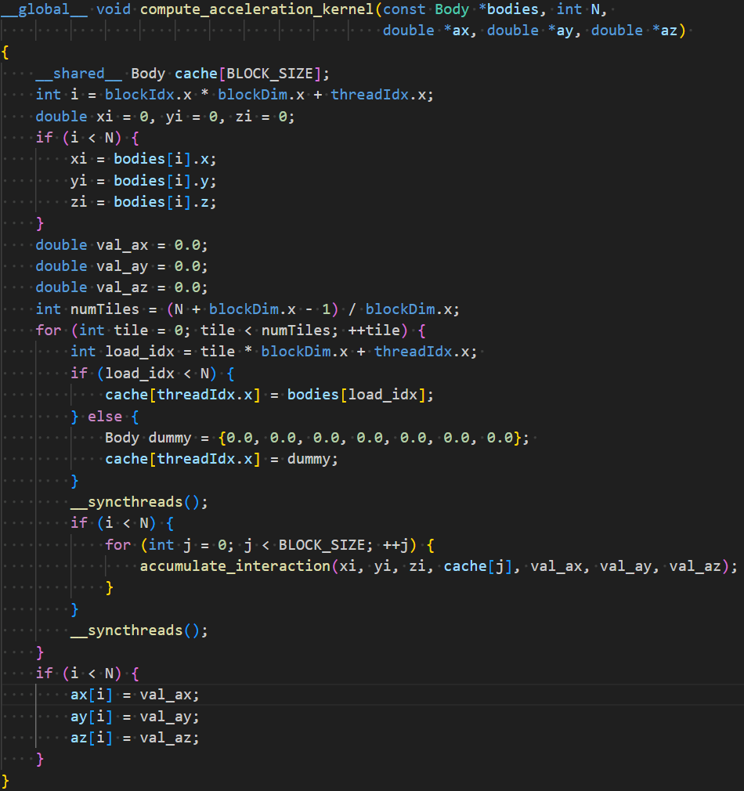
Share Memory
Considering that each thread within a block needs to compute interaction forces with all other N bodies, shared memory is utilized to maximize data reuse.
This strategy effectively reduces the number of global memory accesses by a factor of BLOCK_SIZE, significantly saving memory bandwidth.

Slide 18
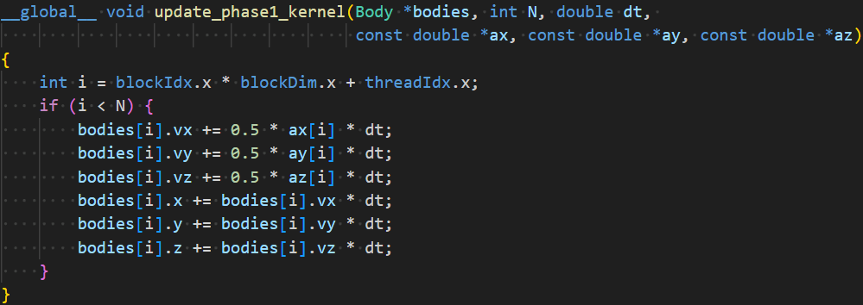
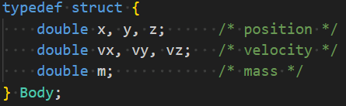
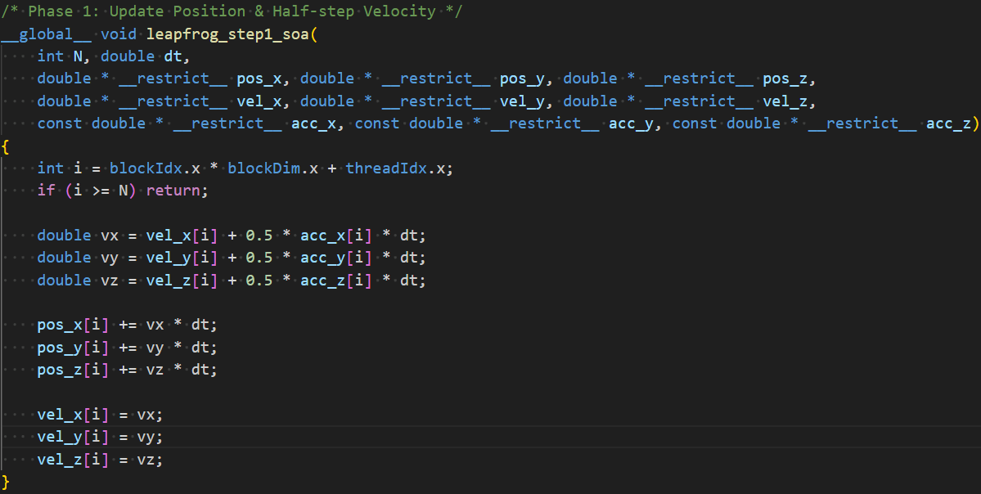
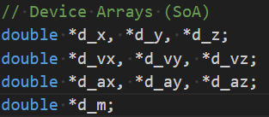
Structure of Arrays

Slide 19
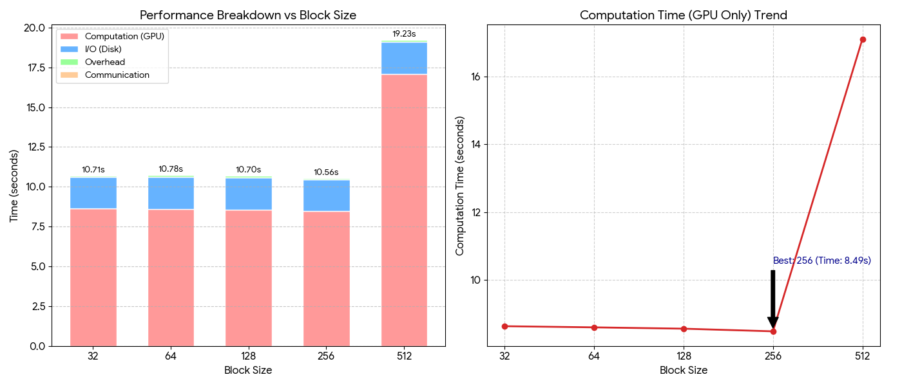
Block Size Tuning and Observations
Most efficient configuration: BLOCK_SIZE=256 at N=4096, w/ Lowest total GPU computation time of ~8.49 seconds.
Severe performance penalty w/ BLOCK_SIZE=512. Strongly suggests that a larger block size might exceeds the Register Limit per Streaming Multiprocessor (SM), causing Register Spilling to local memory.
The profiling results confirm that the application is Compute-Bound. In the optimal case (Block Size 256), GPU computation accounts for ~80% of the total wall time.

Slide 20
CUDA Profiling Metrics
All the detailed Profiling are measured at N=2048.
Global Memory Load Efficiency (`gld_efficiency`)
Ratio of requested global memory load throughput to required global memory load throughput expressed as percentage.
Global Memory Store Efficiency (`gst_efficiency`)
Ratio of requested global memory store throughput to required global memory store throughput expressed as percentage.
Shared Memory Store Transactions Per Request (`shared_store_transactions_per_request`)
Average number of shared memory store transactions performed for each shared memory store.

Slide 21
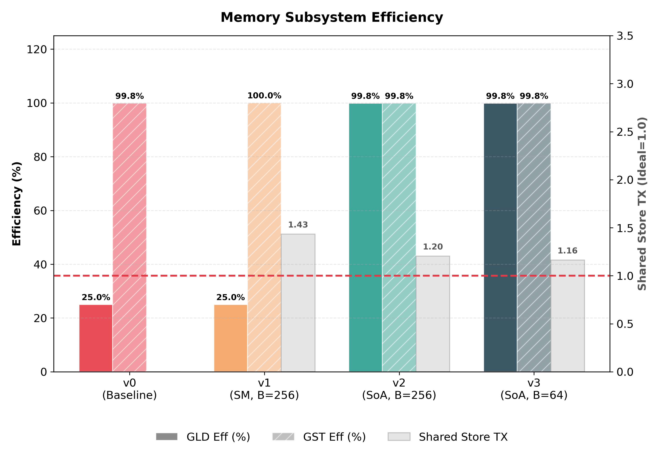
Memory Subsystem Efficiency
Observations:
Array of Structs
Non-Coalescing Memory Access (GLD Eff 25%)
Shared Memory Bank Conflict (Shared Store TX 1.43)
Structure of Arrays
Coalescing Memory Access (GLD Eff 25% -> 99.8%)
Reduced Bank Conflict (Shared Store TX 1.43 -> 1.20)
Conclusions:
Memory Bound -> Compute Bound Problem
FP64 Throughput Limitation from GTX 1080

Slide 22
CUDA Profiling Metrics
Multiprocessor Activity (`sm_efficiency`)
The percentage of time at least one warp is active on a specific multiprocessor.
Achieved Occupancy (`achieved_occupancy`)
Ratio of the average active warps per active cycle to the maximum number of warps supported on a multiprocessor.

Slide 23
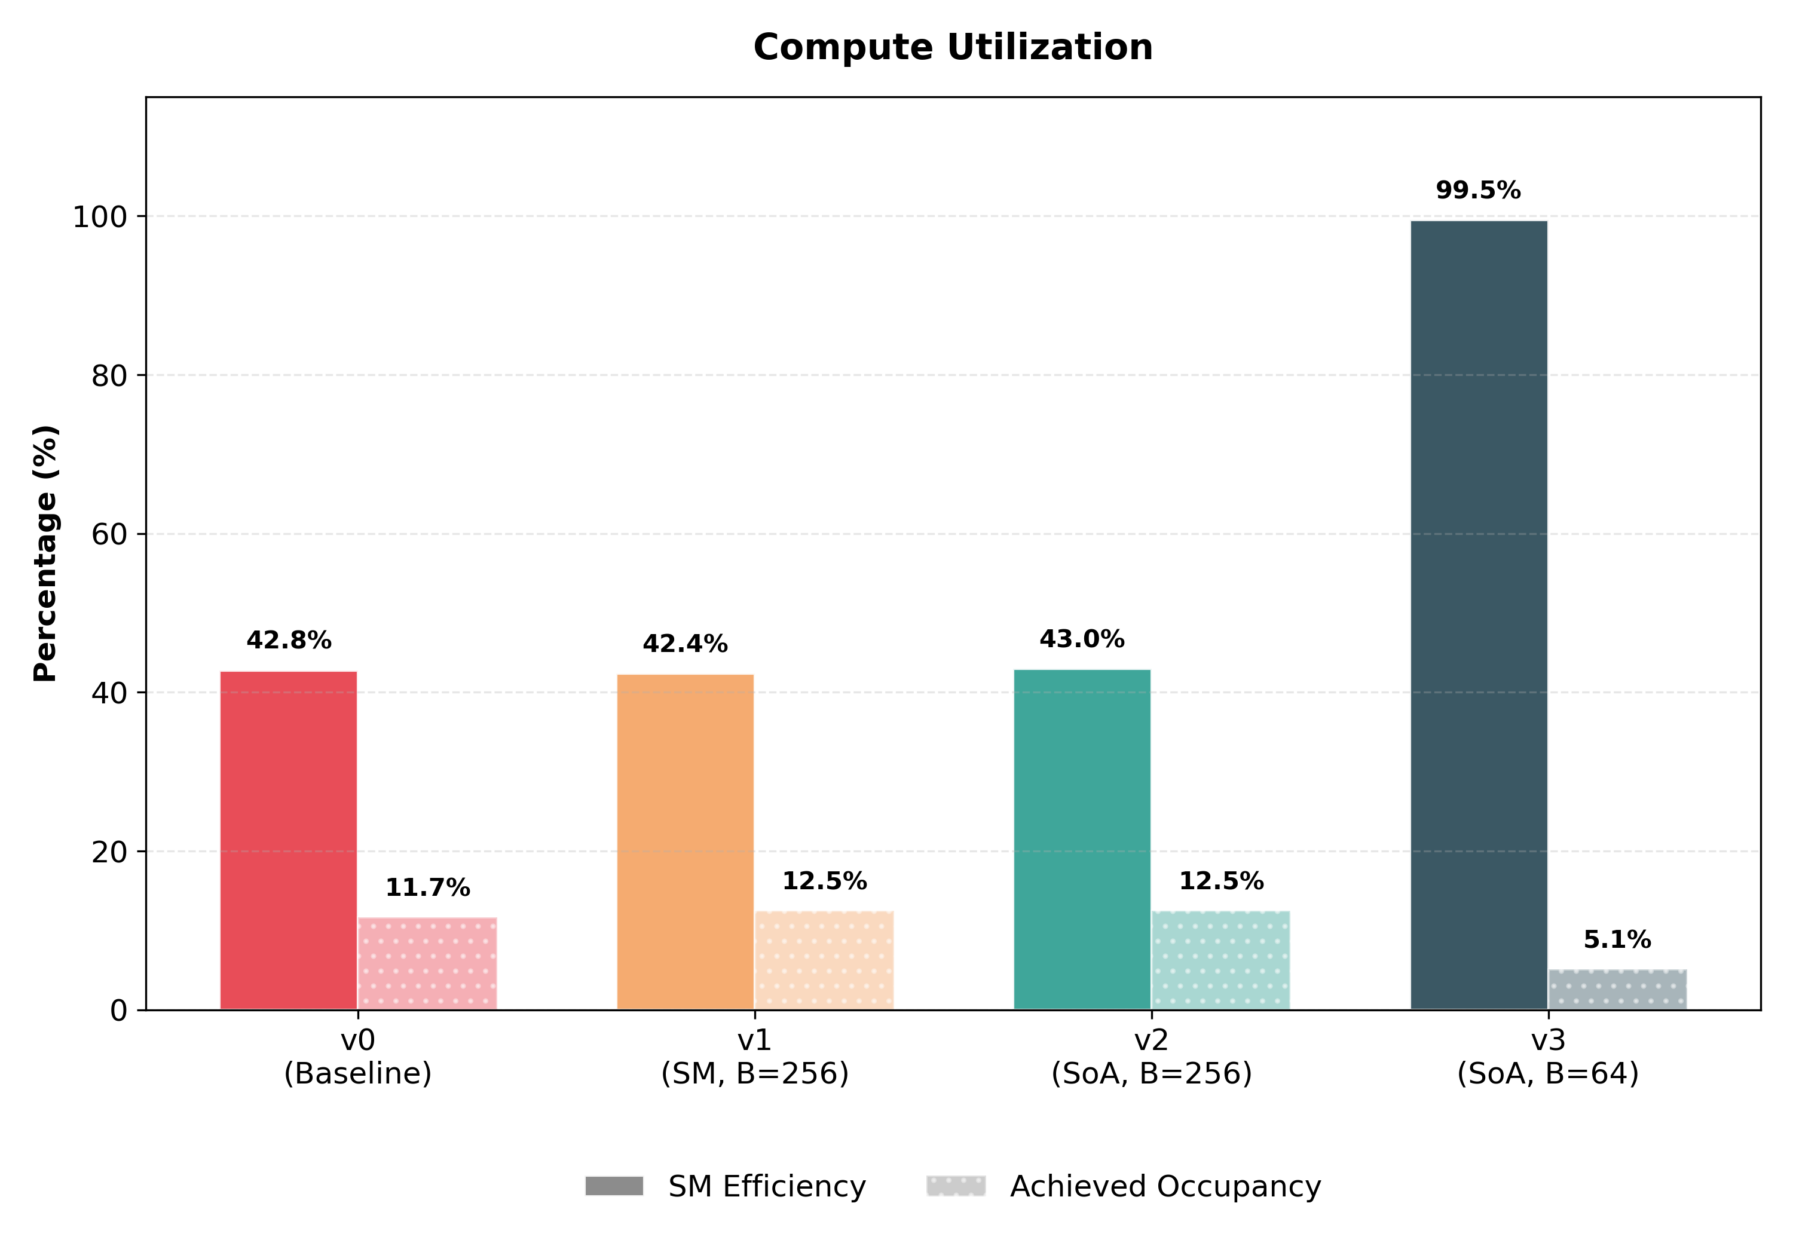
Compute Utilization
Observations:
SM Efficiency
Lot of Stalls => Warps waiting for Memory Read
SoA resolved Memory Read Issue.
However, w/ N = 2048, B = 256, 2048 / 256 = 8 blocks for 20 Streaming Multiprocessors => ~40% actives.
2048 / 64 = 32 blocks => ~100% actives.
Achieved Occupancy
Naturally Low since the problem is too small.
Acceptable since SM Efficiency is high.

Slide 24
CUDA Profiling Metrics
Issue Stall Reasons (Execution Dependency) (`stall_exec_dependency`)
Percentage of stalls occurring because an input required by the instruction is not yet available.
Issue Stall Reasons (Data Request) (`stall_memory_dependency`)
Percentage of stalls occurring because a memory operation cannot be performed due to the required resources not being available or fully utilized, or because too many requests of a given type are outstanding.
Issue Stall Reasons (Synchronization) (`stall_sync`)
Percentage of stalls occurring because the warp is blocked at a __syncthreads() call.

Slide 25
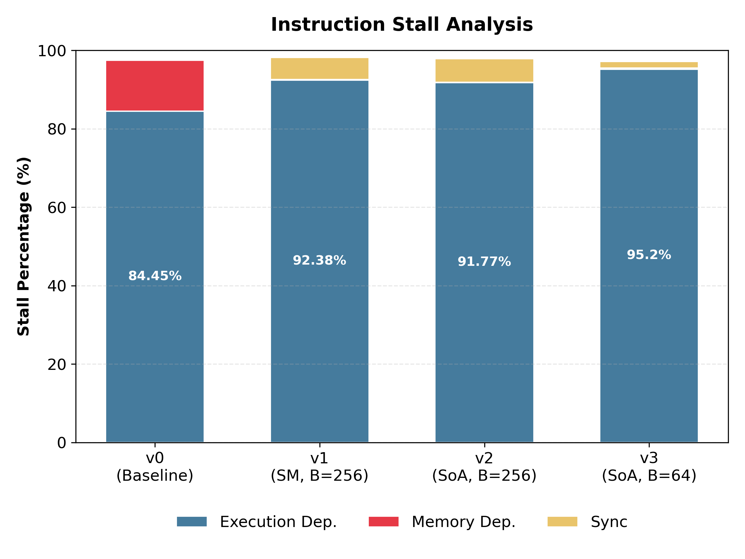
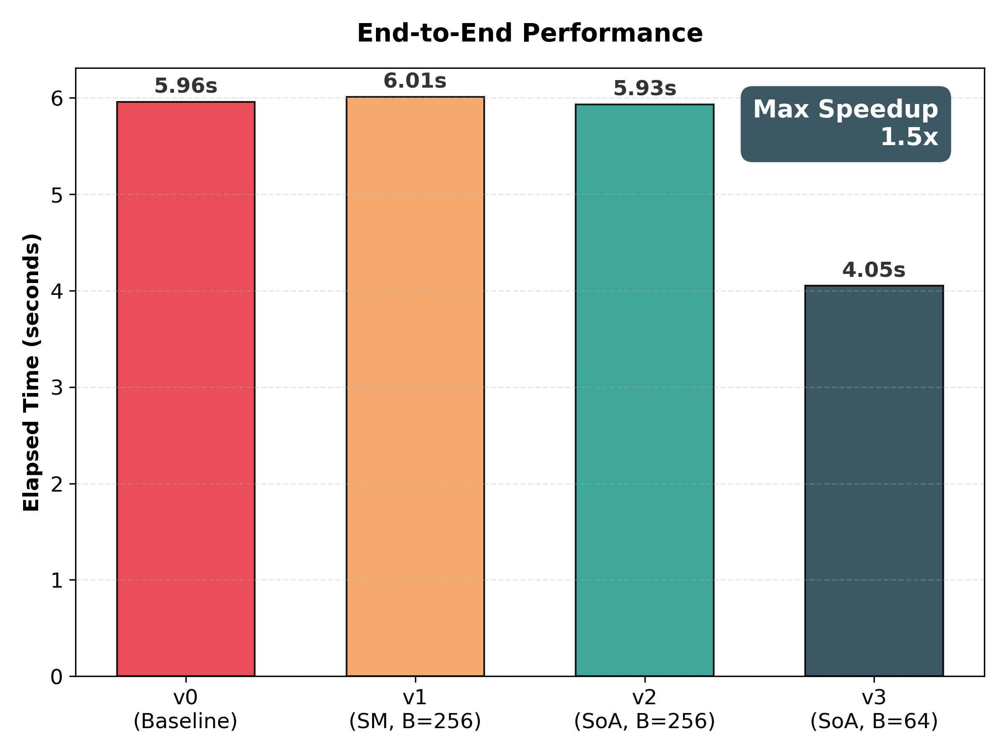
Instruction Stall Analysis
Observations:
Baseline version: Dependency caused by Memory Dependency Stall is ~12% (red), then resolved via Shared Memory.
Memory Dependency Stall becomes Synchronization Overhead w/ Shared Memory & SoA.
The bottleneck proved to be the Execution Dependency Stall, since we use `sqrt ()` to maintain the precision.

Slide 26
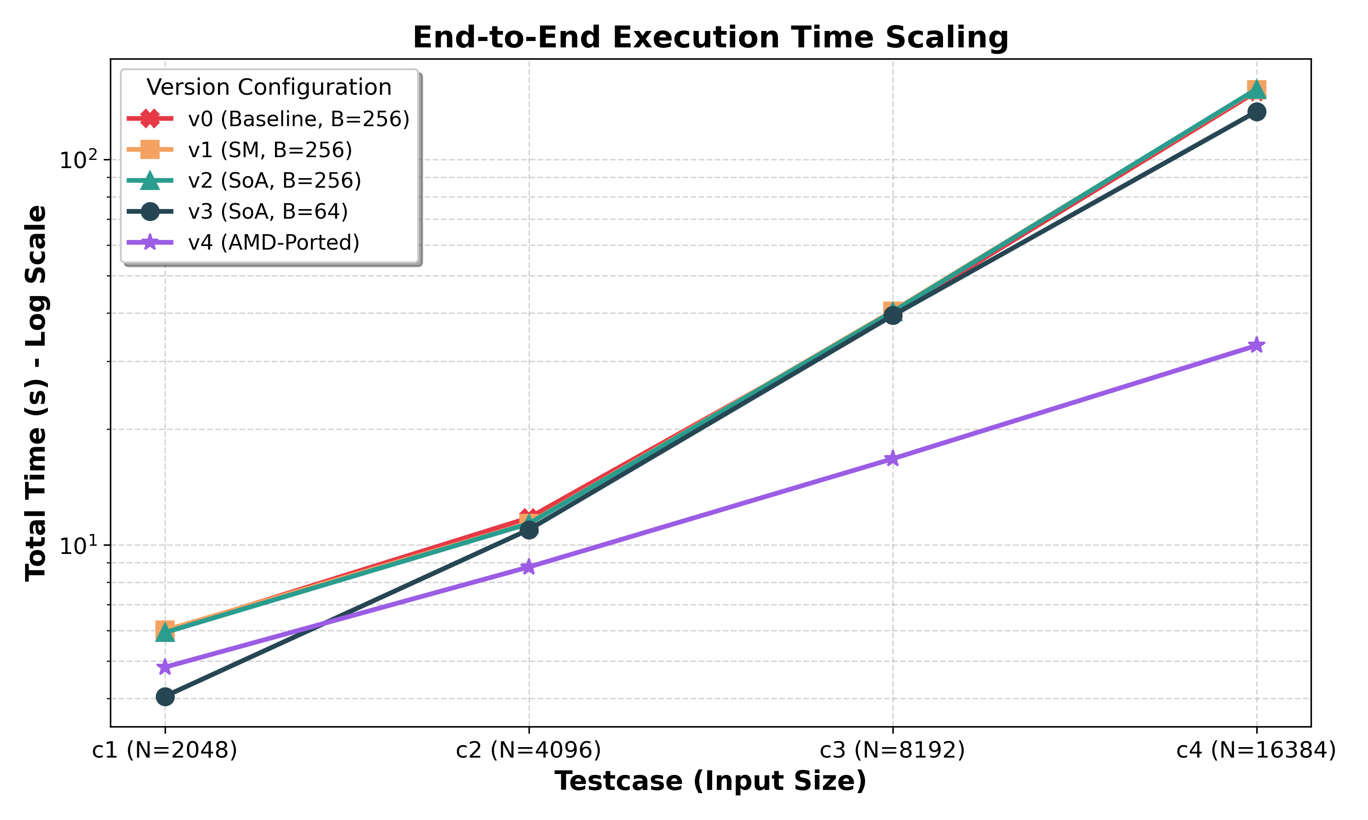
AMD Porting
Solved Problem: Memory Issue.
Unsolved Problem: Compute Bound caused by FP64 Precision Operation and NVIDIA GTX 1080’s Compute Limitation.
Solution: Porting to AMD MI100.
Results: w/ N = 16384, total time spend, reduced from 150s (v2) to 133s (v3), then to 33s (v4), speedup 4.5x.

Slide 27
This page is intentionally left blank.

