Slide 1

BUY 4 REINFORCE SAMPLES,
GET A BASELINE FOR FREE!
ICLR 2019 workshop: Deep RL Meets Structured Prediction
Wouter Kool
University of Amsterdam ORTEC
w.w.m.kool@uva.nl
Herke van Hoof
University of Amsterdam
h.c.vanhoof@uva.nl
Max Welling
University of Amsterdam CIFAR
m.welling@uva.nl
Group 7: Chen-Fang Hu, Kai-Yuan Jeng, Pei-Hsun Wu
*Listed in alphabetical order by last name.

Slide 2
Our Project: Fine-Tuning Vision-Language Models for Action Prediction in Autonomous Driving
Project Goals and Motivation
Leverage Vision-Language Models (VLMs) to generate structured outputs from video inputs.
Generate driving commands and language-based justifications simultaneously.
Address challenges in safety, interpretability, and generalization for autonomous driving.
Advance End-to-End AD (E2E-AD) by integrating VLMs with Reinforcement Learning (RL).

Slide 3
Our Project: Fine-Tuning Vision-Language Models for Action Prediction in Autonomous Driving
Challenges
Solutions: 3-Stage Fine-Tuning via RL
Challenge 1: VLMs require text prompts - impractical for real-time driving.
Challenge 2: VLMs are descriptive, not actionable.
Challenge 3: Need structured outputs (e.g., JSON) directly from visuals.
Stage 1: Adapt VLMs to process video inputs and generate descriptive outputs directly from video frames.
Stage 2: Integrate reasoning mechanisms for actionable decisions.
Stage 3: Fine-tune VLMs for structured outputs (JSON format).

Slide 4
Our Project: Fine-Tuning Vision-Language Models for Action Prediction in Autonomous Driving
MDP Setup:
  States include video frames and generated text; actions are token selections.
Policy Optimization:
  Use PPO and Self-Critical Sequence Training (SCST) for stability.
Reward Signals:
  Semantic Alignment Reward (R1) →Matches video content and text descriptions.
  Action-Reasoning Reward (R2) → Validates actionable commands and reasoning quality.
  Structure-Formatting Reward (R3) → Ensures format and semantic consistency.

Slide 5
Buy 4 REINFORCE Samples, Get a Baseline for Free!
Why the Paper is Relevant and Inspiring?
Structured Prediction / Sequence Modeling:
  The paper applies REINFORCE to structured prediction tasks (e.g., Neural Machine Translation, Image Captioning).
  Our project also focuses on generating structured outputs (actions, justifications) from video frames, similar to sequence modeling.
Variance Reduction in Policy Gradients:
  High variance in REINFORCE gradient estimates is a major challenge.
  The paper proposes using multiple samples per input to create a local baseline for variance reduction.
  This technique can directly benefit our project by stabilizing RL fine-tuning when generating action-justification pairs.

Slide 6
Buy 4 REINFORCE Samples, Get a Baseline for Free!
Why the Paper is Relevant and Inspiring?
Efficient Sampling Techniques:
  The paper introduces sampling with / without replacement to reduce redundancy, using Stochastic Beam Search.
  In our project, generating diverse output sequences from the VLM policy can improve training efficiency.
Improved Data / Computational Efficiency:
  Using multiple samples from a single encoder pass improves efficiency.
  Our project, which involves fine-tuning large VLMs, can benefit from these methods to reduce training time and resource consumption.

Slide 7
Buy 4 REINFORCE Samples, Get a Baseline for Free!
Personal Takeaways
Variance Reduction Techniques:
  Multi-sample baselines → reduce the variance of language-based driving decisions (during fine-tuning VLMs)
Enhancing Training Stability:
  Multiple output candidates for variance reduction→ enhance the stability of PPO + SCST fine-tuning.
Data Efficiency Considerations:
  The approach of generating multiple predictions from one pass can significantly reduce training data requirements.→ crucial (∵ the high computational cost of VLM fine-tuning)

Slide 8
Main Findings and the Connections to Our Method
A recent work proposed using the basic REINFORCE-type algorithms (especially the REINFORCE Leave-Out-One (RLOO) algorithm) rather than the commonly used Proximal Policy Optimization (PPO) algorithm for Reinforcement Learning from Human Feedback (RLHF) and Language Model Fine-Tuning [1].
Our final project aims to fine-tune a Vision Language Model (VLM) in the sense of Image Captioning.
This work [2] is the original paper of RLOO, which motivated us to give a theoretical deep dive.
This work proposed using multiple samplings as the baseline in the REINFORCE algorithm and also proved that this REINFORCE with Multiple Samples is an unbiased estimation.
[1] Back to Basics: Revisiting REINFORCE-Style Optimization for Learning from Human Feedback in LLMs, 2024 ACL, https://arxiv.org/abs/2402.14740
[2] Buy 4 REINFORCE Samples, Get a Baseline for Free!, 2019 ICLR Workshop, https://openreview.net/forum?id=r1lgTGL5DE

Slide 9
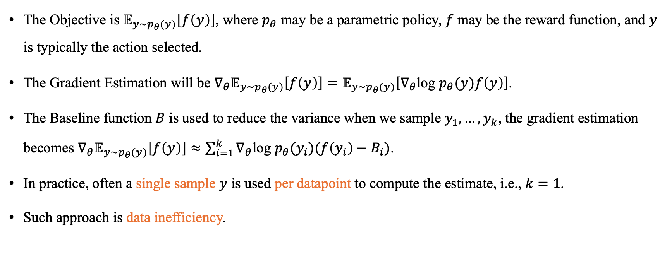
REINFORCE Estimator and Baseline
The Objective is $𝔼_{y∼p_{θ}(y)}\left[f\left(y\right)\right]$, where $p_{θ}$ may be a parametric policy, $f$ may be the reward function, and $y$ is typically the action selected.
The Gradient Estimation will be $∇_{θ}𝔼_{y∼p_{θ}(y)}\left[f\left(y\right)\right]=𝔼_{y∼p_{θ}(y)}\left[∇_{θ}\text{log} p_{θ}(y)f\left(y\right)\right]$.
The Baseline function $B$ is used to reduce the variance when we sample $y_{1}, …, y_{k}$, the gradient estimation becomes $∇_{θ}𝔼_{y∼p_{θ}(y)}\left[f\left(y\right)\right]≈\sum_{i=1}^{k}{∇_{θ}\text{log} p_{θ}(y_{i})(f\left(y_{i}\right)−B_{i})}$.
In practice, often a single sample $y$ is used per datapoint to compute the estimate, i.e., $k=1$.
Such approach is data inefficiency.

Slide 10
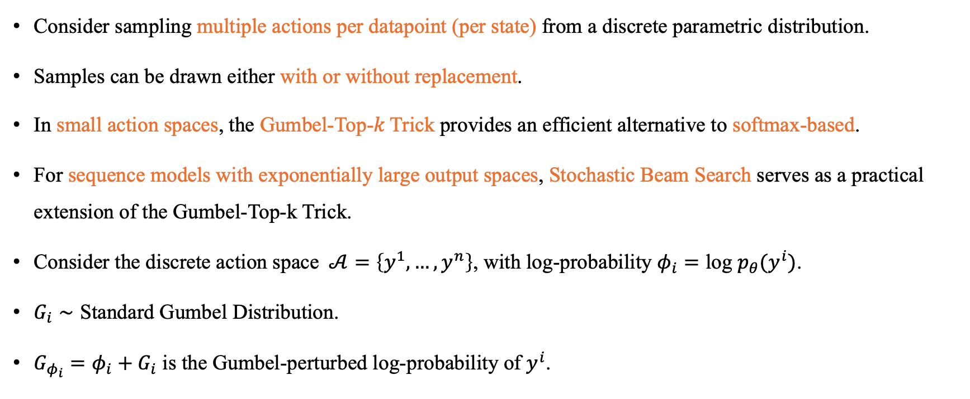

Gumbel-Top-$k$ Trick and Stochastic Beam Searchch
Consider sampling multiple actions per datapoint (per state) from a discrete parametric distribution.
Samples can be drawn either with or without replacement.
In small action spaces, the Gumbel-Top-𝑘 Trick provides an efficient alternative to softmax-based.
For sequence models with exponentially large output spaces, Stochastic Beam Search serves as a practical extension of the Gumbel-Top-k Trick.
Consider the discrete action space $𝒜=\left\{y^{1}, …,y^{n}\right\}$, with log-probability $φ_{i}=\text{log} p_{θ}(y^{i})$.
$G_{i}∼\text{Standard} \text{Gumbel} \text{Distribution}$.
$G_{φ_{i}}=φ_{i}+G_{i}$ is the Gumbel-perturbed log-probability of $y^{i}$.
Notes:
This paper investigates sampling multiple actions per datapoint (per state) from a discrete parametric distribution, which is common in tasks like classification or natural language generation. In such settings, the samples can be drawn either with or without replacement.
For large action spaces, sampling with or without replacement yields nearly equivalent results, as the probability of duplicates is low.
However, in relatively small action spaces, the Gumbel-Top-𝑘 Trick provides an efficient alternative to softmax-based sampling without replacement, which otherwise would require recalculating and renormalizing the distribution after each sample.
Moreover, for sequence models with exponentially large output spaces, Stochastic Beam Search serves as a practical extension of the Gumbel-Top-k Trick, allowing efficient and probabilistically correct sampling of diverse output sequences.
The Gumbel-Top-k Trick ensures sampling without replacement, preserving the correct marginal probabilities, and is computationally attractive for small discrete spaces.
Stochastic Beam Search leverages this idea to efficiently explore diverse sequence hypotheses in structured prediction tasks.

Slide 11
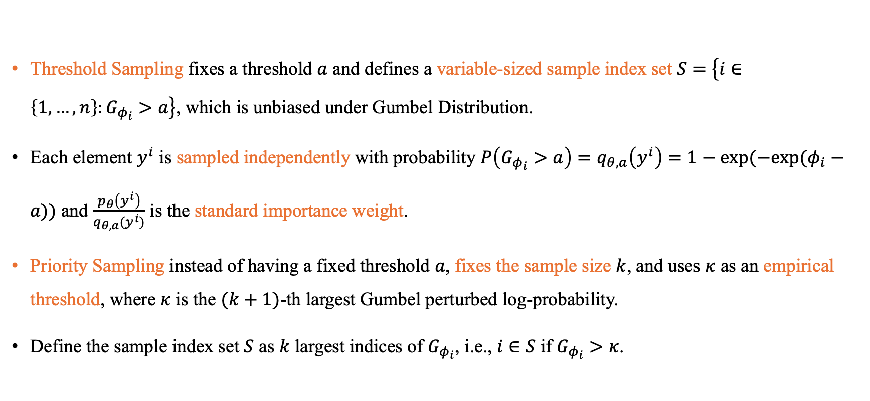
Threshold Sampling and Priority Sampling
Threshold Sampling fixes a threshold $a$ and defines a variable-sized sample index set $S=\left\{i∈\left\{1, …, n\right\}:G_{φ_{i}}>a\right\}$, which is unbiased under Gumbel Distribution.
Each element $y^{i}$ is sampled independently with probability $P\left(G_{φ_{i}}>a\right)=q_{θ, a}\left(y^{i}\right)=1−\text{exp}(−\text{exp}\text{(}φ_{i}−a\text{)})$ and $\frac{p_{θ}\left(y^{i}\right)}{q_{θ, a}(y^{i})}$ is the standard importance weight.
Priority Sampling instead of having a fixed threshold $a$, fixes the sample size $k$, and uses $κ$ as an empirical threshold, where $κ$ is the $(k+1)$-th largest Gumbel perturbed log-probability.
Define the sample index set $S$ as $k$ largest indices of $G_{φ_{i}}$, i.e., $i∈S$ if $G_{φ_{i}}>κ$.
Notes:
Sample without replacement
to select the top k
benefit of gumbel

Slide 12
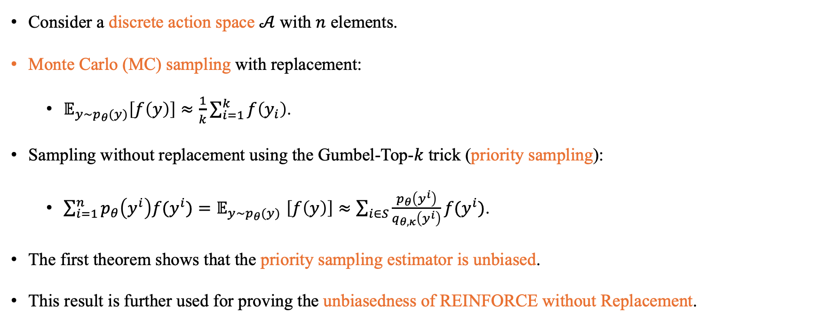
Different REINFORCE Estimations
Consider a discrete action space $𝒜$ with $n$ elements.
Monte Carlo (MC) sampling with replacement:
  $𝔼_{y∼p_{θ}(y)}\left[f\left(y\right)\right]≈\frac{1}{k}\sum_{i=1}^{k}{f\left(y_{i}\right)}$.
Sampling without replacement using the Gumbel-Top-$k$ trick (priority sampling):
  $\sum_{i=1}^{n}{p_{θ}\left(y^{i}\right)f(y^{i})}{=𝔼}_{y∼p_{θ}(y)}\left[f\left(y\right)\right]≈\sum_{i∈S}{\frac{p_{θ}\left(y^{i}\right)}{q_{θ, κ}\left(y^{i}\right)}f(y^{i})}$.
The first theorem shows that the priority sampling estimator is unbiased.
This result is further used for proving the unbiasedness of REINFORCE without Replacement.

Slide 13
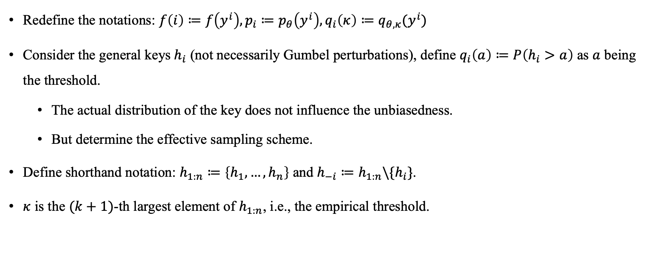
Proof of Unbiasedness of Priority Sampling Estimator
Redefine the notations: $f\left(i\right)≔f\left(y^{i}\right), p_{i}≔p_{θ}\left(y^{i}\right), q_{i}\left(κ\right)≔q_{θ,κ}(y^{i})$
Consider the general keys$h_{i}$ (not necessarily Gumbel perturbations), define $q_{i}\left(a\right)≔P\left(h_{i}>a\right)$ as $a$ being the threshold.
  The actual distribution of the key does not influence the unbiasedness.
  But determine the effective sampling scheme.
Define shorthand notation: $h_{1:n}≔\left\{h_{1},…,h_{n}\right\}$ and $h_{−i}≔h_{1:n}\backslash \{h_{i}\}$.
$κ$ is the $(k+1)$-th largest element of $h_{1:n}$, i.e., the empirical threshold.

Slide 14
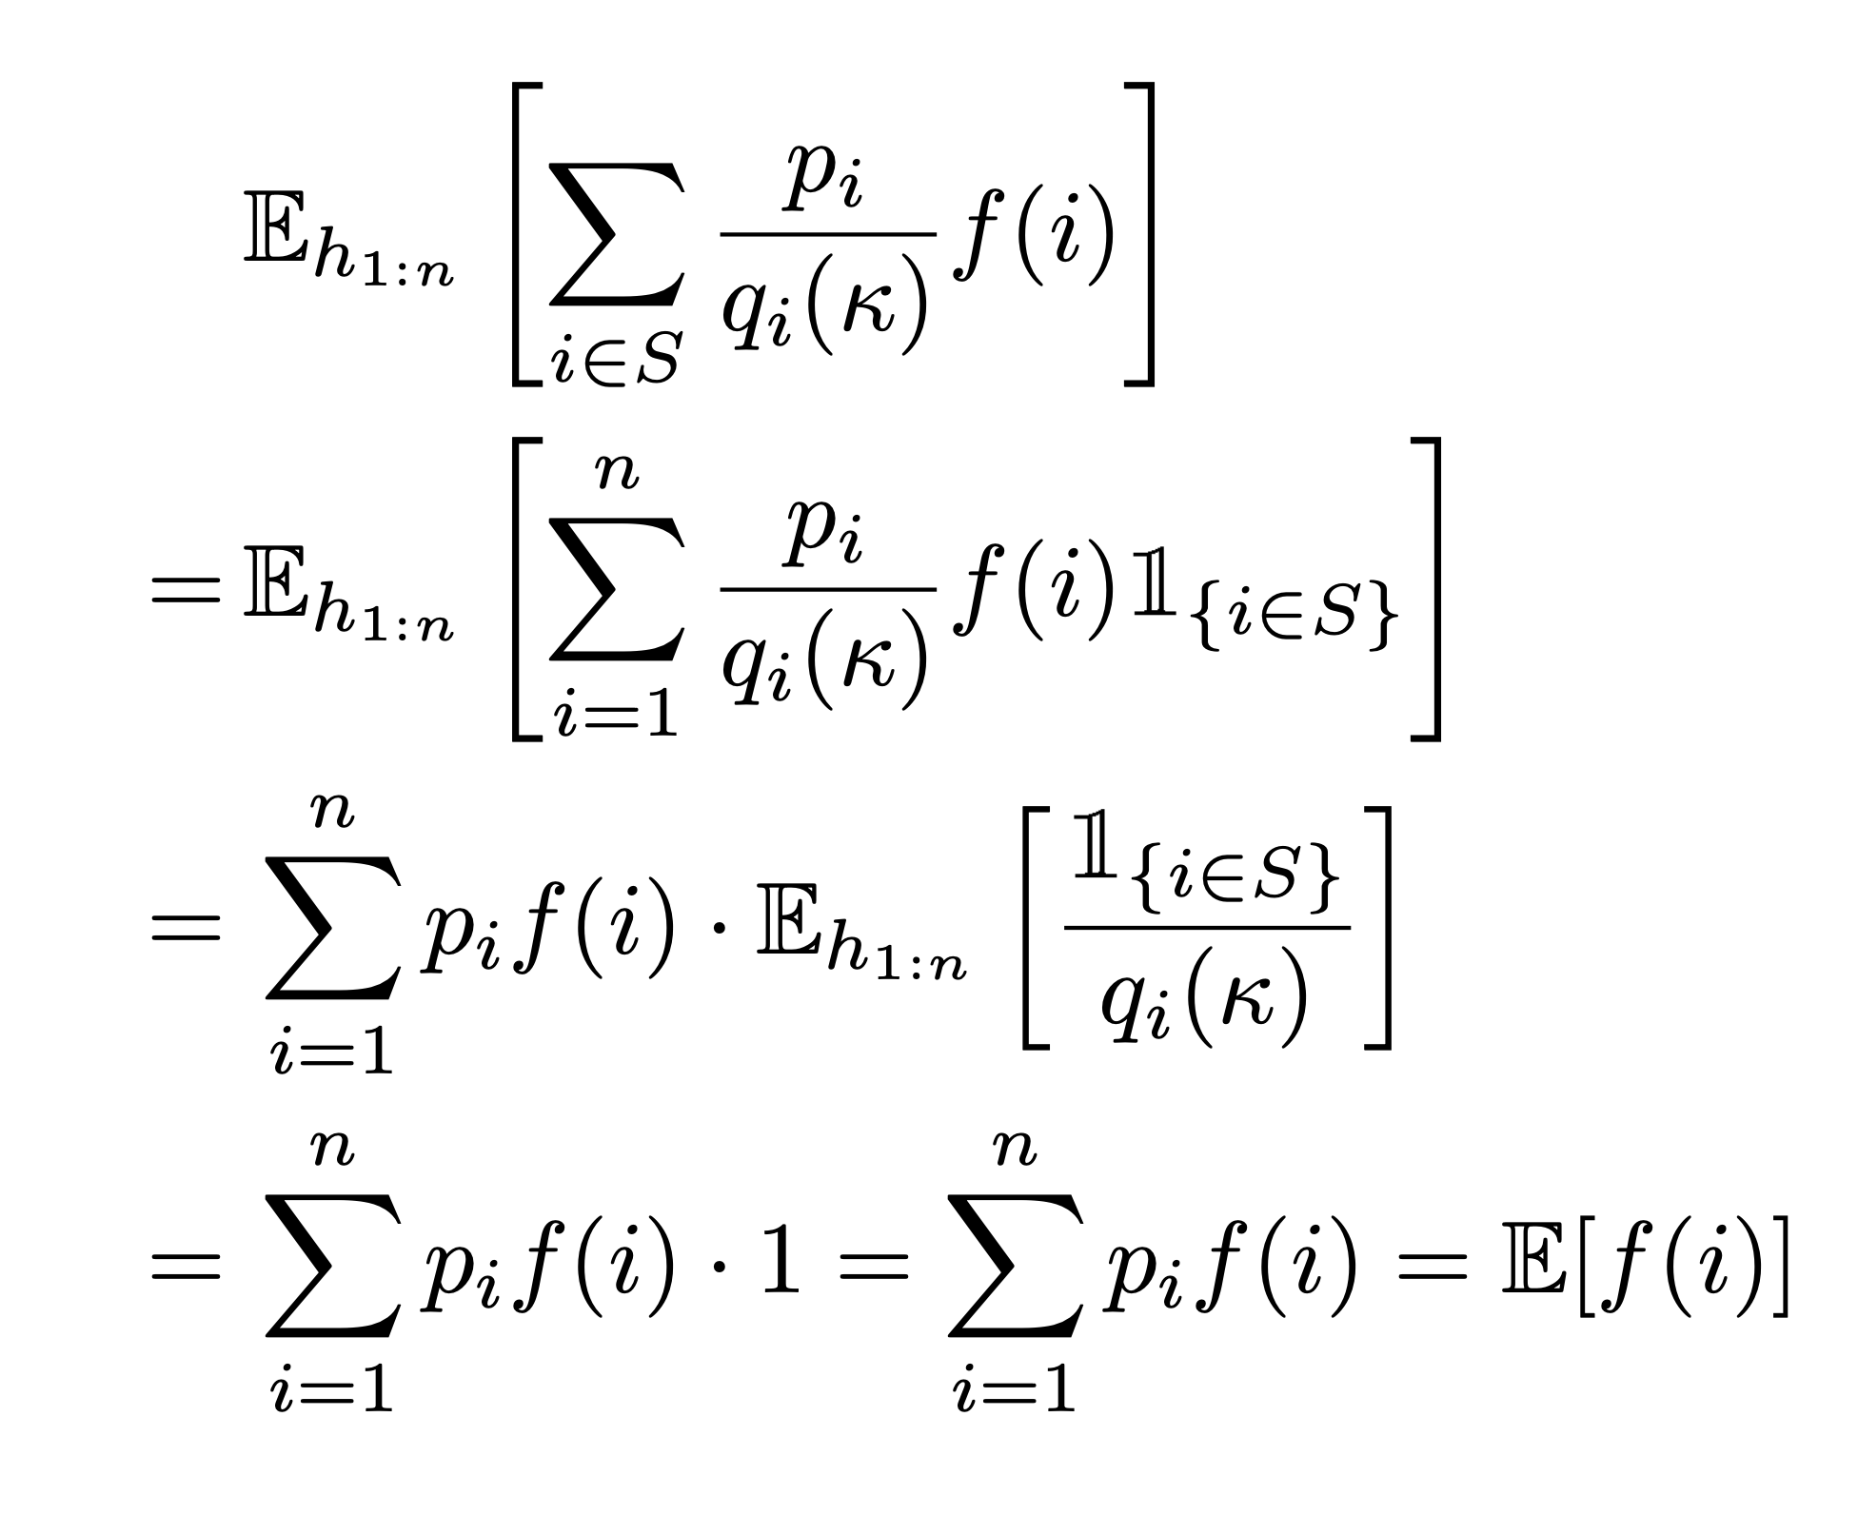
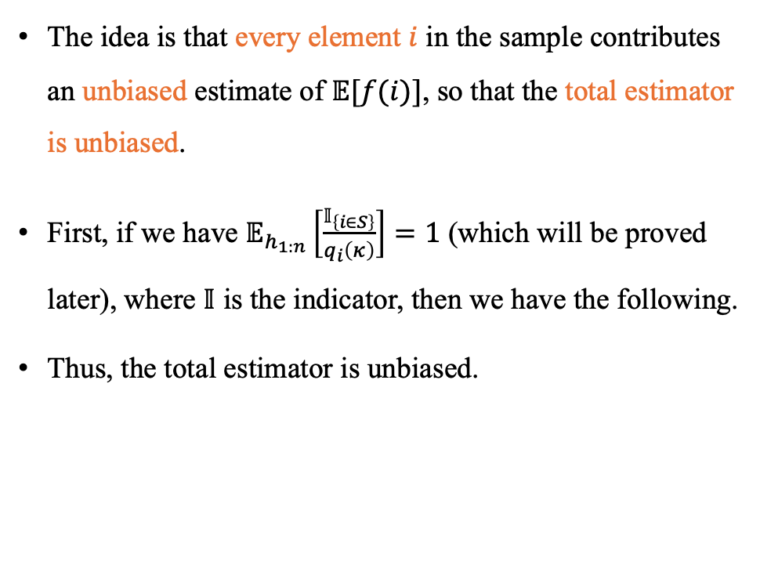
Proof of Unbiasedness of Priority Sampling Estimator
The idea is that every element $i$ in the sample contributes an unbiased estimate of $𝔼[f(i)]$, so that the total estimator is unbiased.
First, if we have $𝔼_{h_{1:n}}\left[\frac{𝕀_{\left\{i∈S\right\}}}{q_{i}\left(κ\right)}\right]=1$ (which will be proved later), where $𝕀$ is the indicator, then we have the following.
Thus, the total estimator is unbiased.

Slide 15
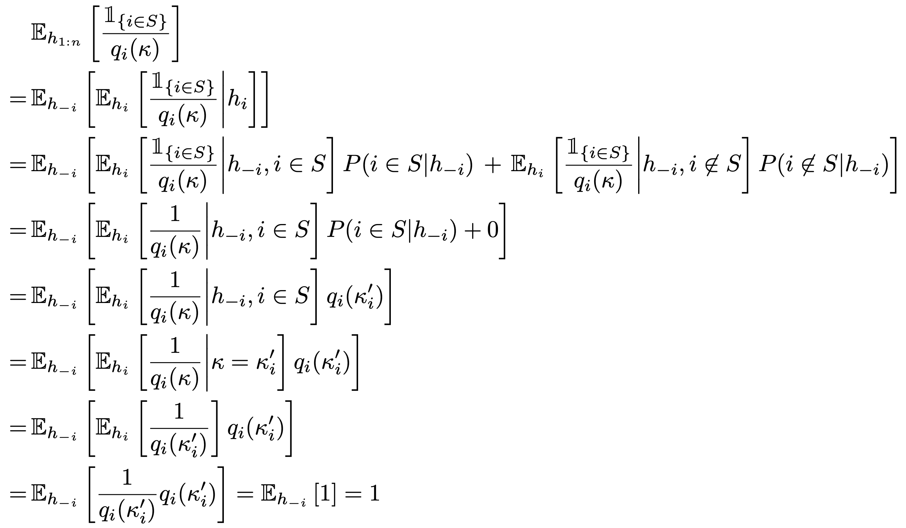
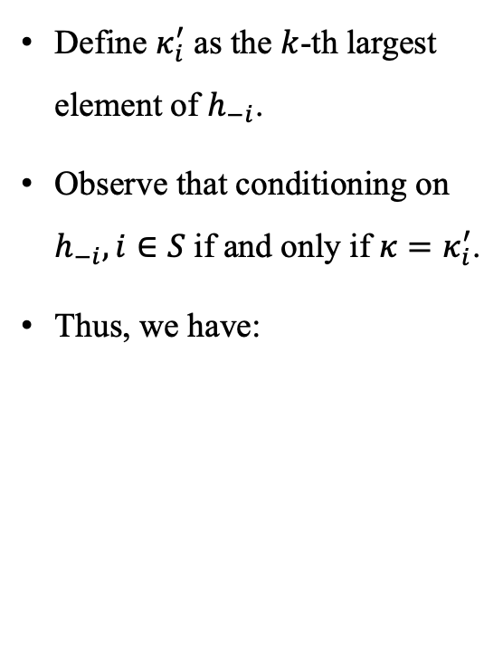
Proof of Unbiasedness of Priority Sampling Estimator
Define $κ_{i}^{′}$ as the $k$-th largest element of $h_{−i}$.
Observe that conditioning on $h_{−i}, i∈S$ if and only if $κ=κ_{i}^{′}$.
Thus, we have:

Slide 16
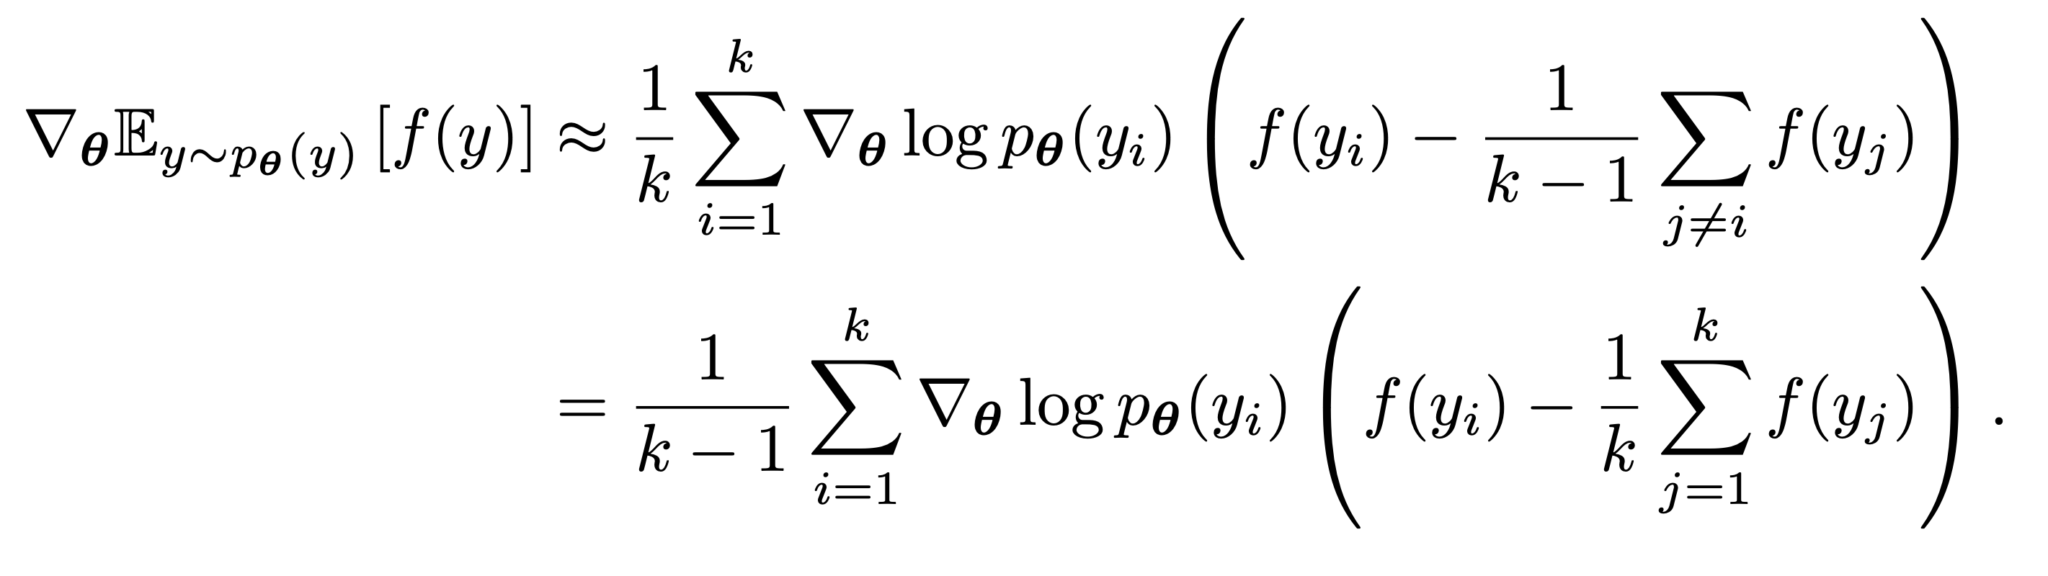

REINFORCE with Replacement
REINFORCE with Replacement Setting = REINFORCE Leave-Out-One (RLOO)
Recall that the vanilla REINFORCE with baseline evaluates the policy gradient as:
  $∇_{θ}𝔼_{y∼p_{θ}(y)}\left[f\left(y\right)\right]≈\sum_{i=1}^{k}{∇_{θ}\text{log} p_{θ}\left(y_{i}\right)\left(f\left(y_{i}\right)−B_{i}\right)},k=1$
With replacement, define the baseline function as $B_{i}≔ \frac{1}{k−1}\sum_{j≠i}{f(y_{j})}$, when drawing $k$ i.i.d. samples.
The estimator becomes:

Slide 17
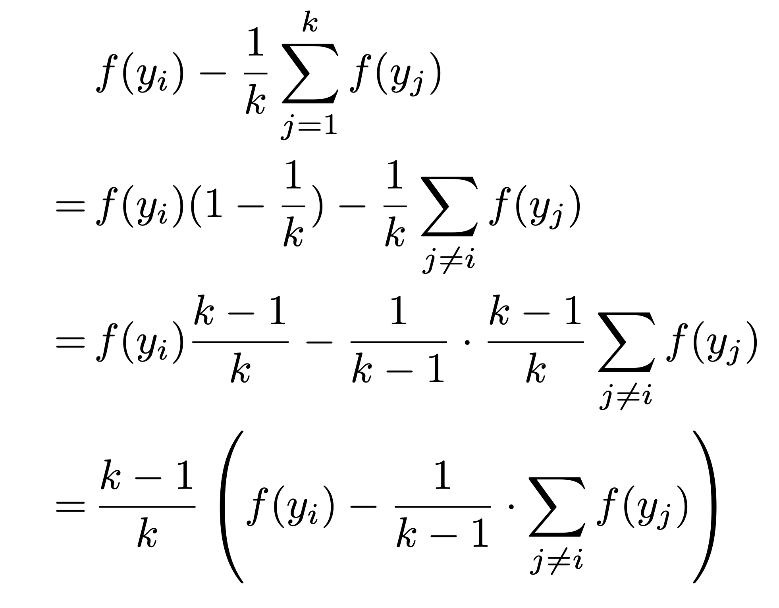

Proof of Unbiasedness of REINFORCE with Replacement Estimator
Define $y_{1:k}=\{y_{1},…,y_{k}\}$ as the set of independent samples with replacement from the policy $p_{θ}(y)$.
First, we claim that, using the batch mean as baseline is equivalent to using the mean of the other elements in the batch.
The proof simply follows:

Slide 18

Proof of Unbiasedness of REINFORCE with Replacement Estimator
Note that the policy gradient has the following property:
  $𝔼_{y}\left[∇_{θ}\text{log} p_{θ}\left(y\right)\right]=\sum_{y}{p_{θ}\left(y\right)⋅∇_{θ}\text{log} p_{θ}\left(y\right)}=\sum_{y}{p_{θ}\left(y\right)⋅(\frac{1}{p_{θ}\left(y\right)}⋅∇_{θ}p_{θ}\left(y\right))}=\sum_{y}{∇_{θ}p_{θ}\left(y\right)=∇_{θ}\sum_{y}{p_{θ}(y)}=∇_{θ}1}=0$.

Slide 19
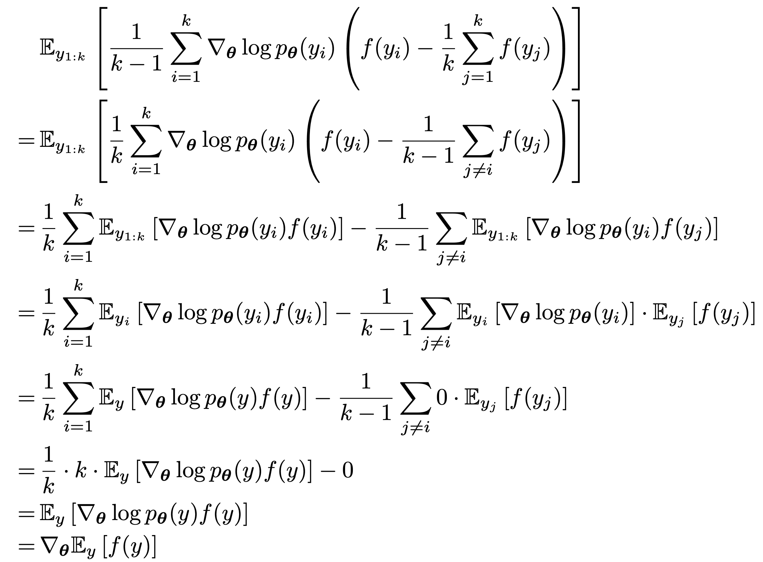
Proof of Unbiasedness of REINFORCE with Replacement Estimator
Then the unbiasedness follows:

Slide 20
Conclusion
We could use multiple samples to naturally construct a REINFORCE baseline.
Sampling without Replacement could be fulfilled via Threshold Sampling or Priority Sampling, both are unbiased (in general).
Sampling with Replacement in the REINFORCE setting (REINFORCE Leave-One-Out, RLOO) is also unbiased.
RLOO is data-efficient for using multiple samples as estimation for a single datapoint, i.e., multiple trajectories per one given state.
RLOO avoids training a Critic network, which may require additional computation.

