Slide 1
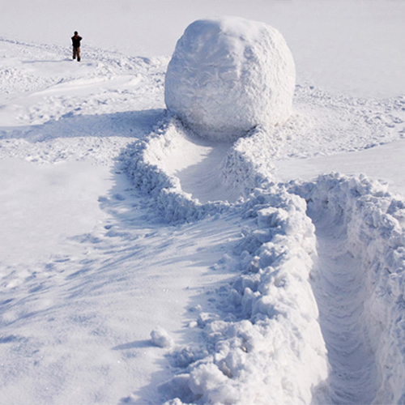
Snowballing
YingXue Du(Christie)
Zican Wang(Violet)

Slide 2
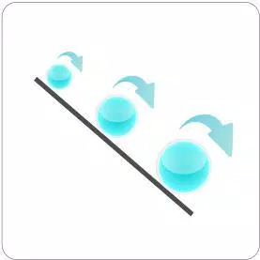
Definition
makert research
individuals
spread
increase sample size

Slide 3
Advantage | Disadvantage
Cheap Quick | Difficult to determine unbais findings

