Slide 1
Part II: Working through a simple model

Slide 2
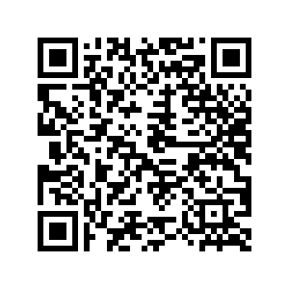
Three ways to access materials
Google drive

Slide 3
Three ways to access materials
Google drive
https://drive.google.com/drive/folders/1YurwOwVKcZOwYc1F0ccaNZ_fBjhHSWWR?usp=sharing
Zipped folder sent via email
USB thumb drive

Slide 4
Three ways to access materials
Google drive
Zipped folder sent via email
USB thumb drive

Slide 5
Download model
Place in easy to find directory (e.g., “Downloads”)
Extract contents

Slide 6
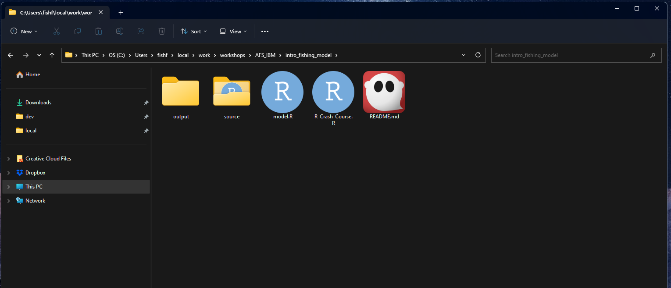
Goal is to get here

Slide 7
Critical R
Matrix
Data frame
List
Functions
For loops

Slide 8
Why these particular R basics?
Will be useful to increase efficiency (speed) of your model and are essential for working with and expanding your model

Slide 9
Vectors, matrices, data frames, list
vector = 1 dimensional representation of data
vector = 1,2,3,2,1

Slide 10
Vectors, matrices, data frames, list
matrix = 2 dimensional representation of numbers
Matrix = 1 1 2 3
1 2 1 1
has rows and columns

Slide 11
Vectors, matrices, data frames, list
Lists = add any element of any type and dimension

Slide 12
Vectors, matrices, data frames, list
Data frame = 2 dimensional representation of data
Data frame = 1 1 2 A
1 2 1 B
has rows and columns; can mix classes

Slide 13
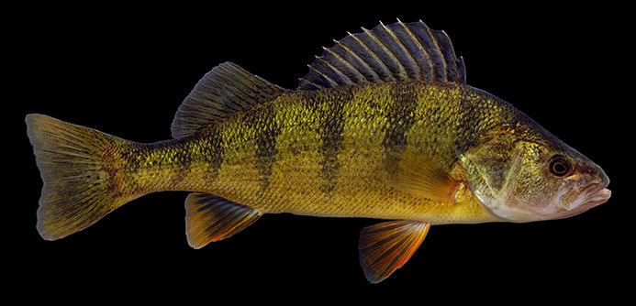
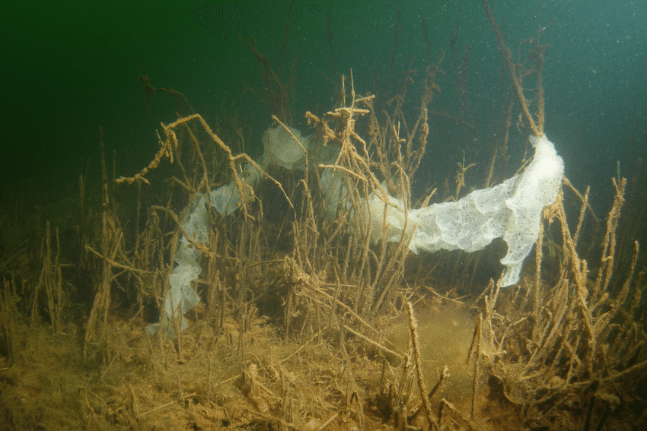
Fishing on yellow perch

Slide 14
Let’s step through
setwd
function sourcer
Parameters (both function and as list)
Dems and pops
Functions

Slide 15
Parameters to change
Add fishing pressure
Change population sizes
Add variance in adult population sizes

Slide 16
Break
10 - 15 minutes

Slide 17
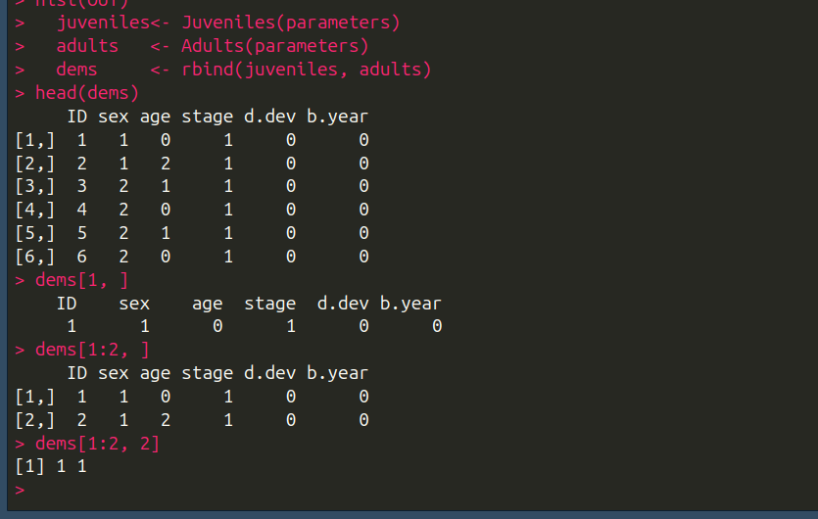
Matrices

Slide 18
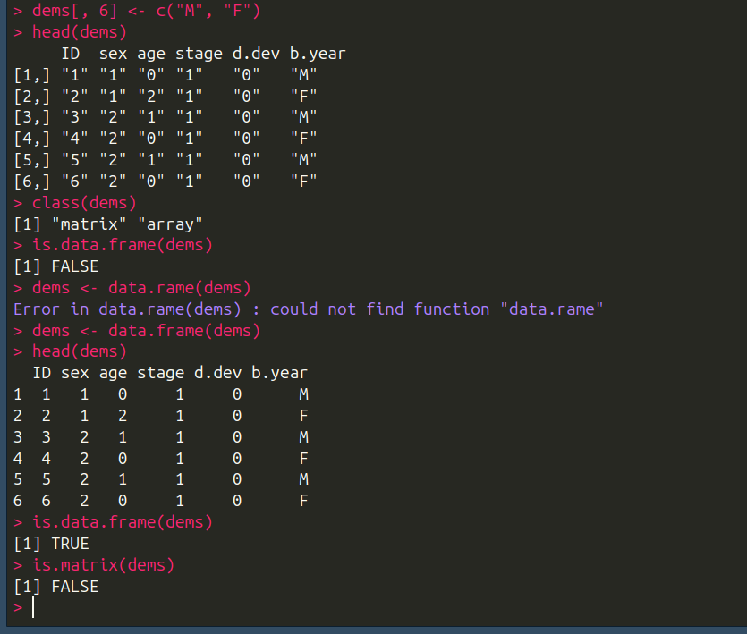
Data frames

Slide 19
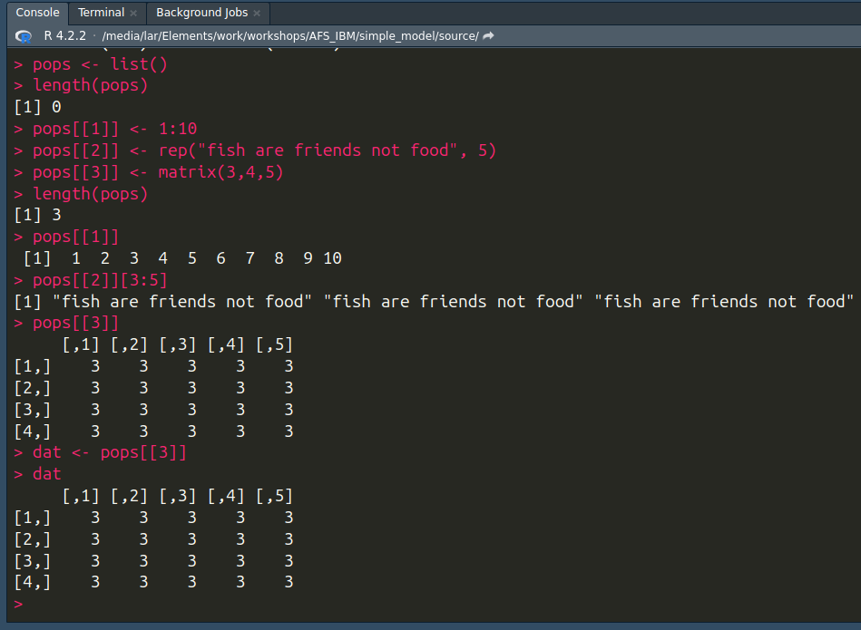
Lists

Slide 20
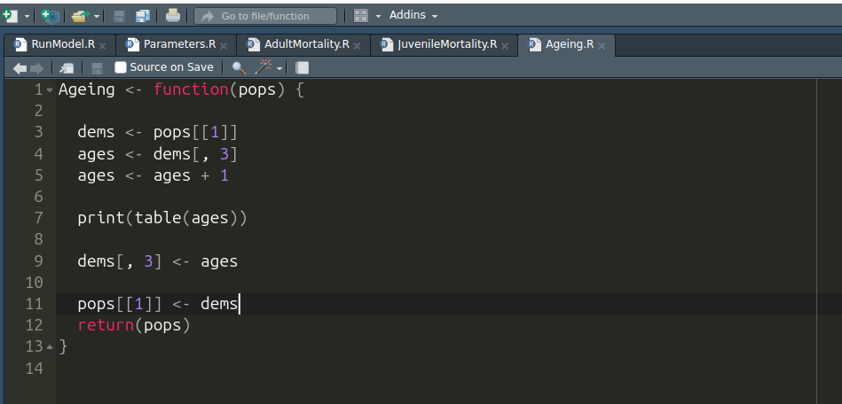
Functions

Slide 21
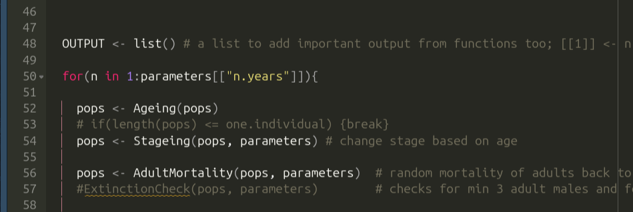
Functions

