Slide 1




Public Safety Intelligence Lakehouse
Public safety data, graphs and generative AI on a Databricks lakehouse
Christiellen Okubo - Data Engineering and AI - October 2026
github.com/Christiellen/Public-Safety-Intelligence-Lakehouse
Notes:
A portfolio project built on real public data. In 10 minutes: the problem, the solution, the results and the engineering decisions. Everything shown here is running: Databricks, Neo4j, Gemini and n8n.

Slide 2



Where does lethal violence concentrate and spill over?
Answering it means joining sources that were not built to be joined
No common key
Mixed levels and measures
Data come from police records
SINESP and SENATRAN identify municipalities by name, and Brazil has many repeated names across states. Joining by name attaches one city's population to another.
Some events are published per municipality, others per state only; some in occurrences, others in victims or kilograms. Summing everything gives wrong numbers.
Each state sends its own police reports. Differences between states also reflect how they record events, and that has to be explicit.
Notes:
The business question is spatial: where lethal violence is and whether it spills over to neighbors. The two data quality problems are the core of the project: a common key and mixed levels of aggregation.

Slide 3




One data platform, from raw data to decision
Neo4j graph
neighbors, clusters and communities
5 public sources
Bronze
Silver
Gold
Multi-agent assistant
SINESP - IBGE - SENATRAN - Atlas Brasil - IBGE mesh
data as published, with SHA-256 hash
IBGE code on every source, name QA
star schema + spatial analytics
questions in natural language
Weekly briefing (n8n)
executive e-mail written with Gemini
Orchestration as code (Databricks Asset Bundle) - incremental processing - 147 tests in CI - data dictionary
Notes:
Medallion architecture on Databricks with Unity Catalog. Everything is incremental: each file has a hash and only what changed is reprocessed. The Gold layer feeds four products: the graph, the assistant, the automatic briefing and the Superset dashboard.

Slide 4
The national picture: violence concentrates in the Northeast
31,153
CVLI victims in 12 months
14.5
per 100,000 inhabitants
87
national hotspots
496
municipalities in High-High clusters
Window: Oct 2025 to Sep 2026. Source: SINESP, IBGE. CVLI = intentional homicide, feminicide, robbery followed by death and bodily injury followed by death.
Notes:
Real numbers from the Gold layer. Pernambuco has the highest rate, five times São Paulo's. The 496 High-High municipalities are contiguous regions, not isolated points: that is where the graph comes in.

Slide 5



A trusted registry: entity resolution with AI
1. Exact
2. Alias
3. Fuzzy
4. AI review
5. A person decides
normalized name + state
known renames and spellings
Levenshtein ≤ 2, a single candidate
Gemini decides, code validates
aliases applied to the pipeline
34
11/11
28
fuzzy matches reviewed by the AI
correct on the labeled set
names became exact aliases
The model cannot invent a municipality: a suggested code must be one of the candidates and an official name must exist in IBGE.
Notes:
This is the part closest to customer master data: the same problem of unifying entities written in different ways. The AI reviews like a data steward, every answer is validated in code and the final decision is human. Result: the fuzzy rule had no false positives.

Slide 6


Graphs reveal clusters and spillover
LISA (local Moran)
classifies each municipality: High-High, Low-High (spillover target), outliers
Louvain
communities of neighboring municipalities with similar violence
Centrality
betweenness shows municipalities that bridge regions
High-High
Low-High
Others
Isolation in AuraDB
Municipality -[BORDERS]- Municipality
Municipality -[IN_STATE]-> State
Municipality -[IN_COMMUNITY]-> Community
:PSI label on every node, other projects untouched
Notes:
The neighborhood graph is loaded into Neo4j with an incremental upsert. A typical question: which low-rate municipalities border hotspots? They are prevention candidates. I hold the Neo4j Graph Data Science and Neo4j & Generative AI certifications.

Slide 7


A multi-agent assistant, with safety in code
SQL analyst
10/10
Question
Supervisor
Reporter
Answer
routing, answer and safety
Graph analyst
12.7 s
median per question
SQL validated (sqlglot): SELECT only, dictionary tables only
Cypher in a read transaction, writes blocked
Every run audited: queries, tokens and latency
Model fallback and request rate limit
Notes:
LangGraph with Gemini. The supervisor sends the question to SQL, graph or both in parallel. The controls are in code, not only in the prompt. The evaluation computes the expected answers from Gold, including prompt injection attempts.

Slide 8
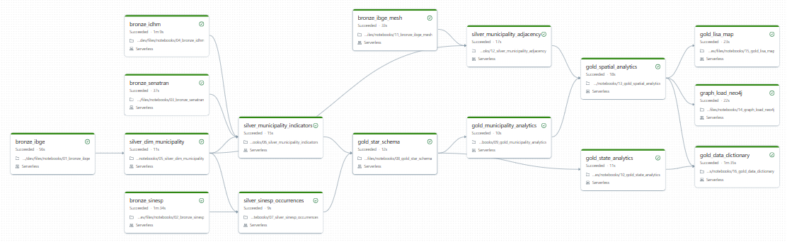
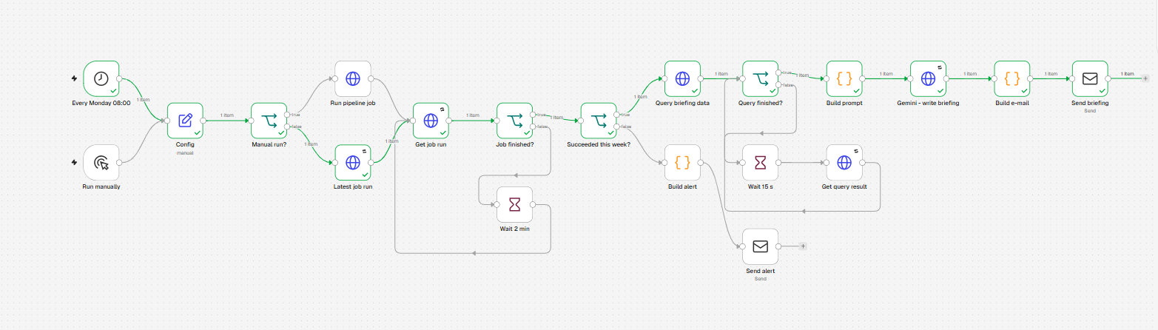
End-to-end automation: the pipeline runs and reports by itself
Databricks Asset Bundle
16 tasks with data-driven dependencies, retries on public APIs and a weekly schedule; validated in CI
n8n + Gemini
checks the job, queries Gold and sends the executive briefing; if the job fails, it sends an alert
Notes:
The job is defined as code and validated in GitHub Actions. n8n delivers the business end: every Monday it sends an e-mail with Gold numbers and a Gemini summary that may only use those numbers.

Slide 9
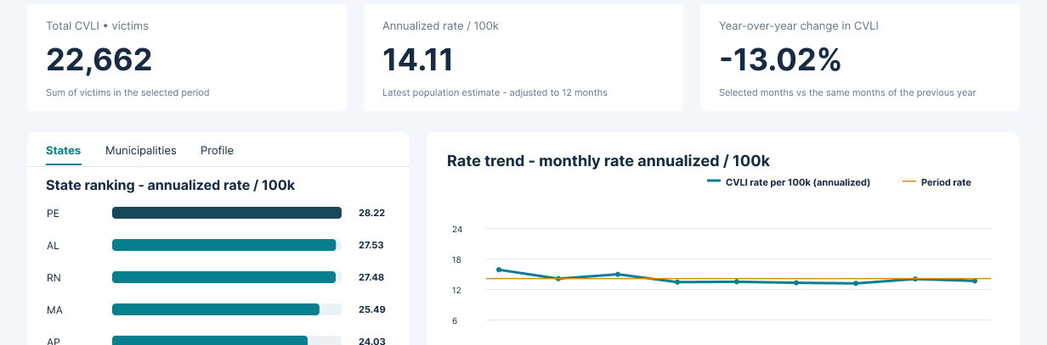

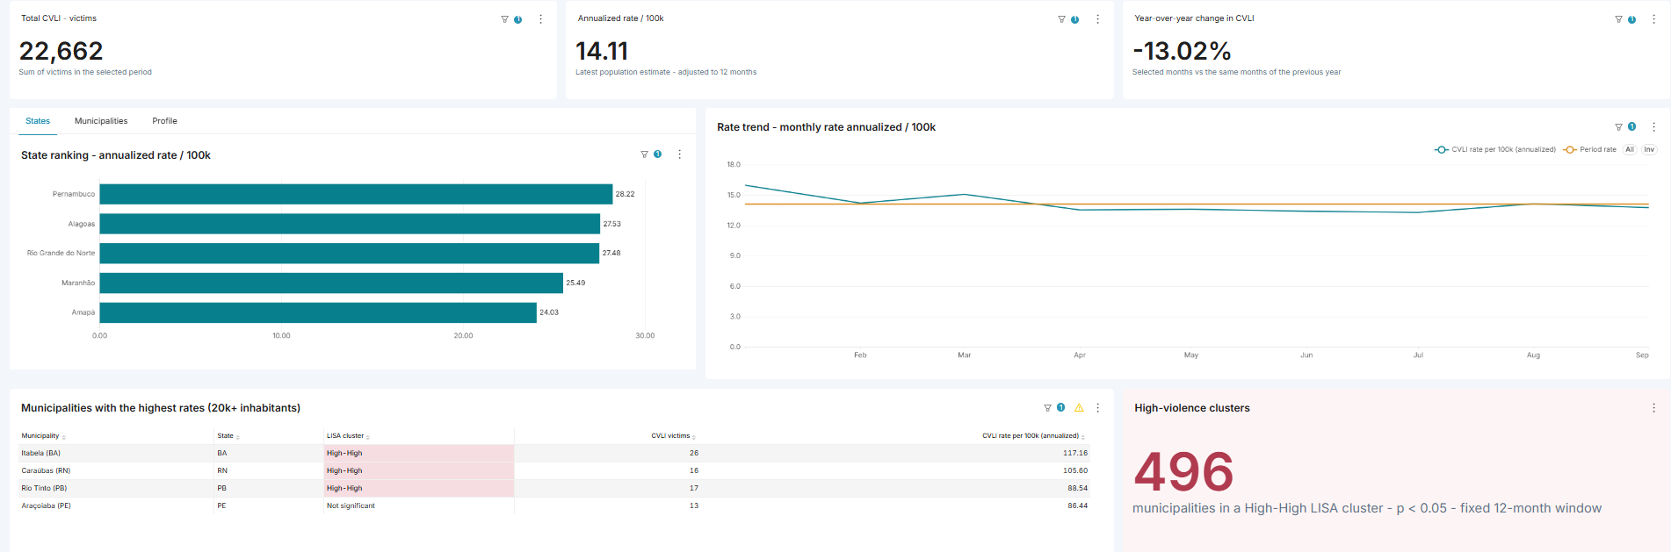
BI dashboard: designed in Figma, built in Superset
Figma prototype
three views (Brazil, state, municipality) drawn with the real Gold numbers before any chart was built
Apache Superset
read-only semantic layer over the Gold export, one formula per metric and the dashboard versioned as code
Notes:
Design first: the prototype fixed the questions and the layout, and the Superset build kept both. The Gold layer reaches PostgreSQL through an export checked by hash and row counts; Superset reads views through a read-only role, and every rate is a ratio of sums defined once. Both show the same numbers: Brazil 22,662 victims and 14.11 per 100k, Rondônia 248 and 18.82, Porto Velho 87 and 22.29.

Slide 10
Data engineering with production practices
Incremental
Tests and CI
Quality
SHA-256 hash per file, only changed partitions replaced, change log
147 pytest tests on local Spark; lint and bundle validation in GitHub Actions
quality gates, QA of unmatched names and audit of fuzzy matches
Governance
Security
Traceability
data dictionary in Unity Catalog and as a download (Excel, CSV)
secrets only in secret scopes and credentials; nothing sensitive in Git
every AI run and every load is recorded
Notes:
These are the practices I apply at work in data governance: the project was built to be maintained, not just to run once.

Slide 11
Decisions that make the difference
01
Numbers come from data, text comes from AI
02
The model proposes, a person decides
In the briefing and the assistant, the model only writes about query results.
In the registry review, nothing changes in the pipeline without human approval.
03
Measure before trusting
04
Be transparent about the data
Labeled sets and automatic evaluation after every model or prompt change.
SINESP limitations made explicit: police records vary between states.
Notes:
If I had to sum up the project in one idea: useful generative AI needs trusted data and controls in code.

Slide 12


Next steps
Certifications and credentials
Power BI version of the dashboard (semantic model and DAX)
Neo4j Graph Data Science
Neo4j & Generative AI
IFDM (Firjan) to update the social component of the index
Azure Databricks Platform Architect
Extend the AI review to unmatched names
Generative AI Fundamentals (Databricks)
Thank you!
github.com/Christiellen/Public-Safety-Intelligence-Lakehouse
Notes:
Closing: next steps and certifications. Open for questions.

