Slide 1
ASP3231 Project

Slide 2
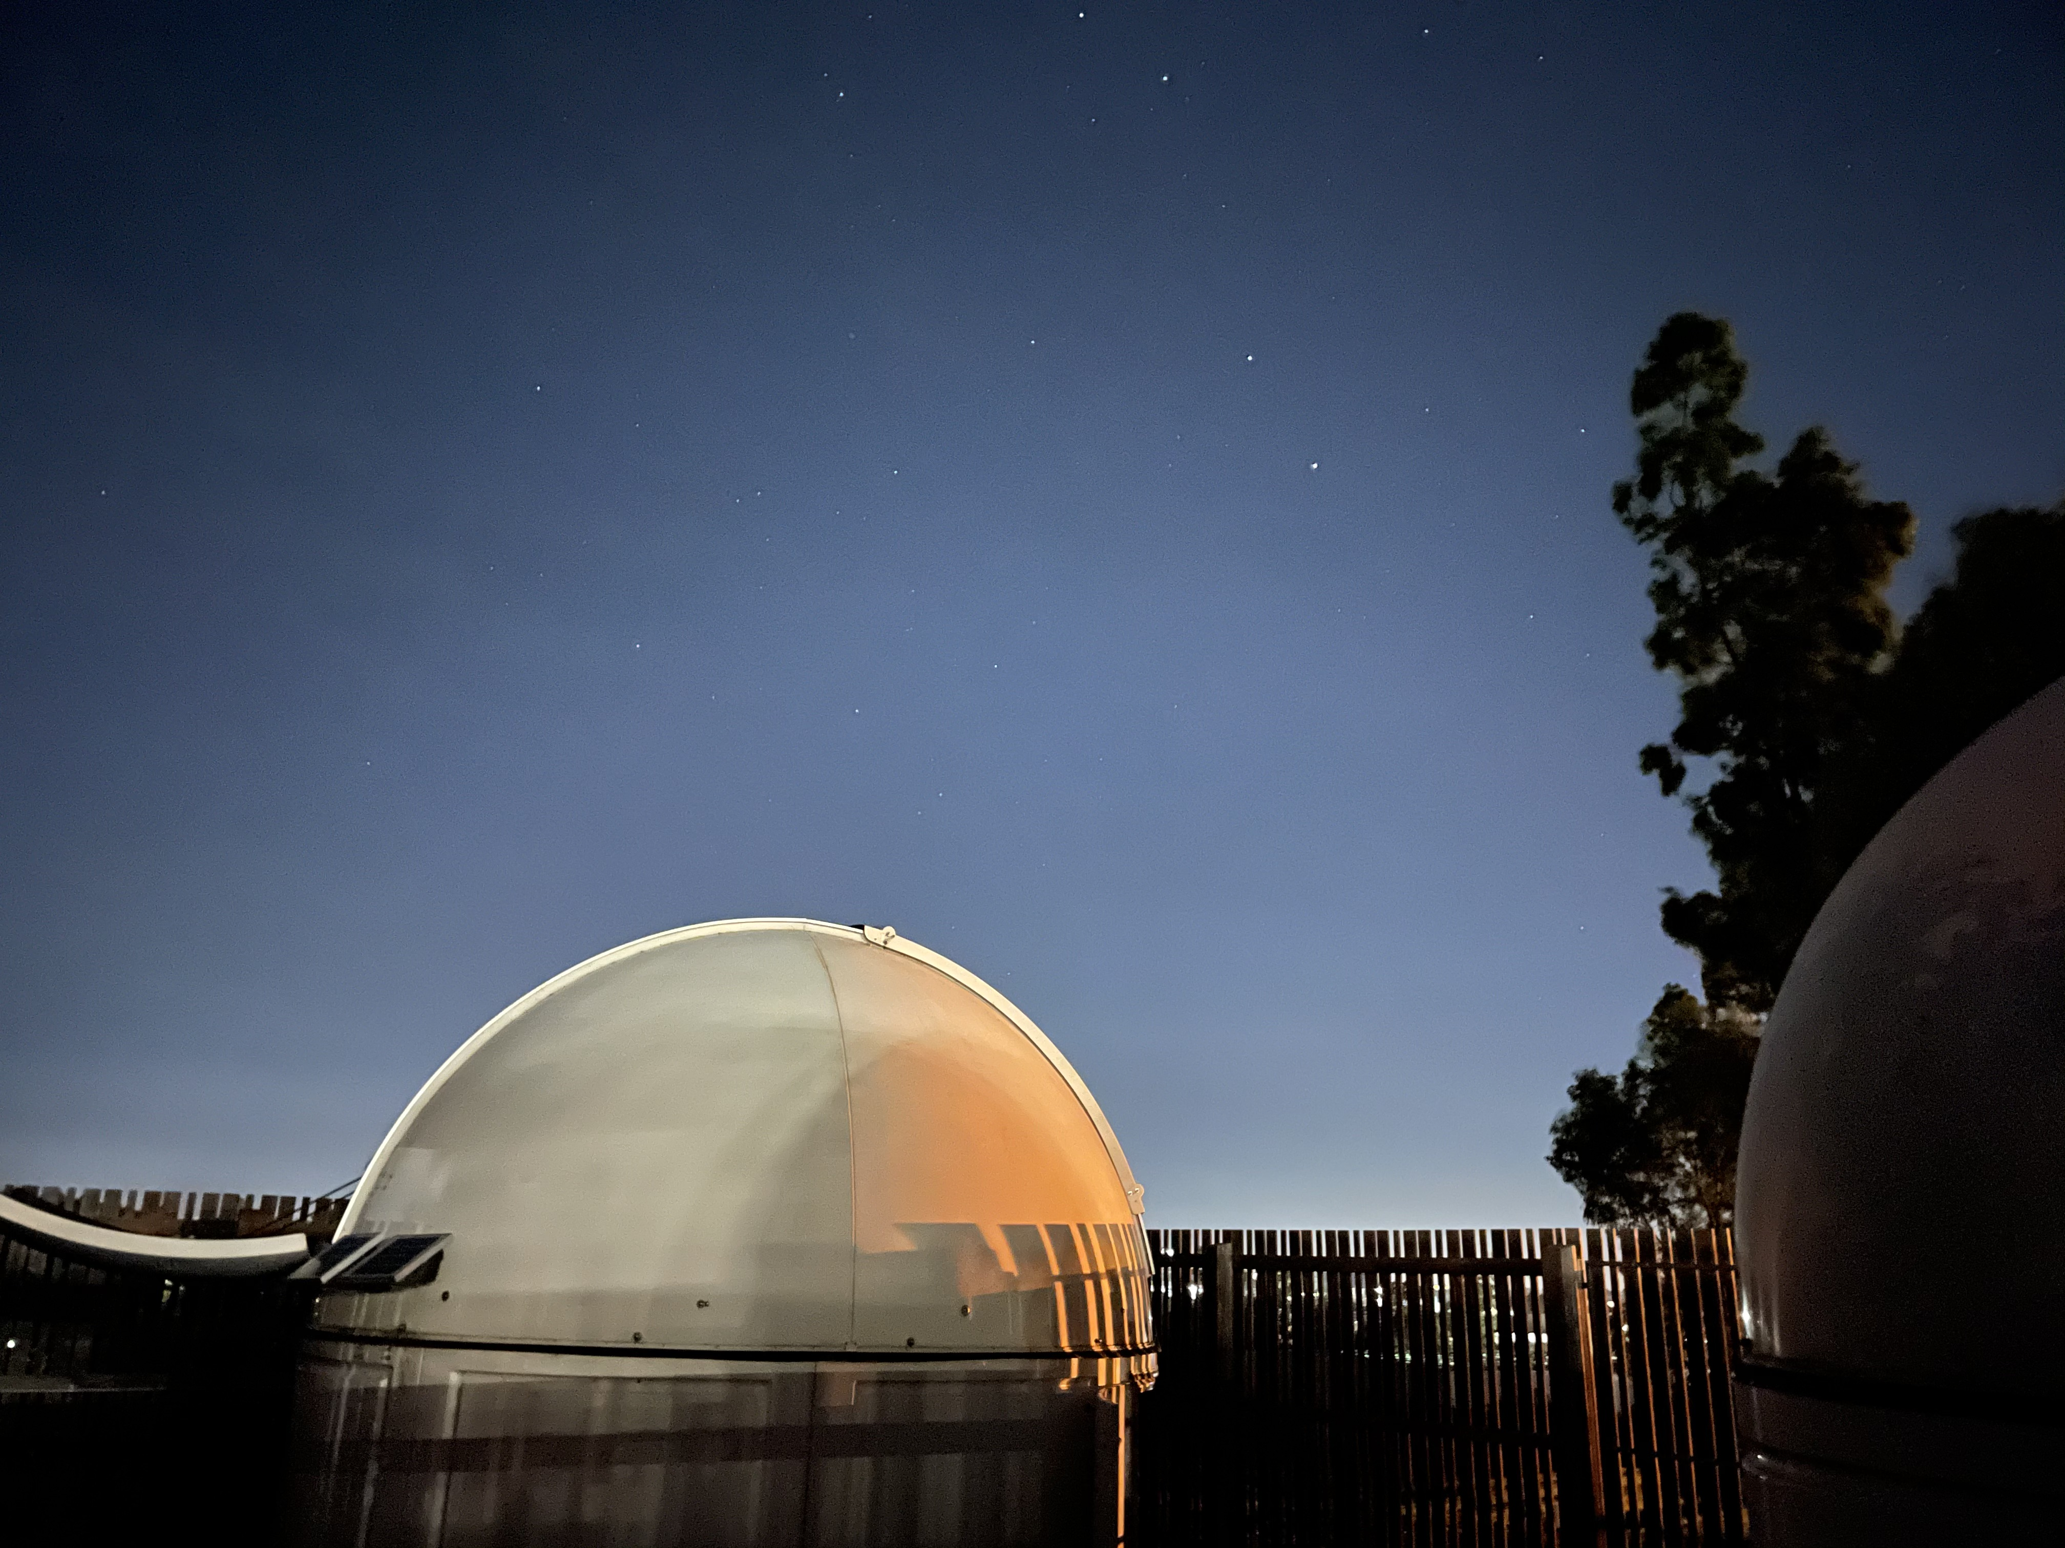
Assignments
Assignment 1 is marked
Assignment 2 is available and due the end of next week
Keep across the videos and work through their notebooks

Slide 3
Project
Combined images should be done (even if improvements needed)
Catalogues and photometry should be done (or close)
HR Diagrams (clusters, globular clusters, LMC)
Colours (globular clusters)
Comparison with main sequence and isochrones
Distance (or lower limits on distance)
Constrains on the age
Use today and the discussion forum
Use the notebook submission for feedback available now

Slide 4
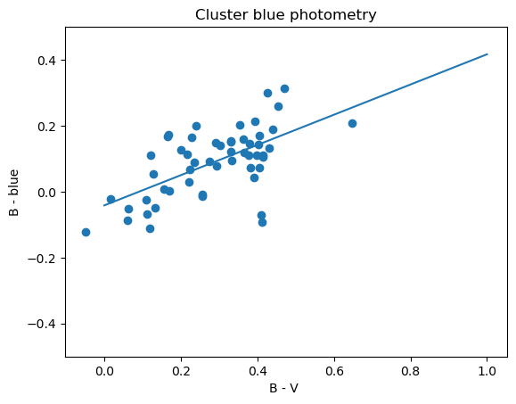
Shifting B, V & R to SeeStar Blue, Green & Red
SeeStar photometry is Vega-based
Green and Red are similar to V and R
Blue is a bit different to standard V
Peak wavelength ~4500 Ang for Blue vs ~4000 Ang for B
Blue = B - 0.45836779 * (B-V) + 0.04156237 for 0.0<B-V<0.6)

Slide 5
Week 9 Sparkler Talks
90 second sparkler talks
One slide – with Group Number included in the filename & the title
Check the observing schedule for your group number
Submit the slide by Thursday AM so I can make one presentation
Discuss what your object is
Some of its basic properties
The data you’re using
The analysis you will do
Why?
Explaining a topic to others is a good way of getting across the key points and identifying knowledge gaps.

Slide 6
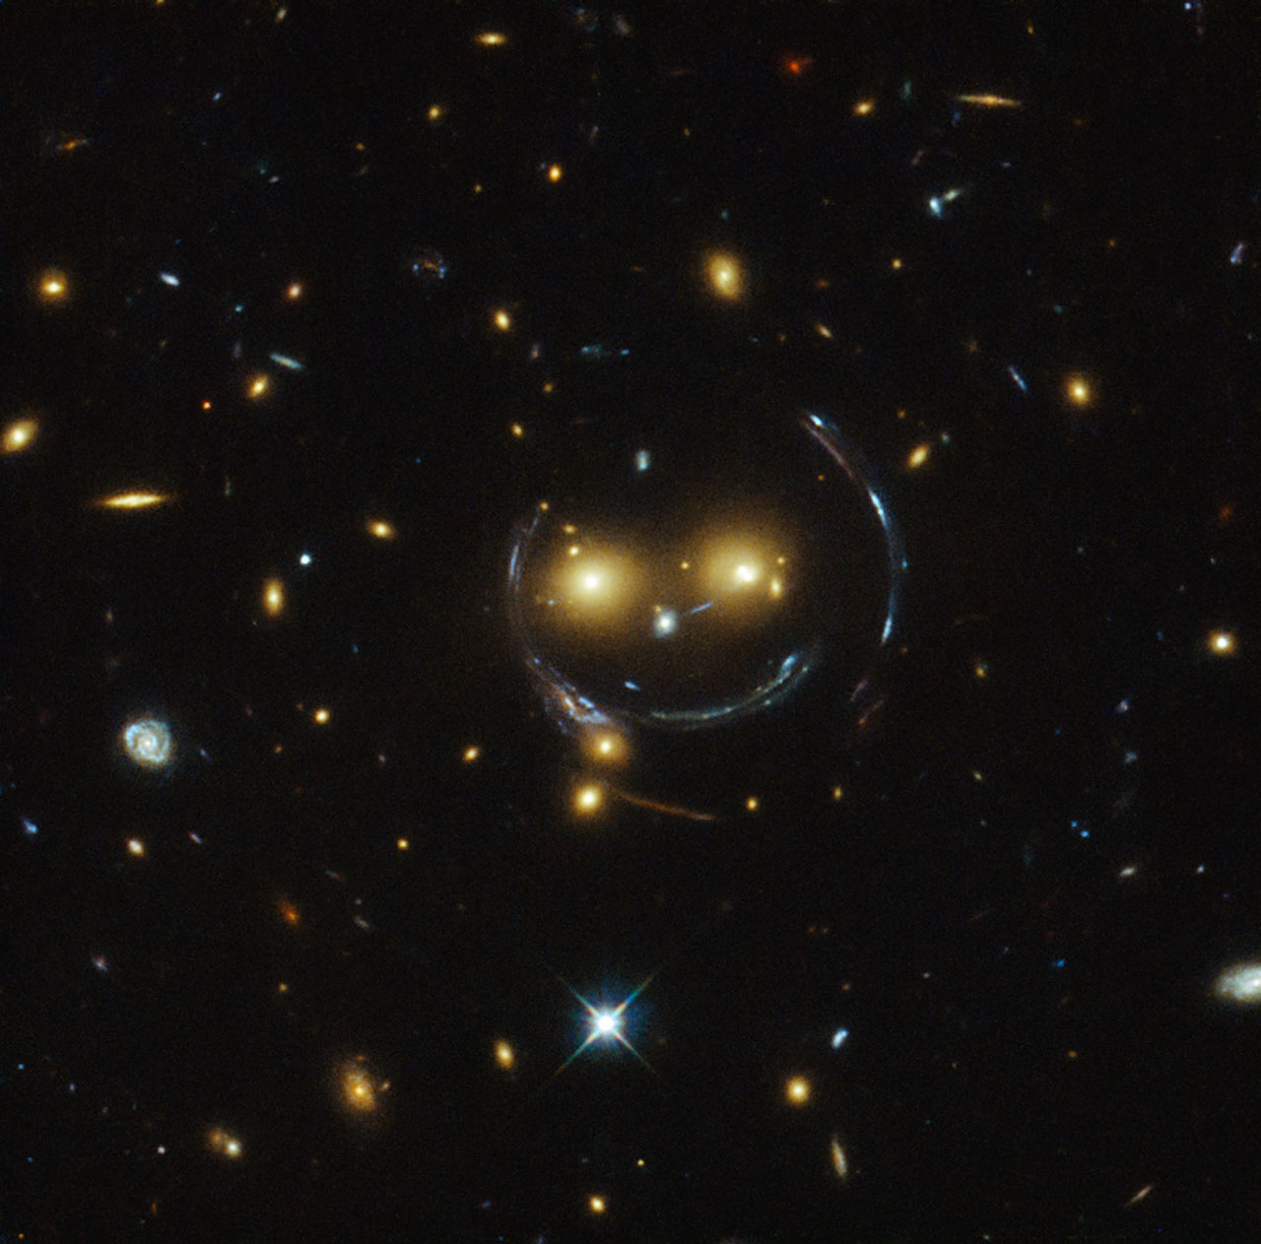
Group 10: NGC 1234 Onson Sweemey, Rey McSriff, Bobson Dugnutt
A whatsit cluster of thingamies
Literature distances of ~9 kpc (e.g. Dustice 2009)
Literature ages of ~2 Gyr (e.g. Gride 2013)
BVR imaging of 23/3/2023 (cloudy) and 29/3/2023
Distance determined using HR diagram and comparison absolute magnitudes and colours of chocolate chip biscuits.
Thingamies masses determined using absolute magnitudes and luminosity-mass relation of Dandleton et al. (2004)
BVR combined images and catalogues done, currently fitting HR.

