Slide 1
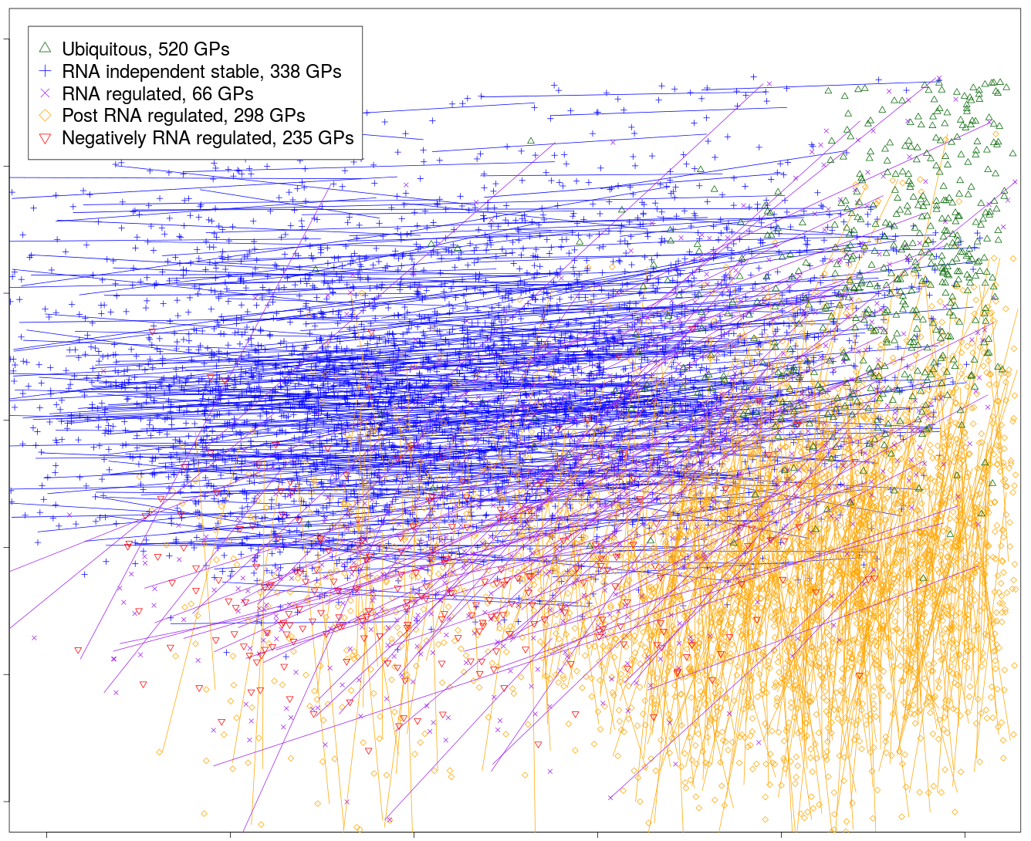
Supplement Figure 5. Comparison of in-situ hybridization data of region-specific gene product from Allen Atlas website with current profiling data
Current proteome profiling vs. Allen atlas ISH
3
2
1
iFOT ( log10)
0
-1
-2
-3
-3
-2
-1
0
1
2
ISH level (log4)

