Slide 1
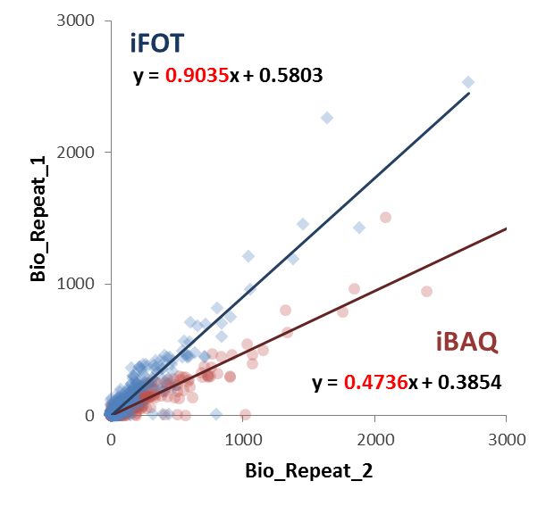
(B)
(A)
Supplement Fig. 1. Comparison of iBAQ and FOT

