Slide 1
Welcome to CEVE 101
Dr. James Doss-Gollin!

Slide 2
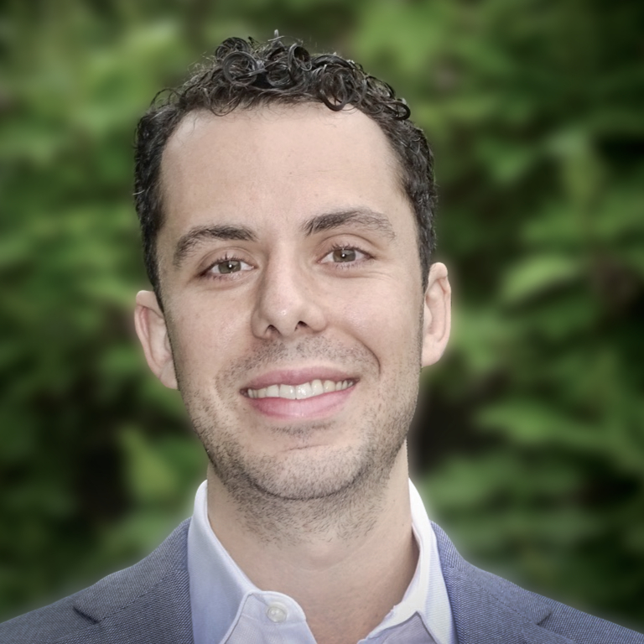
Meet the Professor
Assistant Professor of Civil and Environmental Engineering
dossgollin-lab.github.io
jdossgollin@rice.edu
Office hours: book on Calendly
Notes:
Call me Dr. Doss-Gollin or Professor
Outside the classroom, I often go by James
This doesn’t bother me but in general, it’s good to address professors by their title
I will do my best to teach the “hidden curriculum”

Slide 3
My background

Slide 4
Why you’re taking this class
Understand what civil and environmental engineers do in practice
Explore potential engineering majors (CEVE, MECH, MSNE, Materials Science)
Learn about sustainability, climate solutions, and environmental remediation
Gain insights into real-world CEVE projects and career paths
Discover how CEVE connects to other fields (business, psychology, oil & gas)
Better plan a trajectory thorugh a CEVE major

Slide 5
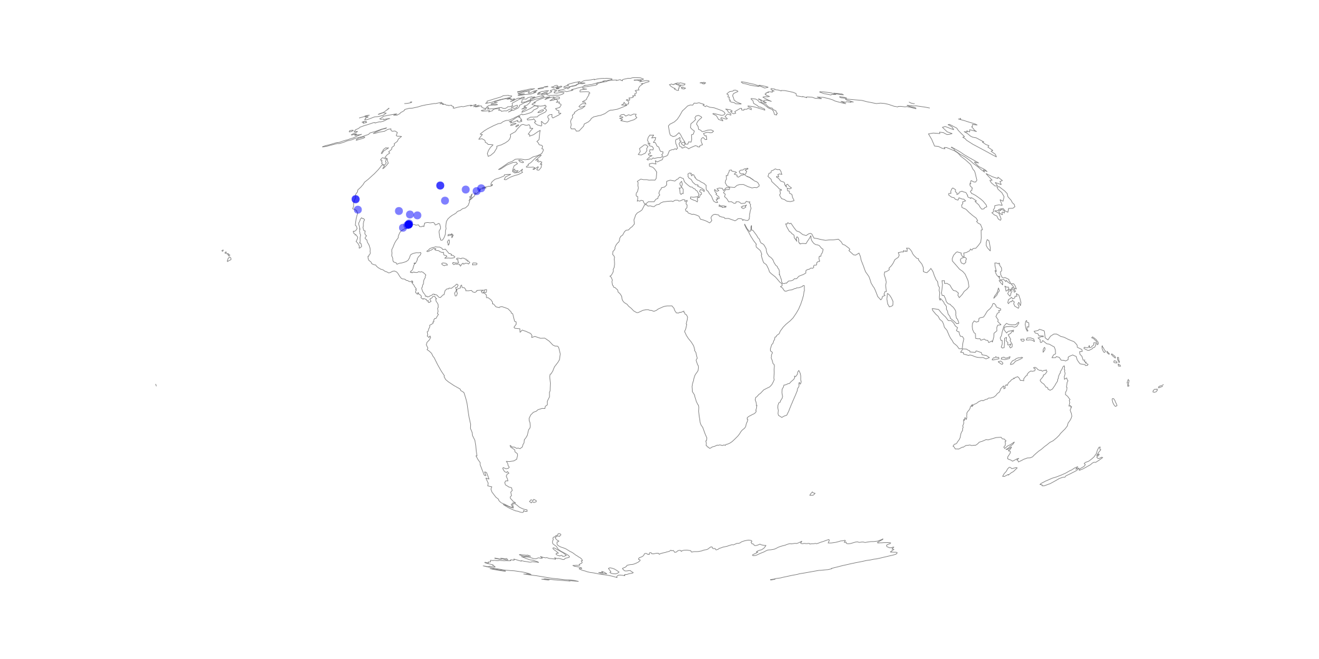
Your Hometowns
# Get coordinates for a location function get_coordinates(location) url = "https://nominatim.openstreetmap.org/search?q=$(HTTP.escapeuri(location))&format=json" try response = HTTP.get(url) if response.status == 200 data = JSON.parse(String(response.body)) if !isempty(data) return parse(Float64, data[1]["lon"]), parse(Float64, data[1]["lat"]) else @warn "No results found for $location" end else @warn "HTTP request failed for $location with status $(response.status)" end catch e @error "Error processing $location: $e" end return nothing end # List of locations locations = [ "Shreveport, Louisiana", "Spring, TX", "Glasgow, KY", "Dallas, TX", "Abernathy, TX", "Redwood City, CA", "North Liberty, Iowa", "Victoria, Texas", "Iowa City, Iowa", "Houston, TX", "Bronx, New York", "Pittsburgh, PA", "Houston, TX", "Mountain View, CA", "La Crescenta, CA", "Houston, TX", "Richmond, TX", "Philadelphia", "Houston" ] # Get coordinates for each location coordinates = filter(!isnothing, map(get_coordinates, locations)) # Create the plot fig = Figure() ga = GeoAxis( fig[1, 1]; # any cell of the figure's layout dest="+proj=moll", # the CRS in which you want to plot ) lines!(ga, GeoMakie.coastlines(), color=:gray, linewidth=0.5) # plot coastlines from Natural Earth as a reference scatter!(ga, [c[1] for c in coordinates], [c[2] for c in coordinates], color=:blue, alpha=0.5) hidedecorations!(ga) fig

Slide 6
About Civil and Environmental Engineering

Slide 7
What problems have Civil and Environmental Engineers Solved?
In small groups:
Discuss this question
Have one person fill in group answers at TODO

Slide 8
Origins of Environmental Engineering
National Geographic

Slide 9
Clean Drinking Water

Slide 10
Mega-Projects

Slide 11
Transportation

Slide 12
Why aren’t we “done”?
In small groups:
Discuss this question
Have one person fill in group answers at https://forms.gle/9jJe9uU8czHduroVA

Slide 13
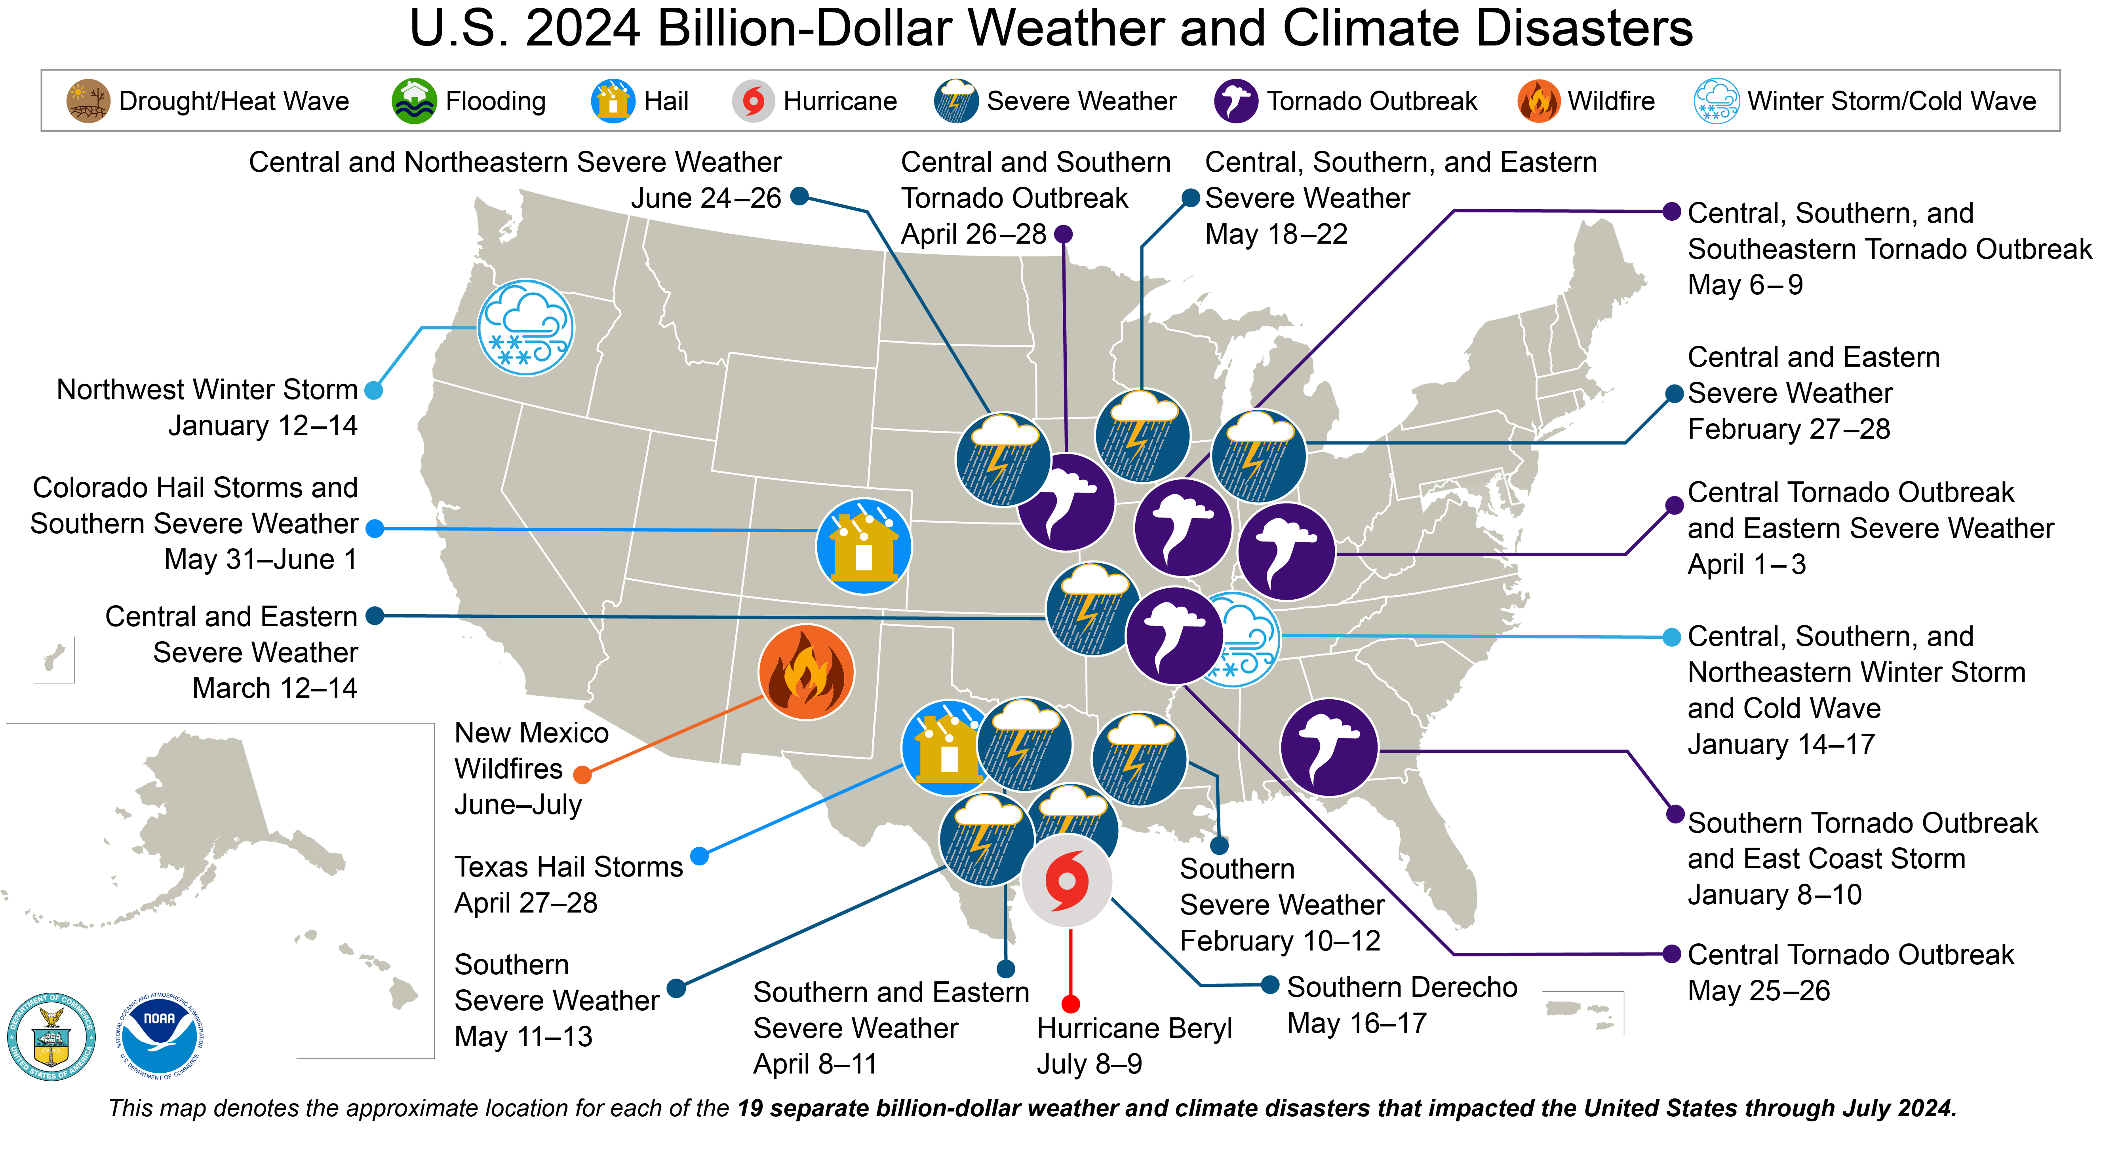
Natural Disasters

Slide 14
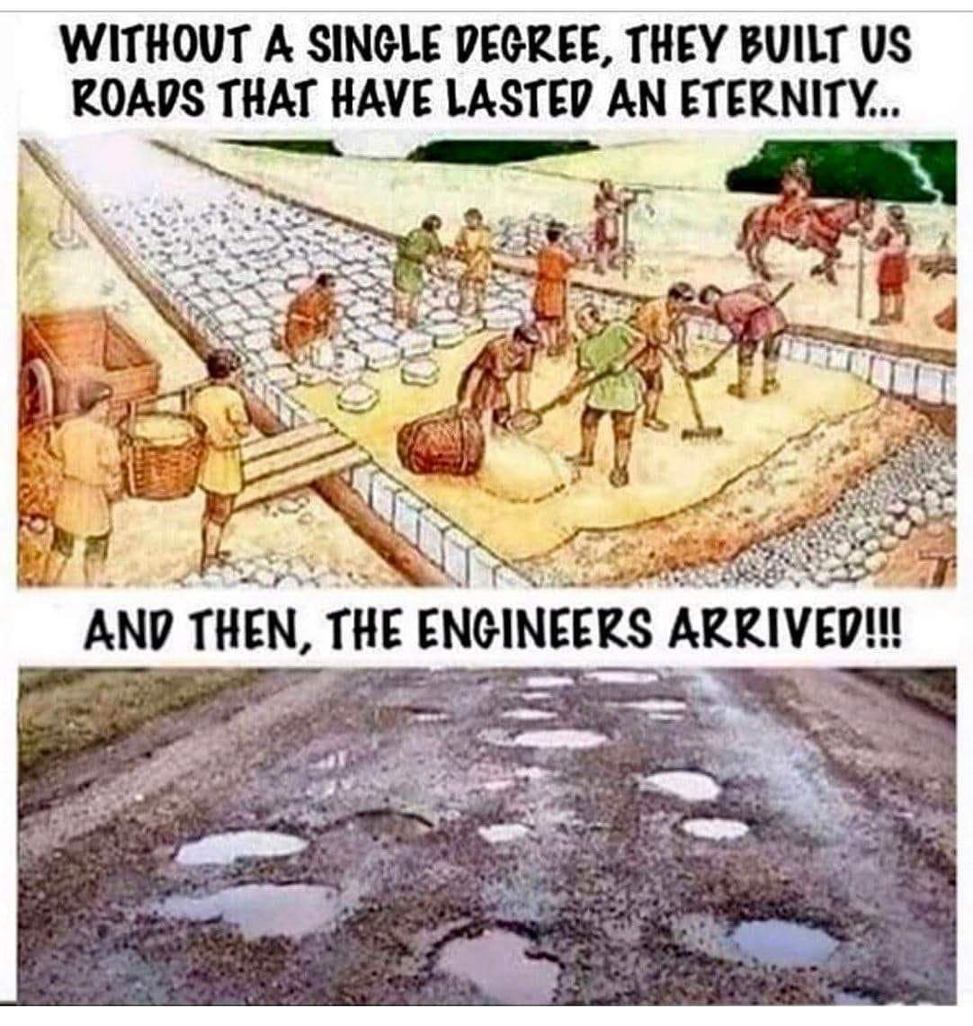
Decaying Infrastructure

Slide 15
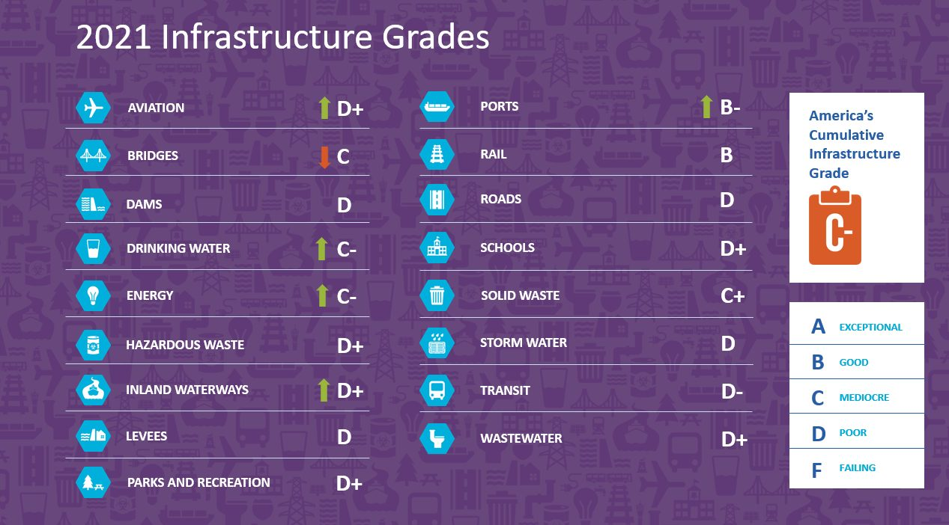
Inadequate Infrastructure

Slide 16
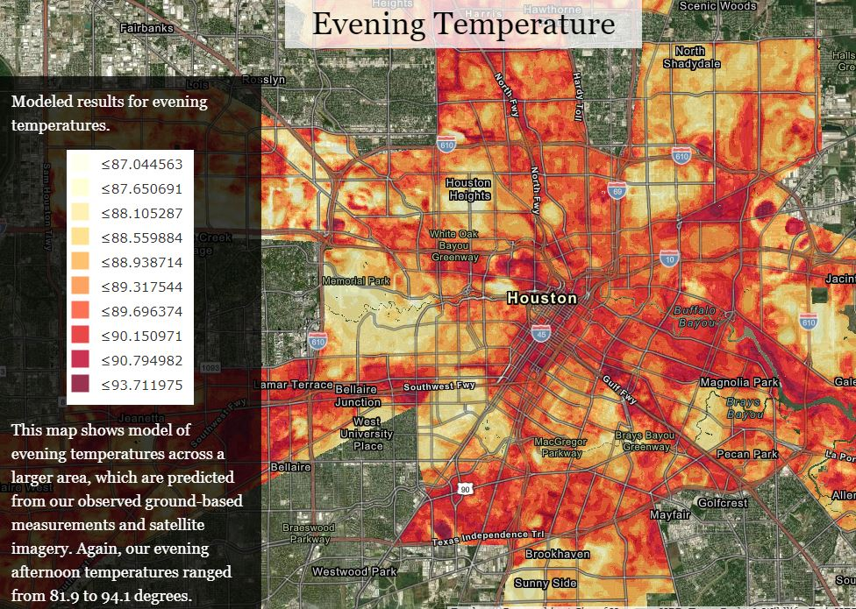
Unequal Burdens

Slide 17
Water Pollution

Slide 18
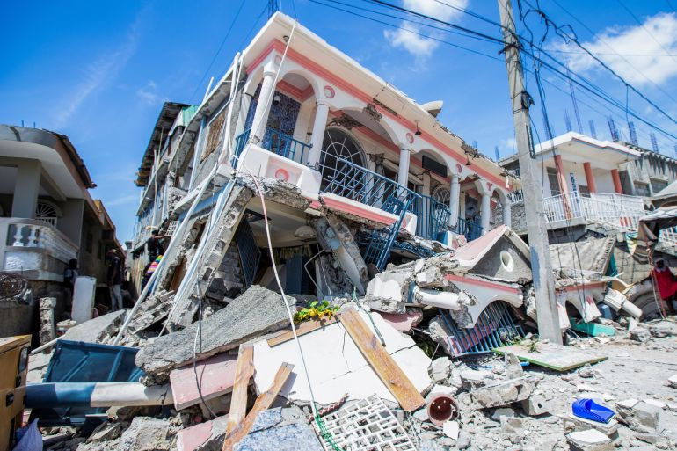
Residual Risk

Slide 19
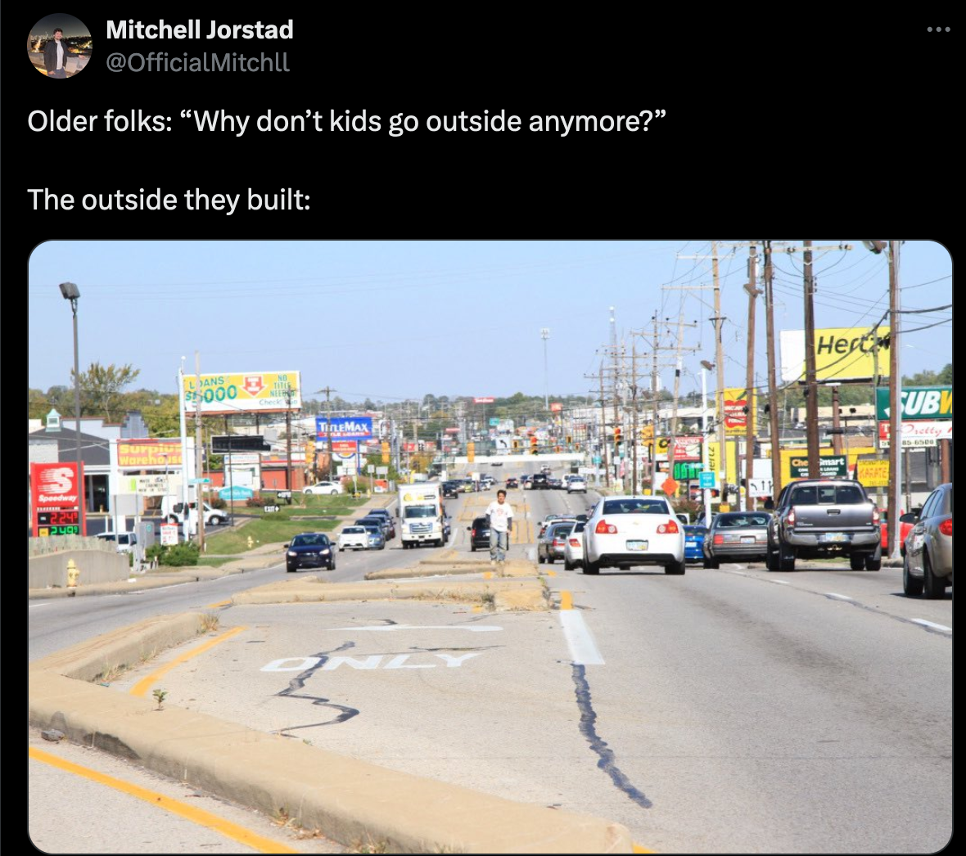
Impacts on Community, Health, and Economy

Slide 20
About CEVE 101

Slide 21
Course Overview
Explore the intersection of built, information, and natural environments
Develop quantitative toolkit to understand and improve sustainability, resilience, and equity in infrastructure systems
Develop skills in data analysis, system modeling, and engineering design

Slide 22
Course Structure
Technical lectures
Topical seminars on applications
Team-based projects

Slide 23
Modules
Four modules, each culminating in a group design project
Climate and energy
Mobility and networks
Water and health
Coastal resilience

Slide 24
Learning Objectives
By the end of this course, you will be able to:
Understand interconnections between CEVE subfields
Apply fundamental principles to solve engineering problems
Generate high-quality engineering calculations and reports
Collaborate effectively in project teams
Recognize the impact of CEVE in addressing global challenges
Evaluate ethical implications of engineering decisions

Slide 25
Course Materials
No required textbook
All materials posted on course website or Canvas
Scientific papers accessible through Rice library
Recommended: Use Zotero for reference management

Slide 26
Grading
Participation (40%)
In-class attendance
Assigned readings
Class discussions
Reading quizzes
Projects (60%)
Four group design projects
One per module
Peer evaluations included

Slide 27
Academic Integrity
Rice Honor Code applies
Collaboration encouraged, but work must represent your own understanding
Proper citation of sources required
Ask if you’re unsure!

Slide 28
AI/ML Resource Policy
LLMs (e.g., GPT) permitted with restrictions
Can be used for coding assistance
Not allowed for generating text submissions
You are responsible for understanding and verifying all output

Slide 29
Getting Help
Canvas Discussions for content questions
Office hours (sign up online!)
Email for personal matters

Slide 30
Course website
Lectures, syllabus, and project descriptions are on the course website
Syllabus
Lectures
Assignments will be posted on Canvas.

Slide 31
About course slides
These slides are web-native, but you may want to save them as PDF for offline viewing or note taking. To print slides:
Open in Chrome / Brave
Press e to open print mode
Print using browser (suggest saving as PDF)
For recommended settings, see RevealJS docs

Slide 32
See you Thursday!

