Slide 1
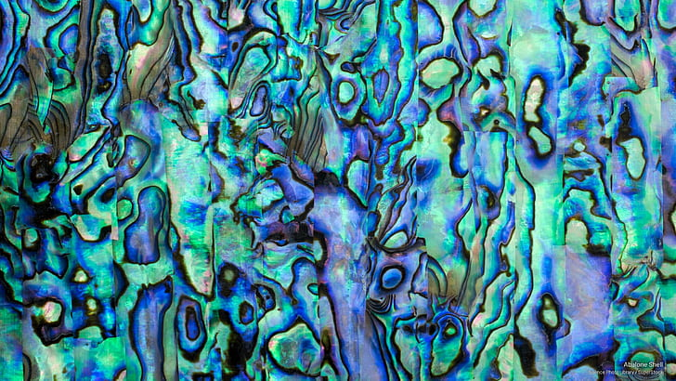
Abalone Age Prediction Midterm Project Christin, Christina

Slide 2
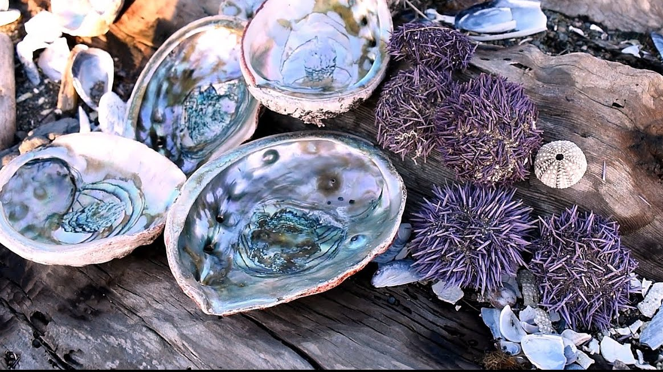
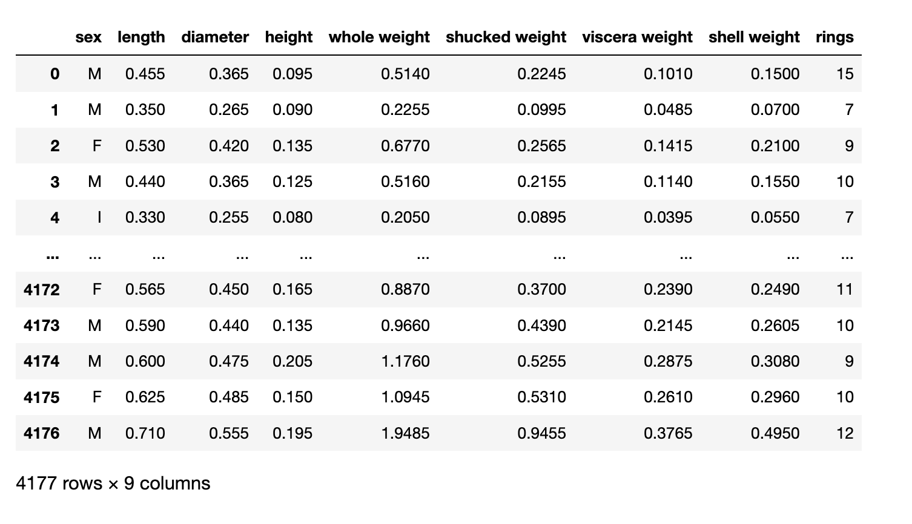
General Info about The Dataset
The Dataset was collected in December 1995 about Abalones that grow in the southeast of Australian
Abalones grow by adding layers to their shell
Adding 1.5 to the number of Rings will give you the age of the Abalone.
8 Variables that are continuous, because they were scaled dividing it by 200
One categorical variable
Total of 4177 observations
Data was cleaned, Nan were removed
Notes:
The Dataset was collected in December 1995 about Abalones that grow in the North Coast and Islands of Bass Strait
Since Abalones grow by adding layers to their shells, so calculating the number of rings inside of the shell and adding 1.5 to it will give you the age of the Abalone.

Slide 3
Central Research Question
Is there an easier way to successfully predict the age of abalones with physical measurements by given observations?
Notes:
Christina
You need to imagine two researcher that for years collect abalones, cut their shells, stain it and countin the found rings under a microscope.
That is not just a very time consuming job at it said but very boring on top.
Since there are plenty of obsvered Abalone already analysed there must be a better way to do it, which leads us to our central research question
We decided to use a Machine learning Model that can help Scientists predict the Age of Abalones by the given variables. If its good model need to be tested

Slide 4
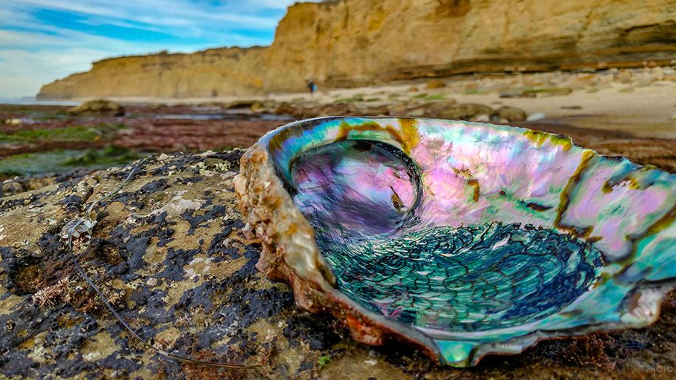
Outline
Bivariate Distributions
Correlations
Linearity
OLS Regression
Conclusion and further Research
Notes:
Christina

Slide 5
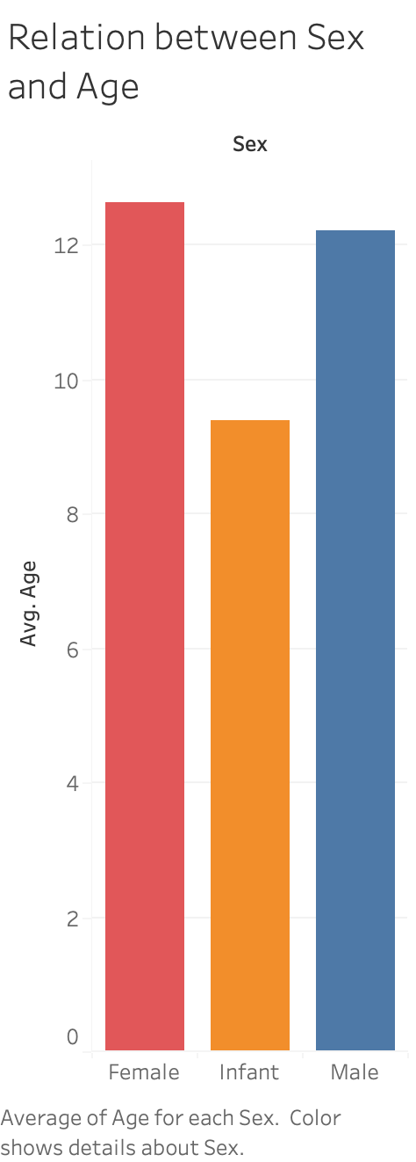
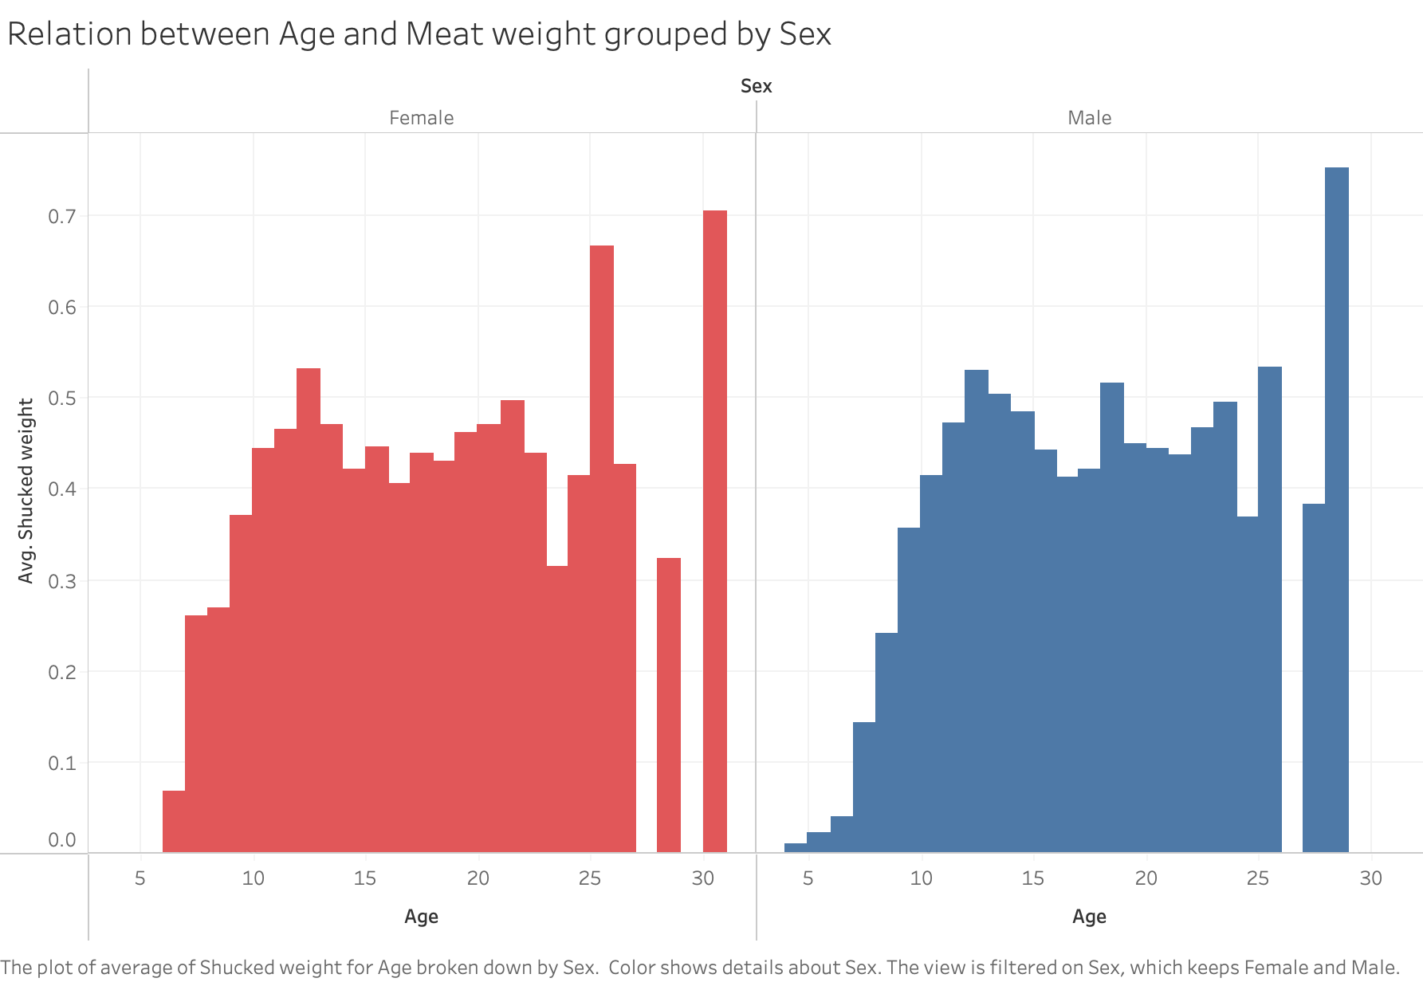
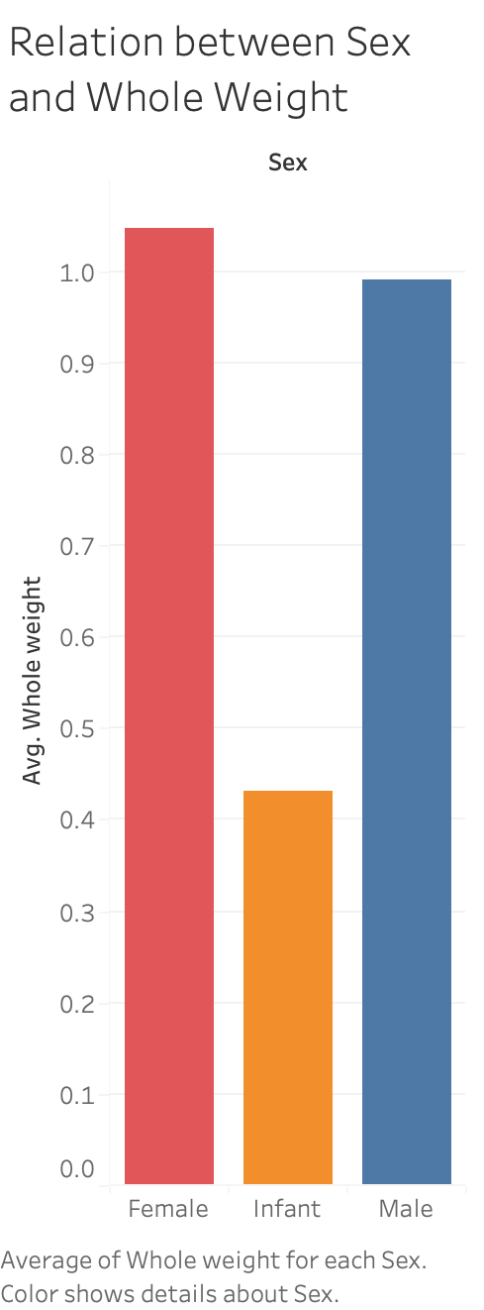
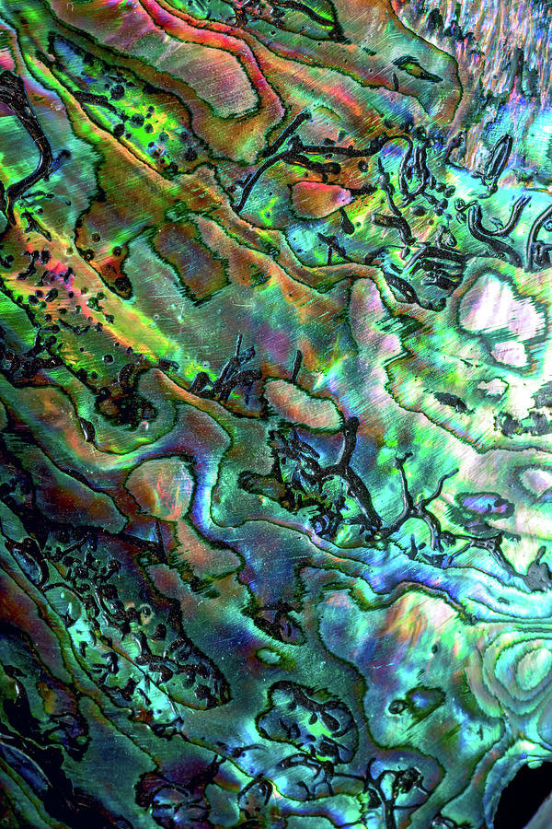
Bivariate Distribution
Average Whole Weight
209,3 gr. Femals
86,28 gr. Infants
198,3 gr. Male
Average Age (Rings + 1,5)
13 years Femals
9 years Infants/ Unidentified
12 years Male
Average Meat Weight by Age
There are no shells older than 31 years old, it is an indication of survival and overharvesting
Meat weight of Males and Females are similar based on age
Note: data collected
was measured in mm and gr and scaled by 200
Notes:
Christin
Here are some insights from our Dataset, which we found interesting to visualize.

Slide 6
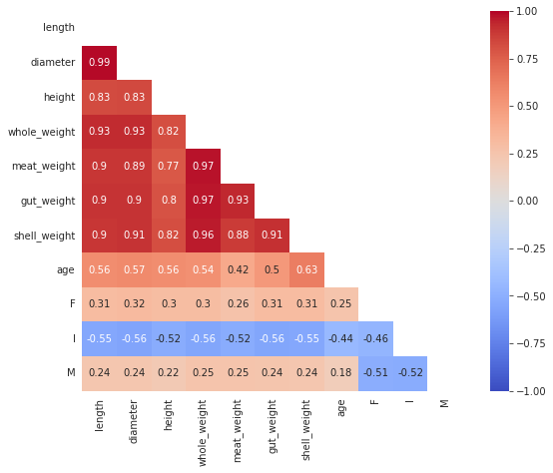
Correlations
Heatmap
Notes:
Christina
As you can see in the heatmap there are some high correlations inbetween our independed variables
Multicolleanrity
When you closer it makes sense that the length of a shell and its height and weight indeed correlate since these messurements belong together.
As we don’t want to anylse the correlation inbetween these we can neglet it.
But we need to keep this inmind for the OLS regression as we see soon.
In the heatmap is also already visible that age correlation with our interested physical messurements
Multicolleanarity

Slide 7
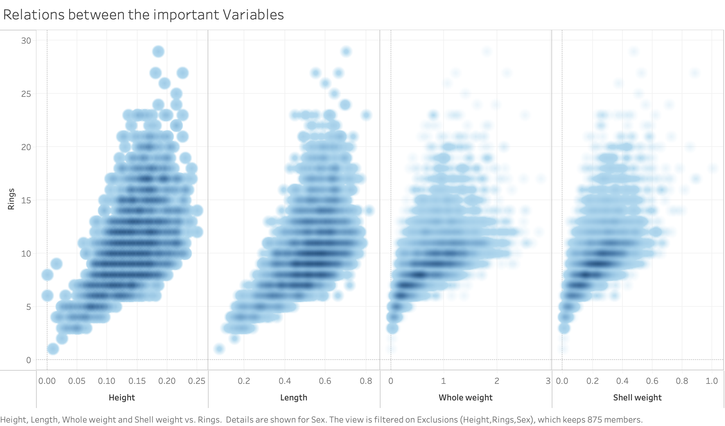
Linearity
Linearity
Notes:
Christin
To show the relation between the most important variables and the rings/age we plotted the distribution of height, length, shell weight and whole weight
It is visible that there are strong connections beetween the variables and the number of rings.
Hight and length have a tendency of growing
But weight has a tendancy of logarithmic growth (inverse of the exponential)

Slide 8
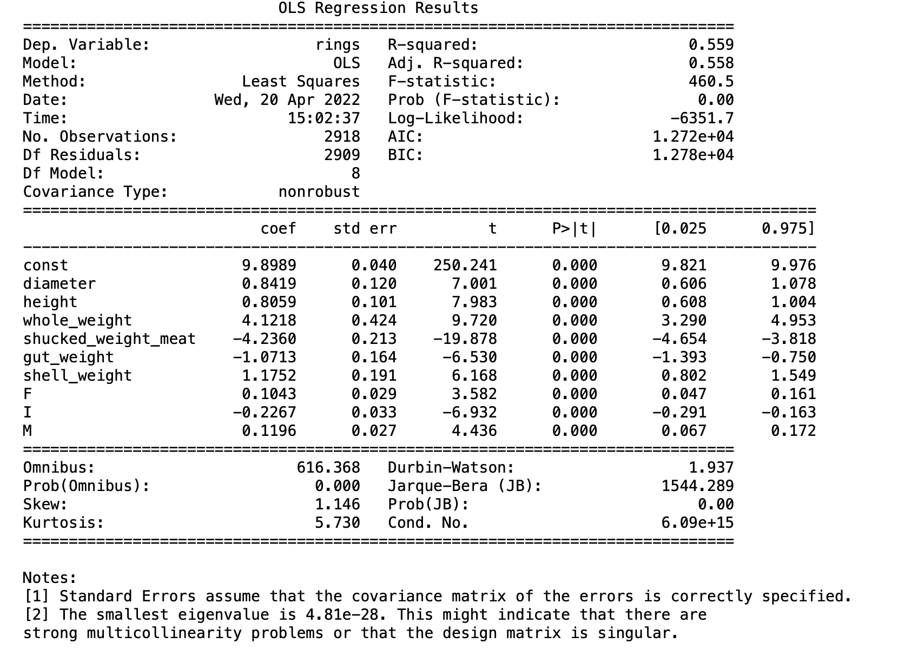
OLS Regression
Notes:
Christina
Scaling variables
Depending Variable Rings/Age
R2 55%
Our model explains 55% of the age of an abalone
All factors are highly significant
Whole weight and shucked weight / meat are the factors are the best predictors
For every change in unit in the weight that means 4 more rings of the shell. 4 rings equals 5,5 years then.
Since the data was transformed and divided by 200 in our dataset this means the shell gains 200 gram of weight in 5,5years
3rd. Model (without length because it wasnt significant and with the dummyvariables of sex)

Slide 9
Conclusion and Further Research
Adjusted R2 shows a max. 55% explained variance to predict the age of an abalone
Variables like nutrition, location, weather conditions etc. are left out, that might could helped improve the model
Sex could be a better predictor for age, if unidentified abalones were better splitted
Multicollinearity allows no valid and logical information about the variable that has the biggest impact
! There are more variables needed to fully predict the age of abalones !
Notes:
The problems with the dataset were the limitations and the cutting out of other variables
Accurate distiction between infants and males and females.

Slide 10
Notes:
:D

