Slide 1
CPP Presentation
members: 李佳纯 黄昊南 邓植仁

Slide 2
Contents

Slide 3
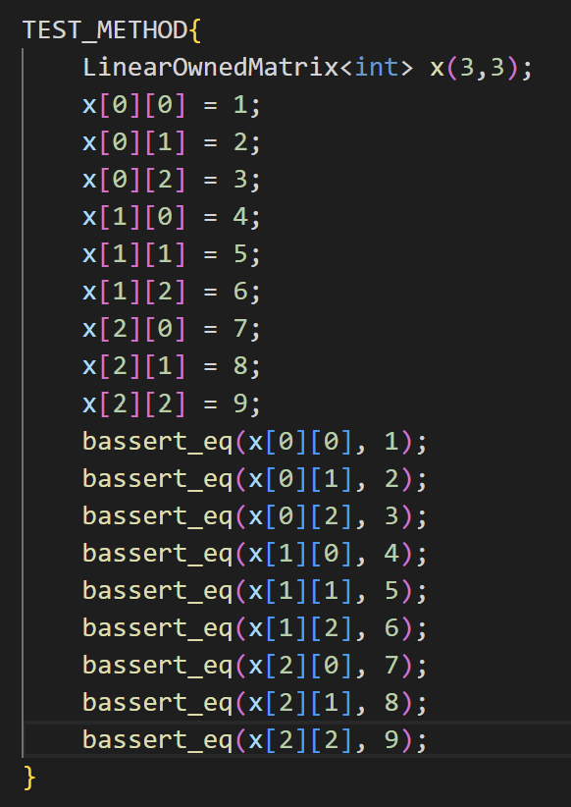
Small Fixed-Size Matrix

Slide 4
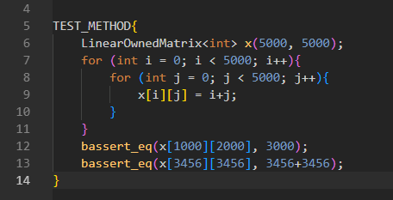
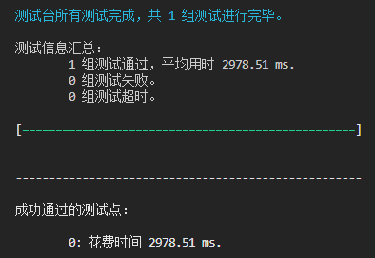
Arbitrarily Large Dense Matrix

Slide 5
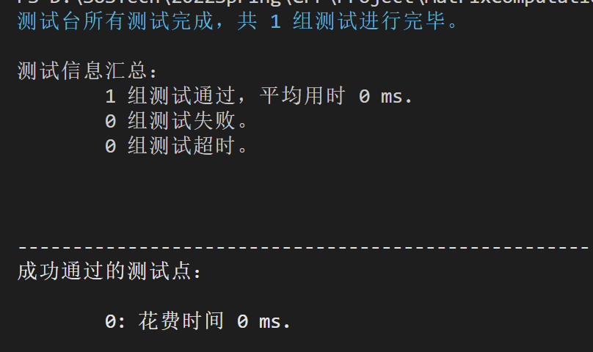
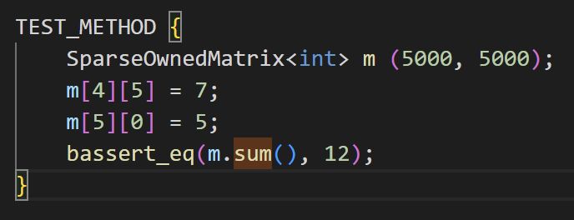
Sparse Matrix

Slide 6
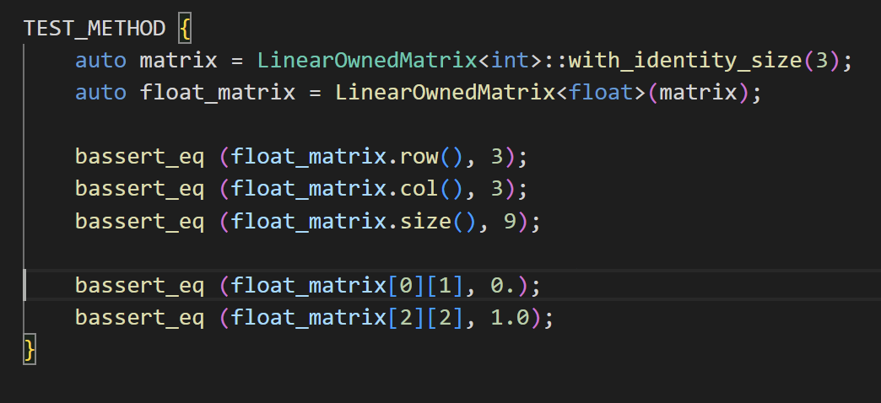
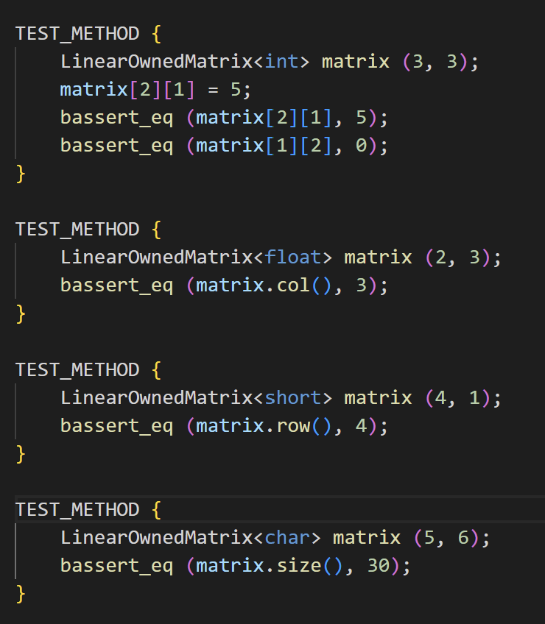
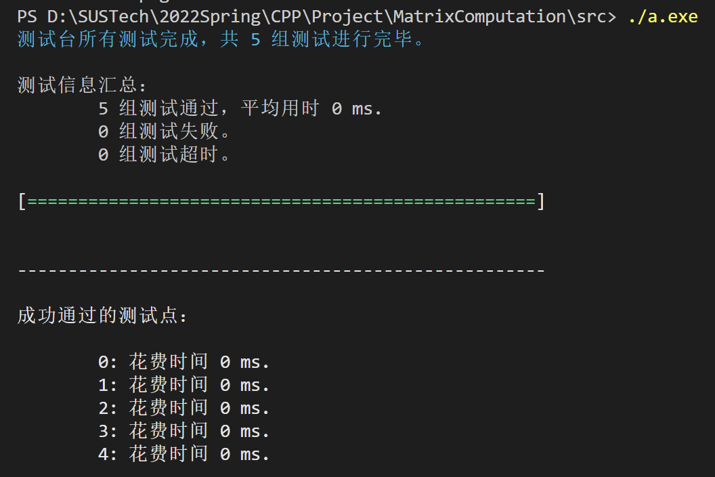
Numeric Types Support - 1

Slide 7
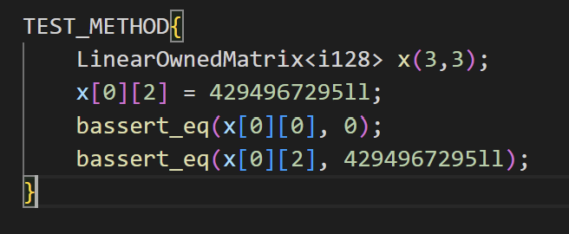
Numeric Types Support - 2

Slide 8
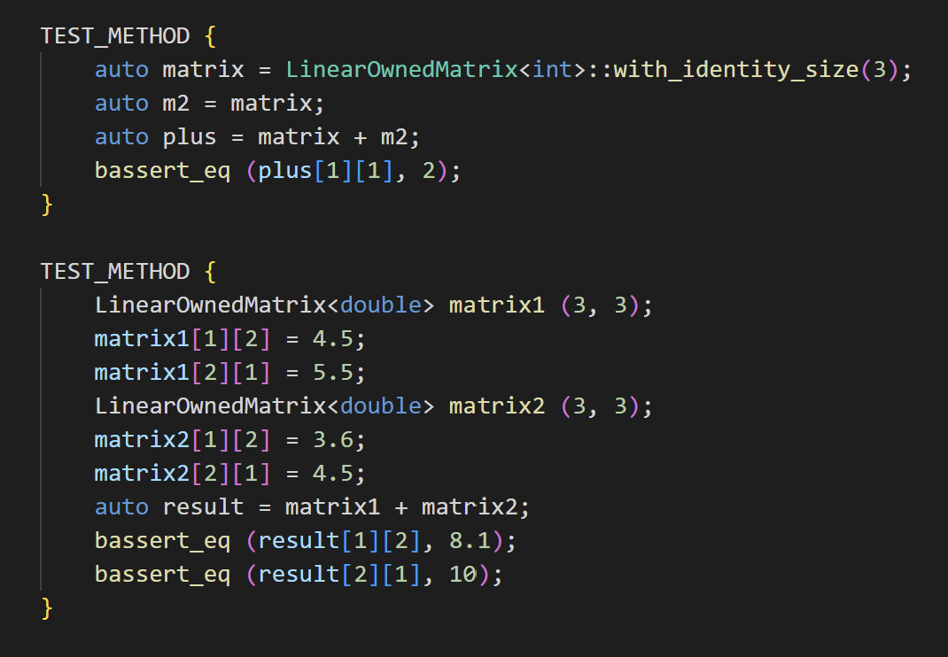
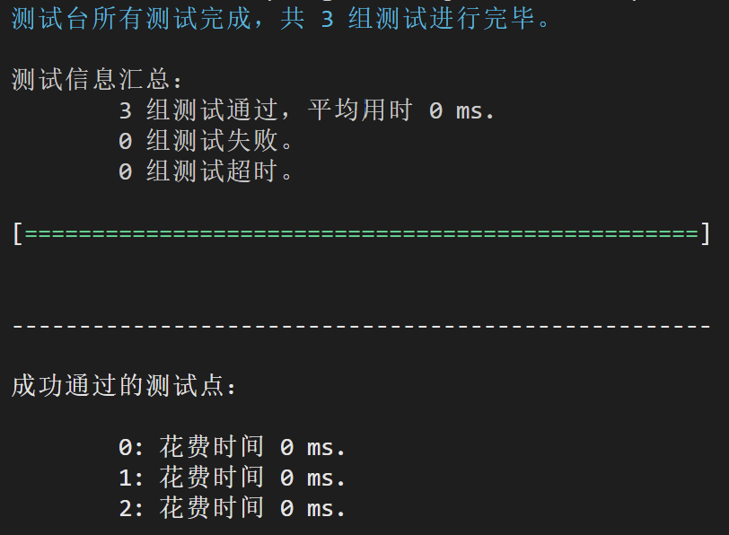
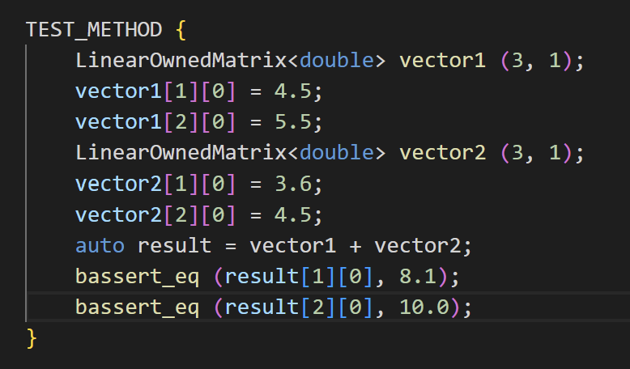
Matrix and Vector Addition

Slide 9
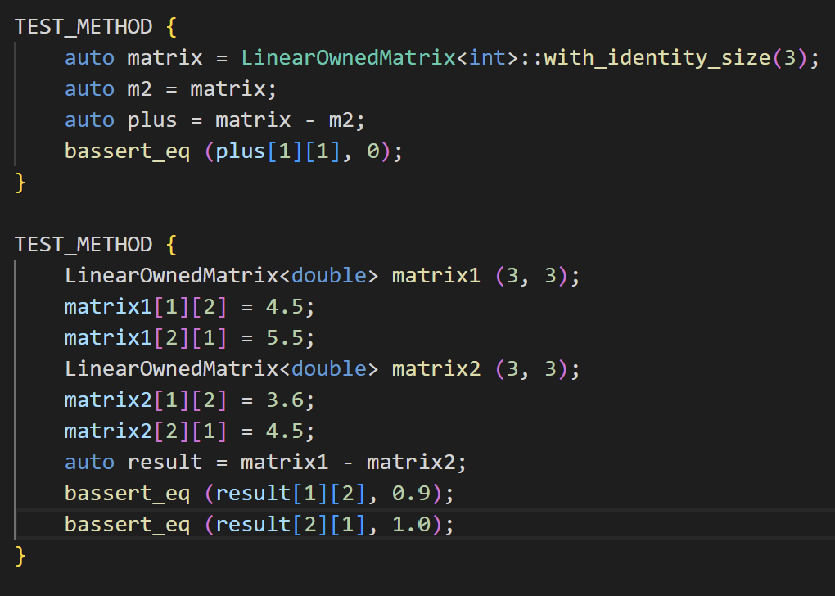
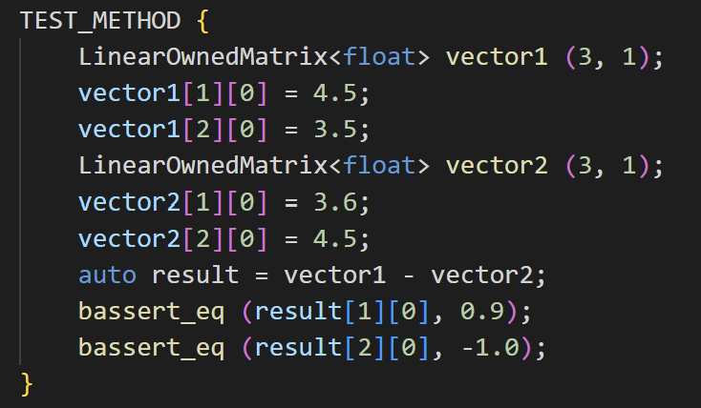
Matrix and Vector Subtraction

Slide 10
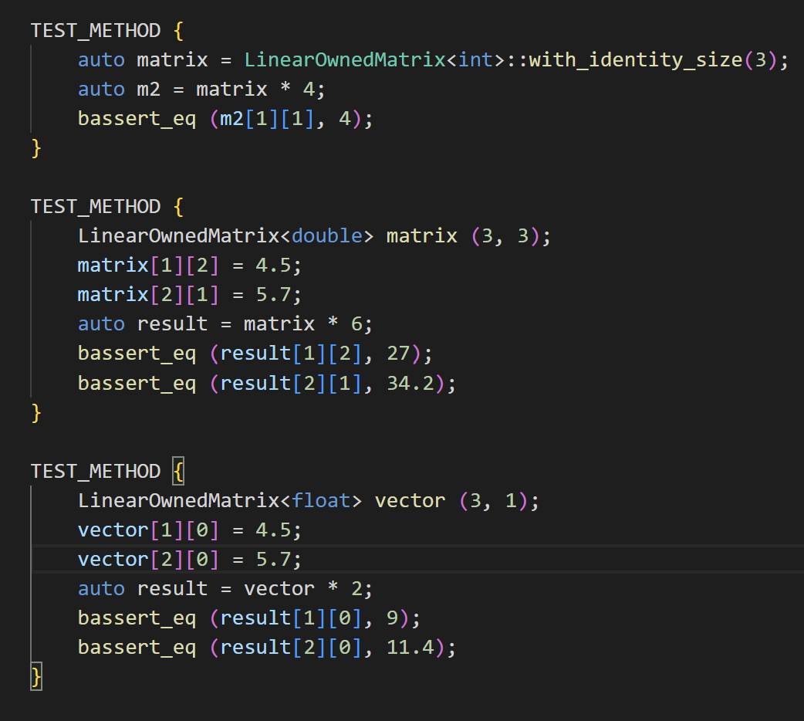
Matrix and Vector Scalar Multiplication

Slide 11
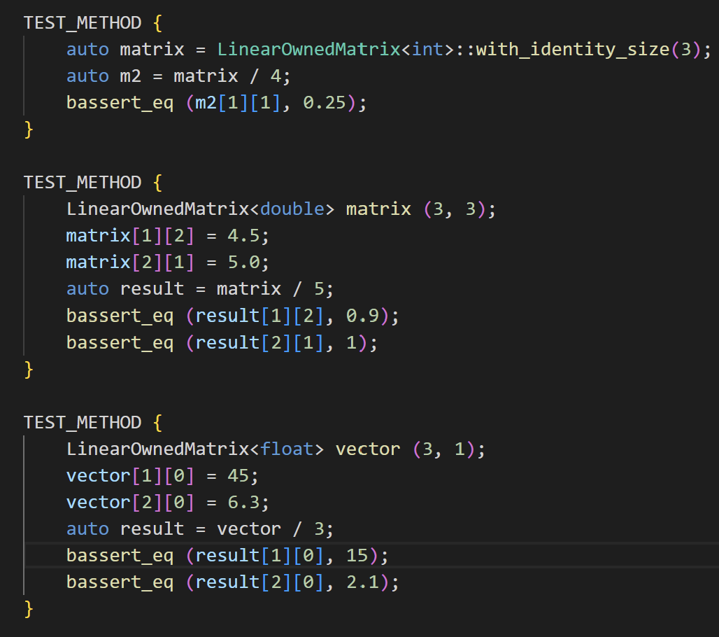
Matrix and Vector Scalar Division

Slide 12
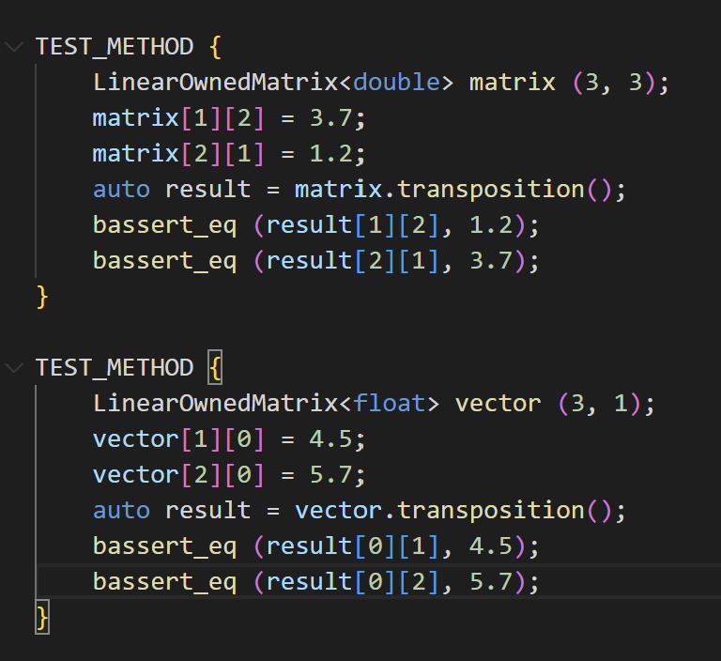
Matrix and Vector Transposition

Slide 13
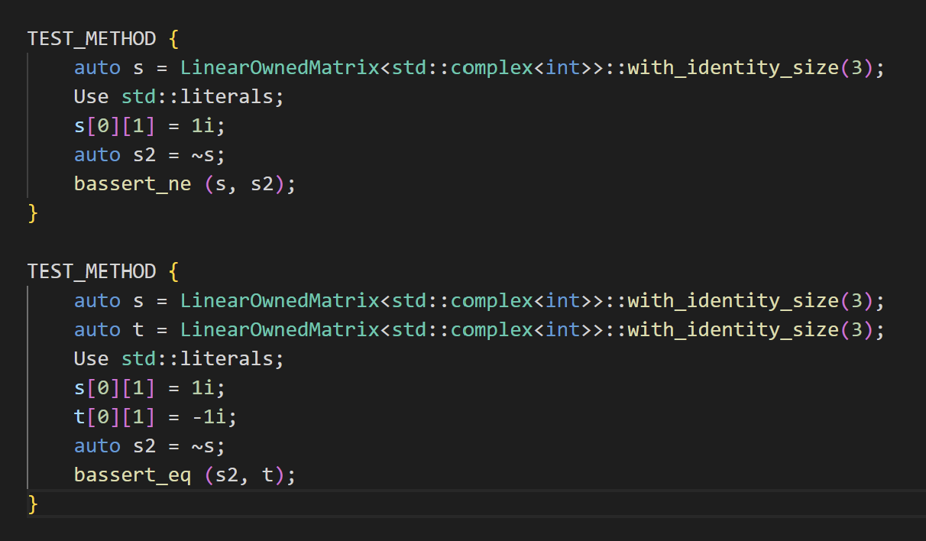
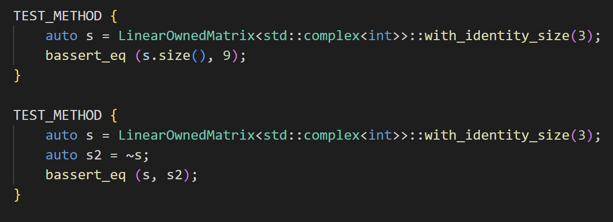
Matrix and Vector Conjugation

Slide 14
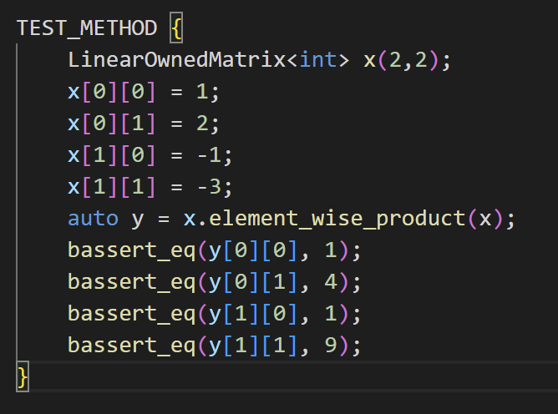
Matrix and Vector Element-Wise Multiplication

Slide 15
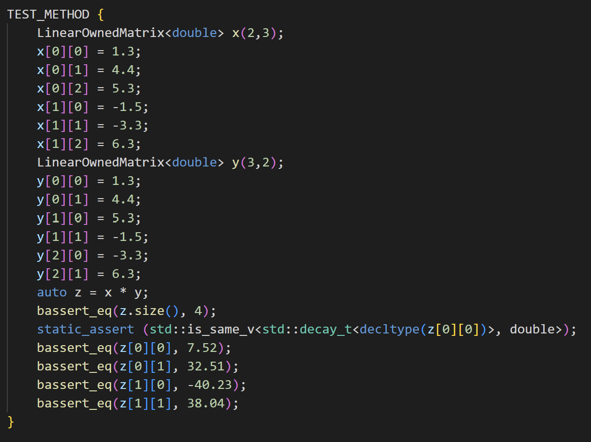
Matrix-Matrix Multiplication

Slide 16
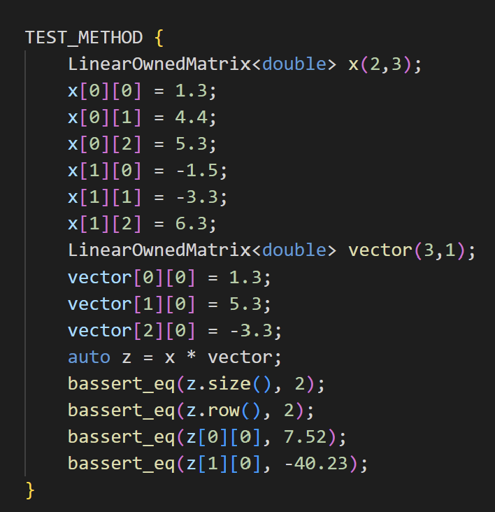
Matrix-Vector Multiplication

Slide 17
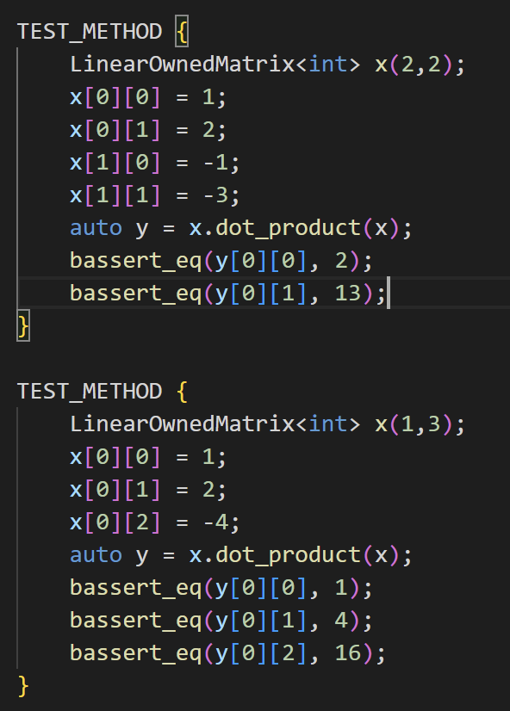
Matrix and Vector Dot Product

Slide 18
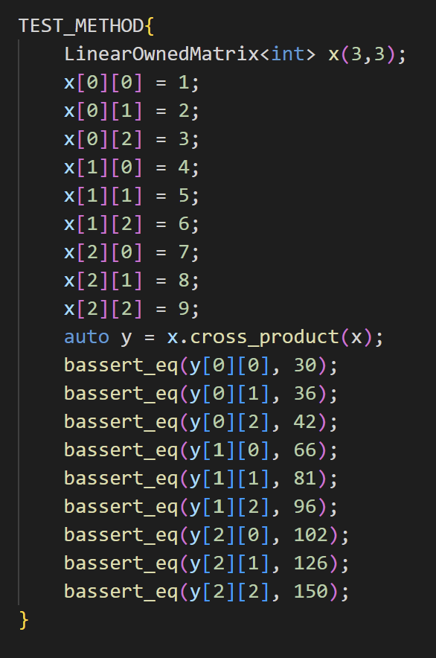
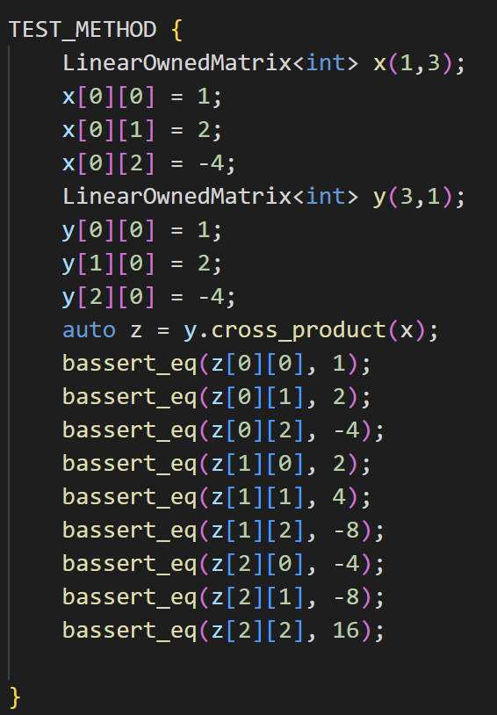
Matrix and Vector Cross Product

Slide 19
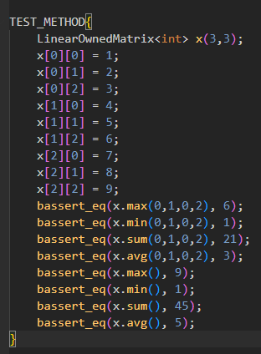
Max Min Sum Avg

Slide 20
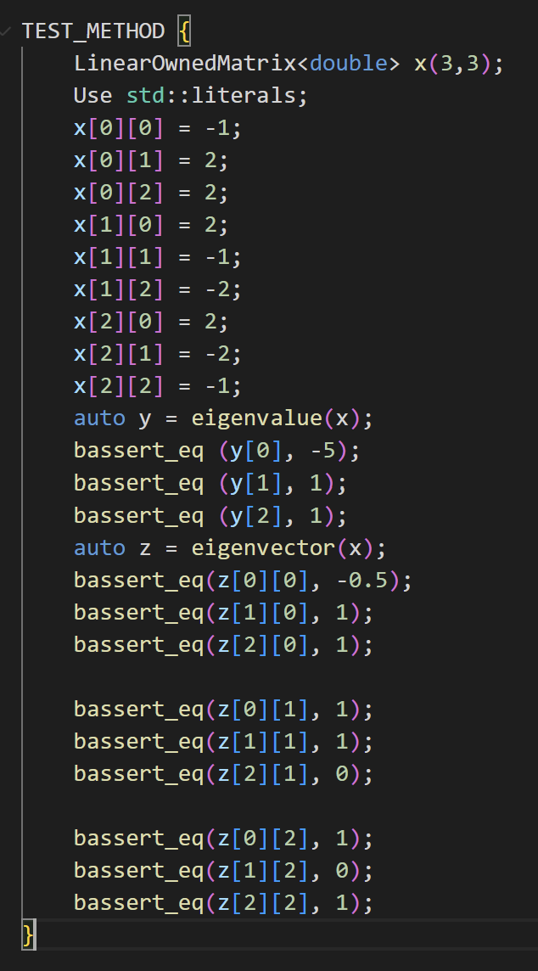
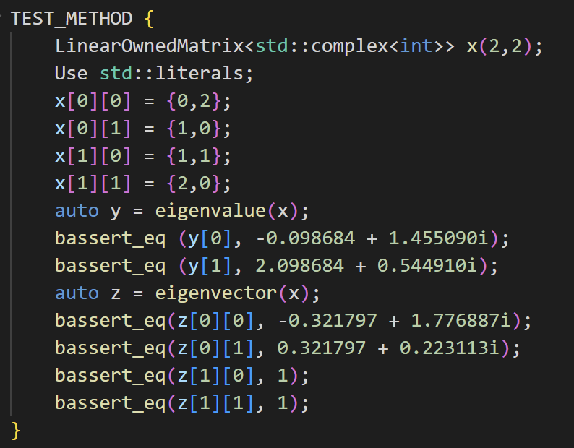
Eigenvalues and Eigenvectors

Slide 21
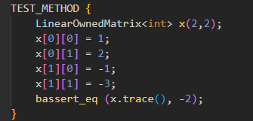
Traces

Slide 22
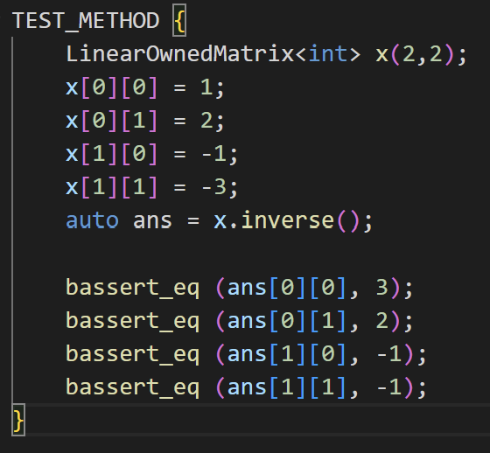
Inverse

Slide 23
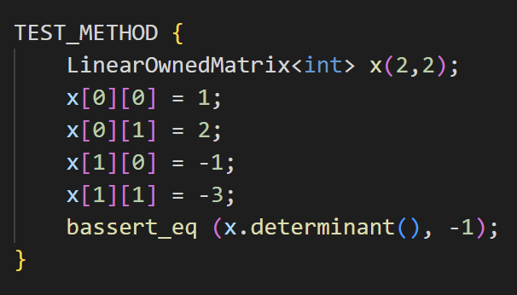
Determinant

Slide 24
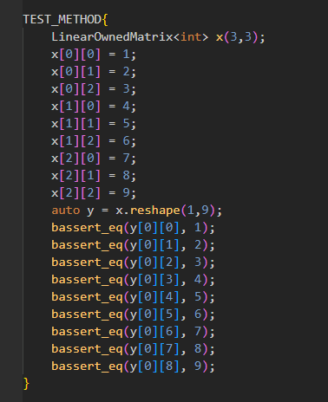
Reshape

Slide 25
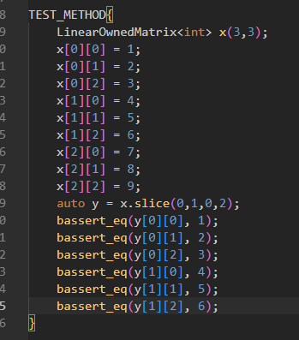
Slicing

Slide 26
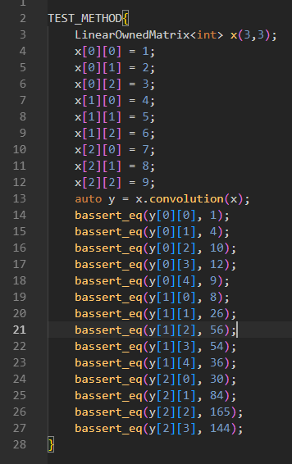
Convolution

Slide 27
OpenCV Transfer

Slide 28
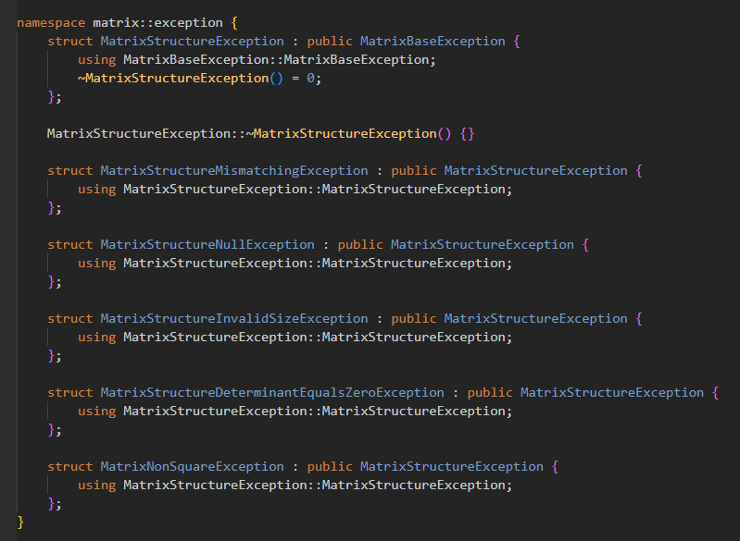
Exceptions -1

Slide 29


Exceptions - 2

Slide 30
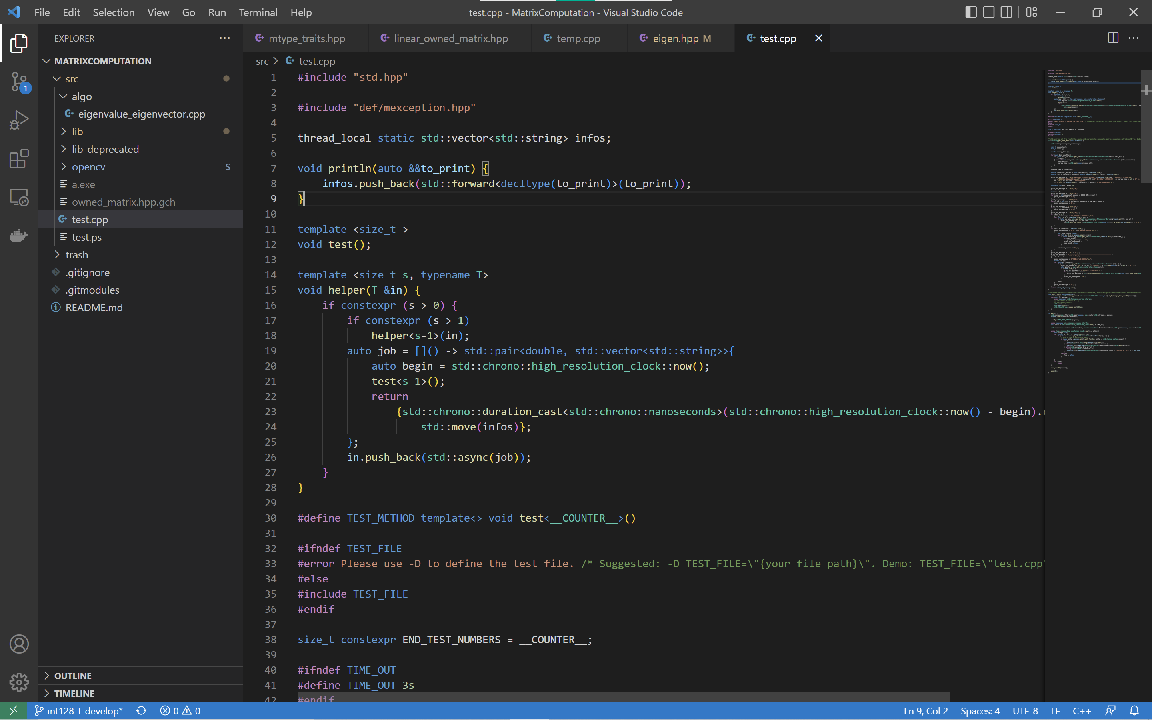
Highlights Test Framework

Slide 31

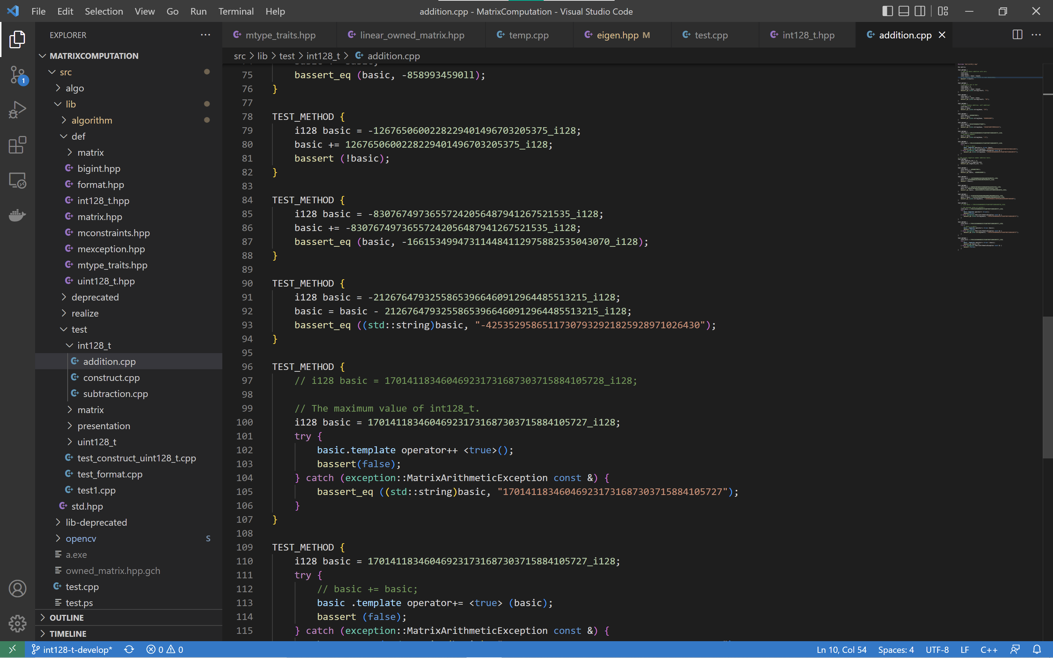
i128

Slide 32
Difficulties
Eigenvalue is hard to compute
Hard to cope with complex in Eigenvalue computation
OpenCV
It needs hard thoughts to comparing different basic data types.
Complex is quite difficult to deal with, because it seems a normal data type but completely different from other normal data types.

Slide 33
Novelties

