Slide 1
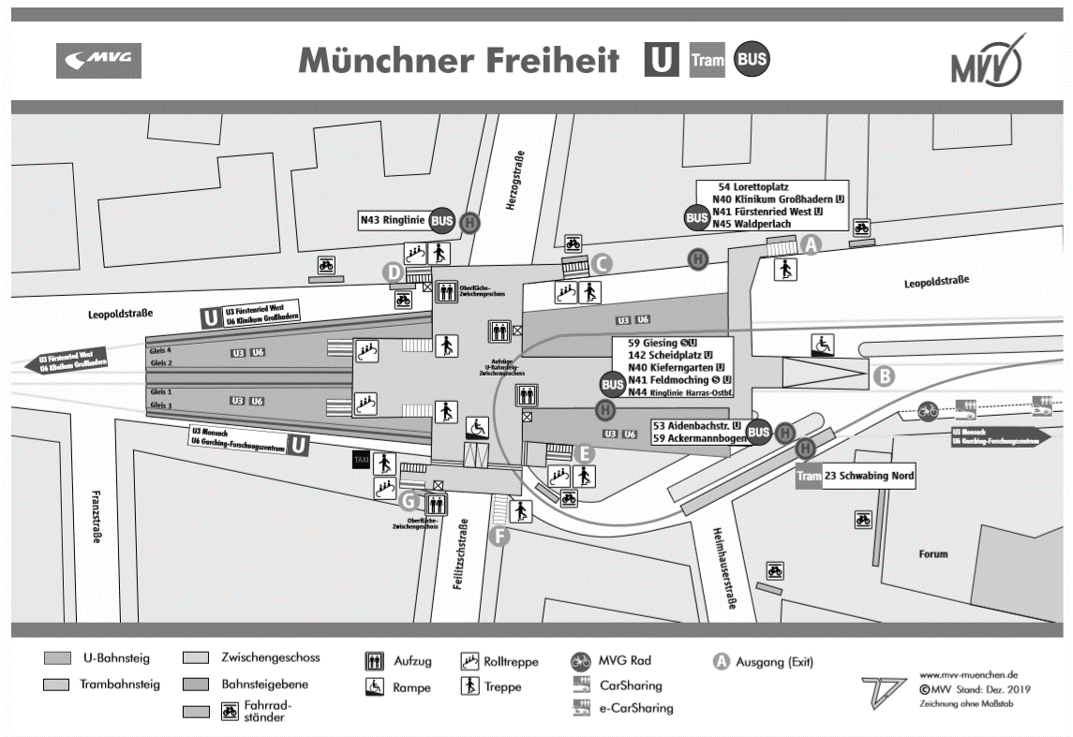
3
train
2
Medium route
1b
1a
Short route
Long route

