Slide 1
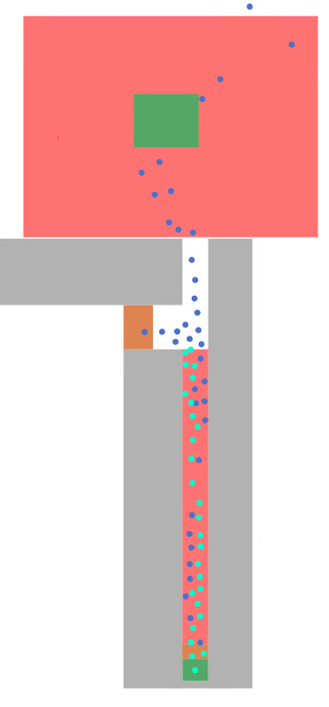
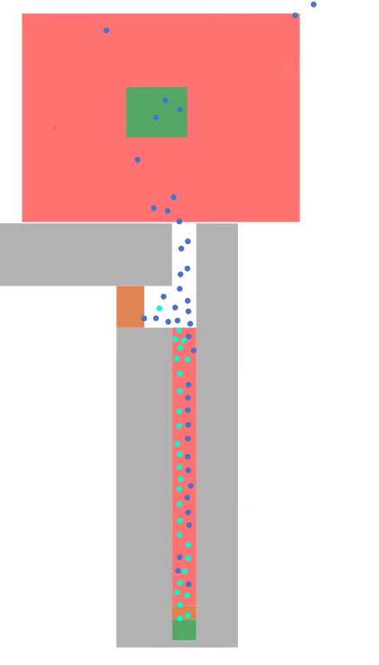
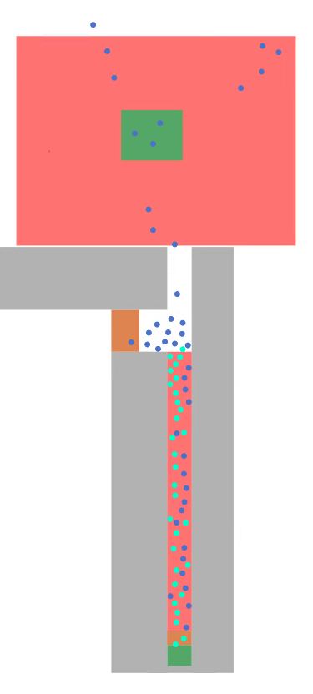

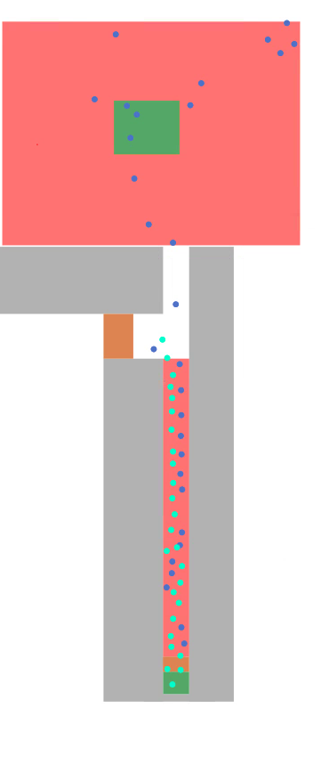



Long
route
Medium
route
Without guidance
Arrival area
Short
route
Agents (cross) are waiting
Counter-flow
130s 140s 150s 160s
Simulation time
With guidance (long route recommended)
130s 140s 150s 160s
Simulation time

