Slide 1
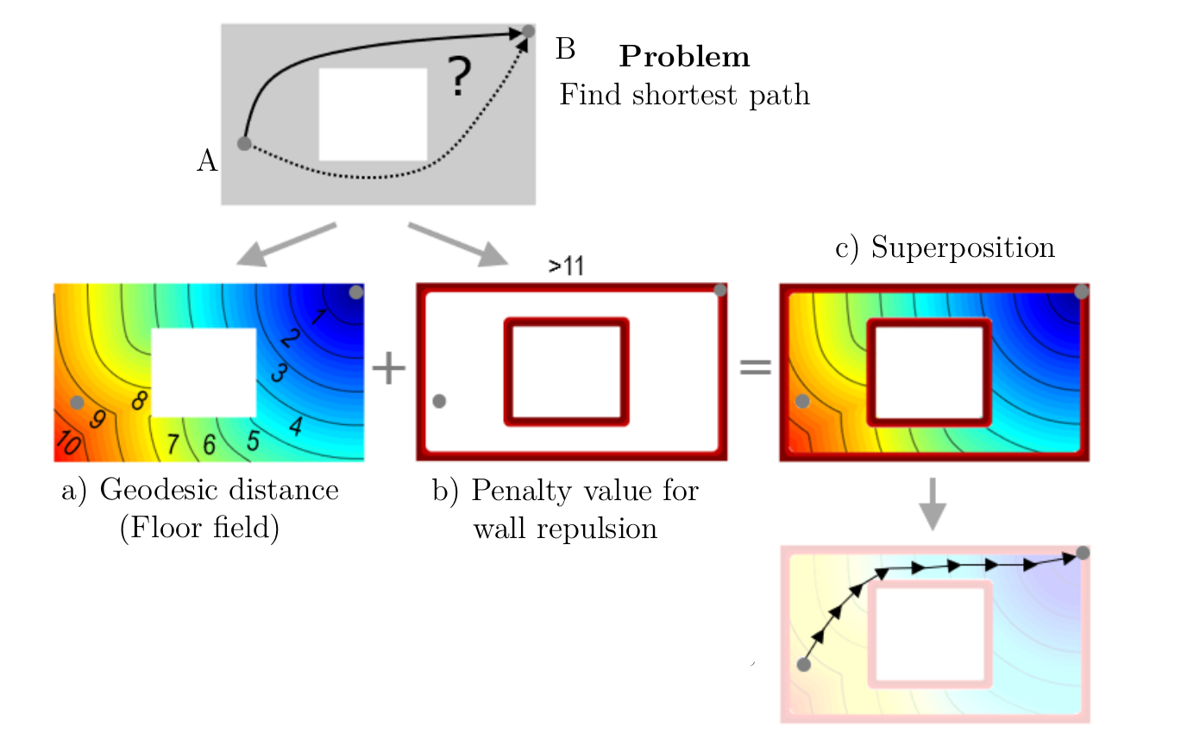
Static floorfield potential
Obstacle potential
Agent potential
Agent (1) steps to the position
where the superposed potential is minimal within the step circle (dashed).
2
2
2
1
1
1

