Slide 1


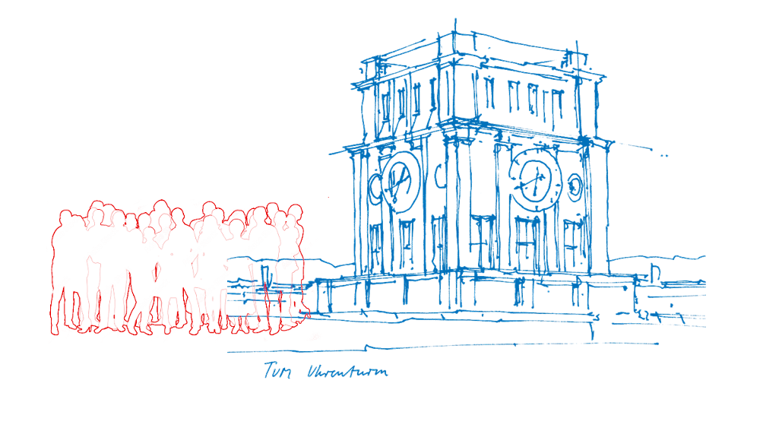
Crowd management based on direct communication technology
Christina Maria Mayr
Doctoral Defense
10th July, 2024
Technical University of Munich
Hochschule München University of Applied Sciences

Slide 2


Crowd management ensures safety and comfort
Several approaches are used in practice [1]
Staff
Christina Maria Mayr | Doctoral defense | Crowd Management 2

Slide 3
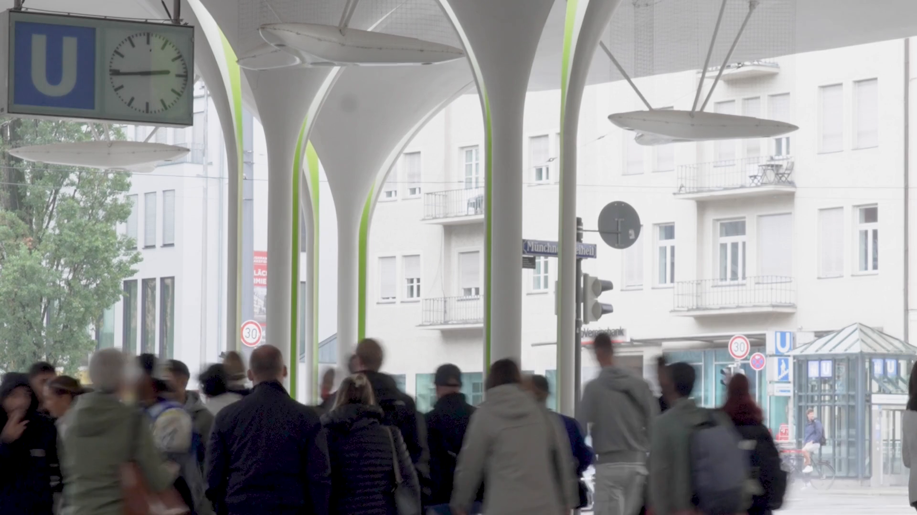
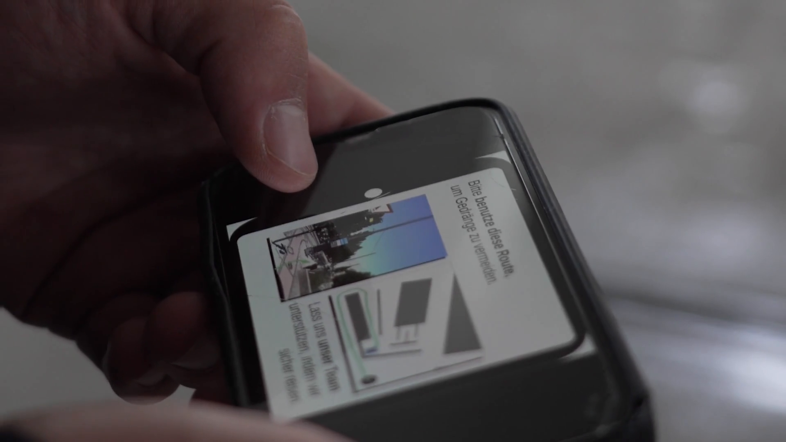
Infrastructure is often missing at transportation hubs
Inform the crowd through mobile applications?
Images: Wolfram Schlenker, rights granted
Christina Maria Mayr | Doctoral defense | Crowd Management 3

Slide 4




Direct communication for crowd management applications?
Vehicles exchange data through direct communication technologies.
Example: IEEE 802.11p [2]
?
Christina Maria Mayr | Doctoral defense | Crowd Management 4

Slide 5




How can crowds be redirected with mobile applications
based on direct communication technology?
Christina Maria Mayr | Doctoral defense | Crowd Management 5

Slide 6
How can crowds be redirected with mobile applications
based on direct communication technology?
Direct communication technology:
Does the information dissemination work?
?
?
Staff
Christina Maria Mayr | Doctoral defense | Crowd Management 6

Slide 7

How can crowds be redirected with mobile applications
based on direct communication technology?
Direct communication technology:
Does the information dissemination work?
Route recommendation algorithm:
Which one is suitable?
?
Christina Maria Mayr | Doctoral defense | Crowd Management 7

Slide 8

How can crowds be redirected with mobile applications
based on direct communication technology?
Direct communication technology:
Does the information dissemination work?
Route recommendation algorithm:
Which one is suitable?
Crowd:
How to design messages to foster compliance?
Christina Maria Mayr | Doctoral defense | Crowd Management 8

Slide 9






Focus of today
Novel socio-technical system
Component investigation
Proof of concept
Mobile network
Algorithm
Real life use case
Modeling & Simulation
Algorithm
Mobile network
Modeling & Simulation
Crowd
Crowd behavior
Survey
Novel simulator flowcontrol
Novel simulator CrowNet
Uncertainty of parameters
=
Thesis
Thesis
Thesis
Christina Maria Mayr | Doctoral defense | Crowd Management 9

Slide 10

Novel model of a crowd guidance system
Map perspective System perspective
See Fig. 3.1 & 4.27 of my thesis
Direct
communication
Algorithm
Route
Mobile application
Crowd
Density
Density sensor
Direct
communication
Christina Maria Mayr | Doctoral defense | Crowd Management 10

Slide 11

Which route recommendation algorithm is suitable?
Direct
communication
Algorithm
Route
Mobile application
Crowd
Density
Density sensor
Direct
communication
Christina Maria Mayr | Doctoral defense | Crowd Management 11

Slide 12

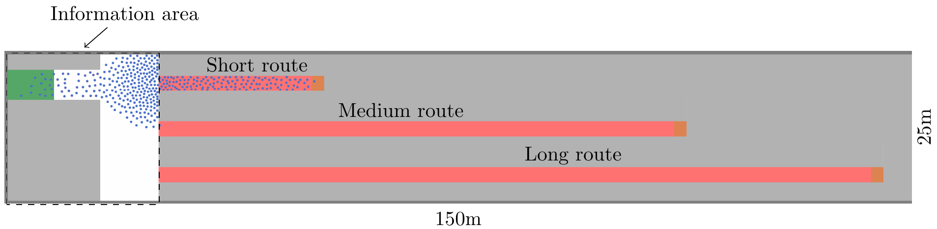
Algorithms have been designed for fully controllable fluids –
a crowd does not behave like a fluid!
State-of-the-art algorithms:
Proportional Integral control [7], On-Off-control [8], State-space control [9-12], Model predictive control [13], …
Congestion
Snapshot of a crowd simulation
150m x 25m
Christina Maria Mayr | Doctoral defense | Crowd Management 12

Slide 13
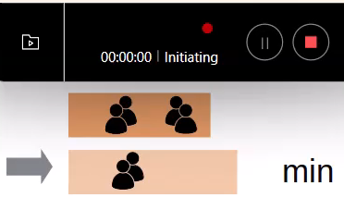
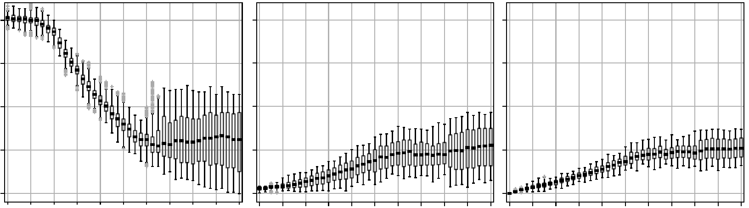
Recommend the route where the density is the lowest
My algorithm resolves congestion and compensates missing compliance [6]
Congestion
Density in ped/m²
Short route Medium route Long route
2.0
1.0
0.0
0.0 0.5 1.0 0.5 1.0 0.5 1.0
Compliance rate
Compensation
Christina Maria Mayr | Doctoral defense | Crowd Management 13

Slide 14

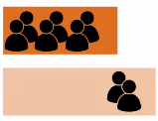
A density-based algorithm succesfully resolves congestion
Detailed comparison of algorithms:
See my publication “Guiding …” [6]
Direct
communication
Algorithm
Route
Mobile application
Crowd
Density
Density sensor
Direct
communication
Christina Maria Mayr | Doctoral defense | Crowd Management 14

Slide 15
Does the information dissemination work?
Direct
communication
Algorithm
Route
Mobile application
Crowd
Density
Density sensor
Direct
communication
Christina Maria Mayr | Doctoral defense | Crowd Management 15

Slide 16

Testing direct communication under worst case conditions
Simple technology Extreme signal modeling Scenario
WLAN
IEEE 802.11p
[2]
IEEE 802.11bd
[14]
Cellular
No signal
LTE V2X
[15-19]
5G V2X
[20-26]
Niche
Christina Maria Mayr | Doctoral defense | Crowd Management 16

Slide 17
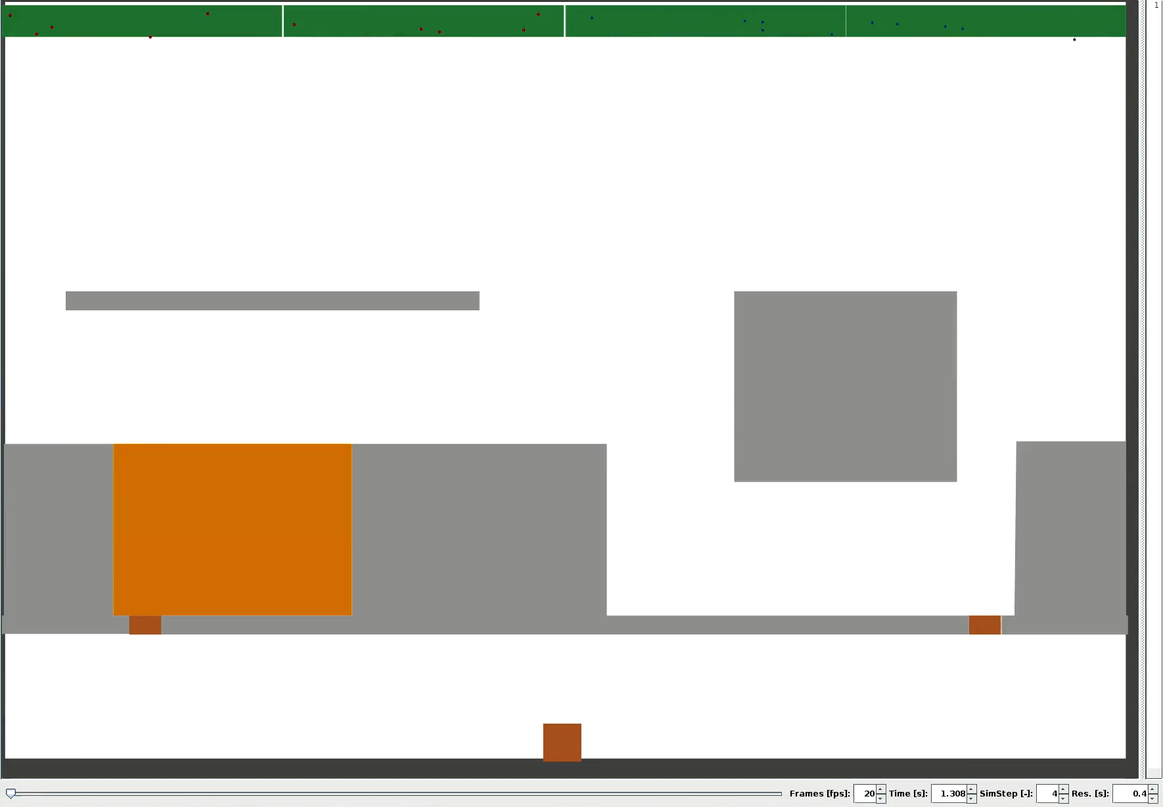
17

Slide 18
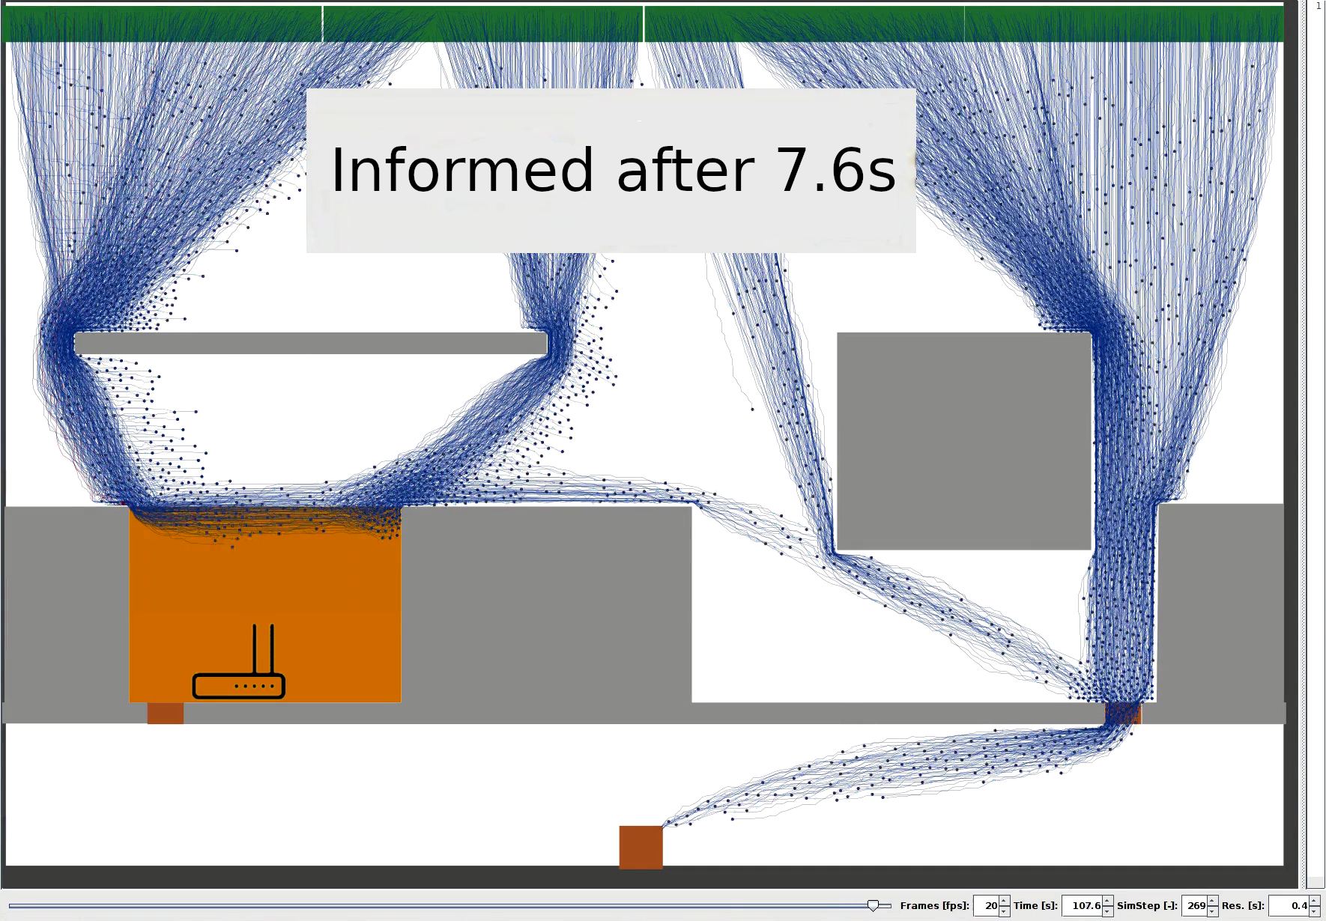
The crowd is successfully informed after several seconds
Parameter studies:
See my publication
“Analysis of info …” [27]
Christina Maria Mayr | Doctoral defense | Crowd Management 18

Slide 19
Direct communication is suitable for redirecting crowds
Parameter studies:
See my publication
“Analysis of info …” [27]
Direct
communication
Algorithm
Route
Mobile application
Crowd
Density
Density sensor
Direct
communication
Christina Maria Mayr | Doctoral defense | Crowd Management 19

Slide 20
How to design mobile messages to foster compliance?
Direct
communication
Algorithm
Route
Mobile application
Crowd
Density
Density sensor
Direct
communication
Christina Maria Mayr | Doctoral defense | Crowd Management 20

Slide 21
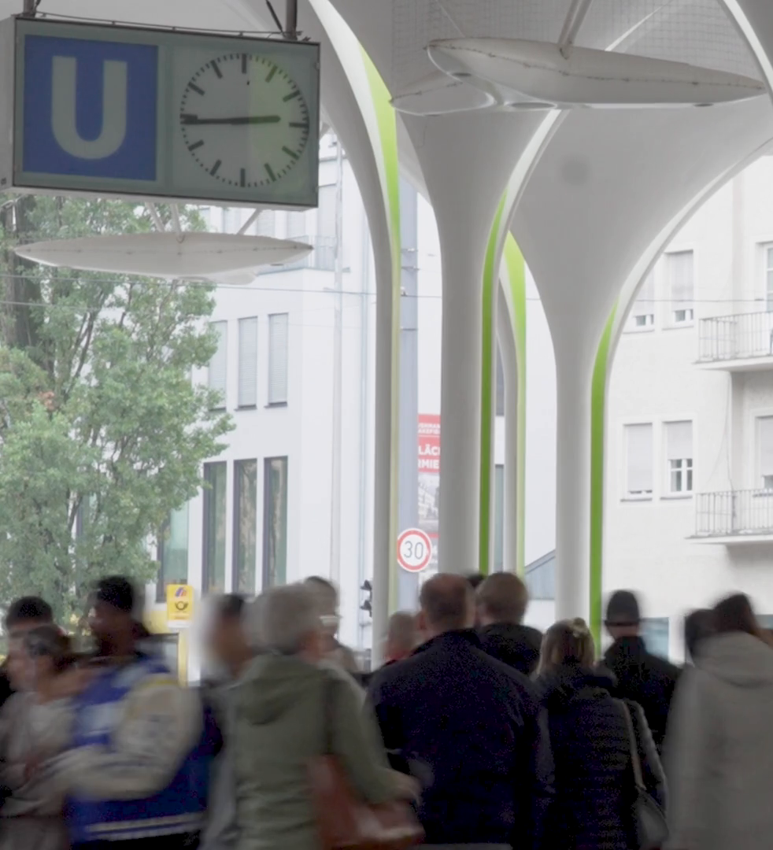
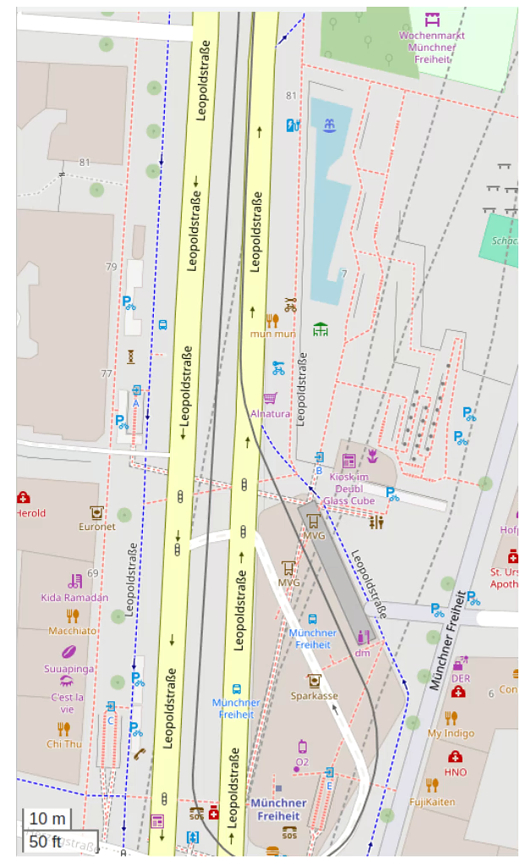
Long route
Metro station (surface level)
Münchner Freiheit
Munich, Germany
Medium route
Image: Wolfram Schlenker,
rights granted
Short route
©OpenStreetMap
openstreetmap.org/copyright
21

Slide 22
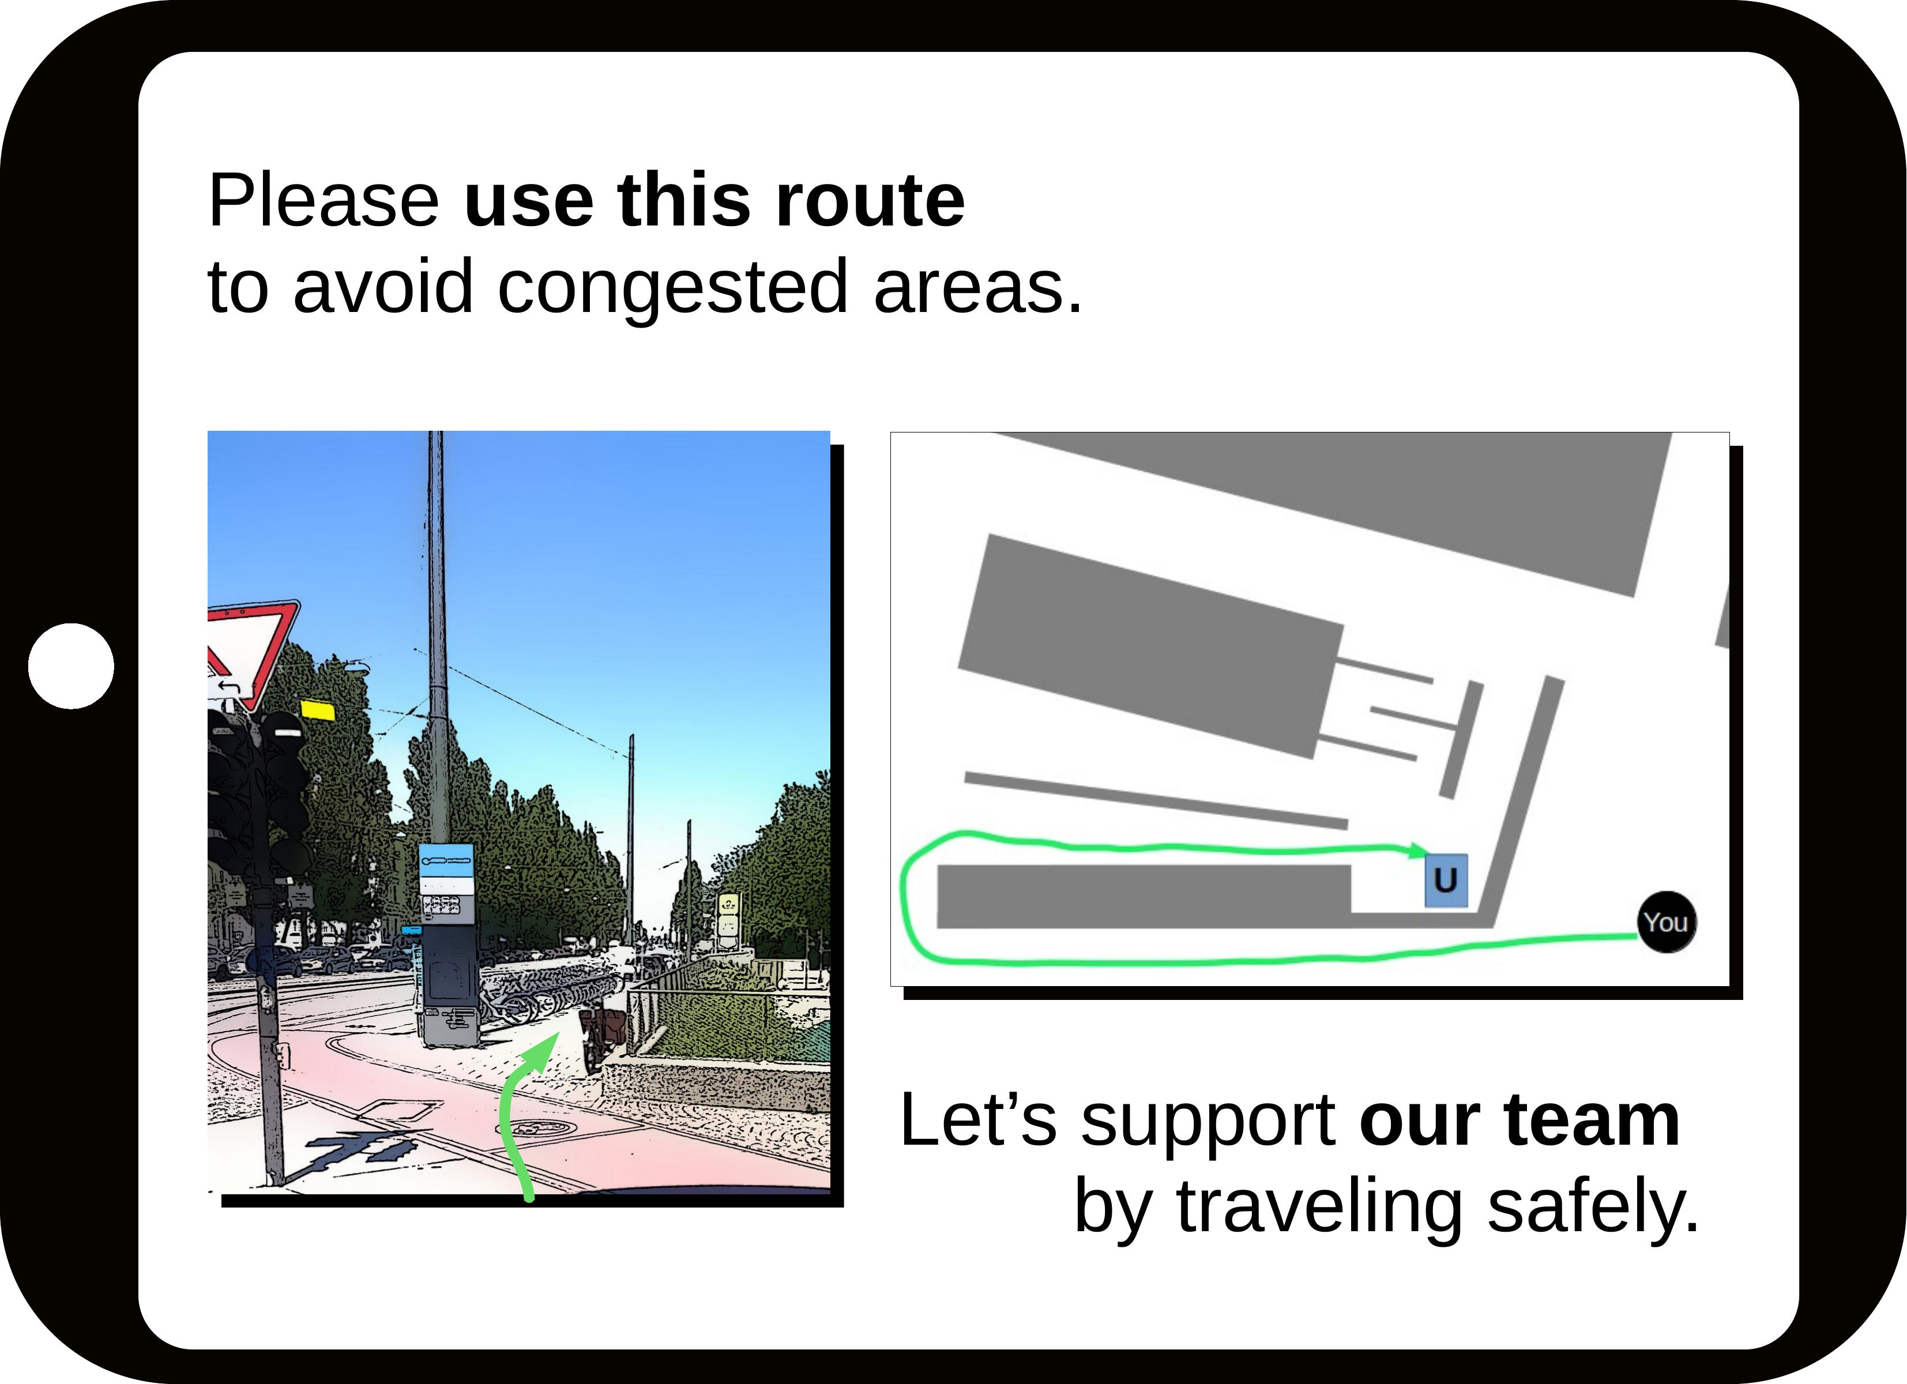
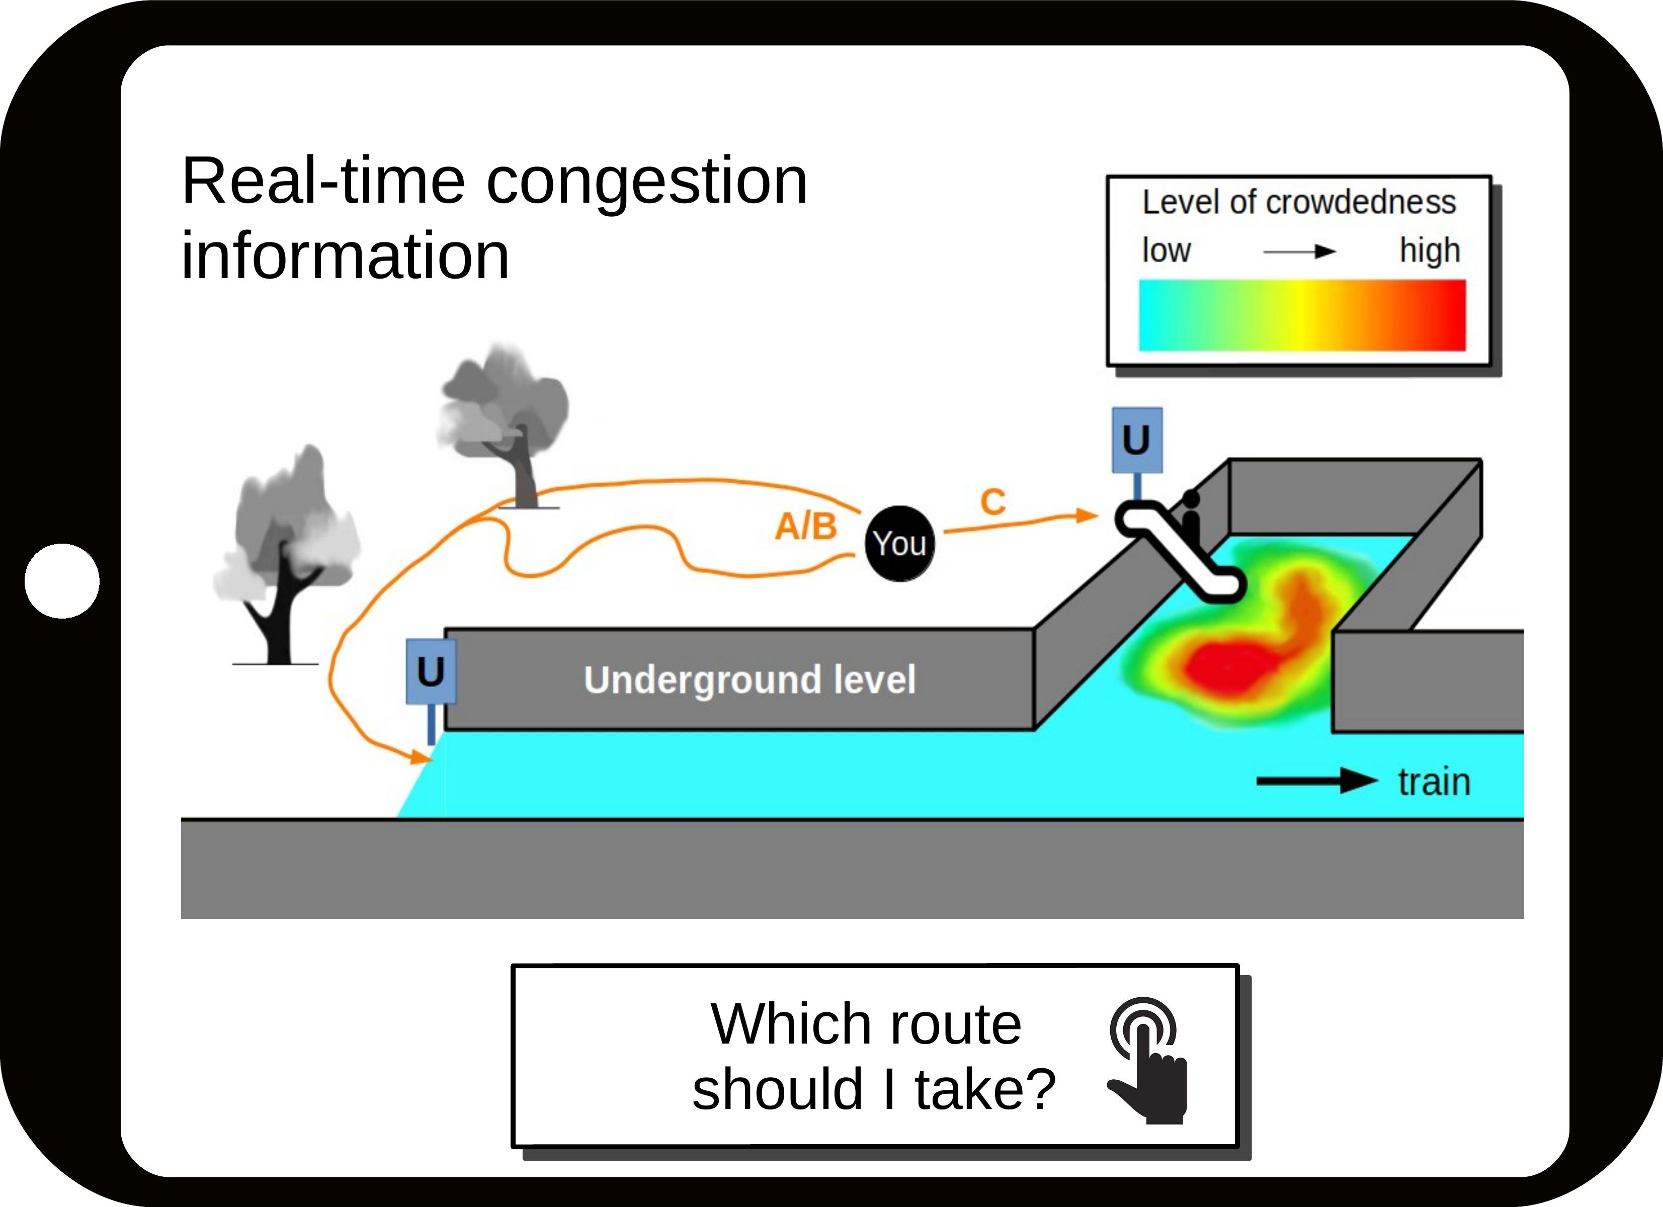
Online survey [28]: testing the effect of three message elements
Top-down view
Appeal to fans’ team spirit
Congestion information
Christina Maria Mayr | Doctoral defense | Crowd Management 22

Slide 23

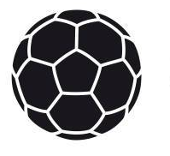

Online survey [28]: design of the survey
The combination of the three elements leads to 8 message designs:
Assumption: fans share a social identity (the control group does not)
Fans 921 participants
Control 444 participants
Christina Maria Mayr | Doctoral defense | Crowd Management 23

Slide 24
“How likely is it that you take the short, medium and long route?”
Participants rated the attractiveness of the short ( ), medium ( ), and long ( ) route (5-point Likert scale)
Kruskal-Wallis test
Christina Maria Mayr | Doctoral defense | Crowd Management 24

Slide 25
There are differences in between message designs
Results of Kruskal-Wallis tests:
Fans: Short route Medium route Long route
Significant difference (p < 0.05)
Significant difference (p < 0.05)
Significant difference (p < 0.05)
Control: Short route Medium route Long route
Significant difference (p < 0.05)
Significant difference (p < 0.05)
Christina Maria Mayr | Doctoral defense | Crowd Management 25

Slide 26
Appealing to fans’ “team spirit” can foster compliance
Analysis of all combinations:
See my publication “Designing …” [28]
Fans:
Adding “team spirit” made the long route more attractive in one combination [27].
Mann-Whitney U test:
p = 0.0069, W = 4157
Christina Maria Mayr | Doctoral defense | Crowd Management 26

Slide 27
There is no ideal message design
Additional result from the survey:
Realistic route choice probabilities
See my publication “Designing …” [28]
Direct
communication
Algorithm
Route
Mobile app
Crowd
Density
Density sensor
Direct
communication
Christina Maria Mayr | Doctoral defense | Crowd Management 27

Slide 28

Measuring densities using direct communication
I use the decentralized density map application (LTE sidelink, controlled mode) [28]:
Direct
communication
Algorithm
Route
Mobile app
Crowd
Density
Density map app
Direct
communication
Christina Maria Mayr | Doctoral defense | Crowd Management 28

Slide 29
Can the proposed system resolve safety-critical congestion?
I model, implement and simulate the overall system in CrowNet:
Direct
communication
Algorithm
Route
Mobile app
Crowd
Density
Density map app
Direct
communication
Christina Maria Mayr | Doctoral defense | Crowd Management 29

Slide 30
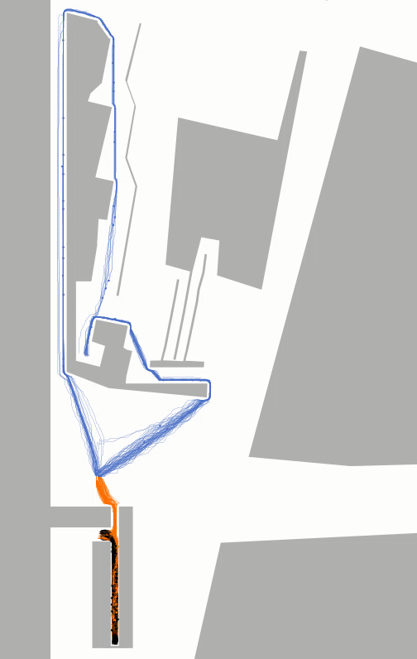
Crowd simulation
Münchner Freiheit
Munich, Germany
Realistic modeling:
Image: Wolfram Schlenker,
rights granted
App usage:
40% [30]
Compliance: 40% [28]
30

Slide 31
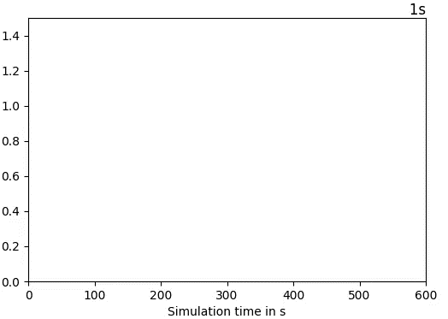
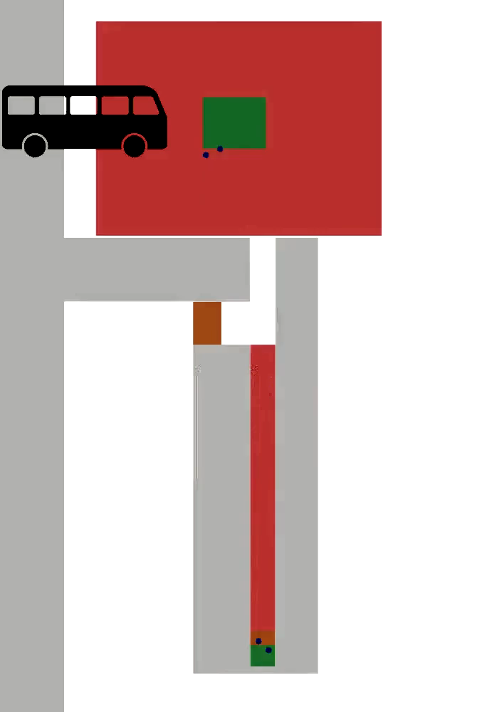
Without guidance: congestion along the short route
Density in ped/m²
31

Slide 32
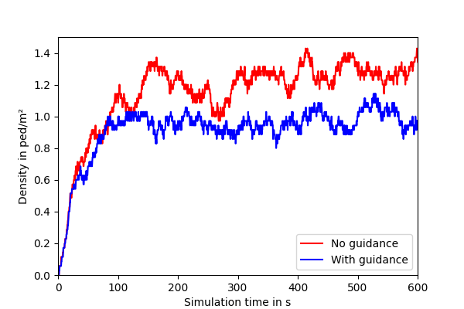
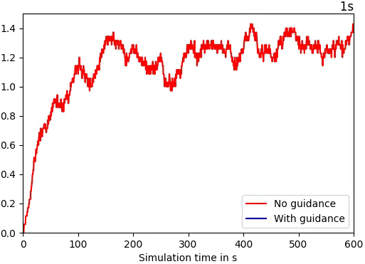
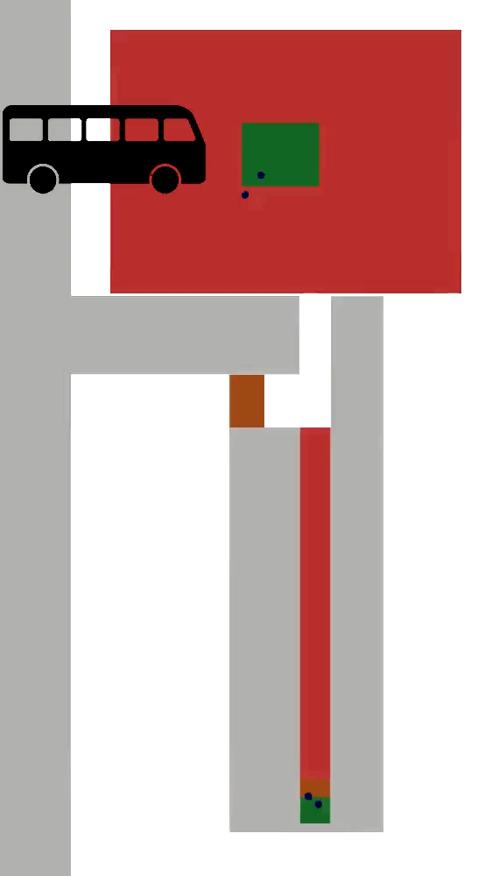
The guidance system resolves safety-critical congestion
Area where app shows redirections
Density in ped/m²
32

Slide 33
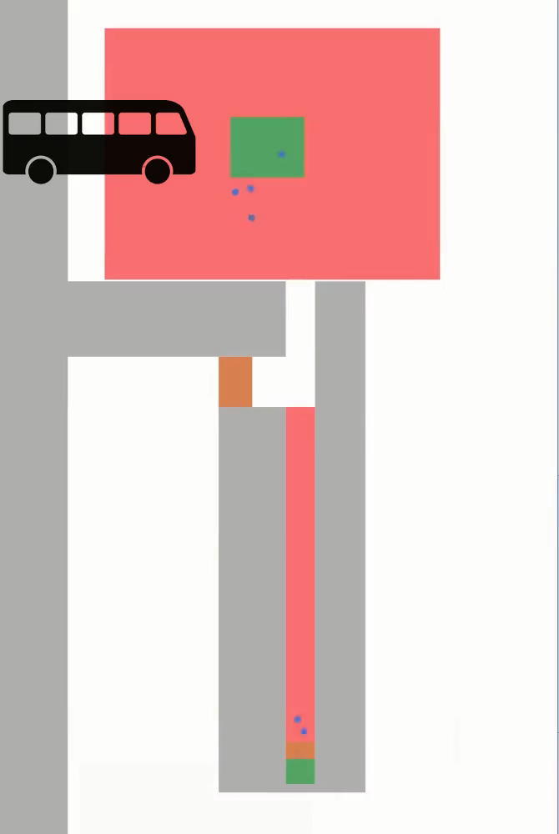
How can crowds be redirected with mobile applications
based on direct communication technology?
Proof of concept:
Direct
communication
Algorithm
Route
Mobile app
Crowd
Density
Density map app
Direct
communication
The system resolves safety-critical congestion.
Christina Maria Mayr | Doctoral defense | Crowd Management 33

Slide 34
I modeled and simulated a novel crowd guidance system
Novel socio-technical system
Multi-method investigation
Proof of concept
Mobile network
Algorithm
Real life use case
Modeling & Simulation
Algorithm
Direct communication
Modeling & Simulation
Survey data
Crowd
Crowd behavior
Survey
The system resolves congestion
See my publications [6,27,28]
Novel simulator CrowNet
Next step
Build the system
Validated
models
Thesis
Validate the system
github.com/roVer-HM/crownet
Christina Maria Mayr | Doctoral defense | Crowd Management 34

Slide 35
Conclusion
A system was proposed that detects and redirects crowds through mobile applications.
It is possible to redirect crowds using mobile applications based on direct communication technology.
The proposed system can resolve safety-critical jams even when only a part of the crowd uses the technology.
Christina Maria Mayr | Doctoral defense | Crowd Management 35

Slide 36
References (1/2)
Claudio Feliciani, Kenichiro Shimura, and Katsuhiro Nishinari. Introduction to Crowd Management. Managing Crowds in the Digital Era: Theory and Practice. 1st ed. Springer Cham, 2021. doi: 10.1007/978-3-030-90012-0.
802.11 WG Wireless LAN Working Group. IEEE 802.11p-2010. Tech. rep. IEEE standards association, 2010.
Stefan Schuhbäck et al. Towards a Bidirectional Coupling of Pedestrian Dynamics and Mobile Communication Simulation. In: Proceedings of the OMNeT++ Community Summit 2019. 2019. doi: 10.29007/nnfj.
Benedikt Kleinmeier, Benedikt Zönnchen, Marion Gödel, Gerta Köster. Vadere: An open-source simulation framework to promote interdisciplinary understanding. In: Collective Dynamics (4). 2019. doi: 10.17815/CD.2019.21
Antonio Virdis, Michael Kirsche (eds). Recent Advances in Network Simulation. Springer Pub. 2019. doi:10.1007/978-3-030-12842-5
Christina Maria Mayr and Gerta Köster. Guiding crowds when facing limited compliance: Simulating strategies. In: PLOS ONE 17.11 (Nov. 2022), pp. 1-24. doi: 10.1371/journal.pone.0276229.
H. Ren, Y. Yan, and F. Gao. Variable guiding strategies in multi-exits evacuation: Pursuing balanced pedestrian densities. In: Applied Mathematics and Computation 397 (2021). doi: 10.1016/j.amc.2021.125965.
F. Gao et al. Effect of density control in partially observable asymmetric-exit evacuation under guidance: Strategic suggestion under time delay. In: AppliedMathematics and Computation 418 (2022). doi: 10.1016/j.amc.2021.126838.
Pushkin Kachroo et al. Pedestrian Dynamics: Feedback Control of Crowd Evacuation. Springer, 2010. doi: 10.1007/978-3-540-75561-6.
Apoorva Shende, Mahendra Singh, and Pushkin Kachroo. Optimization-Based Feedback Control for Pedestrian Evacuation From an Exit Corridor. In: IEEE Transactions on Intelligent Transportation Systems 12 (Dec. 2011), pp. 1167-1176. doi: 10.1109/TITS.2011.2146251.
Apoorva Shende, Mahendra P. Singh, and Pushkin Kachroo. Optimal Feedback Flow Rates for Pedestrian Evacuation in a Network of Corridors. In: IEEE Transactions on Intelligent Transportation Systems 14.3 (2013), pp. 1053-1066. doi: 10.1109/TITS.2013.2250965.
Zhe Zhang, Limin Jia, and Yong Qin. “Level-of-Service Based Hierarchical Feedback Control Method of Network-Wide Pedestrian Flow”. In: Mathematical Problems in Engineering 2016 (Jan. 2016), pp. 1-4. doi: 10.1155/2016/9617890.
Marcel Menner et al. MPC-based Pedestrian Routing for Congestion Balancing. Mitsubishi Electric Research Laboratories, 2023.
802.11 WG Wireless LAN Working Group. IEEE 802.11bd-2022 - IEEE Standard for Information Technology -Telecommunications and Information Exchange between Systems Local and Metropolitan Area Networks - Specific Requirements Part 11: Wireless LAN Medium Access Control (MAC) and Physical Layer (PHY). Specifications Amendment 5: Enhancements for Next Generation V2X. Tech. rep. Mar. 10, 2023.

Slide 37
References (2/2)
3GPP Technical Specification Group Services and System Aspects. TR 22.885 Study on LTE Support for Vehicle to Everything (V2X) Services (Release 14). Tech. rep. 2015.
3GPP Technical Specification Group Services and System Aspects. TR 36.885 Study on LTE-Based V2X Services (Release 14). Tech. rep. 2016.
3GPP Technical Specification Group Services and System Aspects. 3GPP TS 22.185 Service Requirements for V2X Services (Release 16). Tech. rep. 2020.
3GPP Technical Specification Group Services and System Aspects. TS 23.285 Architecture Enhancements for V2X Services (Release 16). Tech. rep. 2020
3GPP Technical Specification Group Radio Access Network. TS 36.213 Evolved Universal Terrestrial Radio Access (E-UTRA); Physical Layer Procedures (Release 16). Tech. rep. 2020.
3GPP Technical Specification Group Services and System Aspects. TR 22.886 Study on Enhancement of 3GPP Support for 5G V2X Services (Release 16). Tech. rep. 2018.
3GPP Technical Specification Group Radio Access Network. TR 38.885 Study on NR Vehicle-to-Everything (V2X) (Release 16). Tech. rep. 2019.
3GPP Technical Specification Group Services and System Aspects. TS 23.287 Architecture Enhancements for 5G System (5GS) to Support Vehicle-to-Everything (V2X) Services (Release 16). Tech. rep. 2020.
3GPP Technical Specification Group Services and System Aspects. TS 22.186 Enhancement of 3GPP support for V2X scenarios (Release 16). Tech. rep. 2019.
3GPP Technical Specification Group Radio Access Network. TS 38.213 Physical Layer Procedures for Control (Release 16). Tech. rep. 2020.
3GPP Technical Specification Group Radio Access Network. TS 38.321 Medium Access Control (MAC) Protocol Specification (Release 16). Tech. rep. 2020.
3GPP Technical Specification Group Radio Access Network. TS 37.895 Overall Description of Radio Access Network (RAN) Aspects for Vehicle-to-Everything (V2X) Based on LTE and NR (Release 16). Tech. rep. 2020.
Christina Maria Mayr, Stefan Schuhbäck, Lars Wischhof, Gerta Koster. Analysis of information dissemination through direct communication in a moving crowd. Safety Science (142) 105386. doi: 10.1016/j.ssci.2021.105386
Christina Maria Mayr, Anne Templeton, and Gerta Köster. Designing mobile application messages to impact route choice: A survey and simulation study. In: PLOS ONE 18.4 (Apr. 2023), pp. 1–20. doi: 10.1371/journal.pone.0284540.
Stefan Schuhbäck, Lars Wischhof, and Jörg Ott. Cellular Sidelink Enabled Decentralized Pedestrian Sensing. In: IEEE Access 11 (2023), pp. 13349-13369. doi: 10.1109/access.2023.3242946.
Fernando Fonseca et al. Use and Perceptions of Pedestrian Navigation Apps: Findings from Bologna and Porto. In: ISPRS International Journal of Geo-Information 10.7 (2021). doi: 10.3390/ijgi10070446.

Slide 38
CrowNet: a novel simulation framework
Initial simulator coupling [3]: Vadere [4] and OMNeT++ [5]
OMNeT++ Vadere
Direct
communication
Algorithm
Route
Mobile application
Crowd
Density
Density sensor
Direct
communication
Christina Maria Mayr | Doctoral defense | Crowd Management 38

Slide 39
My major contribution to CrowNet: flowcontrol
I developed flowcontrol [6] and integrated it:
flowcontrol OMNeT++ Vadere
Direct
communication
Algorithm
Route
Mobile application
Crowd
Density
Density sensor
Direct
communication
Christina Maria Mayr | Doctoral defense | Crowd Management 39

Slide 40
Algorithm study
Alternative algorithm
Parameter settings:
Route recommendation: every 2s
Corridor width = 2.5m
Inflow = 1.6ped/(ms) “8 agents every 2s” (=30*8ped/2.5m/60s) (4ped/s)
Christina Maria Mayr | Doctoral defense | Crowd Management 40

Slide 41
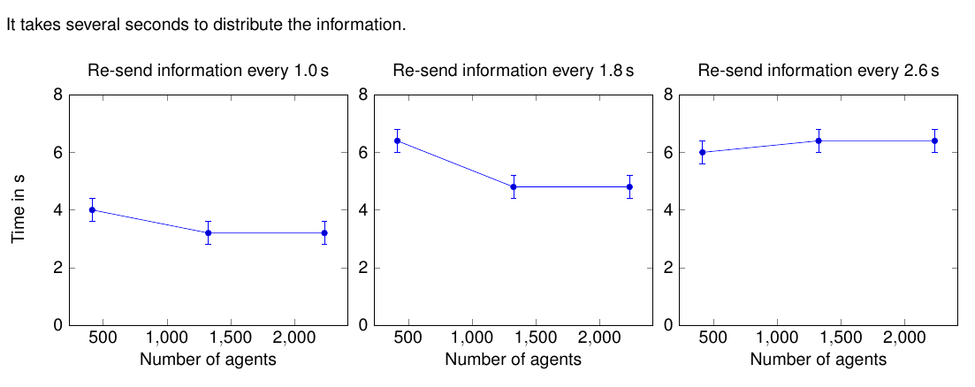
Information dissemination study

Slide 42
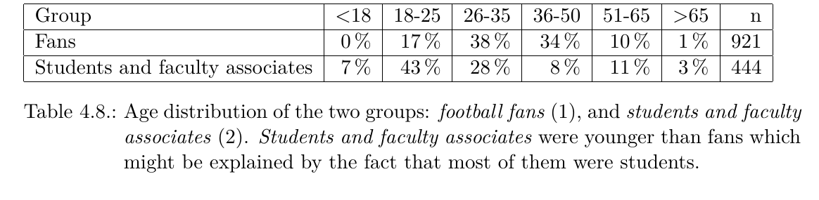
Message design
Dropout: 44.51%
Number of participants who completed the survey: 444 (control), 921 (fans)

Slide 43
Message design study
Christina Maria Mayr | Doctoral defense | Crowd Management 43

Slide 44

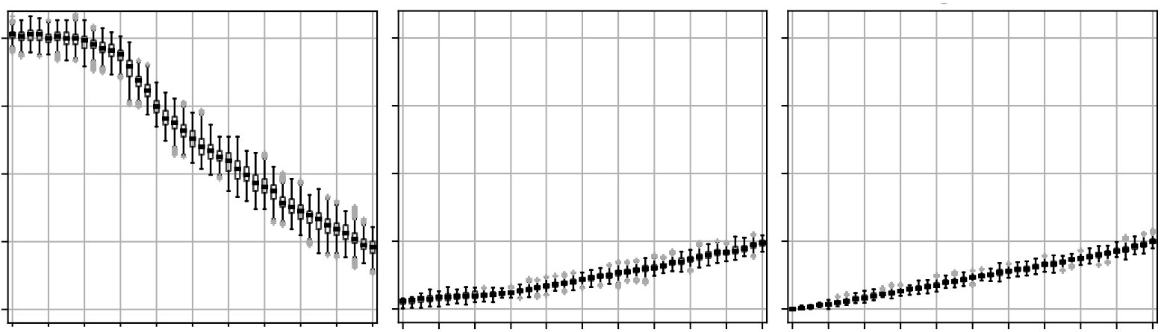
Algorithm study
Alternative algorithm
Density in ped/m²
Short route Medium route Long route
2.0
1.0
0.0
0.0 0.5 1.0 0.5 1.0 0.5 1.0
Compliance rate
Christina Maria Mayr | Doctoral defense | Crowd Management 44

Slide 45
Can appeal to fans’ “team spirit” foster compliance? (see [27])
45

Slide 46
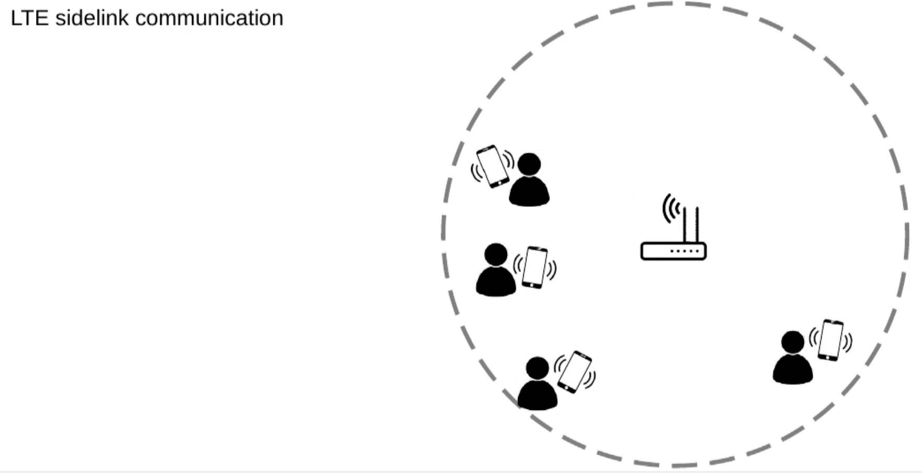
Density map application

Slide 47
System test
Route recommendation: every 2s possible
Short corridor: Corridor width = 1.75m
Inflows:
Bus arrivals: 60peds/min
Counterflow: 40peds/min
Route distributions without recommendations: 49% short, 30% medium, 22% long
Route distribution when the long route is recommended: 25% short, 35% medium, 40% long

Slide 48
Participants ranked the attractiveness of the 3 routes
5-point scale
Christina Maria Mayr | Doctoral defense | Crowd Management 48

Slide 49
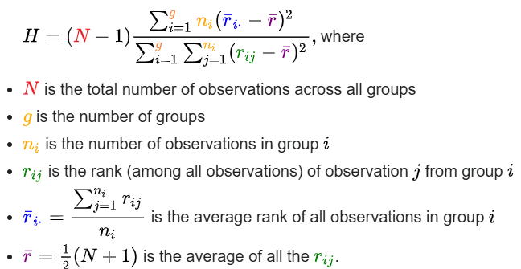
Kruskal Wallis test
H_0: The mean ranks ( ~ “medians”) are equal across 3+ populations.
The smaller the p value, the more likely the null hypothesis must be rejected.
“ p < 0.05 “ -> reject H_O -> “The mean ranks are equal” is false -> difference
“ p >= 0.05 “ -> confirm H_O -> “The mean ranks are equal” is true -> no difference
The Kruskal–Wallis test by ranks “one-way ANOVA on ranks [1]”
non-parametric method
testing whether samples originate from the same distribution
extends the Mann–Whitney U test
Assumptions:
It is used for comparing two or more independent samples
equal or different sample sizes.

Slide 50
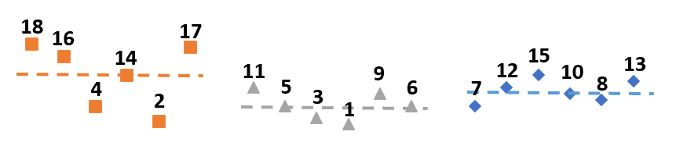
H_0: The mean ranks are equal across 3+ populations.

Slide 51
There is no ideal message design
Results of the Mann-Whitney U tests: p-Value < 0.05
Fans
Short
Medium
Long
Short
Medium
Long
Short
Medium
Long
Congestion info Top-down view “Team spirit”
Control group
Short
Medium
Long
Short
Medium
Long
Short
Medium
Long
Congestion info Top-down view “Team spirit”
Christina Maria Mayr | Doctoral defense | Crowd Management 51

Slide 52
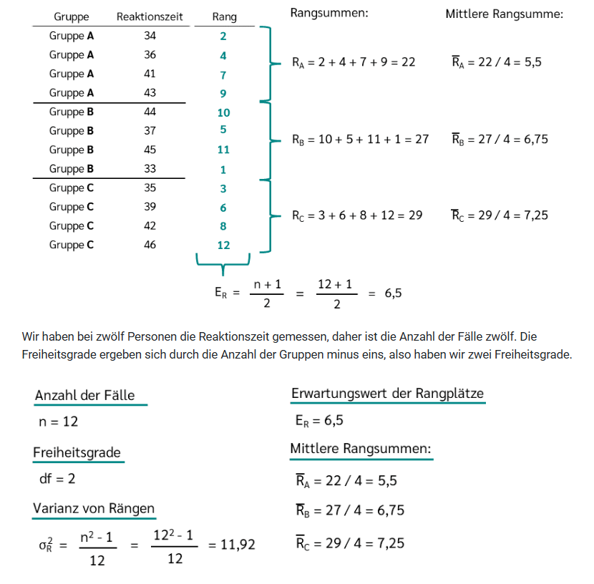
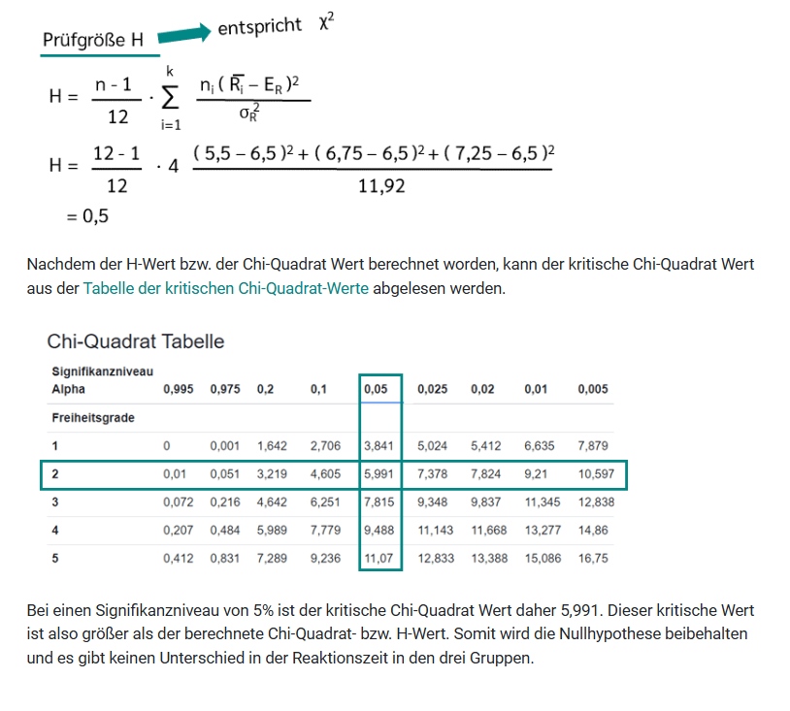

Slide 53
Online survey [28]: football fans and control group, 8 designs
Assumption: fans share a social identity (the control group does not)
Fans 921 participants
Control 444 participants
Christina Maria Mayr | Doctoral defense | Crowd Management 53

Slide 54
Does a message element have an effect?
Fans: Short route
+
Christina Maria Mayr | Doctoral defense | Crowd Management 54

Slide 55
Does a message element has an effect?
Fans: Short route
Christina Maria Mayr | Doctoral defense | Crowd Management 55

Slide 56
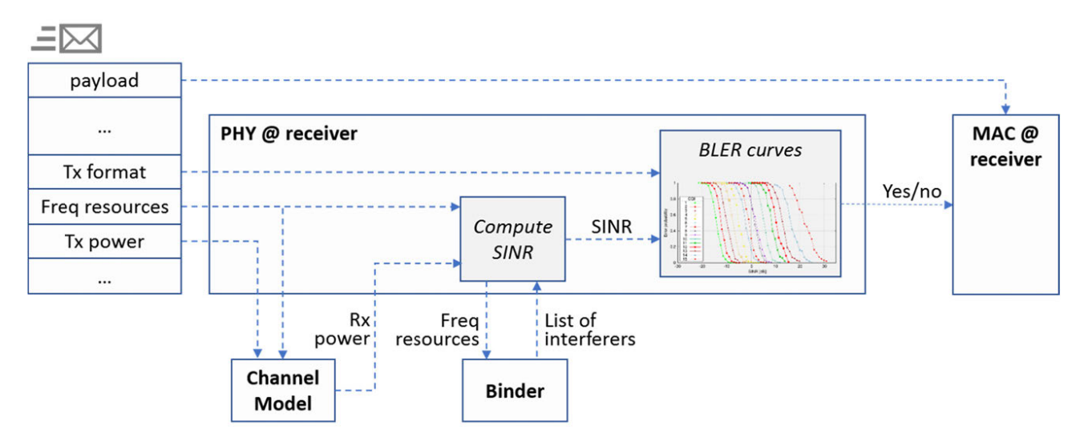
simu5G: model structure

Slide 57
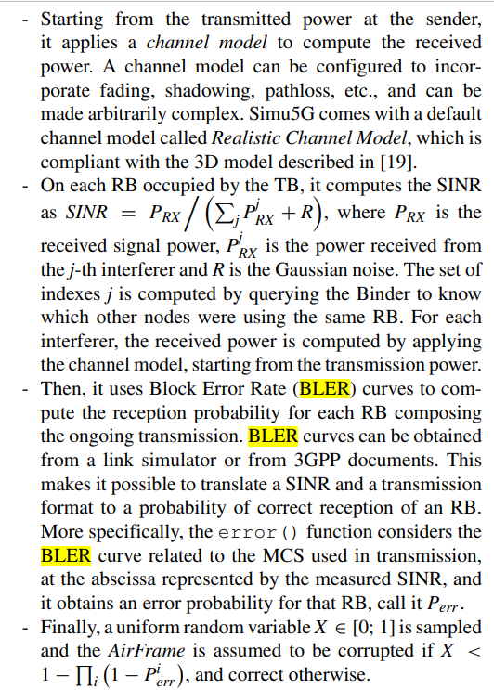
Resource Blocks (RBs)

