Slide 1
Rocket League

Slide 2
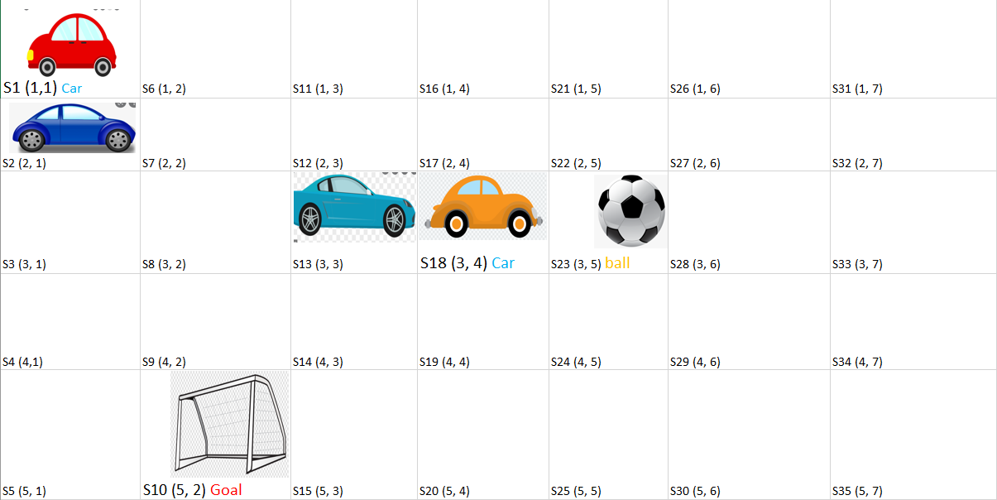
Problem Representation
In order to traverse in our problem, since it depends on distance between objects and target we choose to represent our problem as a grid, like below..

Slide 3
Information & Assumptions
The grid is a representation of the playground
Moving from a cell to another is a distance of one
In this we have only two states:
1. Driving to reach to the ball
2. dribbling with the ball until scoring
Other cars are considered as an obstacle that I cannot traverse through because being suspended is a result.

Slide 4
Information & Assumptions
For instance, in the mentioned grid image before if our agent is at S1 coordinate (1,1), S2 is an obstacle so it cannot traverse.
f(n) = g(n) + h(n)
g(n) = cost so far to reach to, as we said before we determine moving from state to another (cell to another) as a cost of 1
h(n) = estimated cost from n to goal, we assume that it is the Euclidian distance between initial to our ball in case of driving or the goal in state of dribbling

Slide 5
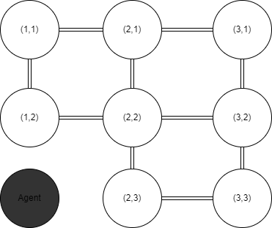
Information & Assumptions
This is how the state graph looks like every cell is a state and if cell contains another agent it won’t be part of the state graph (like the dark node here)
Each state is represented by its (x, y) coordinates

Slide 6
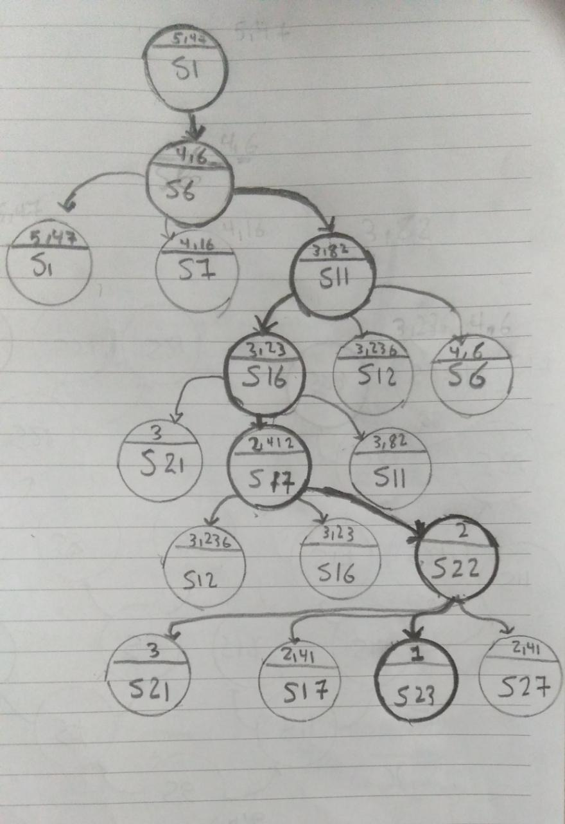
A* on Rocket League
Root is the initial state.
Children of each node are the states we can
transit to.
We fork children of a node which has lowest cost.
Then compare cost of the forked children
with the existence ones.
Repeat that till reach to the goal state.

Slide 7
Implementation
euclideanDist (calculate eculidne distance):
Parameters → (I, J)(current location), SrcDest(source, destination)
Return → the distance between current cell and goal’s one
validMove (check validity of moves)
Parameters → (r, c)(location’s move)
Return → bool

Slide 8
Implementation
foundDest (check whether current cell is the desired one or not):
Parameters → (r,c) current location, SrcDest(source, destination)
Return → bool
printPath:
Print parents after applying A* function

Slide 9
Implementation
aStarSearch:
Parameters → grid(playground representation), SrcDest(source, destination)
Main Sections →Move up, Move down, Move left, Move right.
Main variabes→Has main array of struct (g: cost value), (h: heuristic),
(f: g+h), (parent: node’s parent)
Algorithm → Firstly, check validity of the four main moves. Then, check the current cell is destination or not. Finally If not the destination, calculate h and f and choose the lowest f value, then move and save parent. Repeat.

