Slide 1
Twitter Topic Modeling & Sentiment Analysis
Project #2
Cristina Cano
Sayat Satybaldiyev

Slide 2
Introduction
Twitter data (tweets)
Social Media processing tasks:
Sentiment Analysis – extracting emotional/tonal information from text
Topic Modeling – extracting topical word groups from text

Slide 3
Background
Sentiment Analysis
Topic Modeling (LDA)
Go, Bhayani, Huang
Distant supervision (sentiment determined by emoticons)
Unigrams, bigrams, POS tags
Hu & Liu
Sentiment orientation word lists (gazetteers)
Blei et al. 2003, LDA
Ramage, Dumais
Characterizing Microblogs with Topic Models
Wayne, Jiang
Comparing Twitter and Traditional Media using Topic Models

Slide 4
Data
Human-annotated dataset from Sanders Analytics, LLC
3296 tweets total

Slide 5
Data Annotations
Positive | Positive indicator on topic
Neutral | Neither positive nor negative indicators Mixed positive and negative indicators On topic, but indicator undeterminable Simple factual statements Questions with no strong emotions indicated
Negative | negative indicator on topic
Irrelevant | Not English language Not on-topic (e.g. spam)

Slide 6
Features: Sentiment
numPosEmots | # positive emoticons
numNegEmots | # negative emoticons
numExclam | # ‘!’
numQuest | # ‘?’
numPosGaz | # positive gazetteer words
numNegGaz | # negative gazetteer words
Unigrams | TF-IDF of unigrams not in stoplist which appear in the corpus more than once

Slide 7
Algorithms: Sentiment
Using 10-fold cross-validation
Baseline
Average F-Measure = 0.565

Slide 8
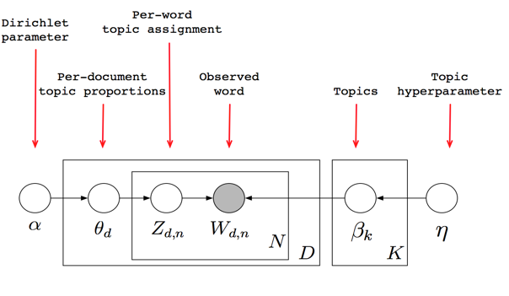
Algorithms: Topic Modeling

Slide 9
Testing
400 English tweets retrieved via Twitter Streaming API
apple
google
microsoft
amazon
Sentiment system less robust (overfitting)

Slide 10
Conclusion
Small corpus + short tweets = noisy data
Preprocessing is key
Results are promising
DEMO

