Slide 1

TOURISM MANAGEMNT SYSTEM
Niyonsaba Christine
27796
Group: F
This system will be used to manage tourism services, including tour packages, bookings, customer details, and payment transactions.

Slide 2

Problem Definition:
The tourism industry face challenges in managing tour packages, bookings, customer data, leading to booking errors, payment errors.
This system will be used in:
Tour planning and management
Tourist attraction listings and bookings
Target users:
Tourists,
Travel agencies,
Tour operators and transport providers.
Outcomes expected:
Enhances tourist experience and satisfaction
Centralized Information Management for tourism services
Enhanced Communication

Slide 3
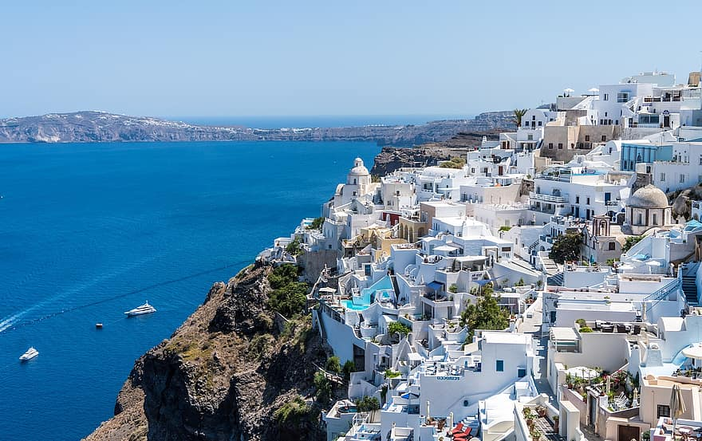
Objectives:
Security and Data Privacy
Sustainable Tourism Development
Main entities:
Tourists(ID, Name, Phone, Email, Nationality)
Tour packages(ID, Name, price, Duration)
Payments(ID, Booking ID, Amount, Payment status)
Bookings (ID, Tourist ID, Package ID, Date, Payment status)
Relationships:
Tourist can book multiple tour
Tour package can have multiple bookings
Bookings are linked to a single tourist
Payments are made for booking
Benefits solution:
Improved Security and Fraud Prevention
Time saving and efficiency

Slide 4
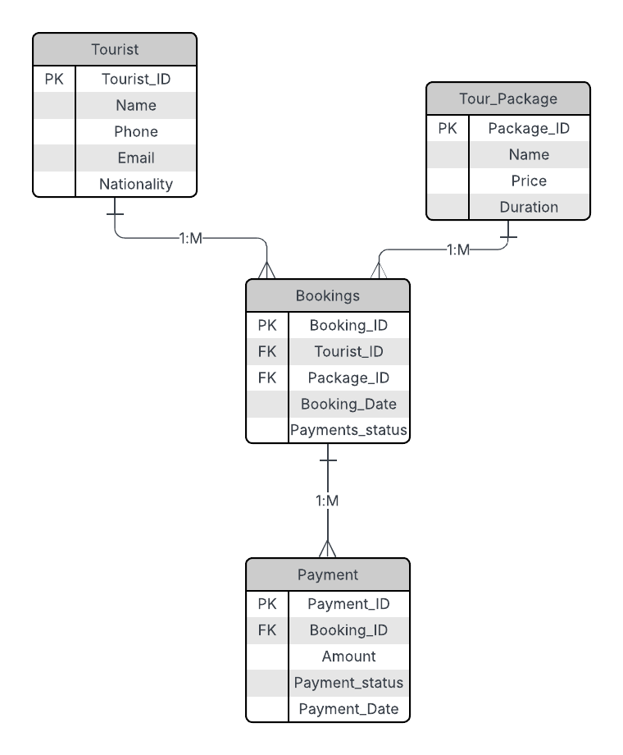
logical MOdel DESIGN
Entities: Tourist,Tour package,Bookings,Payment
Relationships:
Tourist-Booking: one-to-many
package-Bookings: one-to-many
Booking-payment: one-to-one
GOALS:
simplify and automate tour bookings for tourist and agencies.

Slide 5
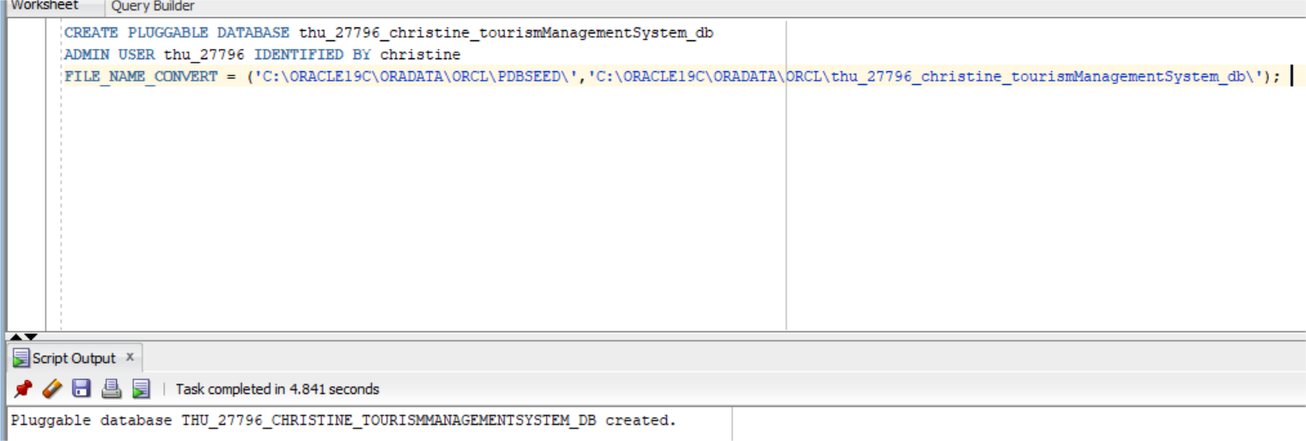
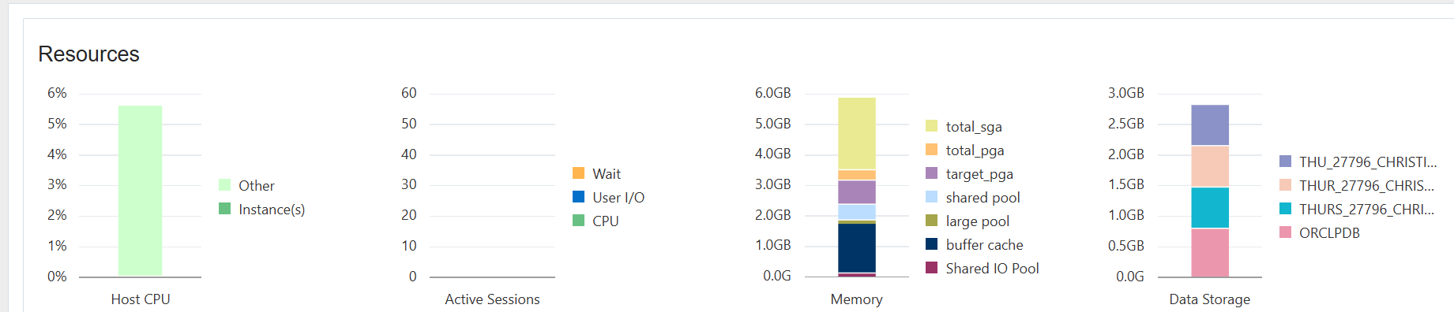
dATABASE CREATION
Create PDB: thu_27796_christine_tourismmanagementSystem_db. I used my name as password
Oracle Enterprise Manager Setup

Slide 6

aDVANCED database programming & auditing
Triggers
track changes to key tables automatically
Cursors
Efficiently handle large datasets
Auditing
Monitor changes for accountability

Slide 7

Conclusion
The Tourism Management System simplifies tourism operations by managing bookings, payments customer data. It improves efficiency, reduces errors, and supports future digital expansion.

