Slide 1

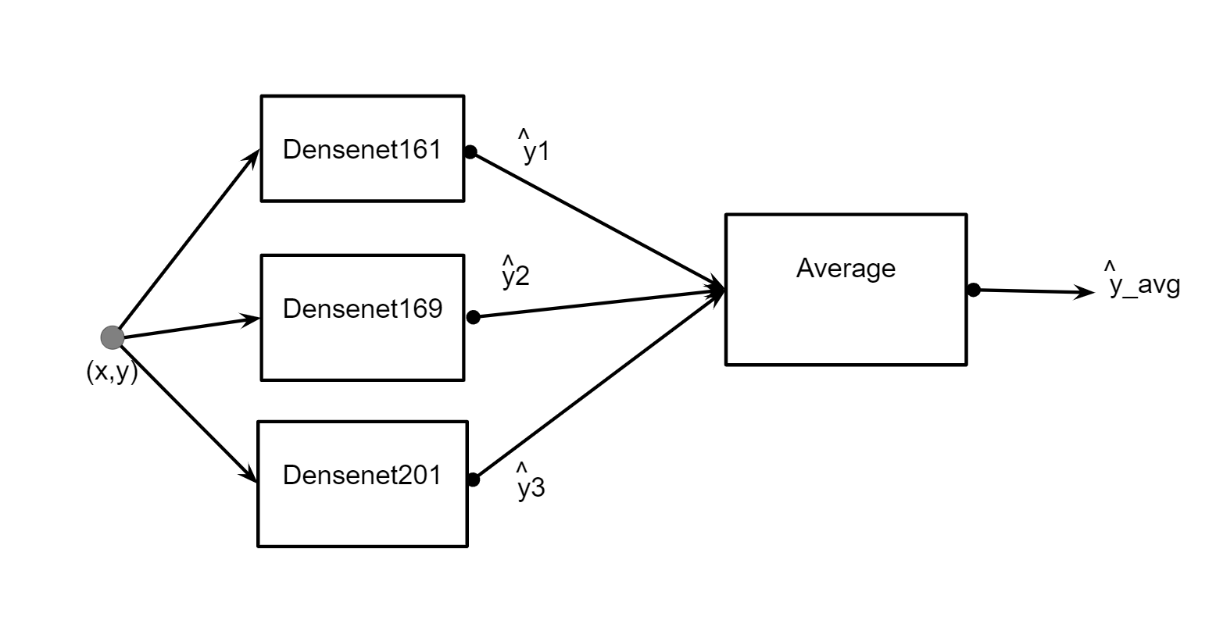
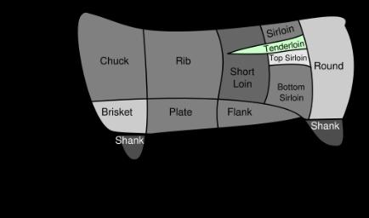
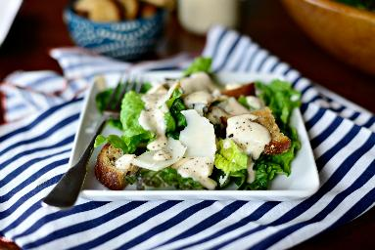
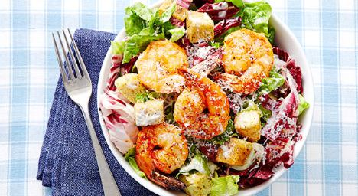
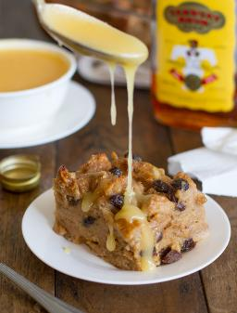
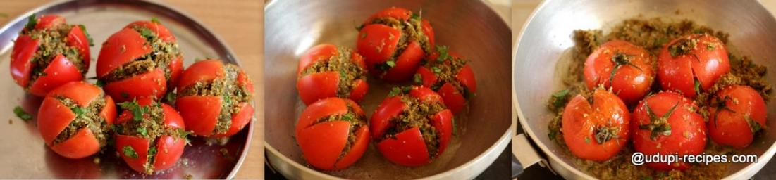
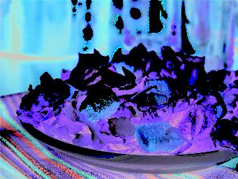
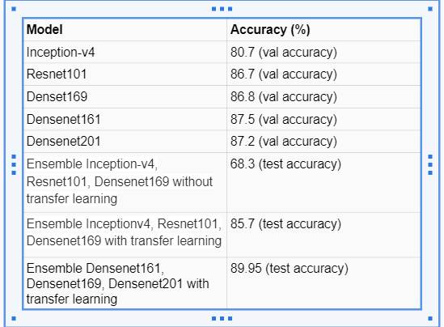
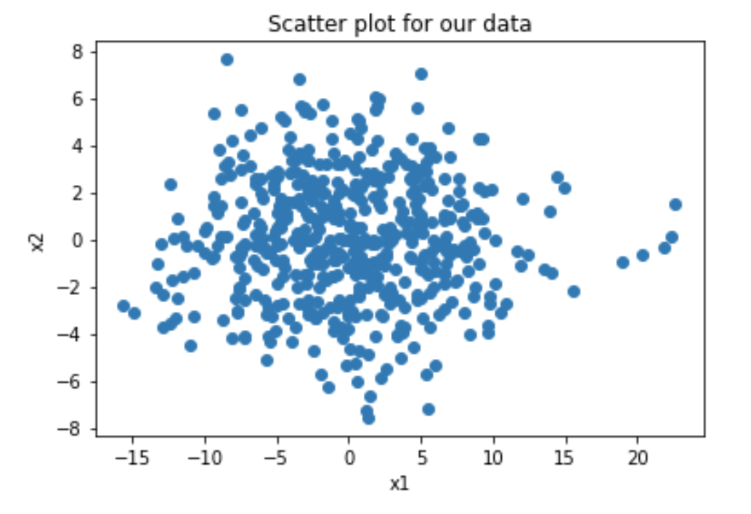
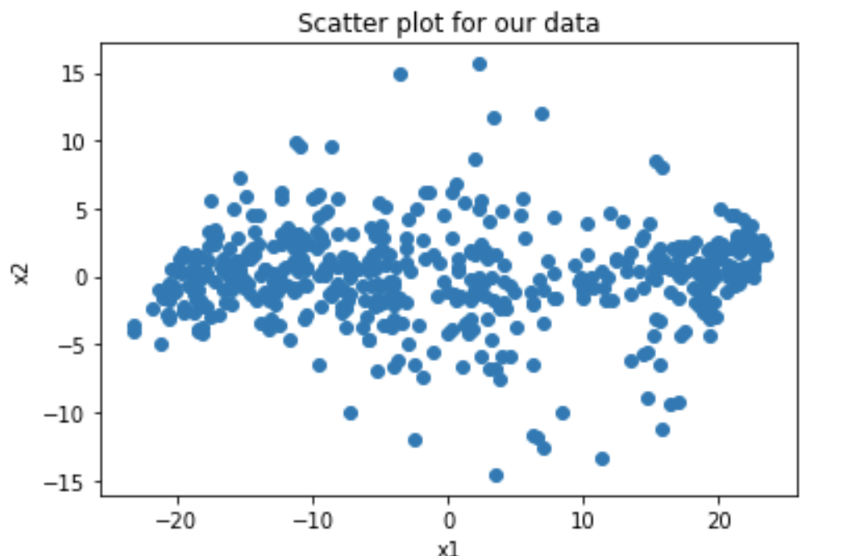
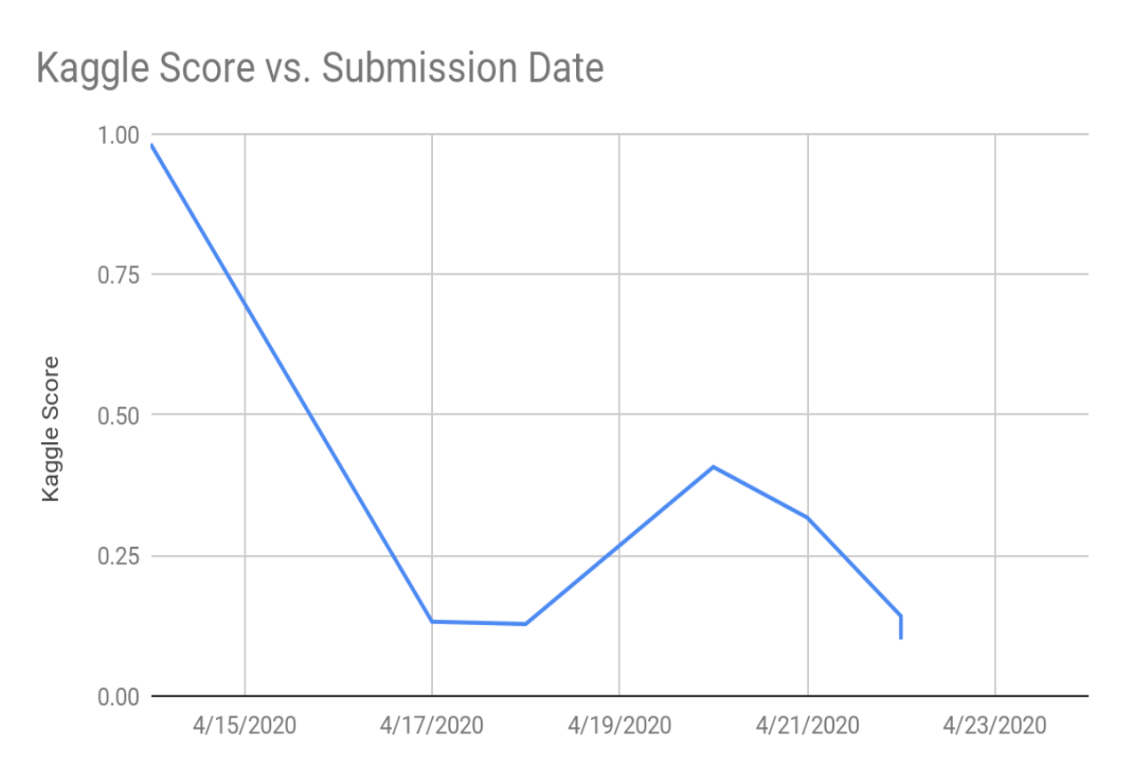
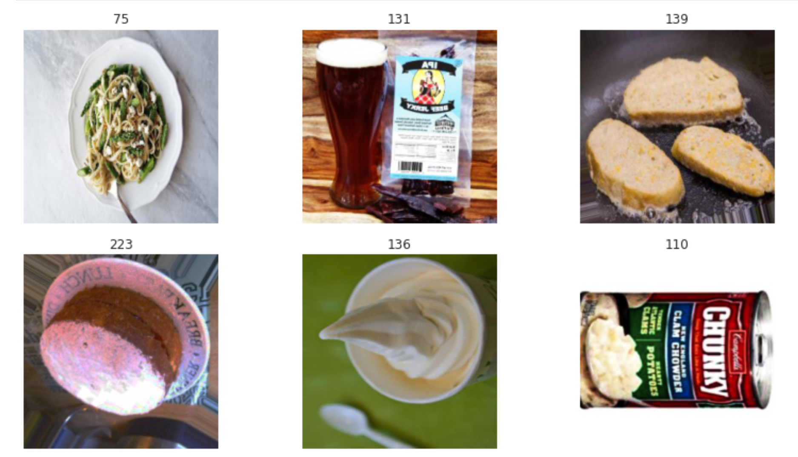
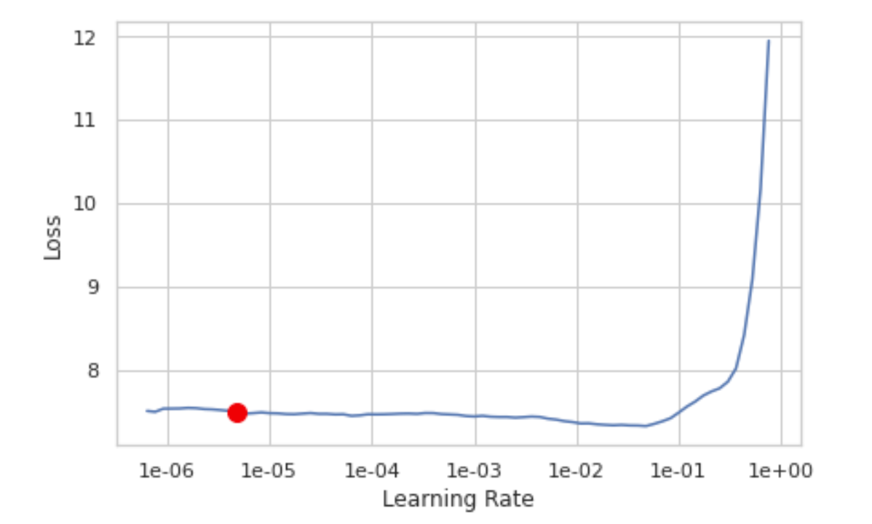
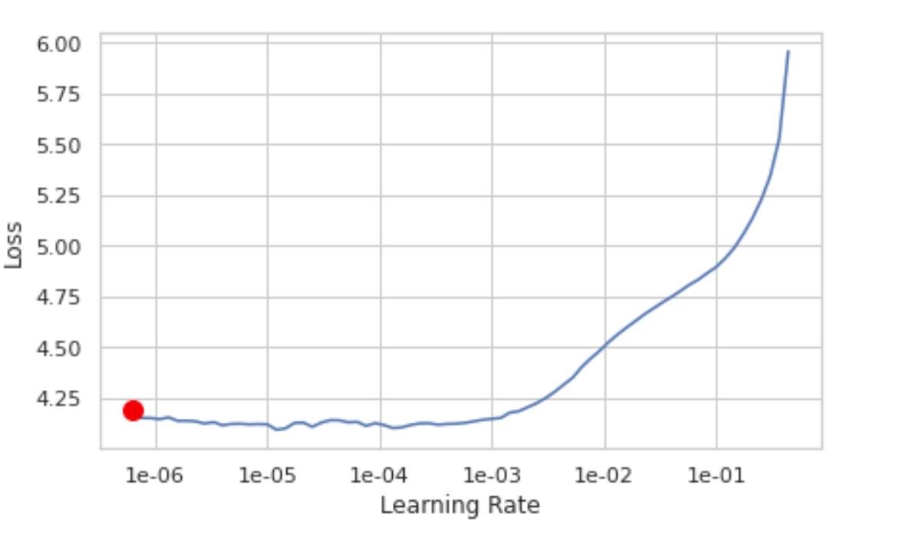
iFOOD KAGGLE CHALLENGE
Ankit Narasimhan (an46)
Christine Grace Tharian (ct49)
Team Name : comp540_an46_ct49
What makes this problem challenging?
Final Model
Noisy web-crawled data Images with varying background
Images of varying size Images with varying lighting
The final model is an ensemble of Densenet161, Densenet169, and Densenet201 with an accuracy of 89.95%. We chose Densenet as it allows gradients to propagate across deep neural network and thus prevents vanishing gradient problem. It has an ability to capture diversified features and richer patterns.Densenet classifier uses features of all complexity level and tends to give a smoother decision boundary. We also adopted transfer learning and pretrained the models on Imagenet.
Exploratory Data Analysis
Results
Using PCA to reduce the dimension of our data, we can see that classes are not scattered uniformly and there are outliers in each class which have the potential to throw off our classification models
Data Augmentation
Image Variations:
do_flip,flip_vert,max_rotate,max_zoom,max_lighting,resize method
Dropout
Mixup:
new_image = t * image1 + (1-t) * image2
new_target = t * target1 + (1-t) * target2
Label Smoothing
Hyperparameter Tuning
We made use of a predefined metric ’top_k_accuracy’ for evaluation our model. It is the percentage that the right class was in the ’k’ highest probability predictions. In our model we set k = 3.
Conclusion
In summary, we tried different CNN architectures, and decided our final model would be an ensemble of Densenet networks. We found that Densenet networks gave us the best accuracy and we believe it is due to its strong gradient flow and ability to capture more diversified features
References
To find an optimal learning_rate we made use of lr_find, which gave us the above two plots. The x-axis shows what happens when you increase the learning rate and y-axis shows the loss. By varying the learning rate, we checked the effect on accuracy.
https://forums.fast.ai/t/deep-learning-lesson-1-notes/27748
http://dev.fast.ai/metrics#top_k_accuracy
https://towardsdatascience.com/understanding-and-visualizing-densenets-7f688092391a
https://www.kaggle.com/tahsin/ifood-2019-fast-ai-implementation
https://www.kaggle.com/phoenix9032/fastai-ensemble-tutorial-aerial-cactu
https://machinelearningmastery.com/model-averaging-ensemble-for-deep-learning-neural-networks/s

