Slide 1
Exploring shootings & Firearm Discharges in Toronto : Analysis & Recommendation
Group 14: Baoqiang Zhang, Dhari Gandhi, Jiawen Li, Lingrui Yu, Yuhui Gu
“The work we submitted as part of this assignment is original, and due credit is given to others where appropriate. We accept and acknowledge that that each member of our team is equally responsible for if the assignment found to be plagiarized in any way, and we will be subject to school’s Academic Integrity policy”

Slide 2
1
3
2
4
Agenda
Executive Summary
Modeling & Analysis
Introduction
Conclusion

Slide 3




Executive Summary
01
Purpose of the report:
Answer the main operational questions: What temporal, spatial, and seasonal factors contribute to the occurrence and severity of shooting incidents?
Recommendations for law enforcement and police departments
Methods and Models used:
Correlation analysis
Logistic regression modeling
Heat map visualization
Time series analysis: ARIMA model
Results and Conclusions:
Shooting incidents occurring in the D51, D14, and D52 areas, as well as in April and January of each year, were more likely to result in serious injury or death.
The predicted likelihood of a shooting incident was higher on Sundays and Tuesdays and during the winter months
The results of the time-series analysis indicate that the number of shooting incidents increased between 2004 and 2022, but begins to decline after 2022.
For Fridays and certain time periods, future shooting incident rates are expected to remain consistent with historical data unless significant changes occur.
Recommendations:
Allocate more resources on/during the following times: Tuesdays, Saturdays, Afternoons, Evenings, and Nights
There are likely to be fewer disruptive incidents on Mondays and Thursdays, as well as in the morning. Relevant departments can use these times for routine maintenance, training or other tasks.
Increased vigilance and preventative measures at subdivisions like D51, D14, and D52 & during specific months such as April and January.

Slide 4
02
Introduction
Main objective:
Understanding the patterns and trends in shooting & firearms incidents in order to support proactive planning and resource allocation.
Key questions to analysis:
Is there a significant correlation between the time of day and the severity of incidents?
Are certain days of the week or time ranges more prone to severe incidents?
Can we predict the severity of incidents based on different factors such as the time of day, day of the week, and location?
Can we forecast the number of incidents for different days of the week and time ranges for the next 12 months?
In this analysis, we used this dataset from Toronto Shooting & Firearms, which included information on the time, date, location, and severity of each incident. We performed a series of analyses, including correlation analysis, logistic regression modeling, and time series forecasting, to address the above questions. The insights from this analysis can provide valuable guidance for audience and decision-making in incident management.

Slide 5
03
Modeling and Analysis
1) Correlation Analysis:
 | OCC_HOUR | DEATH | INJURIES
OCC_HOUR | 1.000000 | 0.005912 | -0.013862
DEATH | 0.005912 | 1.000000 | -0.044544
INJURIES | -0.013862 | -0.044544 | 1.000000
The correlation coefficient between 'OCC_HOUR' (time of day) and 'DEATH' (fatalities) is approximately 0.006, indicating a very weak positive correlation.
The correlation coefficient between 'OCC_HOUR' and 'INJURIES' is approximately -0.014, indicating a very weak negative correlation.
The correlation coefficient between 'DEATH' and 'INJURIES' is approximately -0.045, indicating a weak negative correlation.

Slide 6
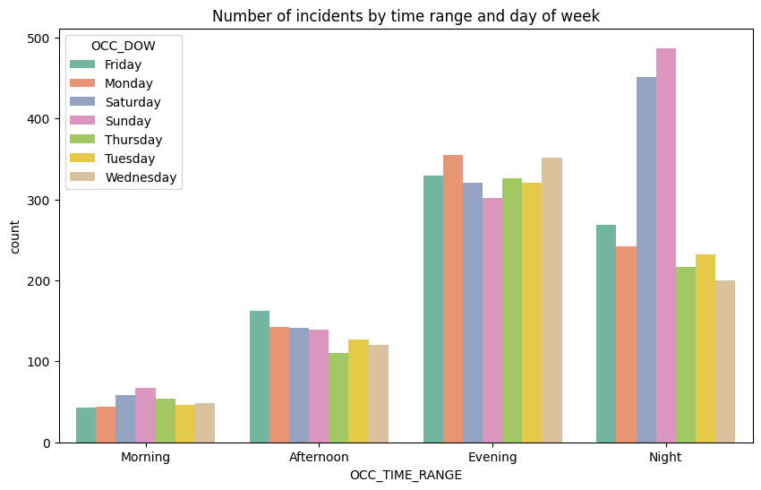
2) Time-Based Severity Analysis:
MODEL CHOICE FOR TIME-BASED SEVERITY ANALYSIS: LOGISTIC REGRESSION MODEL WITH GRIDSEARCH
Confusion matrix:
 | precision | recall | f1-score | support
0 | 0.54 | 0.58 | 0.56 | 883
1 | 0.52 | 0.48 | 0.50 | 830
accuracy |  |  | 0.53 | 1713
macro avg | 0.53 | 0.53 | 0.53 | 1713
weighted avg | 0.53 | 0.53 | 0.53 | 1713
This plot of the number of incidents by time range and day of the week can be helpful for understanding when the majority of incidents occur. The analysis reveals that the majority of incidents occur during the evening and nighttime hours.
The reasons to choose Logistic Regression for this analysis:
Quantify the relationship between the time of occurrence and the likelihood of an incident resulting in fatalities or injuries, which are binary outcomes (either it happens or it doesn't).
A higher accuracy compared to the other models (decision tree and random forest).

Slide 7
LOGISTIC REGRESSION MODEL WITH GRIDSEARCH
Output:
DIVISION_D51, DIVISION_D14, and DIVISION_D52 have the highest odds ratios. This suggests that incidents occurring in these divisions are more likely to result in fatalities or injuries than incidents in other divisions.
OCC_MONTH_April and OCC_MONTH_January have relatively high odds ratios among the months. This means incidents occurring in these months have a higher likelihood of resulting in fatalities or injuries.
OCC_DOW_Sunday and OCC_DOW_Tuesday (days of the week) have relatively high odds ratios. Incidents occurring on these days seem to have a higher likelihood of resulting in fatalities or injuries.
Among seasons, OCC_SEASON_Winter has the highest odds ratio. This implies that incidents occurring in winter are more likely to result in fatalities or injuries compared to other seasons.
Feature | odds_ratio
DIVISION_D51 | 1.458613
DIVISION_D14 | 1.453688
DIVISION_D52 | 1.276984
OCC_MONTH_April | 1.155375
OCC_MONTH_January | 1.147273
OCC_DOW_Sunday | 1.125040
OCC_DOW_Tuesday | 1.079492
OCC_SEASON_Winter | 1.037675

Slide 8
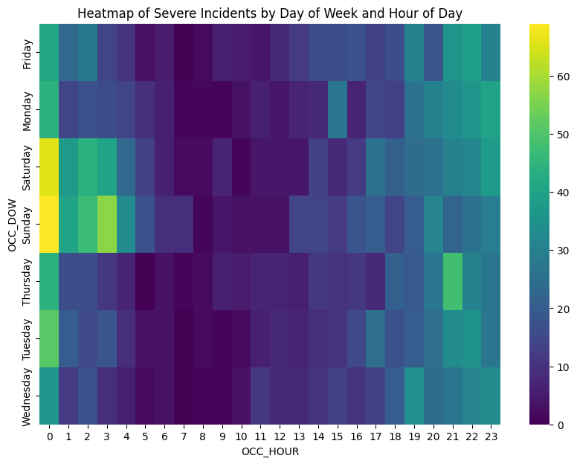
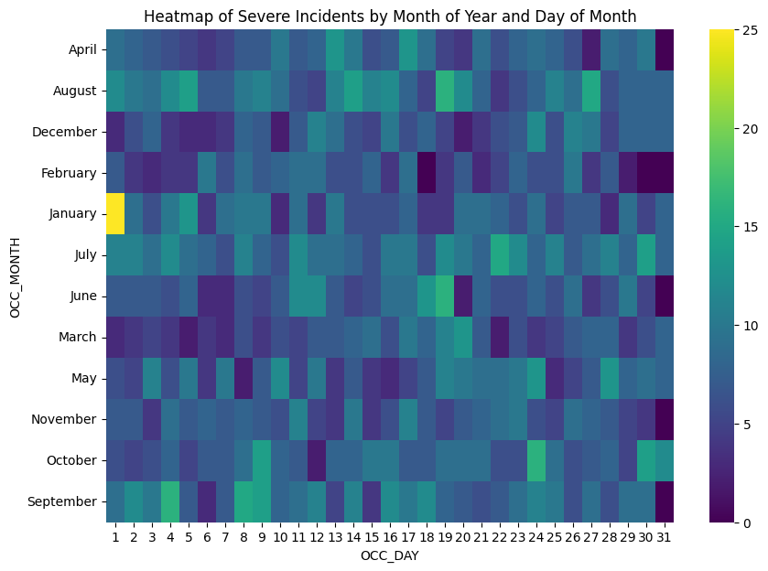
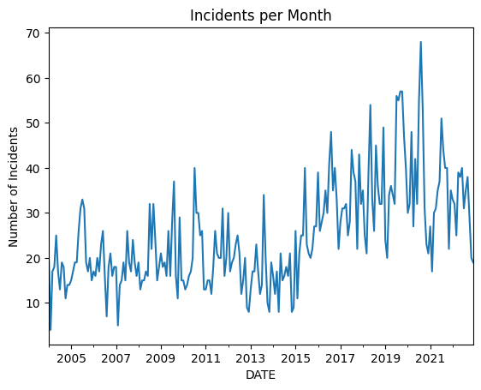
3) Temporal Pattern Identification:
Using heatmaps to visualize the frequency of severe incidents, we found a pattern of high frequency of incidents on certain days of the week, and during certain hours of the day. Friday and Saturday nights showed a higher number of incidents. Also, the hours between 4 am and 12 pm appear to be the times when severe incidents are most likely to occur. Moreover, an analysis of incidents by month and day showed a relatively uniform distribution of incidents, indicating a lack of specific monthly or daily patterns.
This time series graph can help us visualize whether there's a trend or seasonality in the incidents, which can inform the strategic decision making and policy development to reduce firearm incidents and improve community safety.

Slide 9
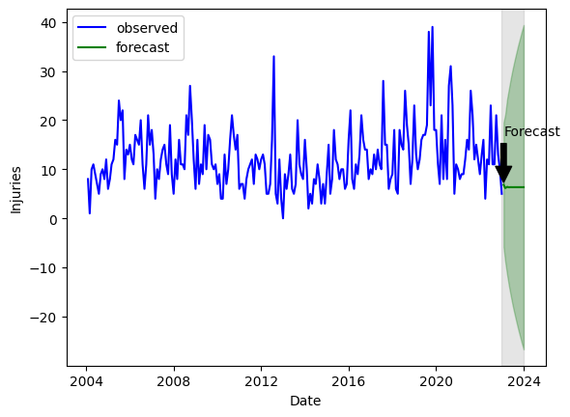
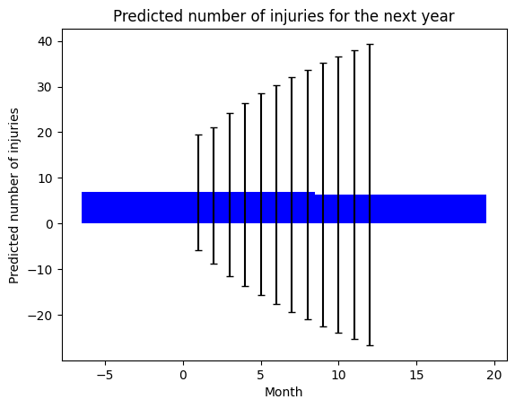
ARIMA PREDICTION
Forecasted monthly number of incidents in 2023:
These outputs represent the forecasted monthly number of incidents for each day of the week and time range for the next 12 months.
From 2004 to 2022: Over this time period of incidents, the plot shows fluctuations in the number of incidents for each year, with a general upward trend in incidents.
After 2022: There is a decrease in the number of incidents.
Prediction for the next year: There is a significant autocorrelation, which indicates that the upward trend in the number of incidents in the past is still likely to occur in the future.
2023-01-31 | 19.299676
2023-02-28 | 19.209870
2023-03-31 | 19.236783
2023-04-30 | 19.228718
2023-05-31 | 19.231135
2023-06-30 | 19.230411
2023-07-31 | 19.230628
2023-08-31 | 19.230563
2023-09-30 | 19.230582
2023-10-31 | 19.230576
2023-11-30 | 19.230578
2023-12-31 | 19.230578

Slide 10
04
Conclusions
Several correlations and odds ratios are associated with firearms incidents and their severity.
Very weak positive correlation between time of day and deaths
Very weak negative correlation between time of day and injuries
Weak negative correlation between the number of deaths and the number of injuries
Accidents occurring in some subdivisions are more likely to result in injuries and fatalities.
DIVISION_D51
DIVISION_D14
DIVISION_D52
Incidents occurring at specific times are more likely to result in injury or death.
Winter
April
January
Saturday
Tuesday
4:00 a.m. to 12:00 p.m.
Prediction for the next year.
Fluctuation and possible upward trend in the number of incidents in the past are still likely to occur in the future.

Slide 11
Recommendation
Community Policing and Resource Allocation
Focus on DIVISION_D51, DIVISION_D14, and DIVISION_D52 as they exhibit higher odds of severe incidents.
Enhancing Patrolling and Awareness
Prioritize targeted law enforcement efforts during high-risk periods, such as winter, Saturdays, and Tuesdays.
Raising Awareness at Specific Times
Increase police presence and proactive patrols during the hours of 4:00 a.m. to 12:00 p.m.
By implementing these recommendations, we believe that law enforcement agencies and policymakers can take significant strides toward reducing firearm incidents and improving community safety in Toronto.

Slide 12
THANKS!

Slide 13
References
[1] Hilakivi, I., Kim, K., Agresti, A., Feinberg, S., & Hosmer, D. W. (2002, August 1). Using logistic regression to estimate the influence of accident factors on accident severity. Accident Analysis & Prevention. https://www.sciencedirect.com/science/article/pii/S0001457501000732
[2] Peixeiro, M. (2023, June 27). The Complete Guide to Time Series Analysis and forecasting. Medium. https://towardsdatascience.com/the-complete-guide-to-time-series-analysis-and-forecasting-70d476bfe775
[3] Hayes, A. (2023, May 22). Autoregressive integrated moving average (ARIMA) prediction model. Investopedia. https://www.investopedia.com/terms/a/autoregressive-integrated-moving-average-arima.asp

Slide 14
Appendix
Final Code (Cleaning + Analysis): https://github.com/dharig22/MMAI500GroupProject

