Slide 1
Best Customer Service PCP Interview Program
Christine Yin
Jan 2023

Slide 2
Problem
Summary:
- In 2018, the CDHealthcare's overall growth is good, and it is growing steadily every month.
- Our membership totals in each state are very similar, but provider totals have some notable differences in some states.
- Based on Customer satisfaction (CSAT, [ Number of positive responses (rating = 5) / Number of total responses ]), we found that the #1 state is ID, followed by FL and AK. State ratings are affected by the distribution.
- In conclusion, review CSAT by provider and recommend top 3 providers based on CSAT rating: 2 ID providers and 1 FL provider.
Recommend the three best customer service PCPs for operations team to interview for, based on 2018 performance.

Slide 3
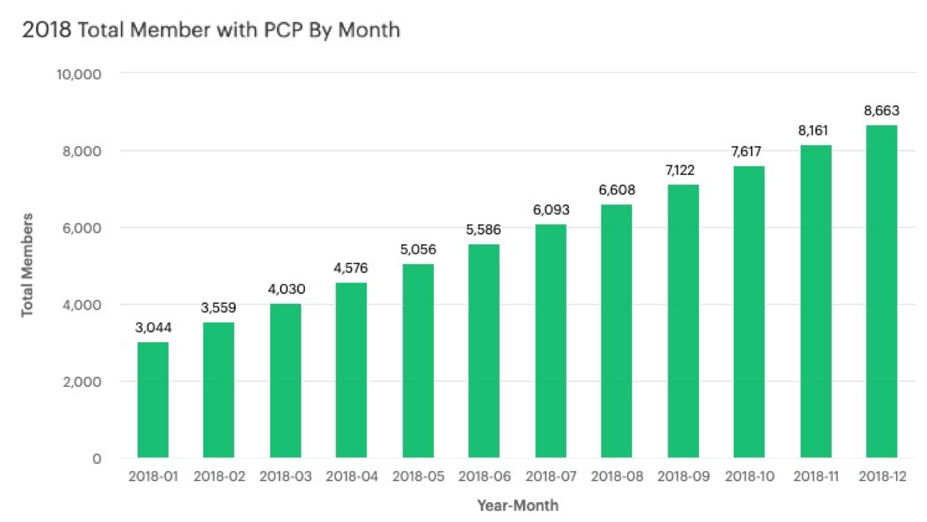
Overview of Active Member *current (as of 12/31/18)
In 2018, the CDHealthcare’s overall growth is good, and it is growing steadily every month
As of December 2018, we have a total of 8663 active members. We will base our analysis on these members.

Slide 4
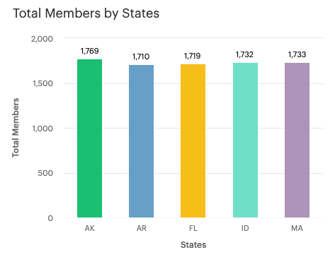
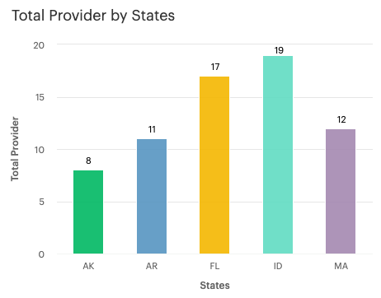
Distribution of Current Active Member by State *current (as of 12/31/18)
The total number of members in each state is very similar (left graph), but the total number of providers has some notable differences in some states (right graph, for example: Idaho has 2.4 times as many providers as Alaska).
This can create a difference in customer experience, an issue to keep in mind in this program.

Slide 5
How to calculate Customer satisfaction (CSAT)
[ Number of positive responses (rating = 5) / Number of total responses ] x 100 = CSAT(%)
Customer satisfaction (CSAT) is a measure of how happy your customers are.
At the end of a calendar year, or when the member changes providers or plans, the member can optionally rate their provider (the provider on this span) on a scale of 1 to 5.

Slide 6
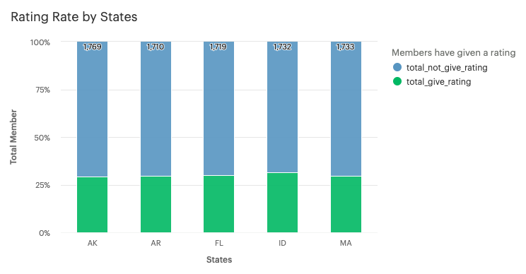
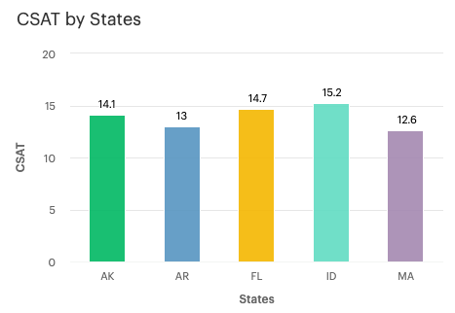
Rating By States
While leaving a comment is optional, we still have a 30% in average response rate, with little variation across states.
The highest CSAT rating is ID(Idaho) of 15.2, followed by FL(Florida) and AK(Alaska).

Slide 7
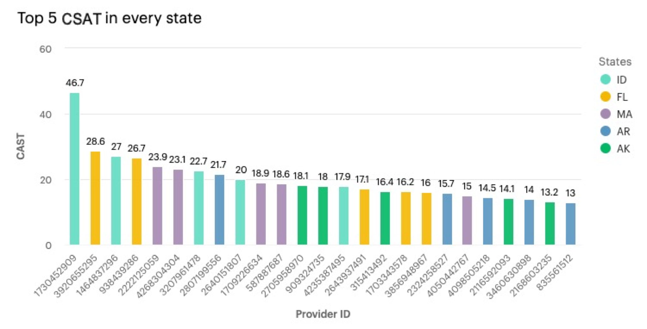
CSAT by Provider
Idaho do ranks first in the state rankings with more providers, however, We can see that its score for each provides is relatively scattered, the gap between the first and the last is still very large.
Alaska performed more consistently despite having relatively few providers, ranking third among the states.

Slide 8
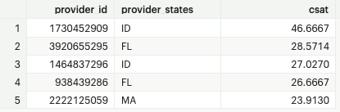
Recommendations
Which three PCPs would you recommend?
I recommend interviewing the top 3 CSAT providers and understanding why they have a high CSAT. 2 providers from ID and 1 provider from FL. (especially provider ID 1730452909, 14 out of 30 people gave this provider a 5 star rating!)
Further Exploration for v2:
Member retention rate, how long has this member been with this provider?
What is the impact of having a more average number of providers for each states?

Slide 9
Thank you

