Slide 1
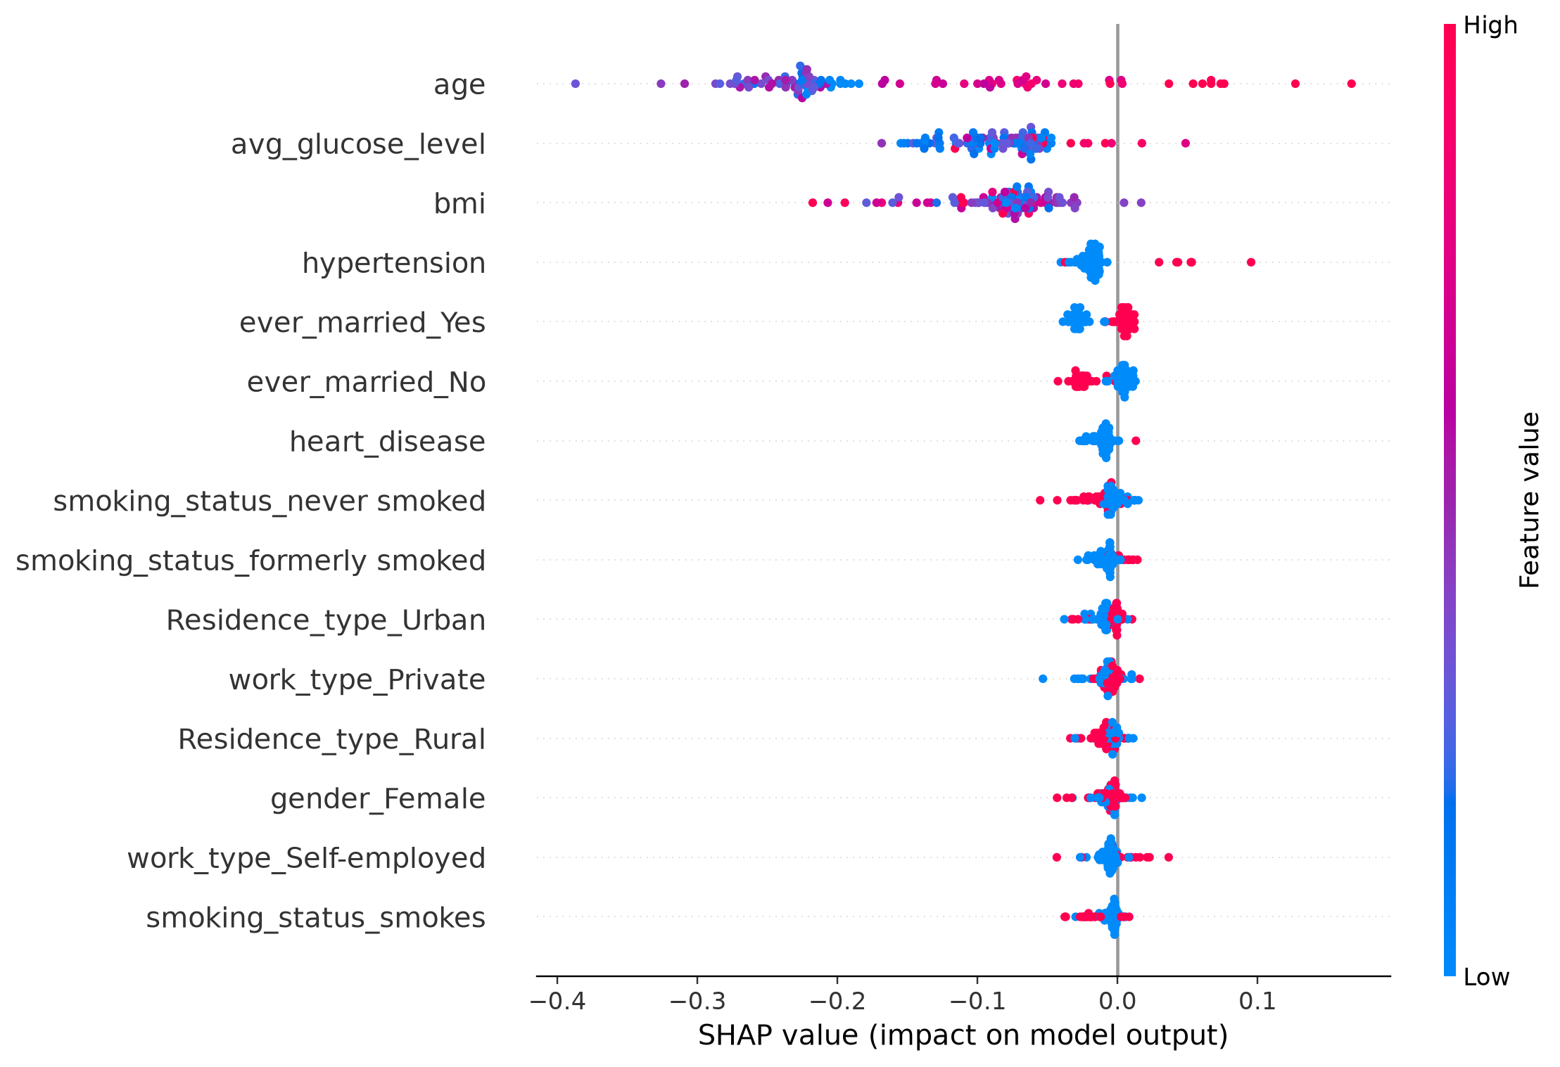
Data scientist | Random Forest and SHAP
Stroke = 1 means recorded stroke history, not future stroke risk
Held-out: 1,022 patients
Accuracy: 94.3%
Balanced accuracy: 53.4%
Stroke recall: 8.0%
Stroke precision: 25.0%
ROC AUC: 0.772
Missed stroke cases: 46 of 50
Caution: class imbalance and no external validation.
Source: stroke dataset; held-out test and SHAP TreeExplainer; seed 42

Slide 2
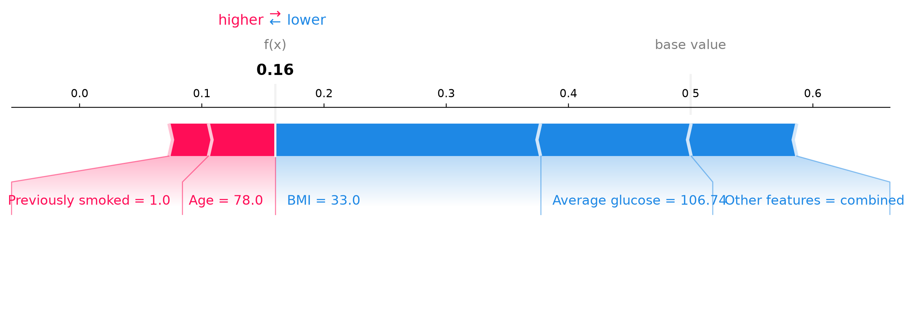
Doctor | Understanding one missed case
A held-out false negative: recorded stroke = 1, model class = 0
Selected patient index: 205
Model's class-1 score: 16.0%; SHAP baseline: 50.0%.
Main downward factors: BMI, Average glucose, gender Male.
Stroke recall in test data: 8.0%; 46 recorded cases were missed.
Check the underlying record and clinical context; external validation is needed.
The plot explains model behaviour; it is not a diagnosis or treatment recommendation

Slide 3
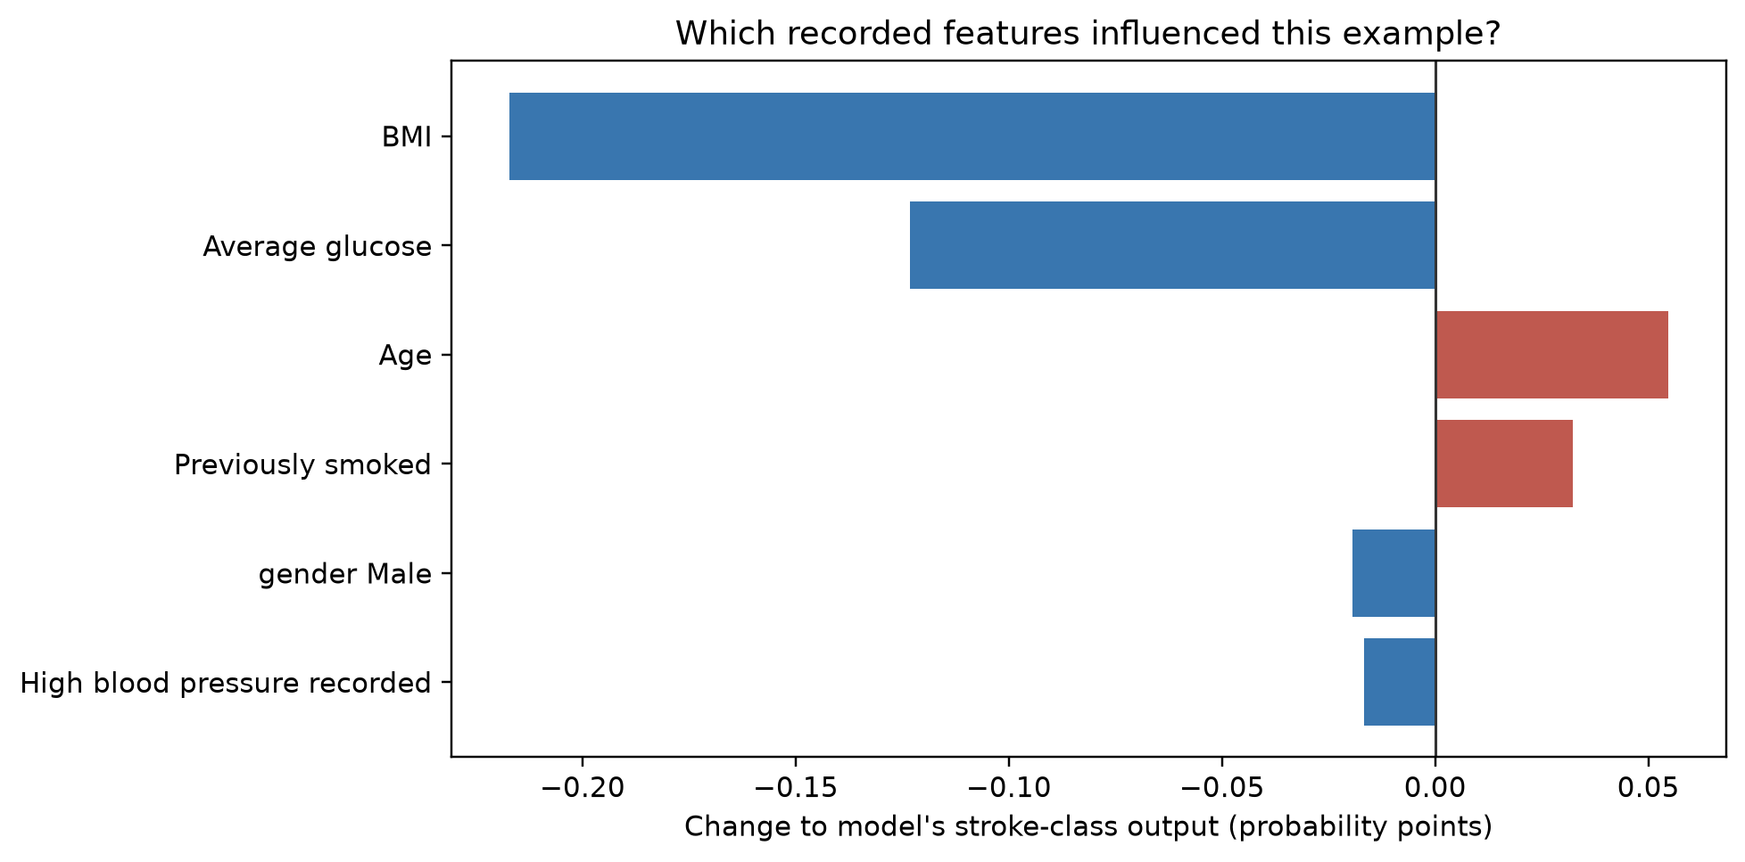
Patient | What this computer result means
Example: the recorded history and the model's classification do not agree
The computer labelled this example 'no recorded stroke', but the record says 'stroke'.
The chart shows which recorded details pushed the computer's answer up or down.
The computer can be wrong. This score is not a prediction of your future health.
A healthcare professional should consider other medical information.
Educational dataset only. A clinician interprets results alongside your full medical information

