Slide 1

Walmart
Data analysis using SQL

Slide 2
Purpose
The goal of this project is to examine Walmart Sales data in order to comprehend top-performing branches and items, sales trends for various products, and consumer behavior . The goal is to investigate how sales methods might be made better and more effective.

Slide 3
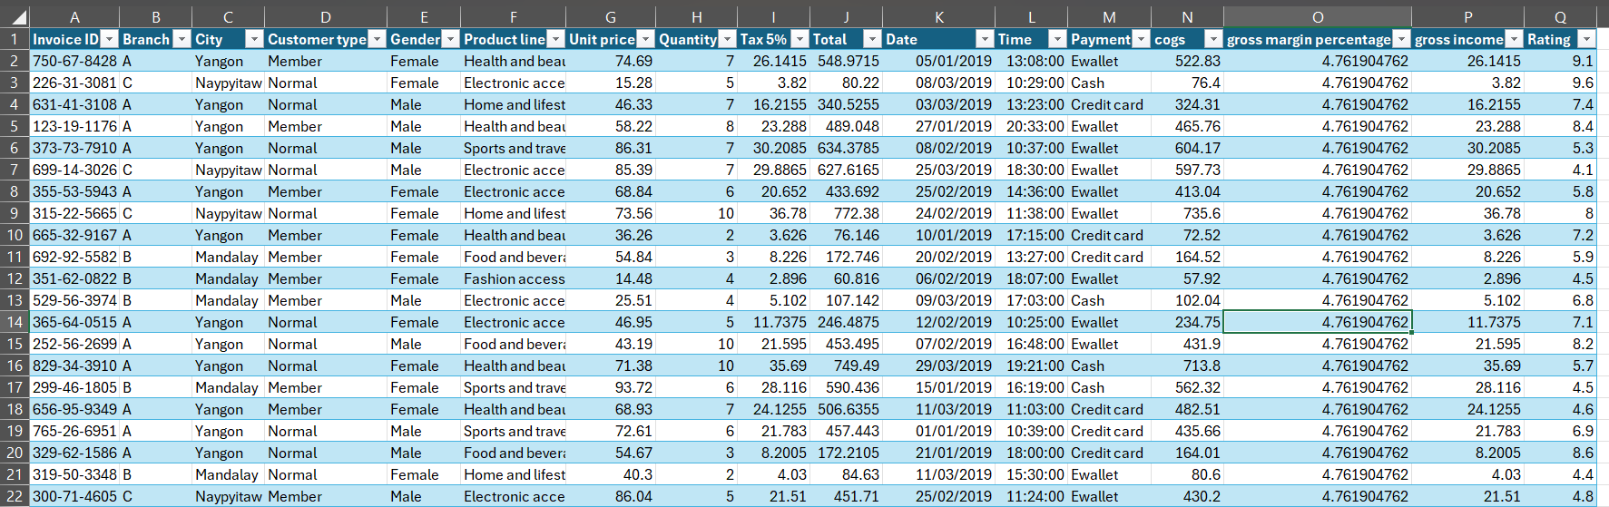
About Data
This dataset contains sales transactions from a three different branches of Walmart, respectively located in Mandalay, Yangon and Naypyitaw. The data contains 17 columns and 1000 rows:

Slide 4
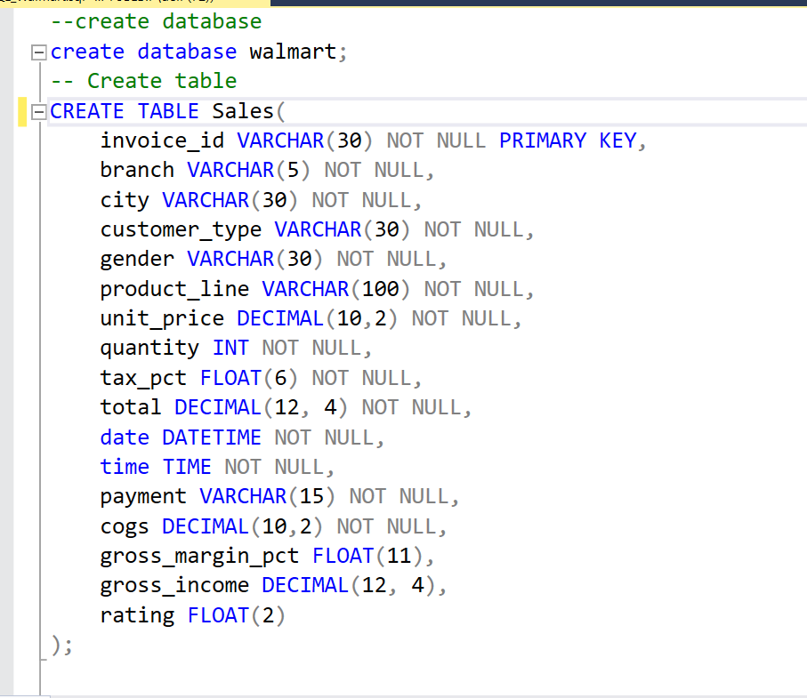
1. Build a database 2. Create table and insert the data. 3. Import Data from CSV

Slide 5
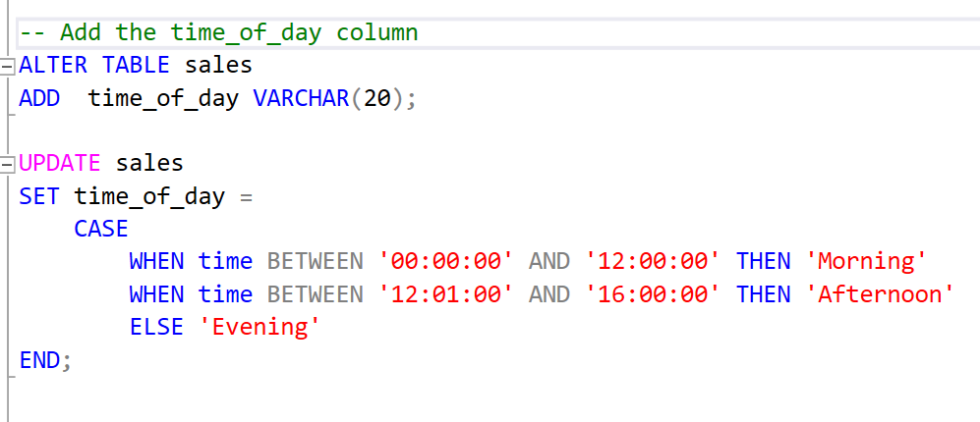
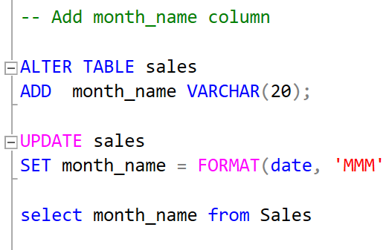
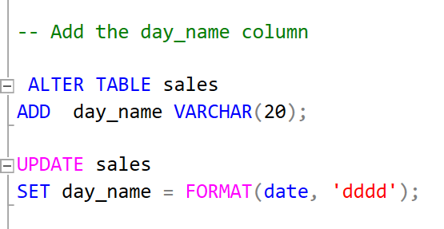
Feature Engineering
1. Add a new column named “ time_of_day “ to give insight of sales in the Morning, Afternoon and Evening. This will help answer the question on which part of the day most sales are made.
2. Add a new column named ” day_name ” that contains the extracted days of the week on which the given transaction took place (Mon, Tue, Wed, Thur, Fri). This will help answer the question on which week of the day each branch is busiest
3. Add a new column named “ month_name “ that contains the extracted months of the year on which the given transaction took place (Jan, Feb, Mar). Help determine which month of the year has the most sales and profit.

Slide 6
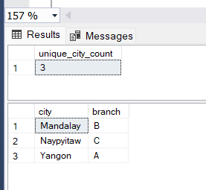
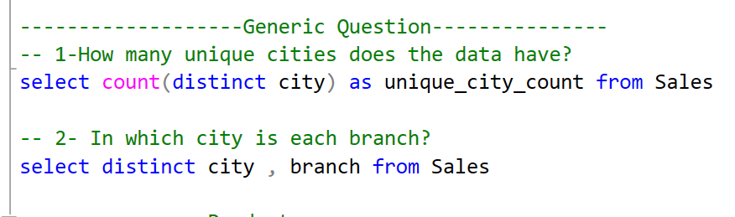
Exploratory Data Analysis (EDA)
Exploratory data analysis is done to answer the listed questions and aims of this project.
Generic Question
How many unique cities does the data have?
In which city is each branch?

Slide 7
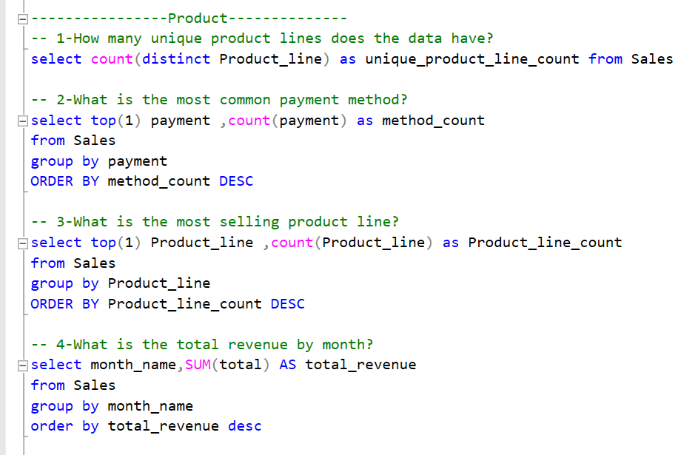
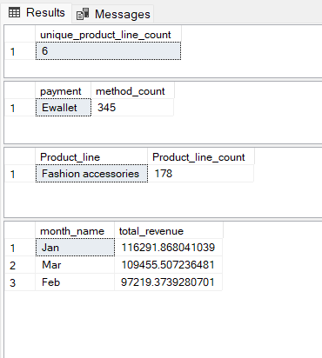
Exploratory Data Analysis (EDA)
Product Analysis
1. How many unique product lines does the data have?
2. What is the most common payment method?
3. What is the most selling product line?
4. What is the total revenue by month?

Slide 8
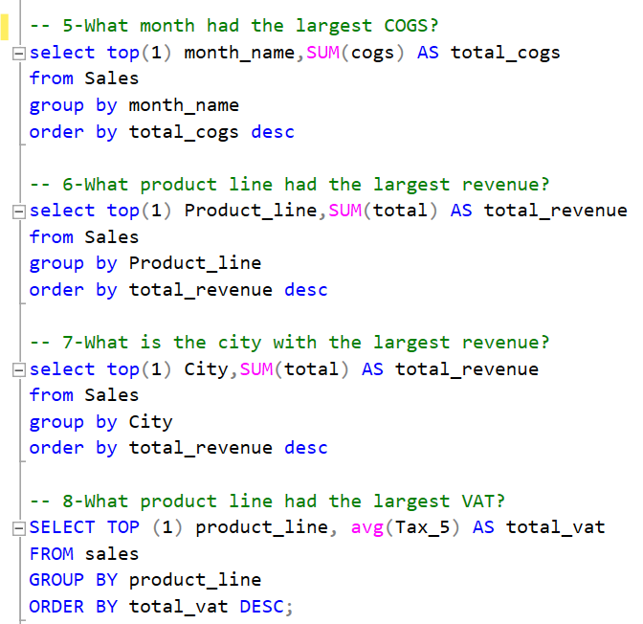
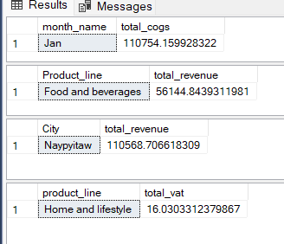
Exploratory Data Analysis (EDA)
5. What month had the largest COGS?
6. What product line had the largest revenue?
7. What is the city with the largest revenue?
8. What product line had the largest VAT?

Slide 9
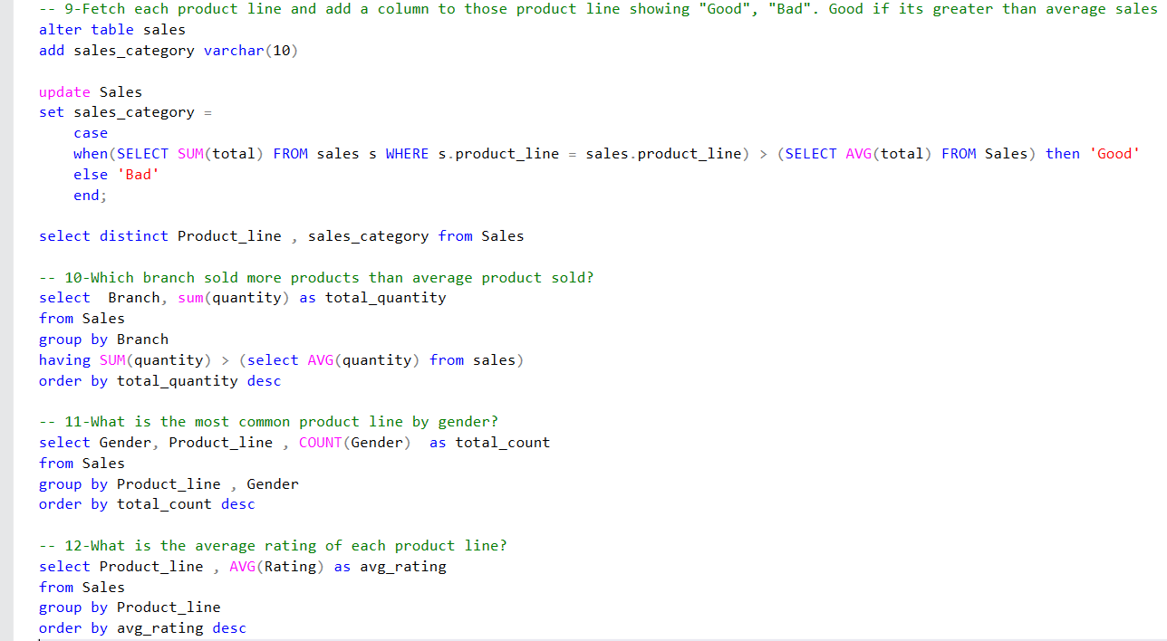
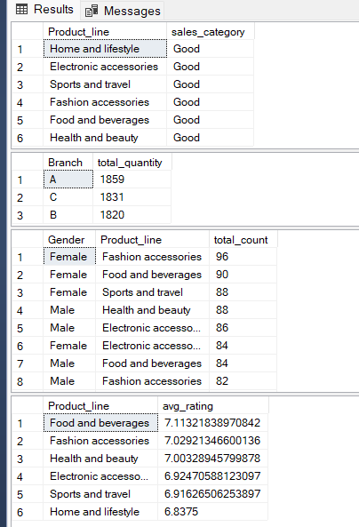
Exploratory Data Analysis (EDA)
9. Fetch each product line and add a column to those product line showing "Good", "Bad". Good if its greater than average sales
10. Which branch sold more products than average product sold?
11. What is the most common product line by gender?
12. What is the average rating of each product line?

Slide 10
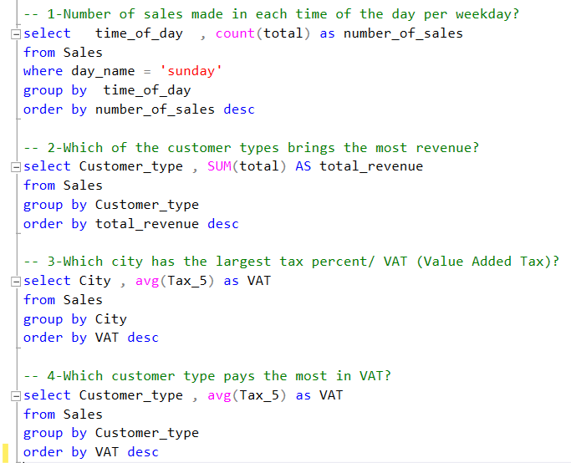
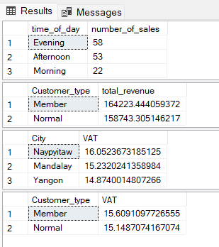
Exploratory Data Analysis (EDA)
Sales Analysis
1. Number of sales made in each time of the day per weekday
2. Which of the customer types brings the most revenue?
3. Which city has the largest tax percent/ VAT (**Value Added Tax**)?
4. Which customer type pays the most in VAT?

Slide 11
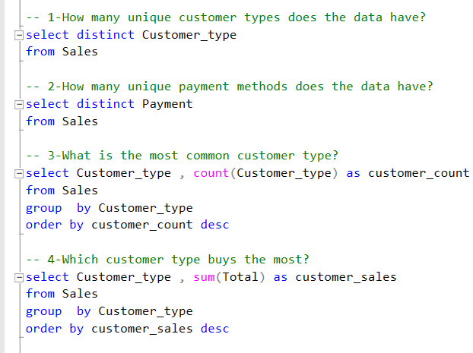
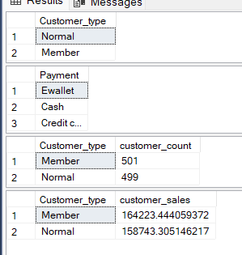
Exploratory Data Analysis (EDA)
Customer Analysis
1. How many unique customer types does the data have?
2. How many unique payment methods does the data have ?
3. What is the most common customer type?
4. Which customer type buys the most?

Slide 12
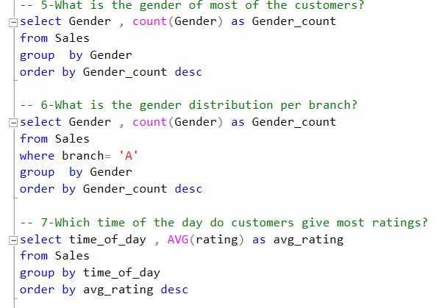
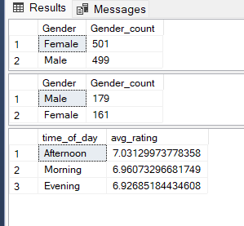
Exploratory Data Analysis (EDA)
5. What is the gender of most of the customers?
6. What is the gender distribution per branch?
7. Which time of the day do customers give most ratings ?

Slide 13
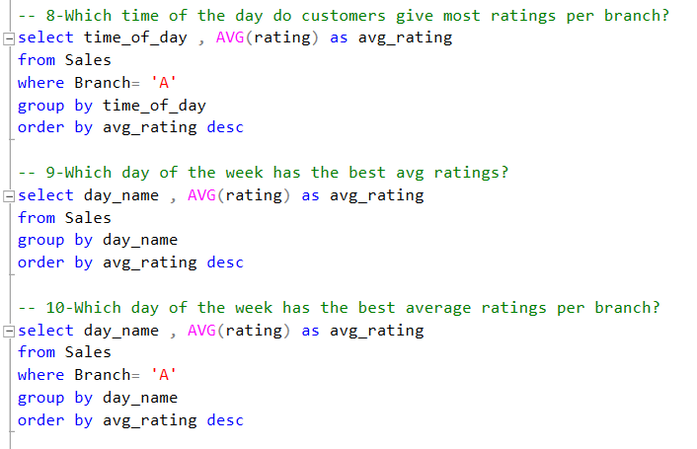
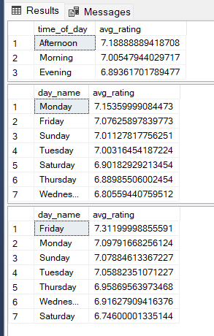
Exploratory Data Analysis (EDA)
8. Which time of the day do customers give most ratings per branch ?
9. Which day of the week has the best avg ratings?
10. Which day of the week has the best average ratings per branch?

Slide 14
Conclusion
In this data analysis project, we embarked on a journey to gain valuable insights from Walmart’s sales data. We began by preparing and exploring the dataset, cleaning any missing or null values, and engineering new features to help us uncover meaningful patterns.
Throughout our analysis, we made use of SQL queries to extract relevant information from the dataset.
Some key takeaways from our analysis include:
Identification of top-performing product lines and branches.
Analysis of sales trends, which can inform sales strategies and modifications.
Profiling of customer segments and their profitability.

